Slide 1
CONTROL THEORY IN FUSION
KALMAN FILTER
Faculty of Nuclear Science and Physical engineering, Max Planck Institute for Plasma Physics
Adéla Vedl Kubincová
16. 1. 2023

Slide 2
Content of the talk
Motivation: Needing fast filter of data and Presumption
Theory
Kalman Filter in Fusion
My Task: Electron Temperature at Pedestal
Workshop
Conclusion

Slide 3
Need of Fast Filter of Data and Prediction
Does not need of much memory, needs to know only current and previous step and every computing is only multiplication matrices
Corrects measured date by using model
Predicts state of value of requested estimate in next step for faster computing
Can combine many diagnostics
Was constructed for space missions

Slide 4
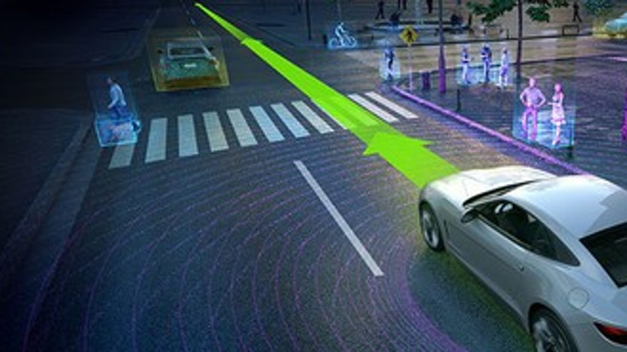
Needing Fast Filter of Data and Presumption
Was constructed for space missions
Does not need to much memory, needs to know only current and previous step
Corrects measured dates by using model
Predicts state of estimate in next step
Can combine many diagnostics

Slide 5
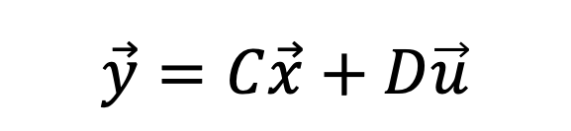
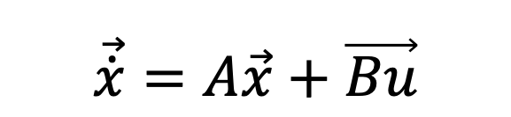
Theory
State Space Model
Model based filter
For construction of model is used state space model, which consists of vectors and matrices
  Linear equation (if equations are not linear, then they need to be linearized)
$$\vec{\dot{x}}=A\vec{x}+\vec{Bu}$$
$$\vec{y}=C\vec{x}+D\vec{u}$$

Slide 6
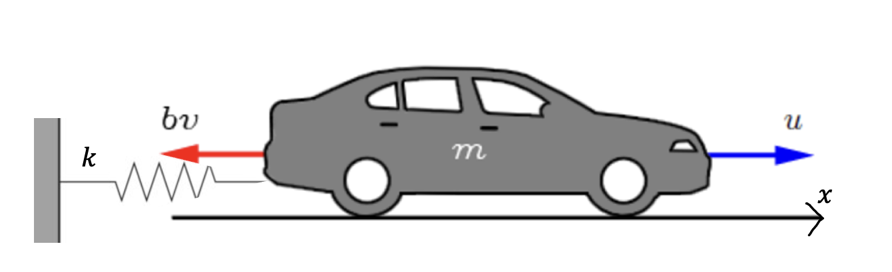
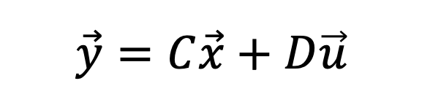
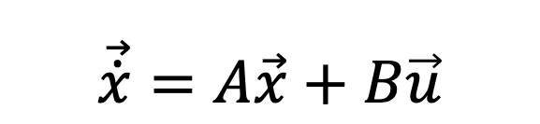
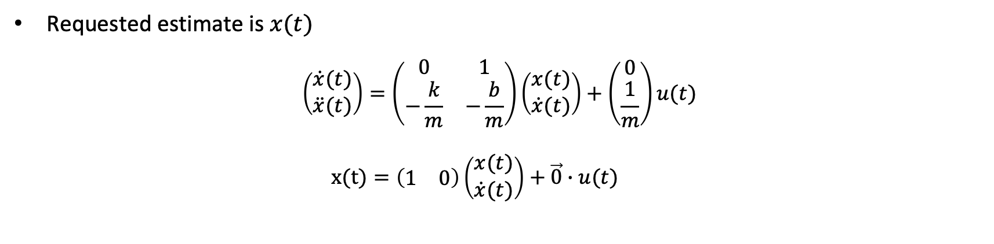

State Space Model Example
$$ma=u\left(t\right)−bv\left(t\right)−kx(t)$$
$$\vec{\dot{x}}=A\vec{x}+B\vec{u}$$
$$\vec{y}=C\vec{x}+D\vec{u}$$
Requested estimate is $x(t)$
$$\left(\begin{matrix}\dot{x}(t) \\ \ddot{x}(t)\end{matrix}\right)=\left(\begin{matrix}0 & 1 \\ −\frac{k}{m} & −\frac{b}{m}\end{matrix}\right)\left(\begin{matrix}x(t) \\ \dot{x}(t)\end{matrix}\right)+\left(\begin{matrix}0 \\ \frac{1}{m}\end{matrix}\right)u(t)$$
  $$x(t)=\left(\begin{matrix}1 & 0\end{matrix}\right)\left(\begin{matrix}x(t) \\ \dot{x}(t)\end{matrix}\right)+\vec{0}∙u(t)$$

Slide 7
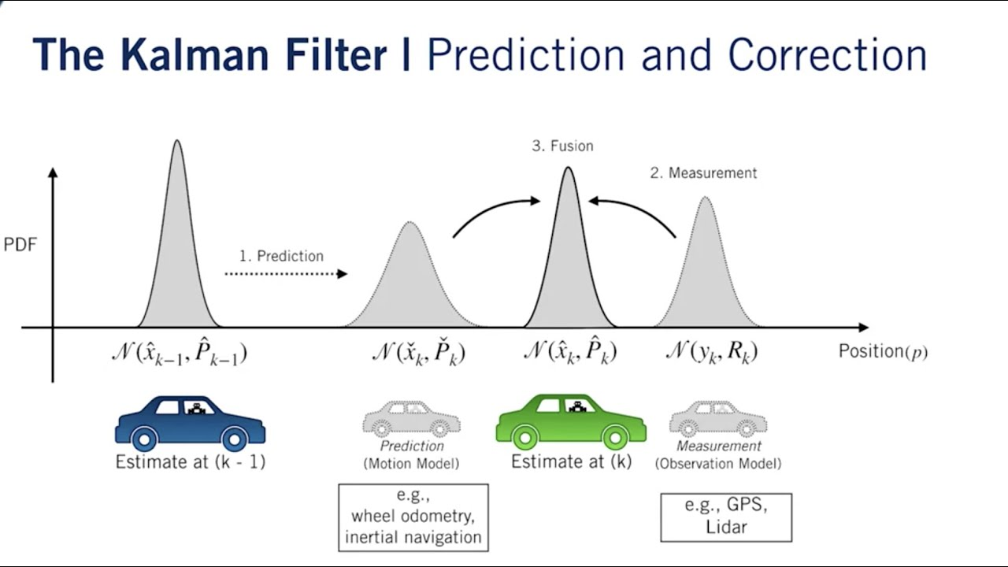
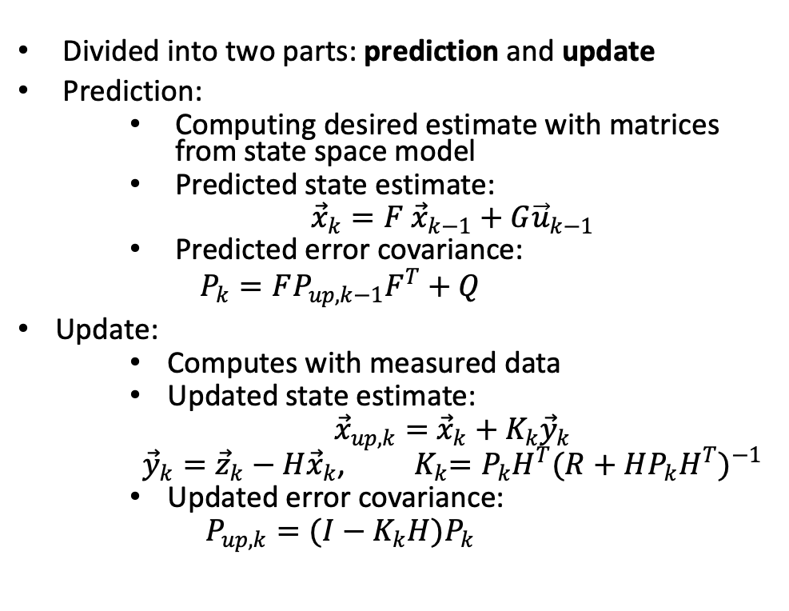
Theory
Kalman Filter
Divided into two parts: prediction and update
Prediction:
    Computing desired estimate with matrices from state space model
    Predicted state estimate:
    ${\vec{x}}_{k}=F$ ${\vec{x}}_{k−1}+G{\vec{u}}_{k−1}$
    Predicted error covariance:
    $$P_{k}=FP_{up,k−1}F^{T}+Q$$
Update:
    Computes with measured data
    Updated state estimate:
    ${\vec{x}}_{up,k}=$ ${\vec{x}}_{k}+K_{k}{\vec{y}}_{k}$
    ${\vec{y}}_{k}={\vec{z}}_{k}−H{\vec{x}}_{k}$, ${ K}_{k}=P_{k}H^{T}{(R+HP_{k}H^{T})}^{−1}$
    Updated error covariance:
    $$P_{up,k}=(I−K_{k}H)P_{k}$$

Slide 8
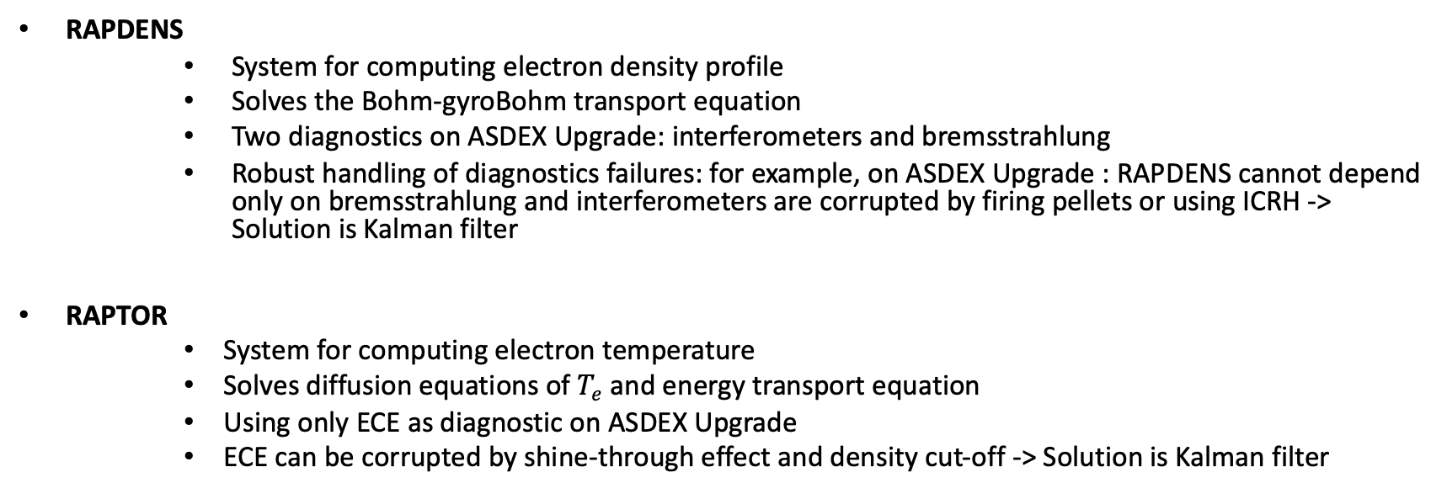
Kalman Filter in Fusion
RAPDENS
      System for computing electron density profile
      Solves the Bohm-gyroBohm transport equation
      Two diagnostics on ASDEX Upgrade: interferometers and bremsstrahlung
      Robust handling of diagnostics failures: for example, on ASDEX Upgrade : RAPDENS cannot depend only on bremsstrahlung and interferometers are corrupted by firing pellets or using ICRH -> Solution is Kalman filter
RAPTOR
      System for computing electron temperature
      Solves diffusion equations of $T_{e}$ and energy transport equation
      Using only ECE as diagnostic on ASDEX Upgrade
      ECE can be corrupted by shine-through effect and density cut-off -> Solution is Kalman filter

Slide 9
Kalman Filter and Electron Temperature at Pedestal
Motivation:
      RAPTOR does not work well near pedestal
      As a benchmark is used Integrated Data Analysis (IDA), which is offline diagnostic system for electron temperature

Slide 10
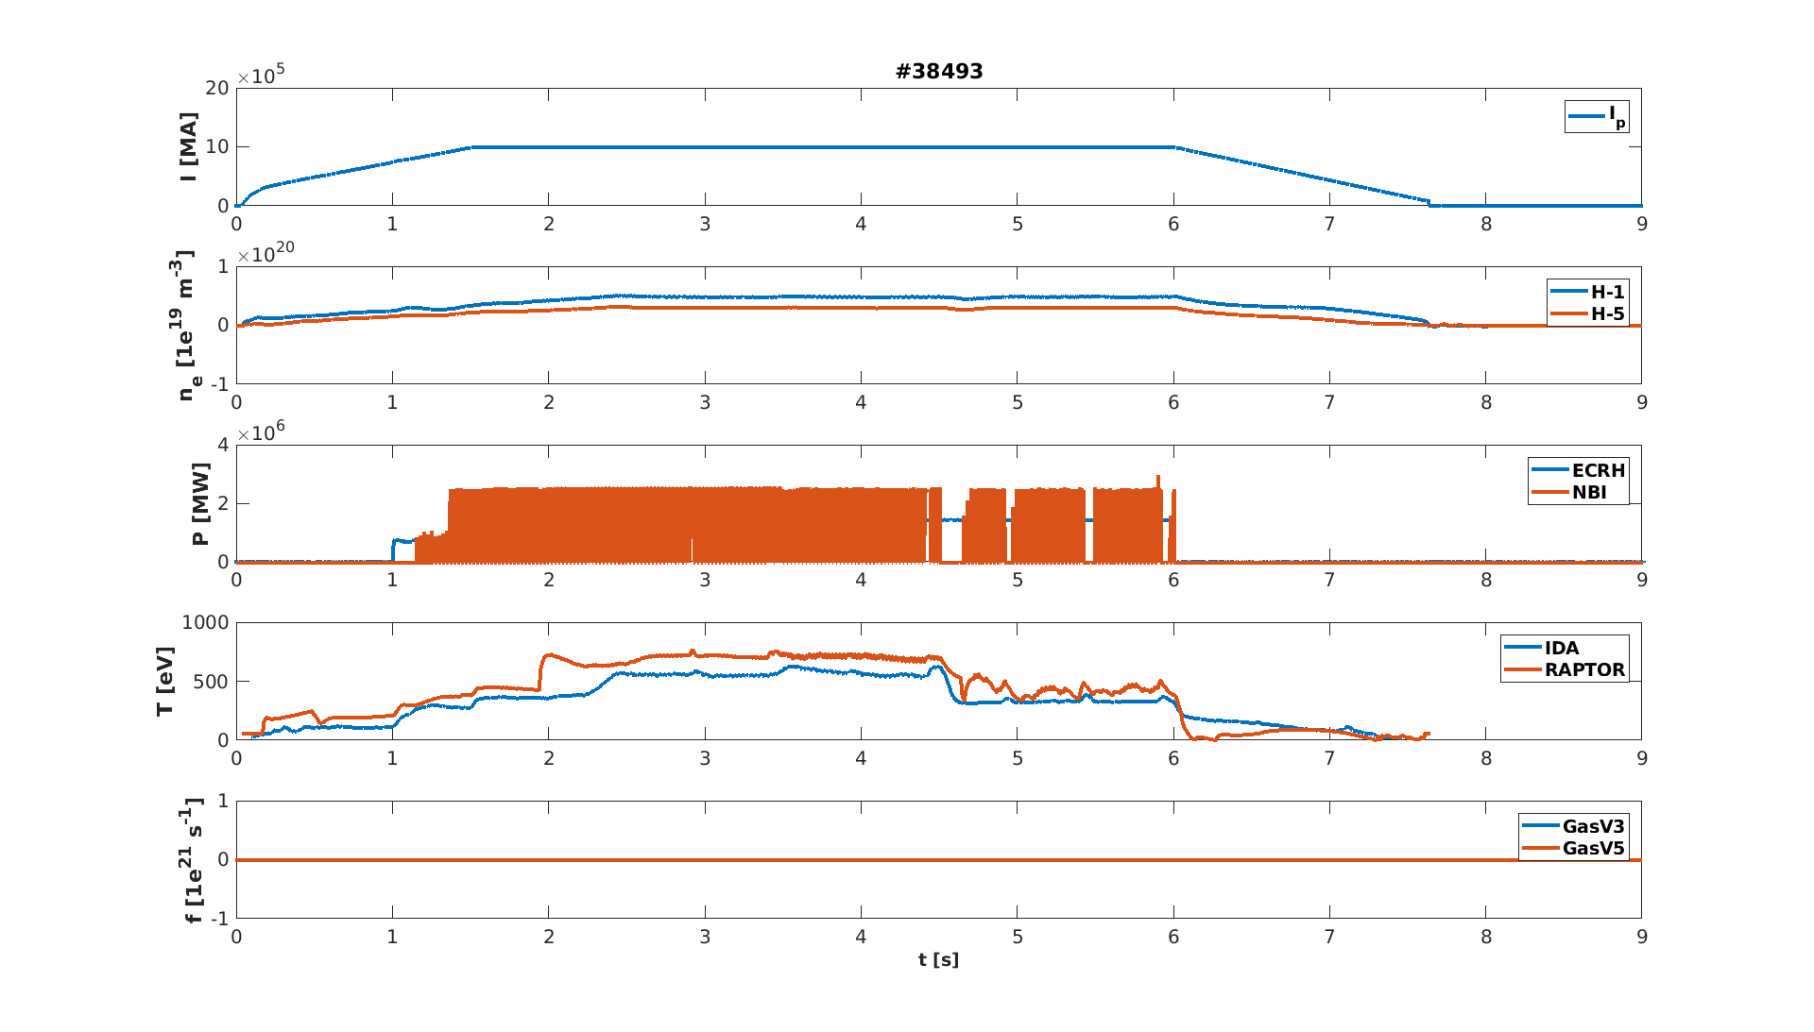
Kalman Filter and Electron Temperature at Pedestal
Motivation:
      RAPTOR does not work well near pedestal
      As a benchmark is used Integrated Data Analysis (IDA), which is offline diagnostic system for electron temperature

Slide 11
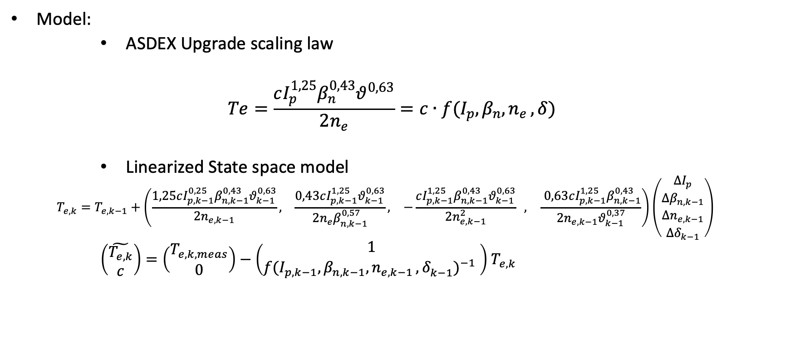
Kalman Filter and Electron Temperature at Pedestal
Model:
      ASDEX Upgrade scaling law
  $$Te=\frac{cI_{p}^{1,25}β_{n}^{0,43}θ^{0,63}}{2n_{e}}=c∙f(I_{p},β_{n}, n_{e }, δ)$$
      Linearized State space model
  $$T_{e,k}=T_{e,k−1}+\left(\begin{matrix}\frac{1,25cI_{p,k−1}^{0,25}β_{n,k−1}^{0,43}θ_{k−1}^{0,63}}{2n_{e,k−1}}, & \frac{0,43cI_{p,k−1}^{1,25}θ_{k−1}^{0,63}}{2n_{e}β_{n,k−1}^{0,57}}, & −\frac{cI_{p,k−1}^{1,25}β_{n,k−1}^{0,43}θ_{k−1}^{0,63}}{2n_{e,k−1}^{2}} , \end{matrix}\frac{ 0,63cI_{p,k−1}^{1,25}β_{n,k−1}^{0,43}}{2n_{e,k−1}θ_{k−1}^{0,37}}\right)\left(\begin{matrix}ΔI_{p} \\ {Δβ}_{n,k−1} \\ Δn_{e,k−1} \\ {Δδ}_{k−1}\end{matrix}\right)$$
      $\left(\begin{matrix}\tilde{T_{e,k}} \\ c\end{matrix}\right)=\left(\begin{matrix}T_{e,k, meas} \\ 0\end{matrix}\right)−\left(\begin{matrix}1 \\ {f(I_{p, k−1},β_{n,k−1}, n_{e,k−1 },δ_{k−1}^{})}^{−1} \end{matrix}\right)$ $T_{e,k}$

Slide 12
Workshop

Slide 13
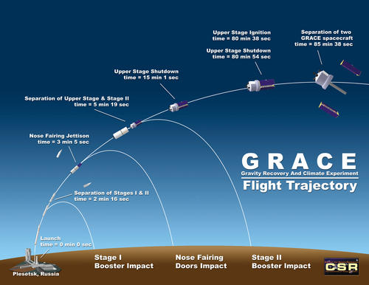
Spaceship (projectile motion )

Slide 14

Workshop
Example: Spaceship (projectile motion )

Slide 15
Overlook
Linear model-based filter
Needs to know only previous and current step
Predicts next state of estimate
Can use many diagnostics

Slide 16
References
Optimal State Estimation, Kalman, H,, and Nonlinear Approaches; Dan Simon; https://isharifi.ir/teaching/2019/IoT/[Dan_Simon]_Optimal_State_Estimation_Kalman,_H_In(BookFi).pdf
F. Felici, “Real-time control of tokamak plasmas: from control of physics to physics-based control,”; https://inis.iaea.org/collection/NCLCollectionStore/_Public/46/094/46094893.pdf

