Slide 1
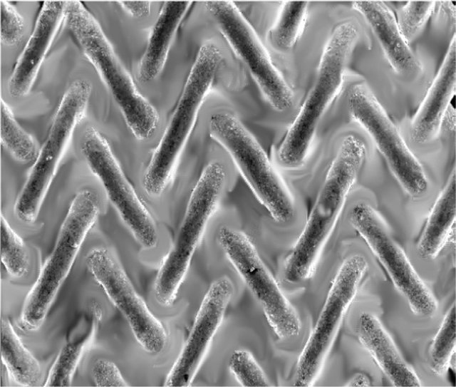


Liquid metal divertors
Jan Čečrdle
Mariánská XIV
11.1.2021

Slide 2
Outline
Introduction to liquid metal divertors
LMD simulations
Current work
Future plans

Slide 3
Divertor overheating
ITER divertor steady state heat flux must be <16 MW/m2 (DEMO <15 MW/m2)
85 % of the power must be radiated (impurity seeding)
For DEMO 98 %!!!
© R. Pitts

Slide 4
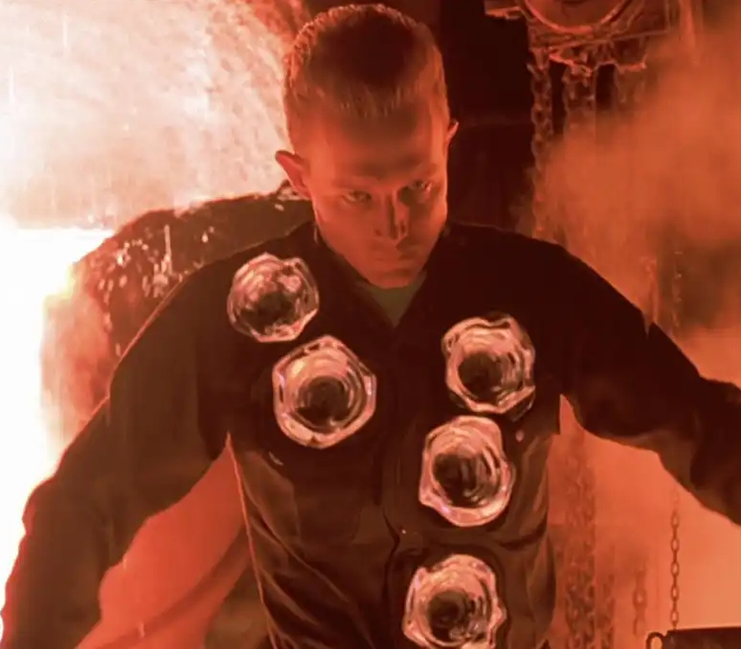

Liquid metal plasma facing components
?
>
Replace the solid plasma facing component with a liquid
No melting
No recrystallization
Self-restoration
Vapour shielding
© Tristar Pictures
© STUDIOCANAL

Slide 5
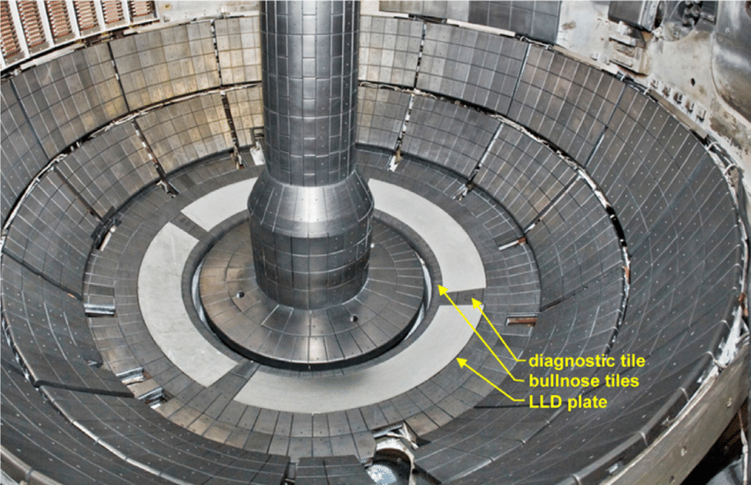
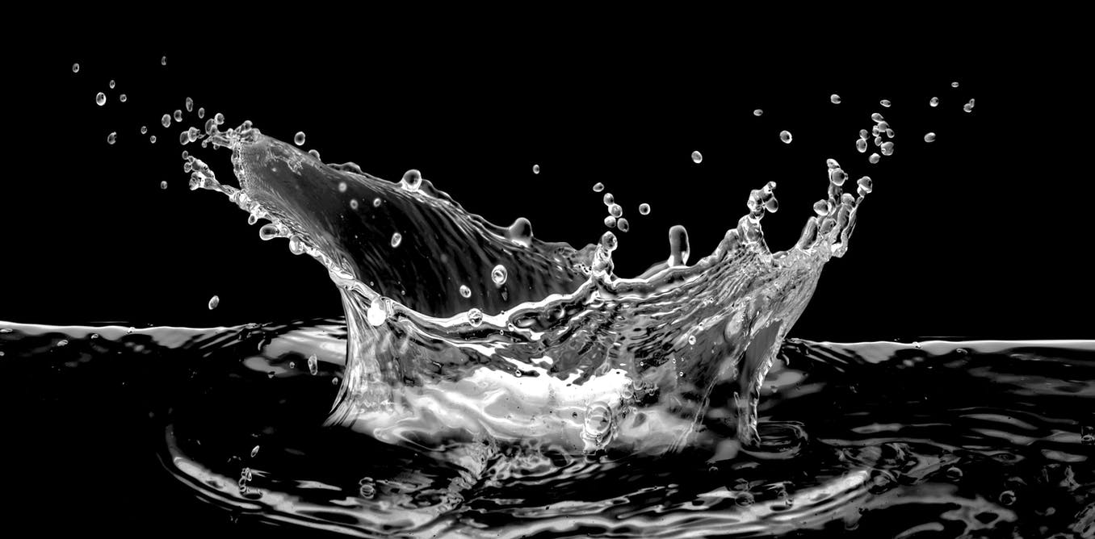
Disadvantages of liquid metals?
Fluidity
High erosion rate
Fuel retention
High SOL and core radiation
© R. E. Nygren

Slide 6
No crystalline lattice versus fluidity
A bulk substrate material needed (tungsten)
Tungsten mesh (felt)
3D printed materials
Bulks with trenches
Thermally induced forces
Flowing metal
© P. Rindt
© V. A. Evtikhin
© Z. Li

Slide 7
Vapor shielding
Cooling effects:
Latent heat
  Sputtered atoms
  Evaporation
Line radiation
Ionisation
© T. W. Morgan

Slide 8
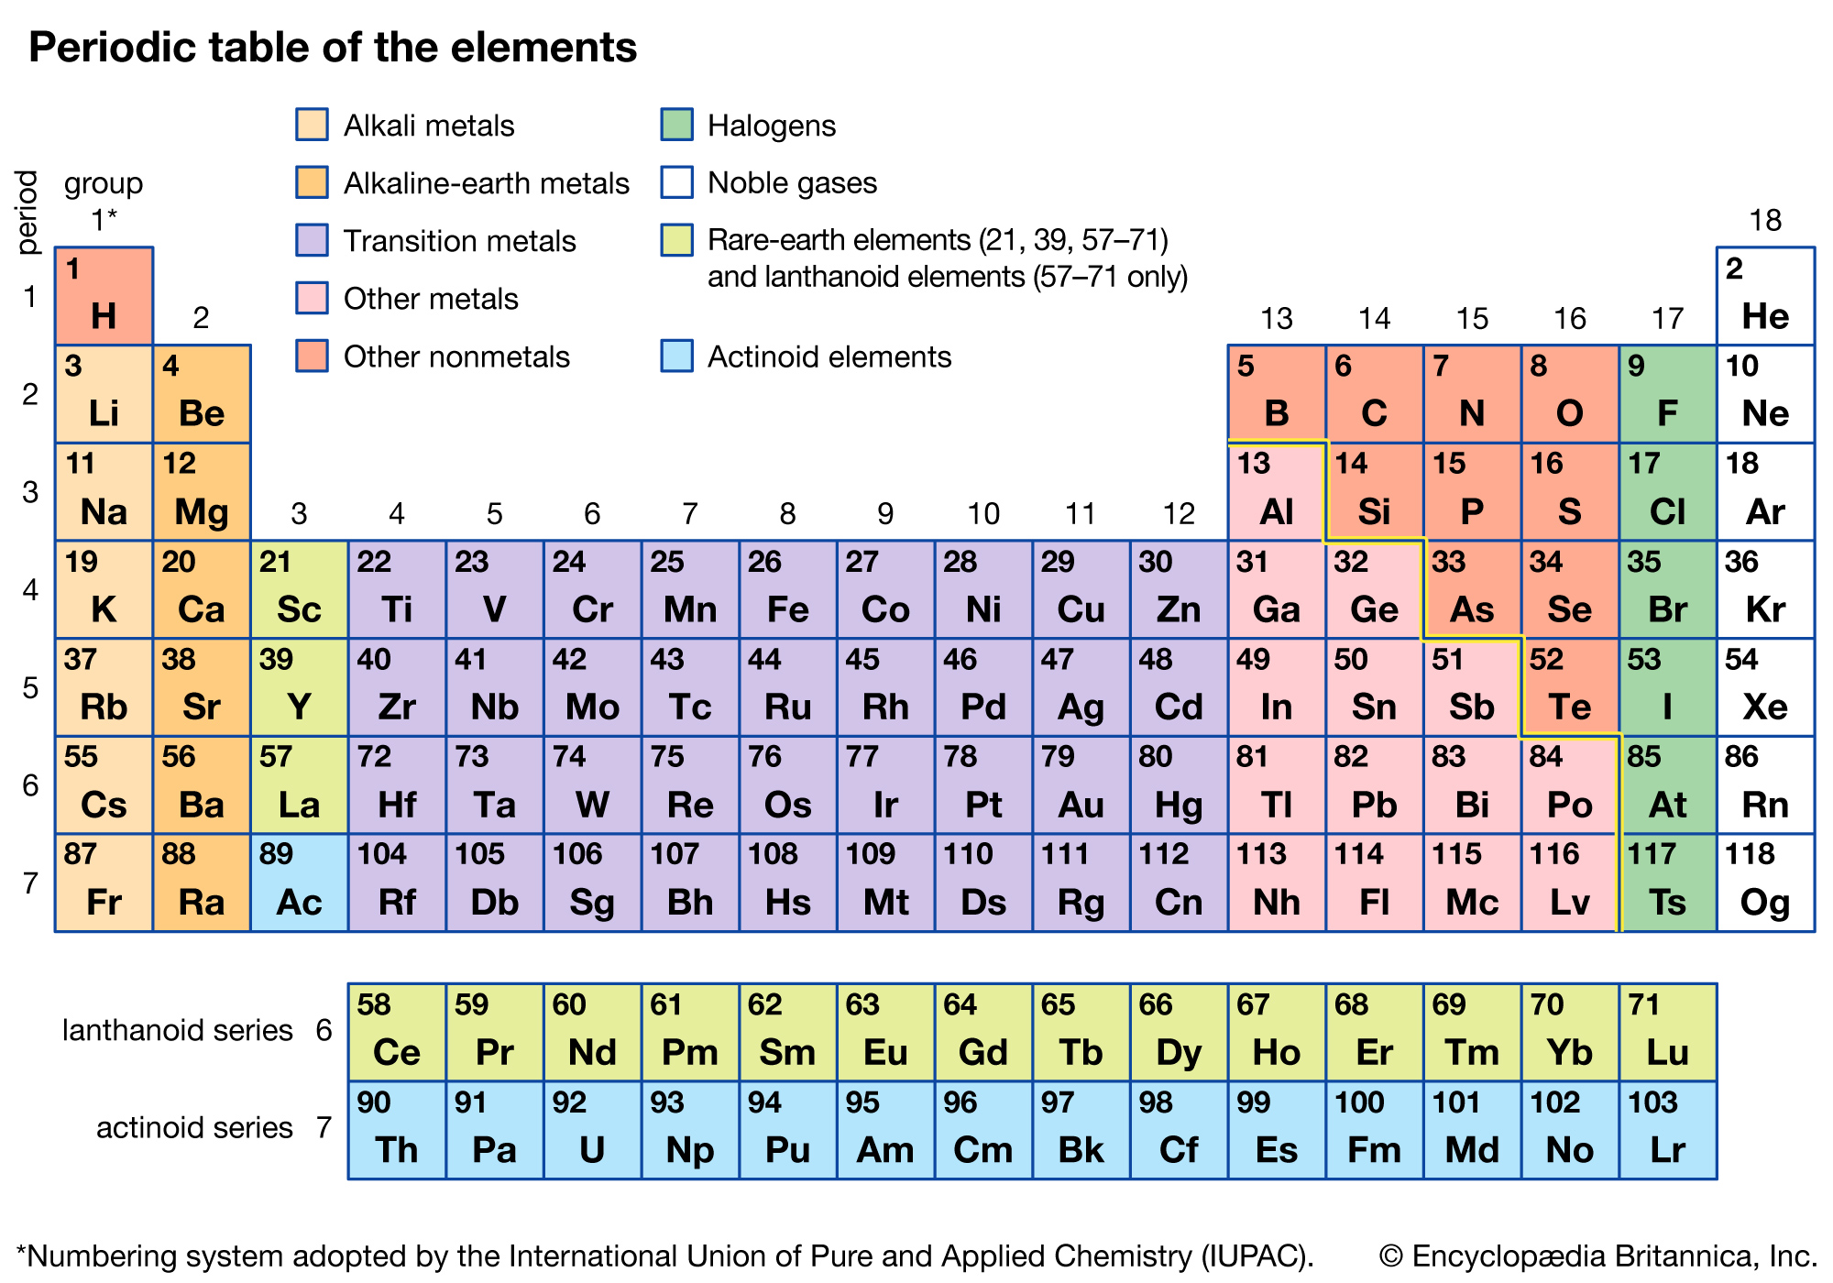
Which metals can be used
Consider:
Melting point
Boiling point
Evaporation rate
Atomic mass

Slide 9
Tin or lithium
Lithium:
Low Z
High outflux
Tin:
High Z
Low outflux
Sn/Li alloy -> best of both
Only Li evaporated
Lower outflux compared to Li

Slide 10
Radiation in plasma
Radiation cooling factor for various elements
Lithium:
Weak vapour shielding per atom
High concentration in core plasma possible >20%
Tin:
Very strong vapour shielding per atom
NO tin in core plasma (<0.03 %)
© T. Pütterich

Slide 11

Two approaches
Vapour shielding regime (lithium)
Equilibrium of steady state heat flux conduction and vapour cooling
Transients mitigated by increased erosion.
Lithium transport control
Fail safe regime (tin)
In steady state business as usual
Vapour cooling serves only as a fail safe for transient heat events
Even a tiny amount eroded can cause problems

Slide 12
Edge localised modes
ITER ELMs energy fluence 66 MJ/m²s^{-1/2} just below the flash melting point
SPARC ELMs comparable to ITER with 4x smaller vessel
ELMs can ‘‘burn’’ through impurity seeding
© J. R. Walk

Slide 13
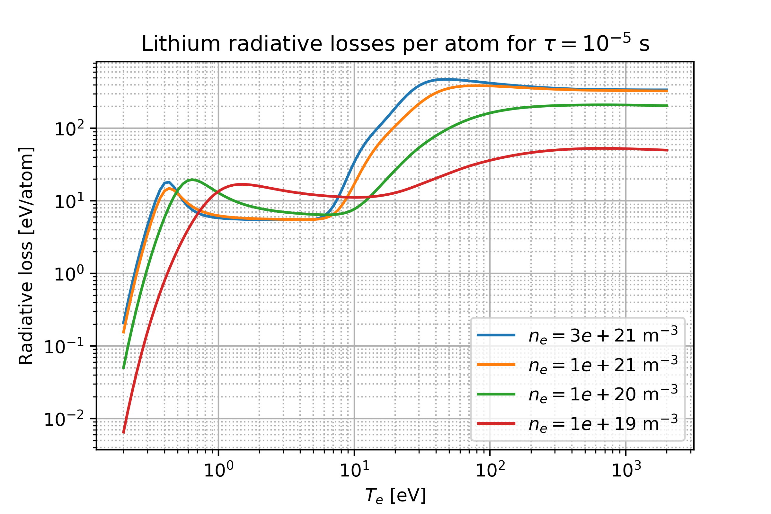
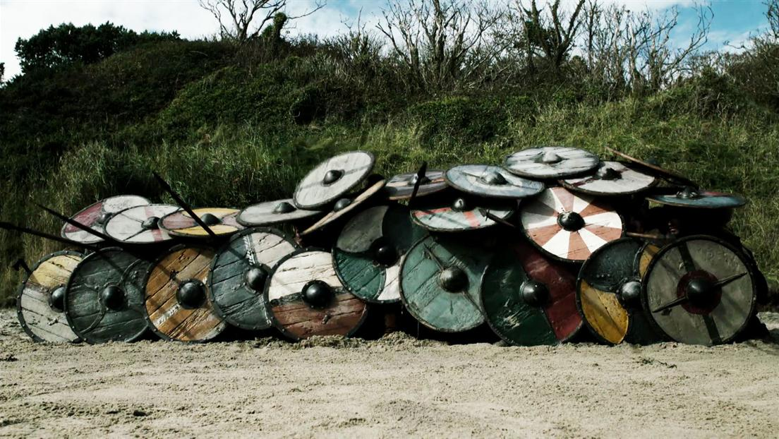
Vapor shielding
Electron density and temperature crucial
Cooling power can easily change by a factor of 100
Very beneficial for ELMs

Slide 14
Effect of electron temperature
H-mode divertor plasma with DEMO like parameters
Steady state heat flux
350 MW/m²
Peak heat flux during ELMs
≈ 1 GW/m²
Electron density
1e21 m⁻³ to 3e21 m⁻³
Electron temperature
10 eV or 30 eV

Slide 15
Liquid metal versus tungsten divertor
Surface temperature
Lithium heat conductivity lower
Vapor shielding suppresses ELM spiking
Vapor shielding slows down temperature increase (eventually saturates)
How to deal with poor LM thermal conductivity?

Slide 16
Liquid metal versus tungsten divertor
Surface temperature
Lithium heat conductivity lower
Vapor shielding suppresses ELM spiking
Vapor shielding slows down temperature increase (eventually saturates)

Slide 17
AUG liquid metal experiment simulations
Currently finalizing a new python version of the code
Model referential discharges
How much tin will be evaporated?
How far can we go?
Discharge parameters
Fig.: Model of the tested target. Dimensions in mm. [Scholte]

Slide 18
Effect of high density
High density plasma may erode the surface significantly by sputtering only
Cannot be counter measured by stronger conductive cooling
Sheath versus conduction limited regimes
Sputtering in detached plasma?

Slide 19
Effect of high density
High density plasma may erode the surface significantly by sputtering only
Cannot be counter measured by stronger conductive cooling
Sheath versus conduction limited regimes
Sputtering in detached plasma?

Slide 20
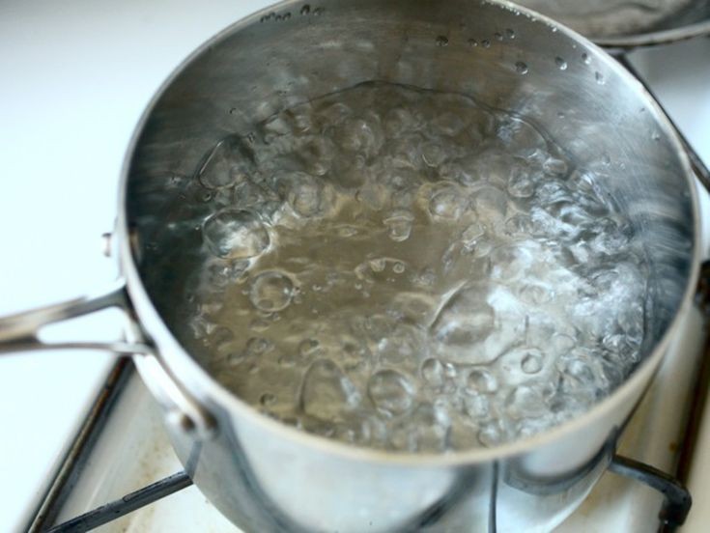
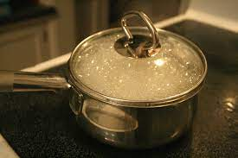
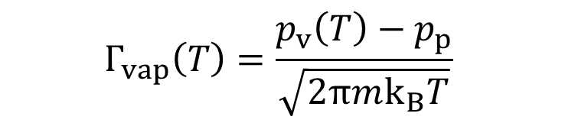
Evaporation suppression
$$Γ_{vap}\left(T\right)=\frac{p_{v}\left(T\right)−p_{p}}{\sqrt{2πmk_{B}T}}$$
OR
Evaporation dependent on surface temperature
AND partial pressure
Partial pressure in all cases assumed equal to zero
Is this true in high recycling/detached regimes?

Slide 21
Thank You very much

