Slide 1
Continuous control on ASDEX-Upgrade tokamak
O. Kudlacek on behalf of:
AUG control group: W. Treutterer, I. Gomez-Ortiz, A. Grater, F. Janky, T. Maceina, B. Sieglin, T. Zehetbauer, G. Raupp
EPFL Lausanne collaborators: F. Felici
TU Eindhoven collaborators: T. Bosman

Slide 2
Content of the presentation
Kinetic control in fusion machines specifics
Examples of our work on “advanced” control
Model based control of the electron temperature
Iterative learning control for electron and ion temperature optimization
Outlook
Nonlinear state observers developments
Model based controller design

Slide 3
I. Kinetic control: challenges from control perspective
Strong non-linearity & coupling of important quantities
Energy transport ~$T_{e}^{3/2},$ T_{e}/T_{i}, current profile
Density peaking coupled with temperature peaking
Current profile ~ T_{e}
Difficulty to measure some of the quantities
Use of Extended Kalman filter observers
Development in shot-to-shot based optimization techniques
Example: Iterative Learning Control
Models can not be always trusted
No physics models exist yet
Semi-empirical models have only limited validity range

Slide 4
II. a: Model based control of the electron temperature
Support of physics studies:
Keep T_{e} profile constant while the beam heating power deposition changes
Actuators: ECRH heating at two locations
T_{e} measurement: state observer RAPTOR
Changed heating location
Original heating location
EC heating location for control

Slide 5
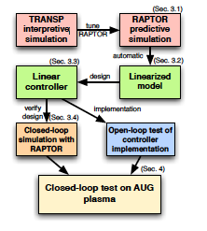
Controller design: model based technique
Goal: keep Te profile (7 locations) constant by actuating at 2 locations
Control-oriented simulation matched to experimental data
Model based MIMO controller design
SVD technique used
F. Felici et al, submitted to Nuclear Fusion

Slide 6
Experimental results
Controller works for the range scenarios it was designed for
Higher density => stiff T_{e}
F. Felici et al, submitted to Nuclear Fusion

Slide 7
II b: Iterative learning control for electron and ion temperature optimization
Iterative adjustment of heating actuator trajectories to optimize ion and electron temperature
T_{e} measurable in RT, T_{i} not
Actuators:
NBI: heats ~70 % ions, ~30 % electrons in our target scenario
ECRH: heats electrons only
Target:
Increase T_{i} while keeping T_{e} constant by adapting NBI and ECRH heating

Slide 8
Introduction: Iterative learning control procedure
Preparation:
Match plasma simulation to existing experiment
Derive linear model of plasma response to actuator changes
Define realistic reference for controlled trajectories
Experiment execution:
Execute experiment and compare real and expected evolution
Update actuator trajectories by solving optimization problem
Repeat till you are happy
... or out of experimental time

Slide 9
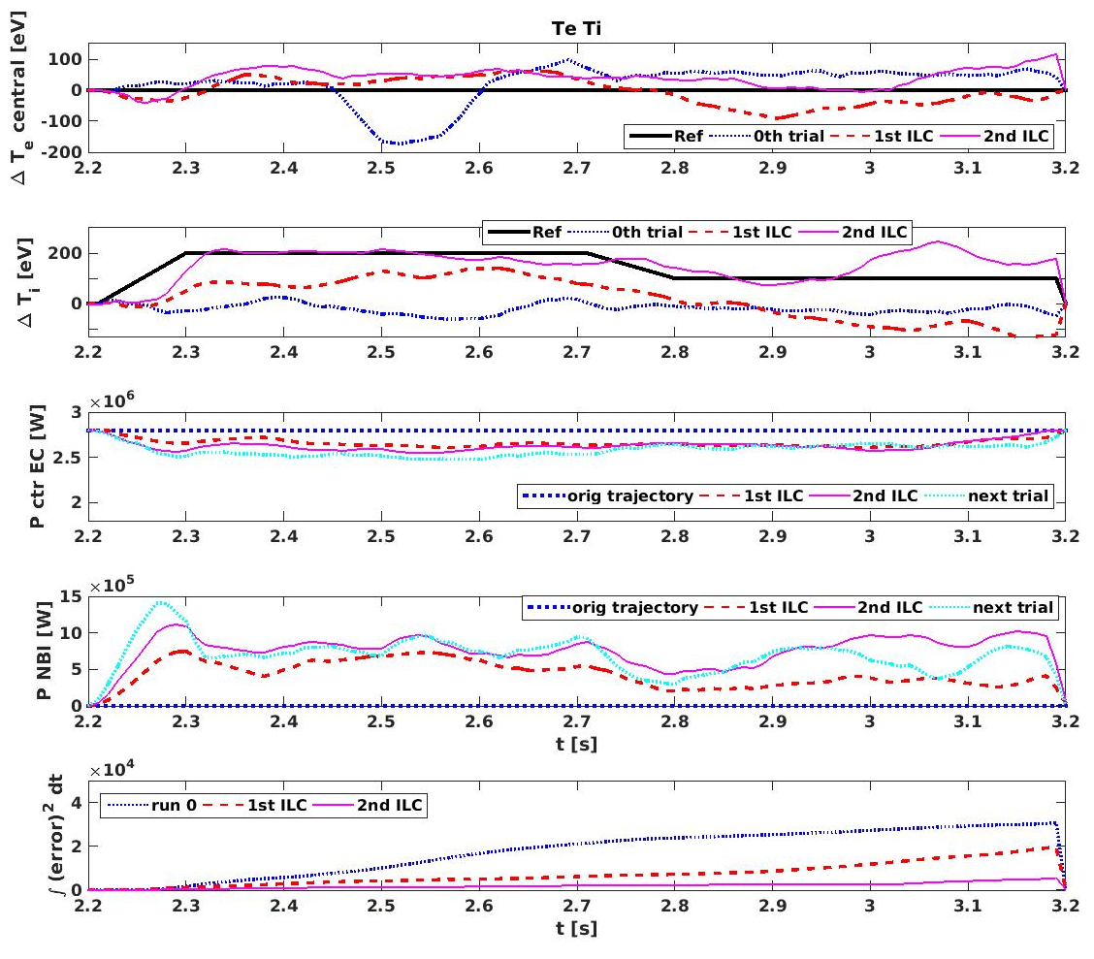
Results: control of Te and Ti
Ti reference reached most of the time, Te does not change that much
Next iteration seems to go in the right direction

Slide 10
Iterative learning control: conclusion
T_{e} and T_{i} can be in principle optimized on shot-to-shot base
Future applications:
Optimization of repetitive processes such as plasma startup
Optimization of quantities that can not be measured in real time

Slide 11
III. Outlook

Slide 12
Further development of state observers
Non-measurable quantities
Measurement of the same quantity by multiple diagnostics
None of the diagnostics is reliable and sufficiently precise for all discharges
Synthetic diagnostics + control-oriented model
Status: existing state observers
RAPTOR: [F. Felici et al, Nuclear Fusion 2011]
electron temperature profile- used in control
current profile: no RT diagnostics available
Ion temperature profile: no RT diagnostics available
RAPDENS: [T. Blanken et al, Fusion Engineering and Design 2018]
Average density
Density profile not mature yet
Plans: include additional diagnostics to the state observers
More diagnostics becoming real time available => add them to observer
Improvement of the control-oriented models

Slide 13
Control outlook: towards model based control
Most of our existing controllers are designed on trial-error base
Switch to model based design (Fenix simulator, next talk)
System identification:
No models for everything in fusion
Example: disruption avoidance in the talk of I. Gomez
Capture basic system dynamics from existing data?
Long term goal:
No operation limit violation by controller action
Explore proper techniques for this: Model Predictive Control?

