Slide 1
Enhanced Plasma Confinement in Tokamaks with Focus on the Turbulence-Flow Interaction Progress towards a dissertation thesis
Ondřej Grover
Faculty of Nuclear Sciences and Physical Engineering, CTU in Prague Training workplace: Institute of Plasma Physics of the Czech Academy of Sciences Supervisor: Ing. Martin Hron, Ph.D.

Slide 2
Outline
Summary of activities in the past year
L-H transition vs. X-point position in COMPASS
Causality and statistics: how to deal with spurious correlations

Slide 3
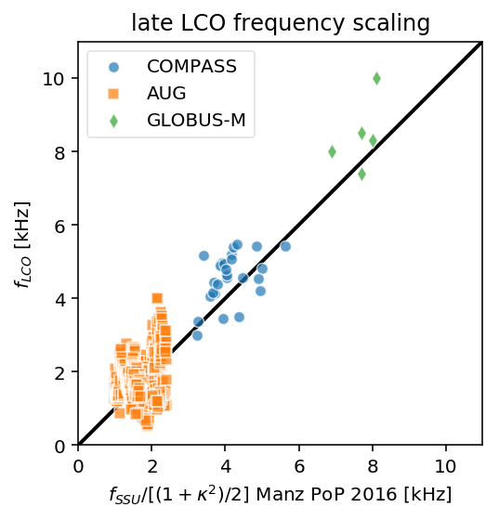
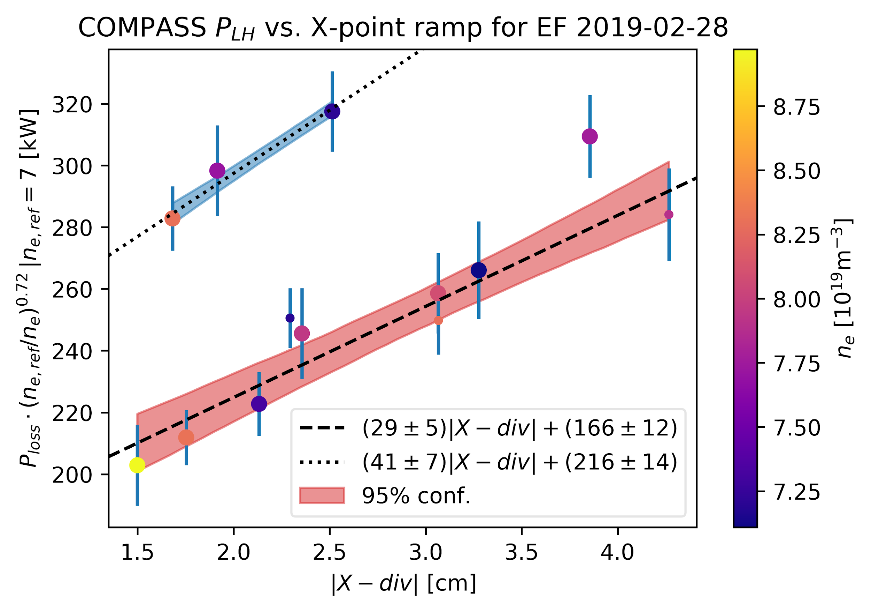
Summary of activities in 2019
Collaboration with UCSD on potential vorticy probe design, supporting HESEL (DTU) turbulent simulations
L-H on COMPASS
Participation in I-mode (seeding, threshold scaling), QH-mode studies at ASDEX Upgrade in the scope of MST1
Finalized and defended the study towards a dissertation thesis (rozprava) => 2 years left for dissertation thesis
Extension of Limit Cycle Oscillation frequency scaling theory with P. Manz
Impact of error fields and X-point position on the L-H transition (GAČR)

Slide 4
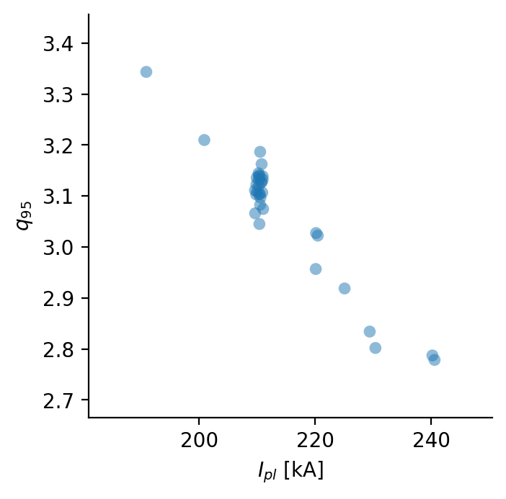
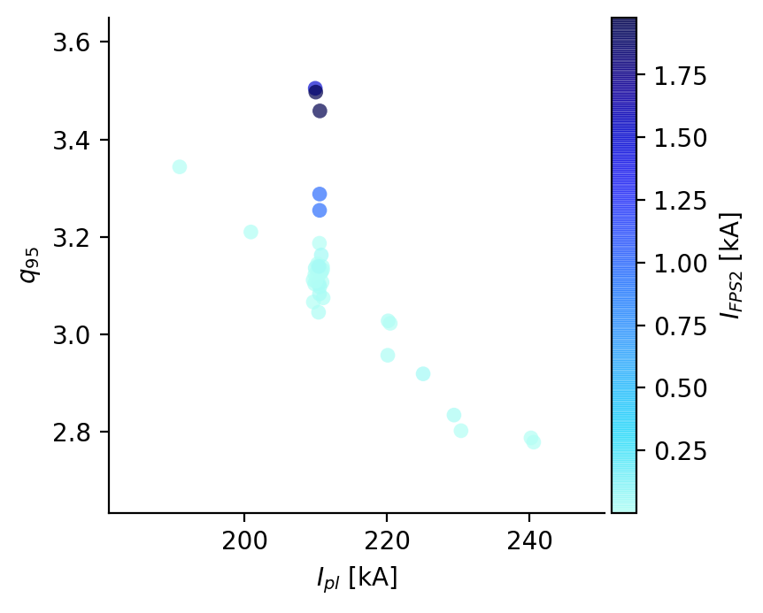
Causality and correlation
I_{pl}
q₉₅
I_{FPS2}
Intervention by other means
I_{pl} and q₉₅ correlated (stat. dependent), but that does not imply causation
I_{pl} and q₉₅ not correlated (independent), because of intervention on q₉₅ => effect does not change its cause
Causality observed as asymmetry in interventional distributions
Graphical (easy to use) models encode conditional (in)dependencies -> causal structure
Intervention: delete arrows from parents
do-calculus : obtaining intervention-like distribution from observational data

Slide 5
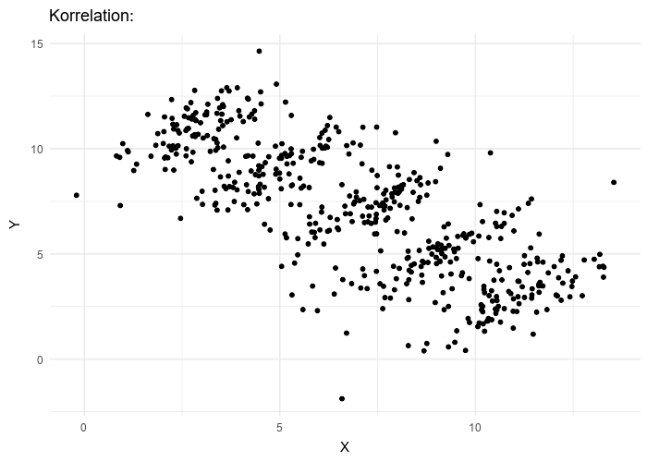
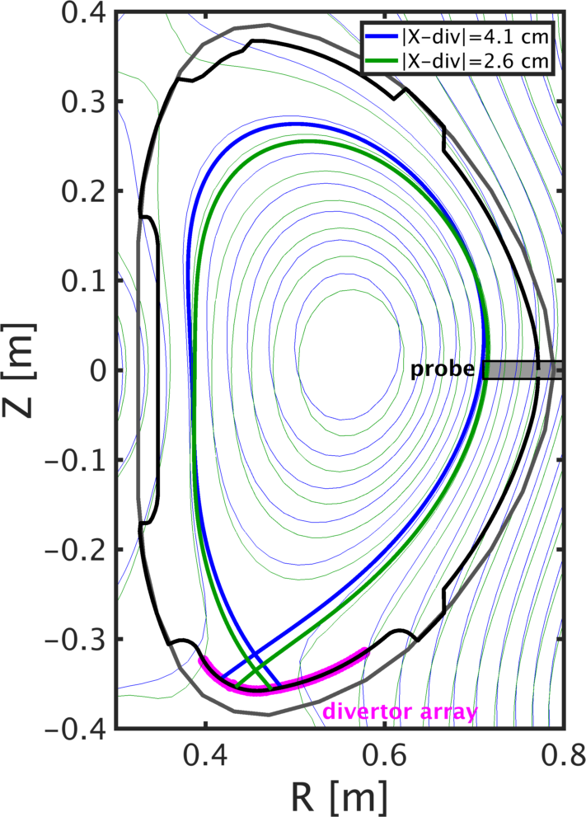
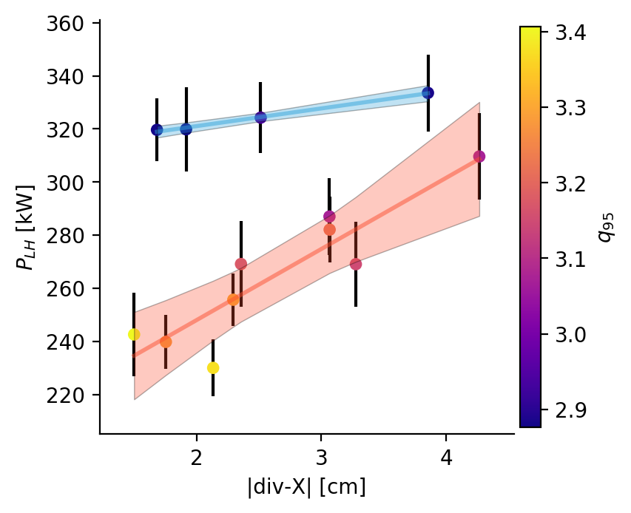
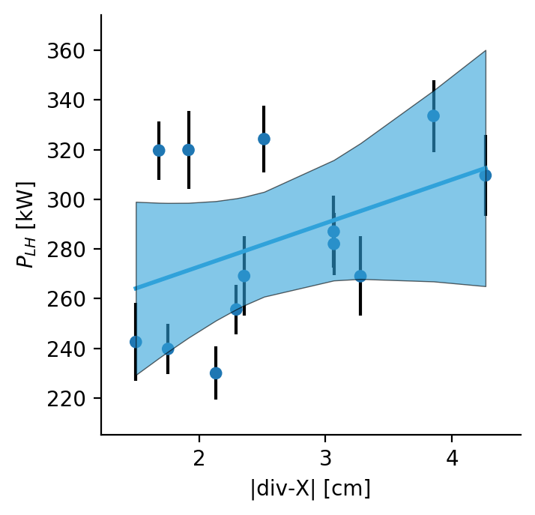
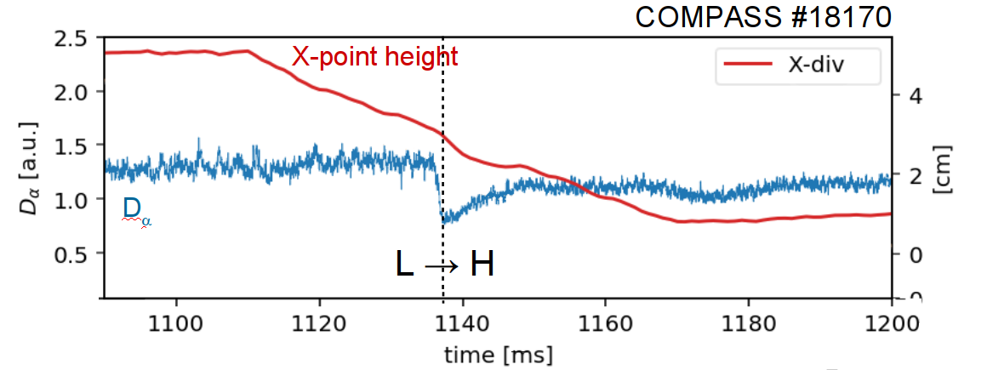
P_{LH}(|div-X|) confounded by q₉₅
I_{pl}
shaping
Z₀
q₉₅~3
equilibrium
conditioning or sub-groups or including in regression blocks the back-door path => intervention-like distribution
|div-X|
q₉₅
q₉₅>3
Back-door path
Edge plasma parameters
P_{LH}
Simpson’s paradox (Wikipedia): conditioning can de-confound dependencies

Slide 6
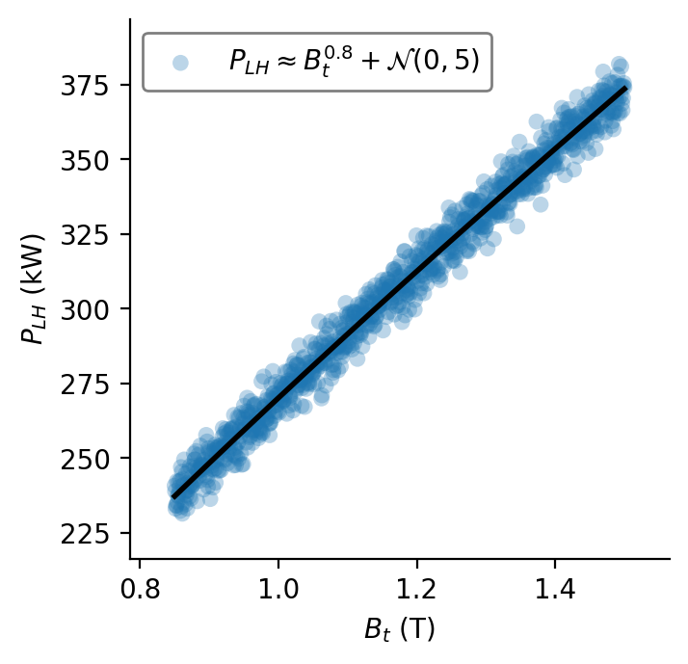
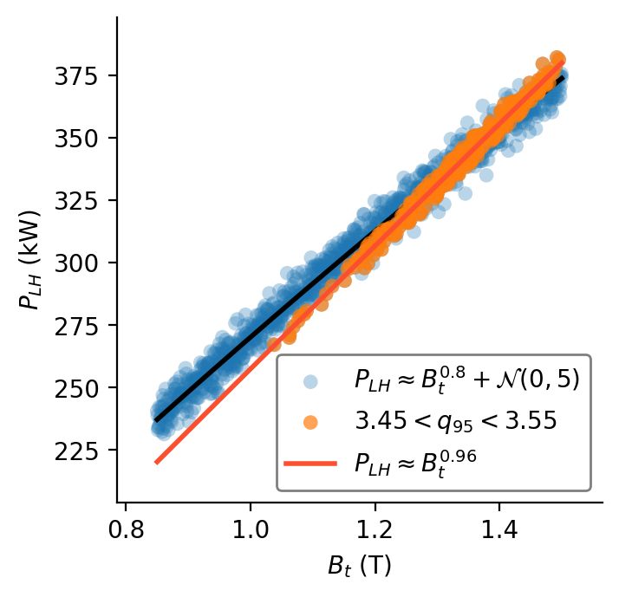
Conditioning on a collider opens up a confounding path
B_{t}
x (B_{t}/1.15 T)^{0.8} x 270 kW [Martin JNM 2008]
P_{LH}
uninformed conditioning can create confounding and result in biased results
Reference: B_{t}=1.15 T I_{pl}=200 kA
q₉₅ = 3.3 P_{LH}=270 kW
x 200 kA / 270 kW
I_{pl}
q₉₅
q₉₅ is a collider: blocks B_{t} -> I_{p} -> P_{LH}
q₉₅=B_{t} / (I_{pl} / 200 kA) x 3.3
Conditioning q₉₅ ~3.5 <- sub-selection, exp. design (stability, ref. scenario), regression

Slide 7
Elimination of n_{e} dependence by counterfactual assignments
I_{pl}
shaping
Z₀
Counterfactual: If measured P_{LH} = Y given n_{e}, I_{pl},Z₀ then knowing the mechanism n_{e}-> P_{LH} given n_{e}=7, I_{pl},Z₀ : P_{LH}^{ne=7} =Y x (7/n_{e})^{0.72}
equilibrium
|div-X|
q₉₅
Reduced scatter in P_{LH} due to n_{e} variation => elimination of direct effect
Extra scatter due to n_{e} variation
Edge plasma parameters
n_{e}
P_{LH}
∝n_{e}^{0.72} [Martin JNM 2008]

Slide 8
Summary and Outlook
Estimating causal effects without manipulation/intervention possible with do-calculus
Good introductory book: J.Pearl, D. Mackenzie: The Book of Why (2018)
Introductory lecture in the Epilogue of J. Pearl: Causality (2009)
Draw your graphs before you draw any conclusions (and before you make experiments)
Priority for coming year: finalize and publish ongoing work (LCO scaling, vorticity, L-H studies) -> dissertation

Slide 9
Backup slides

Slide 10
Impact of error fields and X-point position on the L-H transition
H-mode (high confinement) regime: baseline ITER scenario
Contribution to GAČR team effort at COMPASS
Preparation and participation in experimental campaigns
Data analysis and data mining
Robust trend of P_{LH} on the X-point height above the divertor identified, linked to divertor E_{r}
Possibly high impact on ITER vertical target divertor design
To result in a (co-authored) publication in Nuclear Fusion
Impact HFS error fields on H-mode access and P_{LH} possible to compensate with sufficient rotation
Mock-up experiments of misalignment of ITER central solenoid => high impact for ITER operation
Nuclear Fusion Letter (co-authored) in preparation
q₉₅~ 3
Presented at the EFTSOMP workshop 2019, Padova, Italy

Slide 11
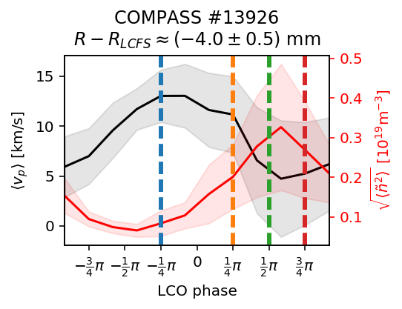
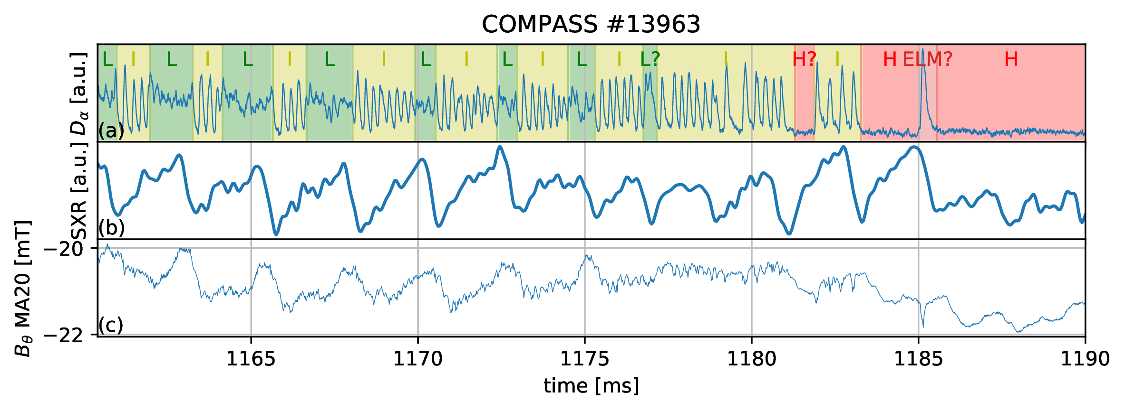
Limit cycle oscillation observations at COMPASS
L-H transition into H-mode (high confinement) can be gradual:
Predator-prey model [Kim, Diamond PRL 90 185006 (2003)] of turbulence-zonal flows (ZF) interaction => limit cycle oscillations (LCO)
Observations in COMPASS point to a different mechanism
Published in [O. Grover et al Nucl. Fusion 58 112010 (2018)]
Velocity max. precedes turbulence intensity peak by almost ~ -π, - but ZF LCO would have π/2
=> points to pressure-driven balooning transport

Slide 12
Multi-machine scaling of balooning LCO
Initial theory of balooning LCO frequency [1] :
Collaboration with P. Manz on
extending theory to elongated plasmas, magnetic flutter for 1/√β scaling
comparison with multiple tokamaks => confirms 1/R scaling
Expected to be published in PRL or Nuclear Fusion (first author)
[1] P. Manz et al Physics of Plasmas 23 052302 (2016)

Slide 13
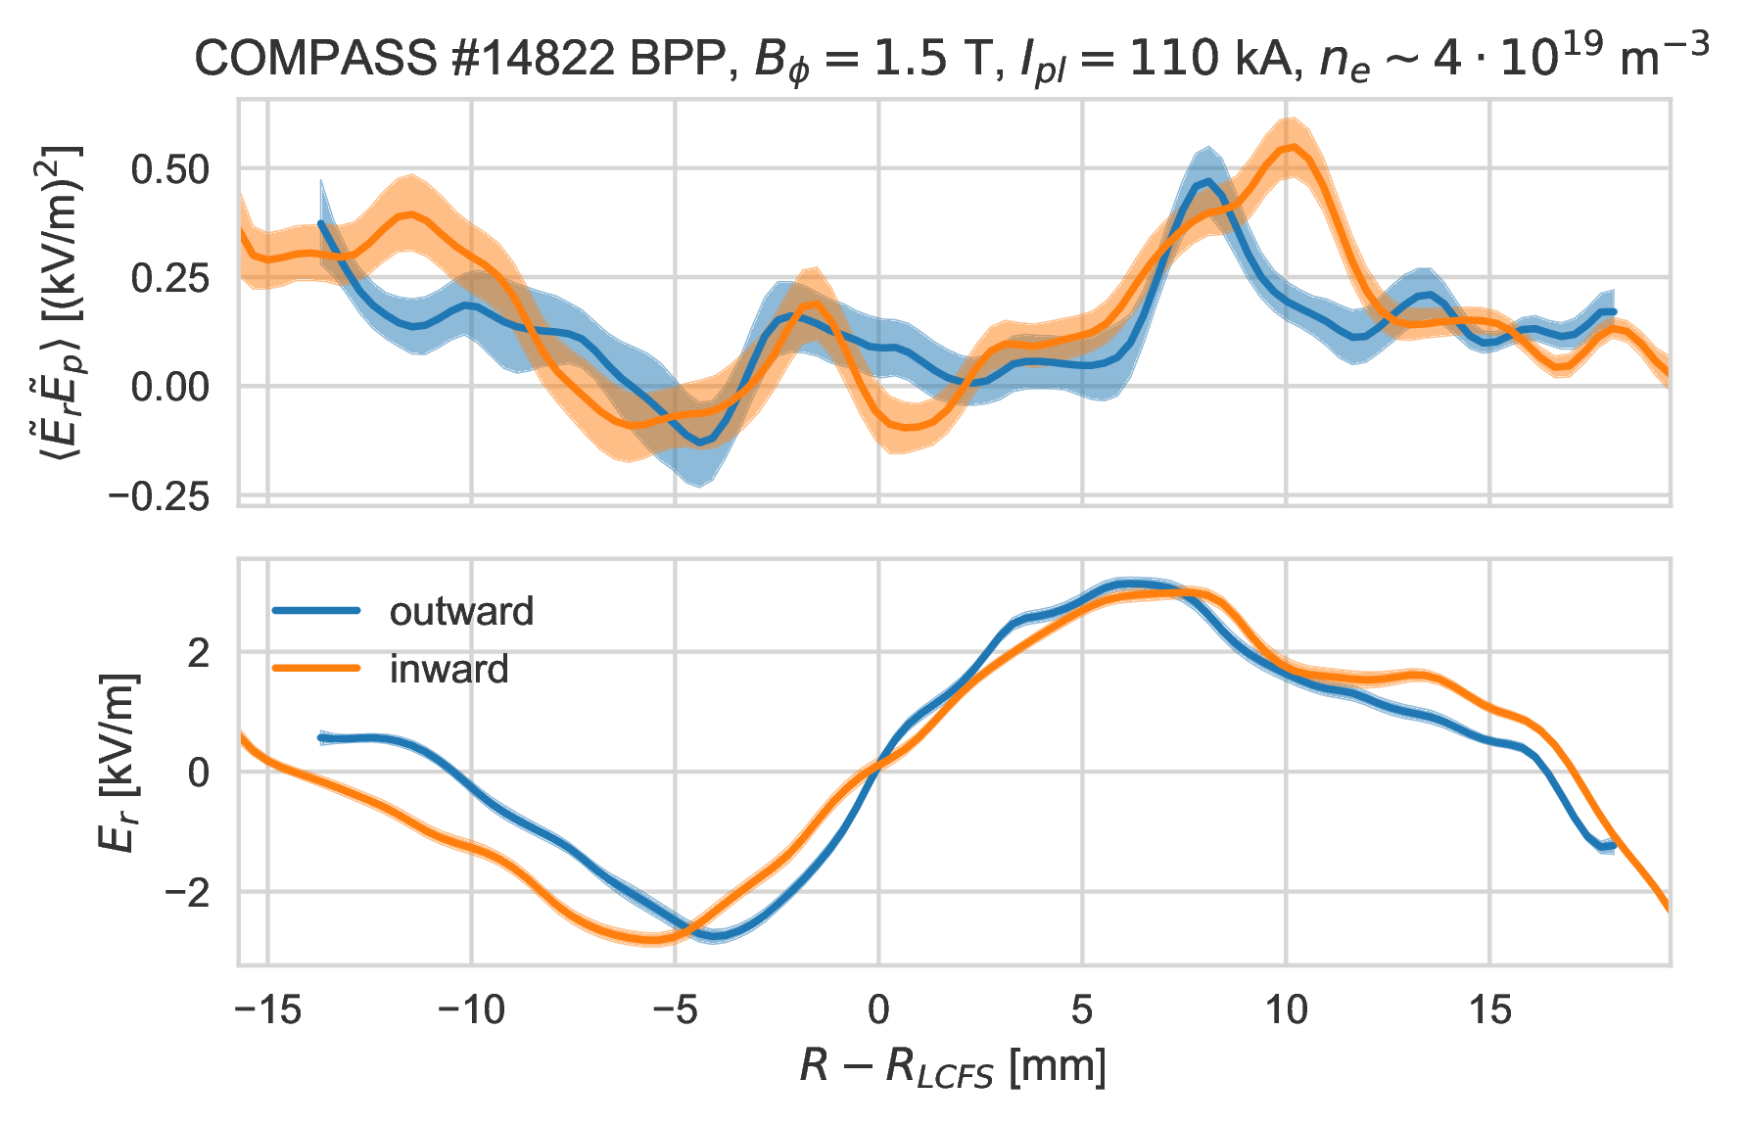
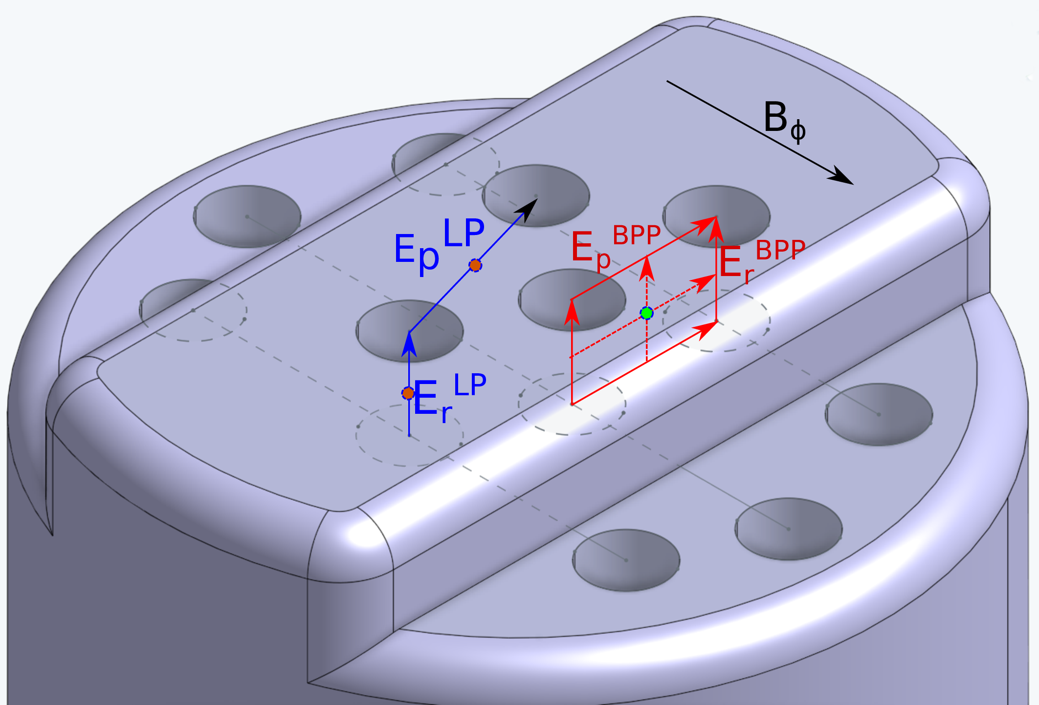
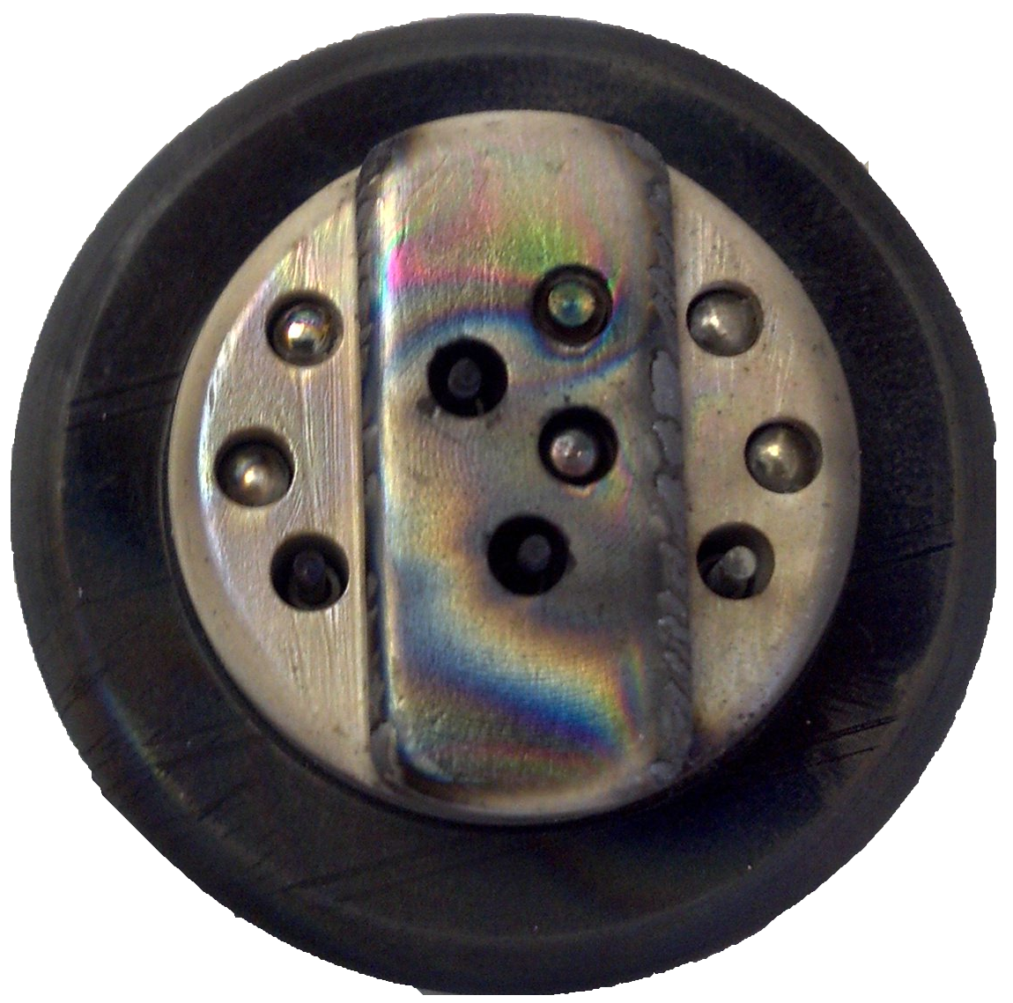
Turbulent moments profiles and comparison with HESEL
Motivated by LCO study: assessment of zonal flow drive and presence
Reynolds stress (RS) force
Bootstrapped kernel regression for self-consistent averaging
confidence bounds for assessment of ZF presence and drive
commendment by the Itoh prize for [O. Grover et al EPS 2018]
Comparison of RS measurements with Langmuir and ball-pen probe => assessment of T_{e} fluctuations influence
Proof-of-principle T_{e} influence correction discovered, partly confirmed in HESEL simulations [O. Grover et al EPS 2019]
Collaboration with UCSD (prof. G. Tynan) on potential vorticity mixing measurements
new probe head being designed
supporting HESEL simulations in progress

Slide 14
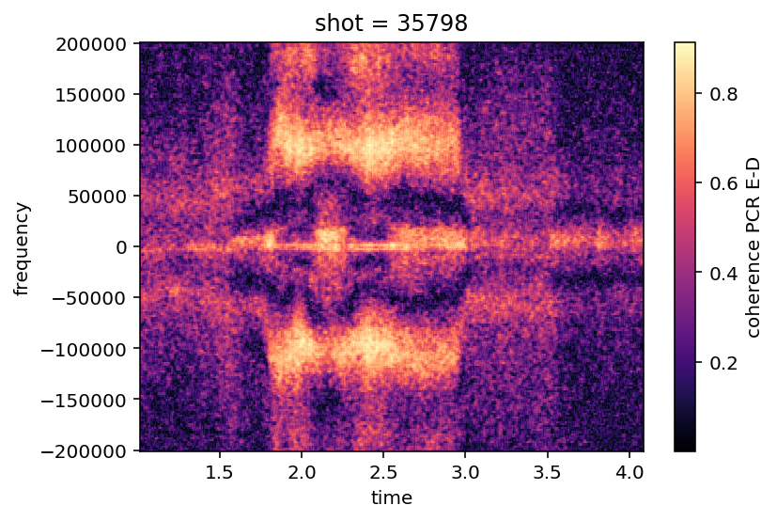
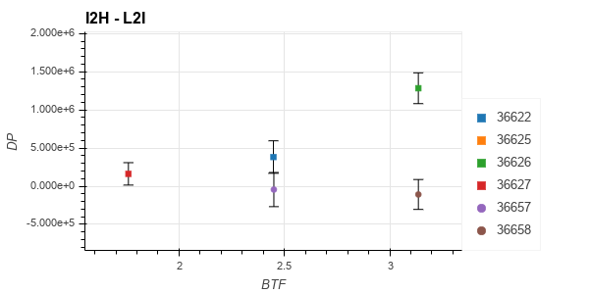
Contribution to I-mode studies at ASDEX Upgrade (in the scope of MST1 T05)
I-mode: enhanced T_{e} confinement as in H-mode, n confinement as in L-mode
No ELM crashes, but bursts
Study of the weakly-coherent mode (WCM) during N₂ seeding of I-modes with pol. corr. reflectometry
L→I and I→H power threshold scaling analysis
Contributed to invited talk by M. Reinke at APS 2019
[Hz]
[s]
ECRH power
N₂ puff
[T]

