Slide 1
EC waves in COMPASS and COMPASS-U tokamaks
Michal Farník
FTTF workshop Mariánská 2020
M. Farník: ECRH / FTTF / 2020
01/16
xx/xx

Slide 2
Part I. ECRH for COMPASS-U
Specifications
Simulations
To Do
Part II. V-ECE for RE measurements in COMPASS
Introduction
Simulations
Measurements
Summary
M. Farník: ECRH / FTTF / 2020
01/16
xx/xx

Slide 3
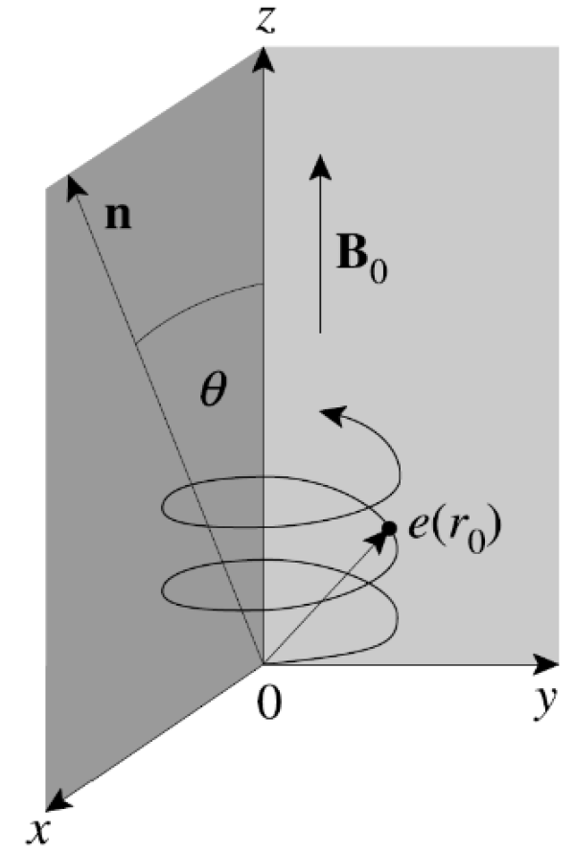
Electron cyclotron (EC) waves are caused by the gyro-motion along the external magnetic field
Thermal ECE: B ~ 1/R → spacial resolution of ECE, ECA and ECRH (T_{e} and heating)
Nonthermal ECE: Emmited frequency is dependent also on the particle position in the velocity phase (v → c)
M. Farník: ECRH / FTTF / 2020
01/16
xx/xx

Slide 4
Part I. ECRH for COMASS-U
M. Farník: ECRH / FTTF / 2020
01/16
1/12

Slide 5
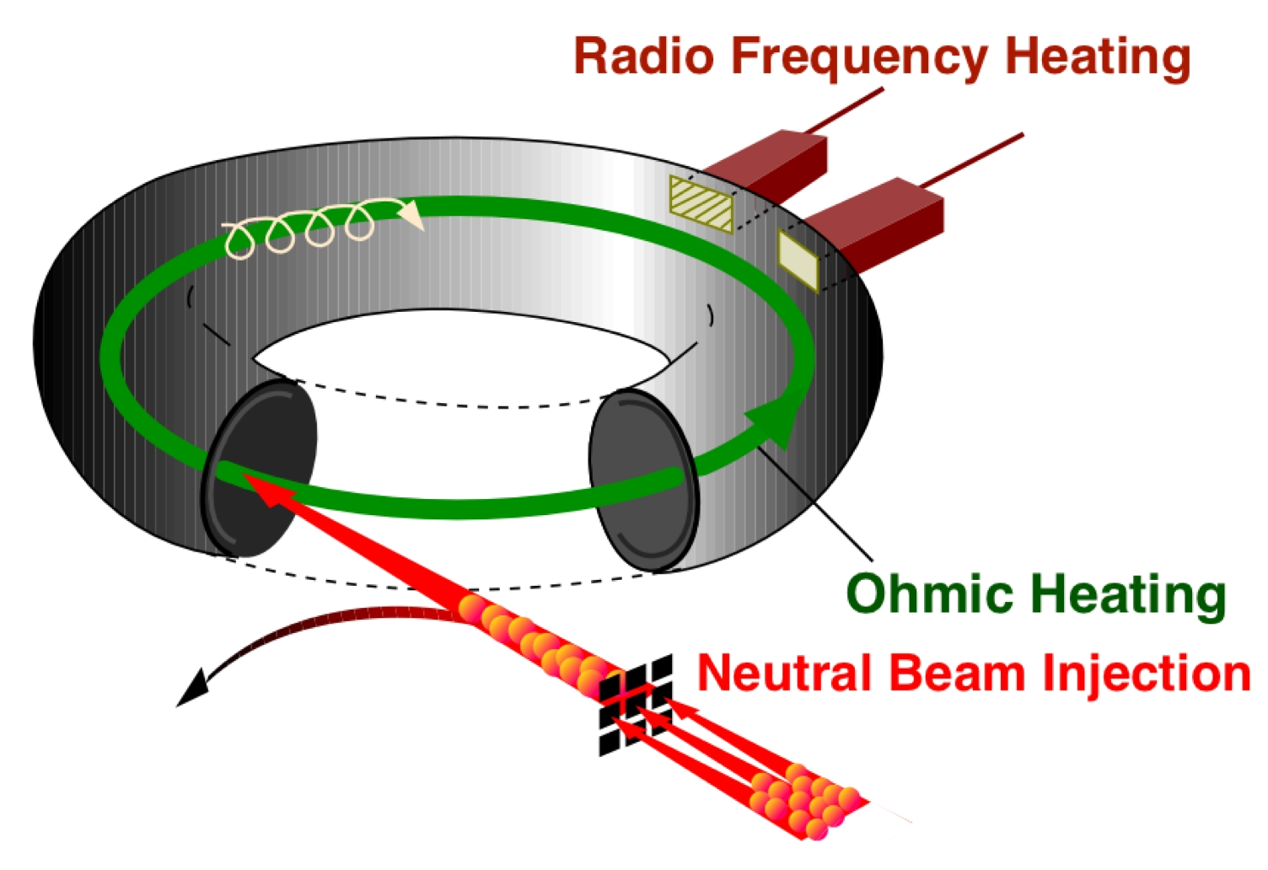
COMPASS-U will be equipped with an NBI heating system. An additional ECRH heating is planned on the tokamak.
Main features of the ECRH:
M. Farník: ECRH / FTTF / 2020
01/16
2/12

Slide 6
COMPASS-U will be equipped with an NBI heating system. An additional ECRH heating is planned on the tokamak.
Main features of the ECRH:
Heating
Improving H-mode performance
M. Farník: ECRH / FTTF / 2020
01/16
2/12

Slide 7
COMPASS-U will be equipped with an NBI heating system. An additional ECRH heating is planned on the tokamak.
Main features of the ECRH:
Heating
Improving H-mode performance
Preventing impurity accumulation (W) in the core
Suppressing Neoclasical Tearing Modes (NTMs)
M. Farník: ECRH / FTTF / 2020
01/16
2/12

Slide 8
COMPASS-U will be equipped with an NBI heating system. An additional ECRH heating is planned on the tokamak.
Main features of the ECRH:
Heating
Improving H-mode performance
Preventing impurity accumulation (W) in the core
Suppressing Neoclasical Tearing Modes (NTMs)
Current Drive (ECCD) – profile tailoring
M. Farník: ECRH / FTTF / 2020
01/16
2/12

Slide 9
COMPASS-U: DEMO relevant research (R₀ = 0.894 m, a = 0.27 m) Extreme power fluxes - up to 70 MW/m² - liquid metal technology Operation with high temperature first wall – up to 600°C B_{T} = 5 T I_{p} = 2 MA t_{flattop} = 1-5 s n_{e}: ~ 10²⁰ m⁻³ P_{NBI} = 4-5 MW P_{ECRH} = 2-10 MW
M. Farník: ECRH / FTTF / 2020
01/16
3/12

Slide 10
COMPASS-U: DEMO relevant research (R₀ = 0.894 m, a = 0.27 m) Extreme power fluxes - up to 70 MW/m² - liquid metal technology Operation with high temperature first wall – up to 600°C B_{T} = 5 T I_{p} = 2 MA t_{flattop} = 1-5 s n_{e}: ~ 10²⁰ m⁻³ P_{NBI} = 4-5 MW P_{ECRH} = 2-10 MW
1st harmonic heating (high B_{T})
140 GHz Considered (AUG,W7-X)
O-mode: cutoff density $≈$ 2.5$∙$10²⁰ m⁻³ X-mode: core achievable from the HFS
M. Farník: ECRH / FTTF / 2020
01/16
3/12

Slide 11
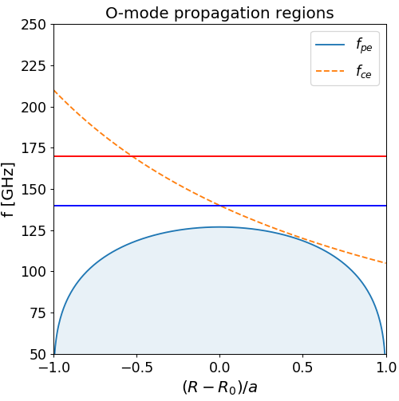
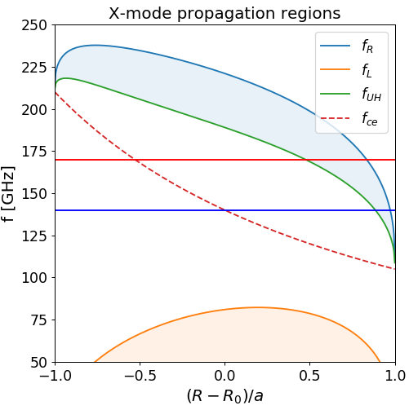
COMPASS-U: DEMO relevant research (R₀ = 0.894 m, a = 0.27 m) Extreme power fluxes - up to 70 MW/m² - liquid metal technology Operation with high temperature first wall – up to 600°C B_{T} = 5 T I_{p} = 2 MA t_{flattop} = 1-5 s n_{e}: ~ 10²⁰ m⁻³ P_{NBI} = 4-5 MW P_{ECRH} = 2-10 MW
1st harmonic heating (high B_{T})
140 GHz Considered (AUG,W7-X)
O-mode: cutoff density $≈$ 2.5$∙$10²⁰ m⁻³ X-mode: core achievable from the HFS
M. Farník: ECRH / FTTF / 2020
01/16
3/12

Slide 12
Scenarios:
# | B_{t} [T] | I_{p} [MA] | t_{flattop} [s] | ECRH | f_{ECRH} [GHz] | n_{cut} [10²⁰ m⁻³]
2.4 | 1.25 | 0.4 | 4.3 | 3rd harm. X-mode | 105 | 0.9
3.4 | 2.50 | 0.8 | 3.2 | 2nd harm. X-mode | 140 | 1.2
4.4 | 4.30 | 1.4 | 1.5 | 1st harm. O-mode | 140* | 2.5
6.4 | 5.00 | 2.0 | 1.0 | 1st harm. O-mode | 140* | 2.5
 | *planned upgrade to 250-280GHz system
M. Farník: ECRH / FTTF / 2020
01/16
4/12

Slide 13
Scenarios:
# | B_{t} [T] | I_{p} [MA] | t_{flattop} [s] | ECRH | f_{ECRH} [GHz] | n_{cut} [10²⁰ m⁻³]
2.4 | 1.25 | 0.4 | 4.3 | 3rd harm. X-mode | 105 | 0.9
3.4 | 2.50 | 0.8 | 3.2 | 2nd harm. X-mode | 140 | 1.2
4.4 | 4.30 | 1.4 | 1.5 | 1st harm. O-mode | 140* | 2.5
6.4 | 5.00 | 2.0 | 1.0 | 1st harm. O-mode | 140* | 2.5
 | *planned upgrade to 250-280GHz system
Variables:
Launcher placement – equatiorial vs. upper port
Toroidal and poloidal angle adujstement
Density (!!!) – unofortunately we are close to cutoff
M. Farník: ECRH / FTTF / 2020
01/16
4/12

Slide 14
TORBEAM
Beam tracing code - calculation of propagation and absorption of an EC wave beam in a tokamak plasma
The paraxial WKB approximation
Set of ODEs – Gaussian beam
Diffraction effects – deposition profiles
M. Farník: ECRH / FTTF / 2020
01/16
5/12

Slide 15
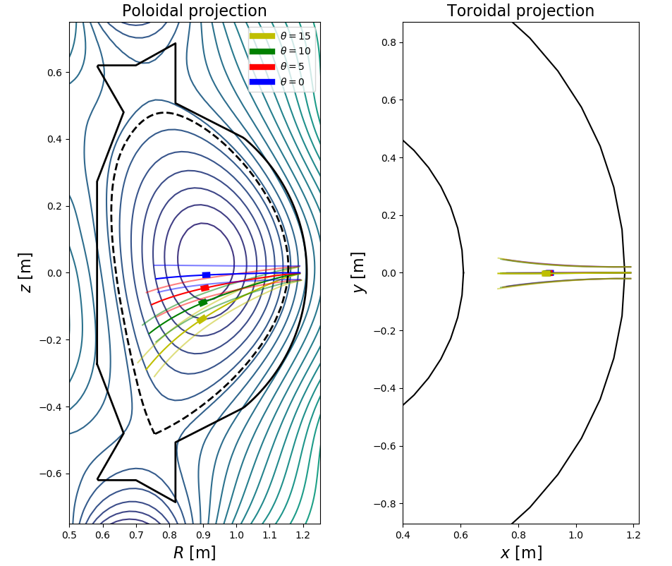
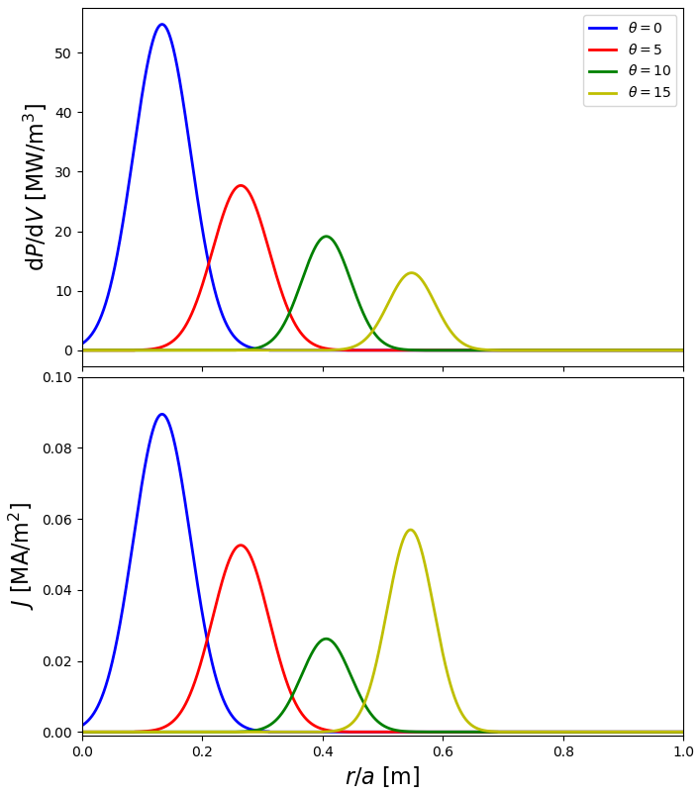
Scenario 3.4
B = 2.5 T → 2nd harmonic heating central density n_{e} = 0.95∙10²⁰ m⁻³
Equatorial port Poloidal angle scan
M. Farník: ECRH / FTTF / 2020
01/16
6/12

Slide 16
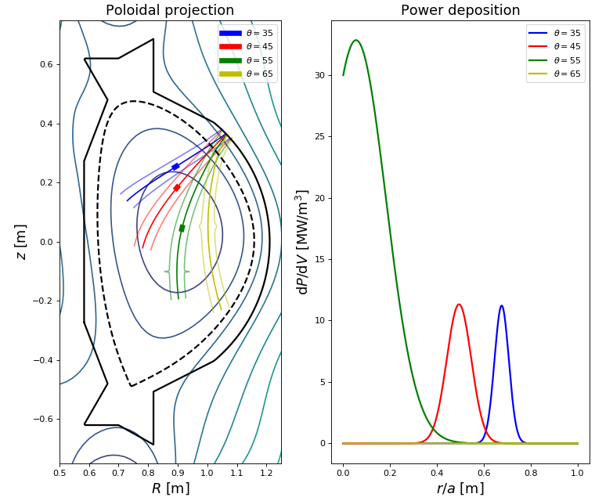
Scenario 3.4
B = 2.5 T → 2nd harmonic heating central density n_{e} = 0.95∙10²⁰ m⁻³
Upper port Poloidal angle scan
Diff. theta → edge deposition
M. Farník: ECRH / FTTF / 2020
01/16
7/12

Slide 17
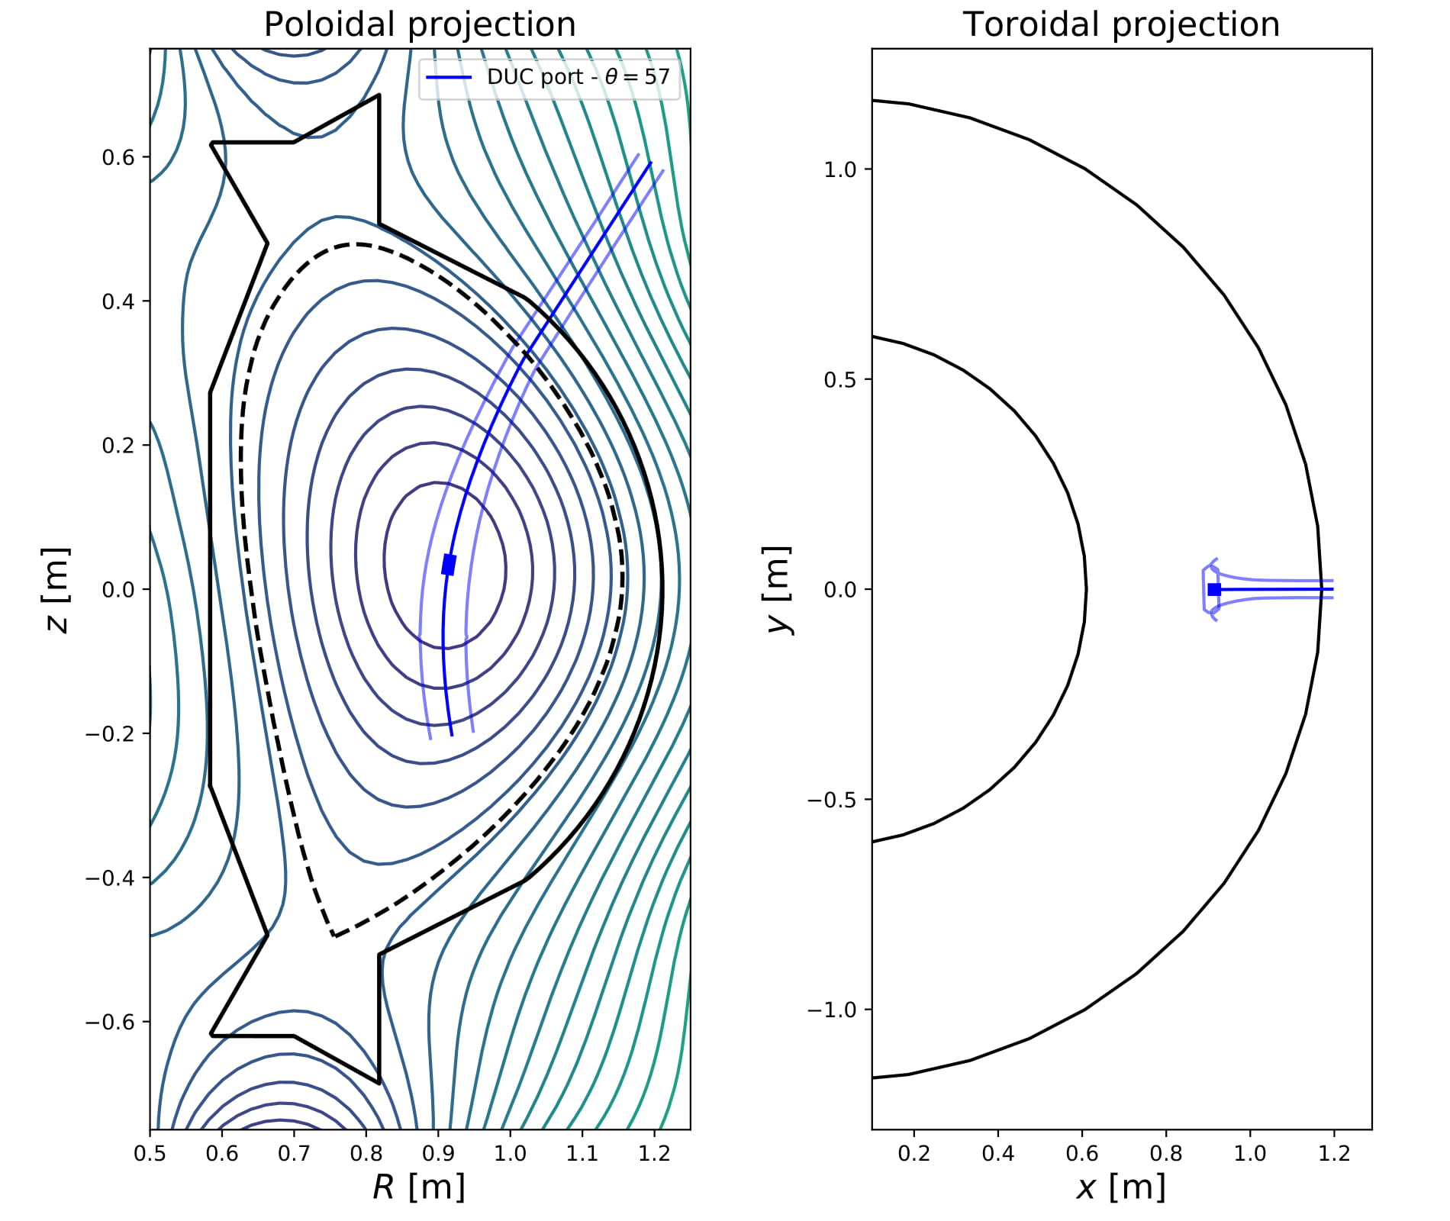
Scenario 3.4
B = 2.5 T → 2nd harmonic heating central density n_{e} = 0.95∙10²⁰ m⁻³
Upper port Poloidal angle scan
Diff. theta → edge deposition
57° - all power deposited
M. Farník: ECRH / FTTF / 2020
01/16
7/12

Slide 18
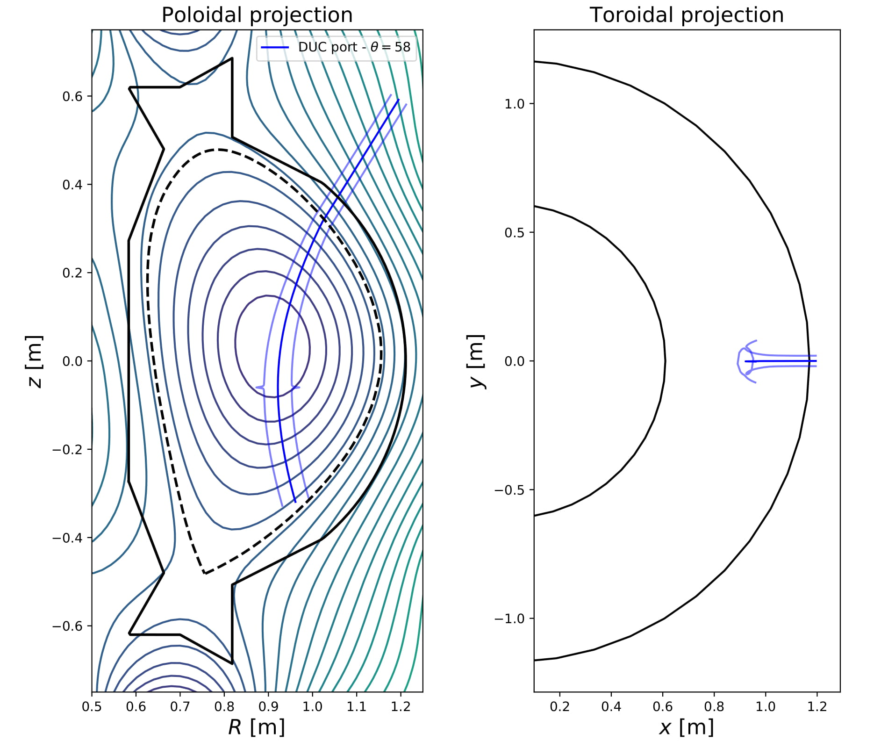
Scenario 3.4
B = 2.5 T → 2nd harmonic heating central density n_{e} = 0.95∙10²⁰ m⁻³
Upper port Poloidal angle scan
Diff. theta → edge deposition
57° - all power deposited
58° - No deposited power
M. Farník: ECRH / FTTF / 2020
01/16
7/12

Slide 19
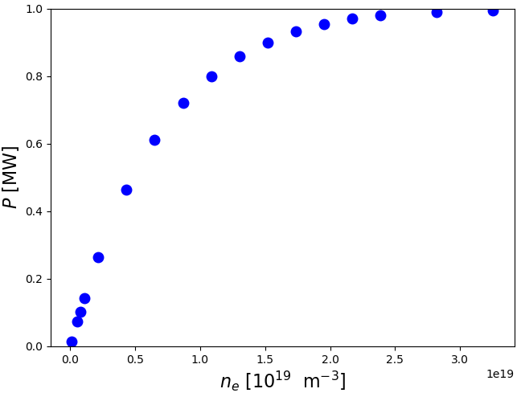
Scenario 3.4
B = 2.5 T → 2nd harmonic heating
Density determines the eventual shine-through of the beam, that would result in serious damage on the plasma-facing components (PFCs)
No significant power deposition on HFS PFCs → no need for reflecting tile
M. Farník: ECRH / FTTF / 2020
01/16
8/12

Slide 20
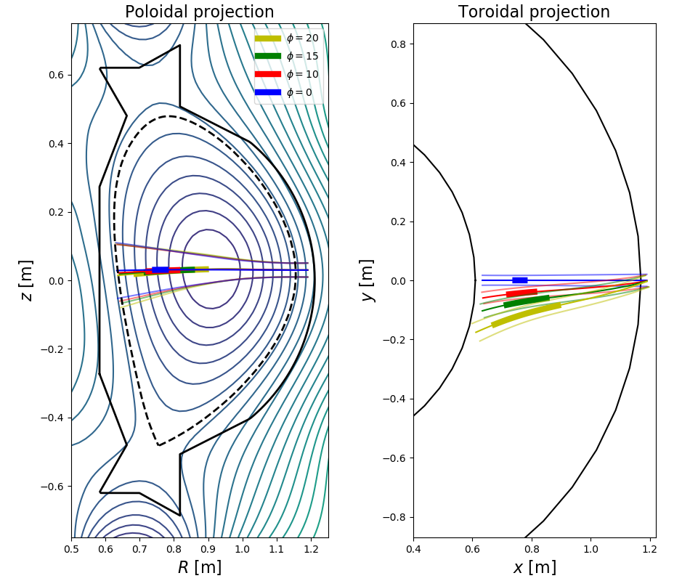
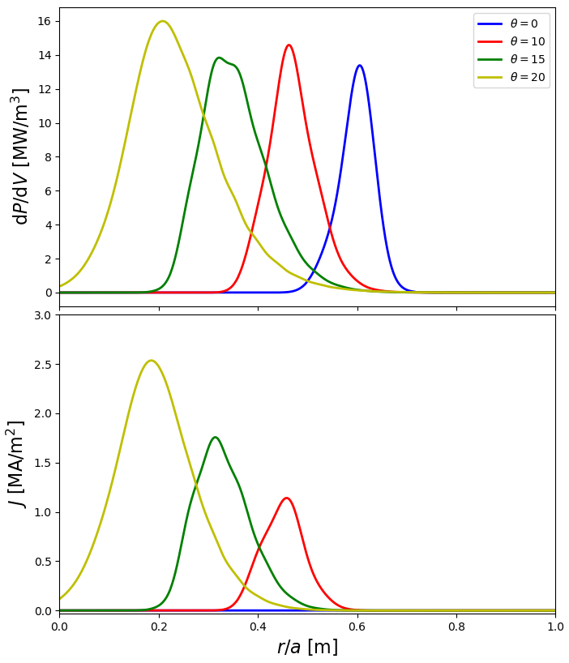
Scenario 4.4
B = 4.3 T → 1st harmonic heating central density n_{e} = 2∙10²⁰ m⁻³
Equatorial port Toroidal angle scan
M. Farník: ECRH / FTTF / 2020
01/16
9/12

Slide 21
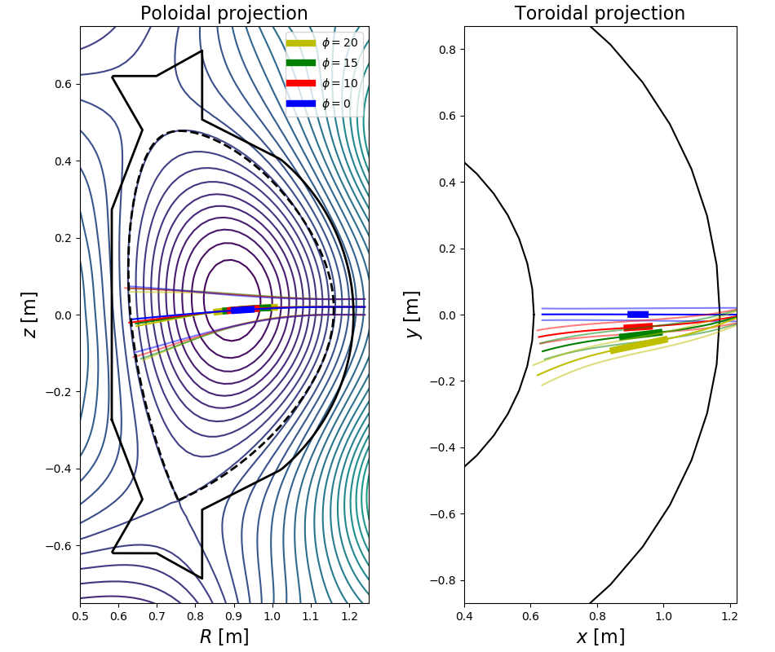
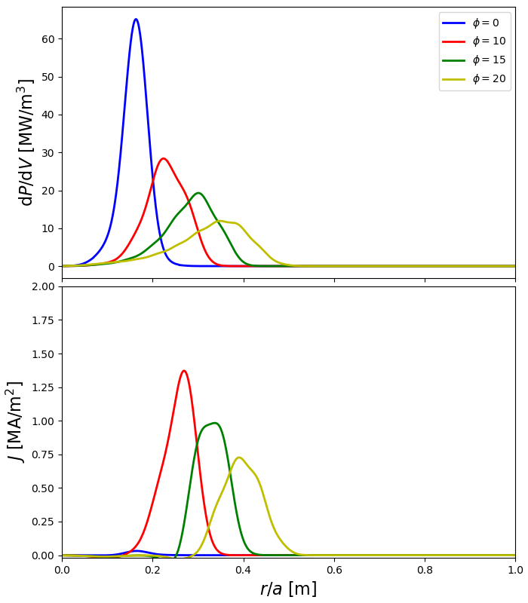
Scenario 6.4
B = 5.0 T → 1st harmonic heating central density n_{e} = 2∙10²⁰ m⁻³
Equatorial port Toroidal angle scan
M. Farník: ECRH / FTTF / 2020
01/16
10/12

Slide 22
Scenario 3.4:
Equatorial injection → narrow deposition
Small beam divergence - no need for focusing mirror
Safe operation up to $≈$1.05∙10²⁰ m⁻³
Scenario 4.4:
Off-axis heating
Toroidal angle necessary to deposit power closer to the core
Focusing mirror necessary
Safe operation up to $≈$2.2∙10²⁰ m⁻³
Scenario 6.4:
Strong beam divergence in higher densities
Safe operation up to $≈$2.2∙10²⁰ m⁻³
Common:
Current drive with toroidal angle injection (~10 kA)
All the power is absorbed. (if beam reaches resonance layer)
M. Farník: ECRH / FTTF / 2020
01/16
11/12

Slide 23
Next steps:
Effect of ECRH and ECCD on profiles
M. Farník: ECRH / FTTF / 2020
01/16
12/12

Slide 24
Next steps:
Effect of ECRH and ECCD on profiles
ECRH assisted breakdown
Optimisation of NTM suppresion efficiency
M. Farník: ECRH / FTTF / 2020
01/16
12/12

Slide 25
Next steps:
Effect of ECRH and ECCD on profiles
ECRH assisted breakdown
Optimisation of NTM suppresion efficiency
Just design the ECRH system
M. Farník: ECRH / FTTF / 2020
01/16
12/12

Slide 26
Part II. V-ECE for RE measurements in COMPASS
M. Farník: VECE / FTTF / 2020
01/16
1/6

Slide 27
Nonthermal ECE:
Vertically placed antenna (V-ECE) → B $≈$ const along the LoS (and θ $≈$ π/2)
Relation between the measured frequency and electron velocity
M. Farník: VECE / FTTF / 2020
01/16
2/6

Slide 28
Nonthermal ECE:
Vertically placed antenna (V-ECE) → B $≈$ const along the LoS (and θ $≈$ π/2)
Relation between the measured frequency and electron velocity
M. Farník: VECE / FTTF / 2020
01/16
2/6

Slide 29
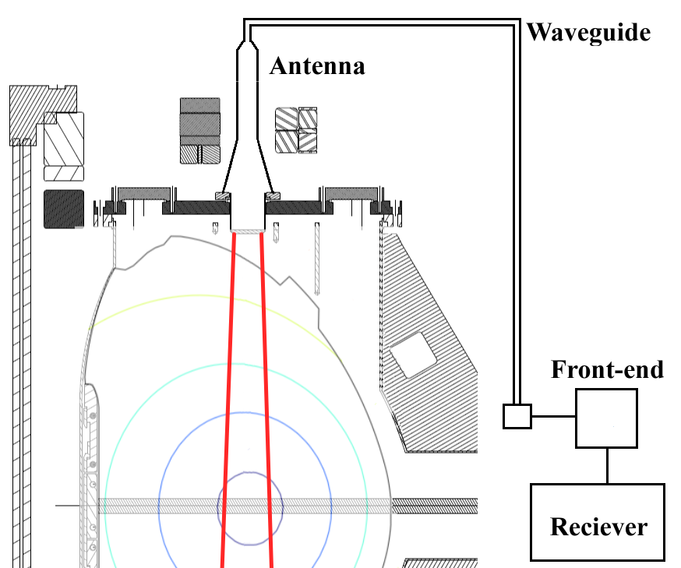
Parameters:
Heterodyne ECE/EBE radiometer
13 channels in function
Range: 76,5 - 88,3 GHz
Detection of reflected waves → change of the energy spectrum (various B-field)
M. Farník: VECE / FTTF / 2020
01/16
3/6

Slide 30
Parameters:
Heterodyne ECE/EBE radiometer
13 channels in function
Range: 76,5 - 88,3 GHz
Detection of reflected waves → change of the energy spectrum (various B-field)
2nd harmonic – 0 - 130 keV 3rd harmonic – 0 - 450 keV 4th harmonic – 75 - 775 keV 5th harmonic – 220 - 1100 keV
in B = 1.15 T discharges
M. Farník: VECE / FTTF / 2020
01/16
3/6

Slide 31
SPECE code simulations
Electron emissivity is dependent on the electron velocity
Thermal emission negligible due to the strong attenuation of the radiometer.
M. Farník: VECE / FTTF / 2020
01/16
4/6

Slide 32
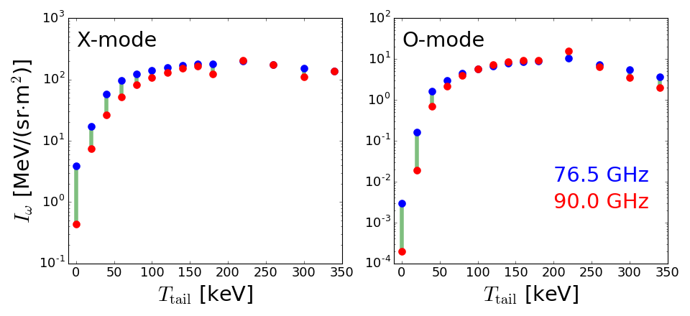
SPECE code simulations
Electron emissivity is dependent on the electron velocity
Thermal emission negligible due to the strong attenuation of the radiometer.
Two orders of magnitude difference
M. Farník: VECE / FTTF / 2020
01/16
4/6

Slide 33
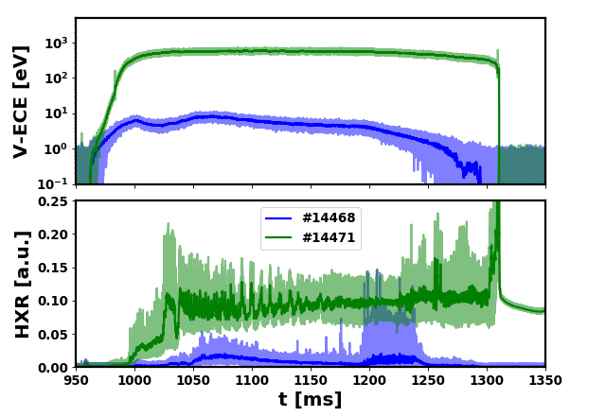
V-ECE measurements
Reliable measurements of RE seed → presence od REs before disruption
V-ECE can be used as a precursor for RE beam generation during a disruption
Only qualitative output → simulations of RE population needed
The same two orders of magnitude difference
M. Farník: VECE / FTTF / 2020
01/16
5/6

Slide 34
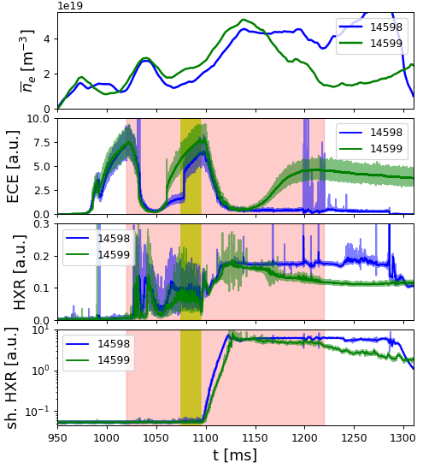
V-ECE measurements
Filamentary structures during the beam generation and beam plateau seen as frequent peaks
Ar puff
D puff
M. Farník: VECE / FTTF / 2020
01/16
6/6

Slide 35
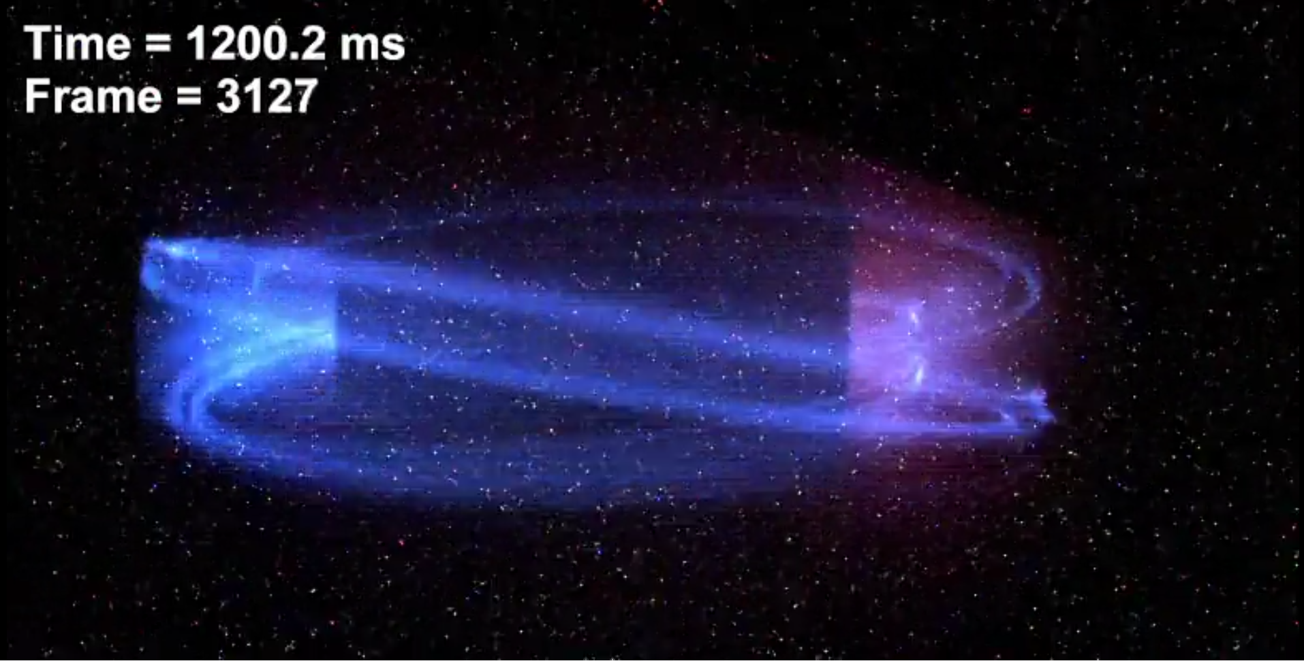
V-ECE measurements
Filamentary structures during the beam generation and beam plateau seen as frequent peaks
Ar puff
D puff
M. Farník: VECE / FTTF / 2020
01/16
6/6

Slide 36
ECRH would be very favourable at COMPASS-U.
The 140 GHz solution is feasible for all major scenarios with densities under the cutoff.
Diagnostic of EC emission was implemented and used at the COMPASS tokamak.
V-ECE provides information especially about the primary runaway generation at the ramp-up and in the flat-top phase of the discharge.
EC waves are fundamental tool in tokamak physics.
M. Farník: ECRH&ECE / FTTF / 2020
01/16
Last one

