Slide 1
Runaway Electrons in Tokamaks
Pravesh Dhyani
FJFI, CVUT
Outline
Runaway electrons in tokamaks
Toroidal electric field in tokamaks
Generation of runaway electrons
Radiation Generation Due to Energetic Particles
Measurement of runaways using scintillation material
An example of runaway measurements at GOLEM

Slide 2
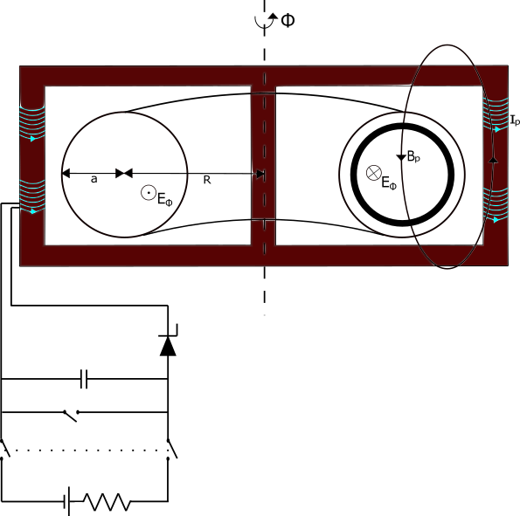
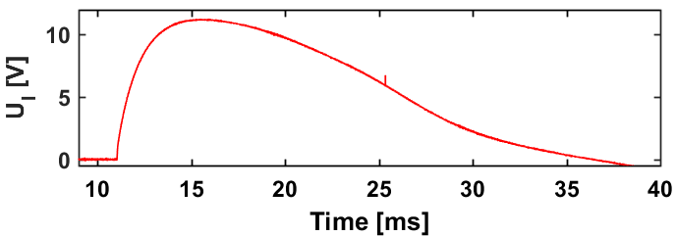
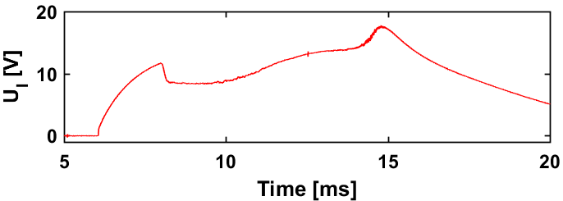


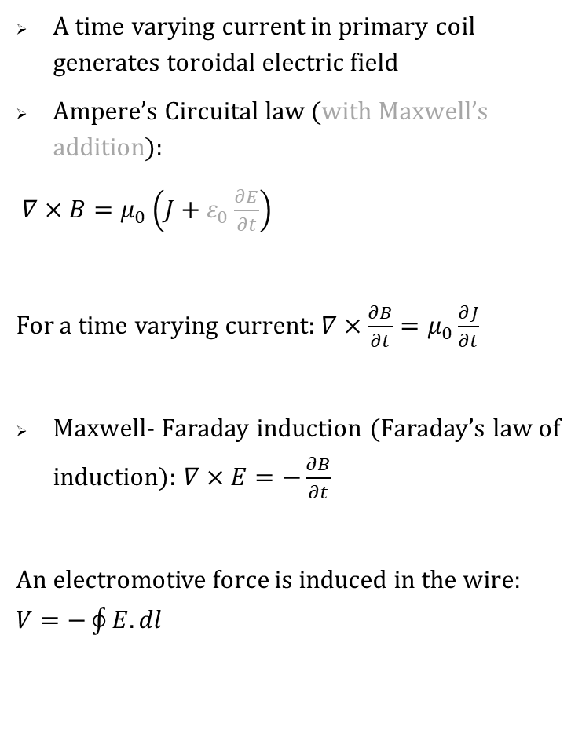
Toroidal electric field $(E_{φ})$ in Tokamaks
A time varying current in primary coil generates toroidal electric field
Ampere’s Circuital law (with Maxwell’s addition):
$∇×B=μ_{0}\left(J+ε_{0}\frac{∂E}{∂t}\right)$
For a time varying current: $∇×\frac{∂B}{∂t}=μ_{0}\frac{∂J}{∂t}$
Maxwell- Faraday induction (Faraday’s law of induction): $∇×E=−\frac{∂B}{∂t}$
An electromotive force is induced in the wire: $V=−\oint{E.dl}$
13.5mF
w/o plasma
w/ plasma
Current Drive Power Supply
Loop voltage with and without plasma
$$E_{Φ}={−U}_{loop}/2πR$$

Slide 3
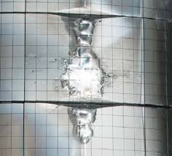
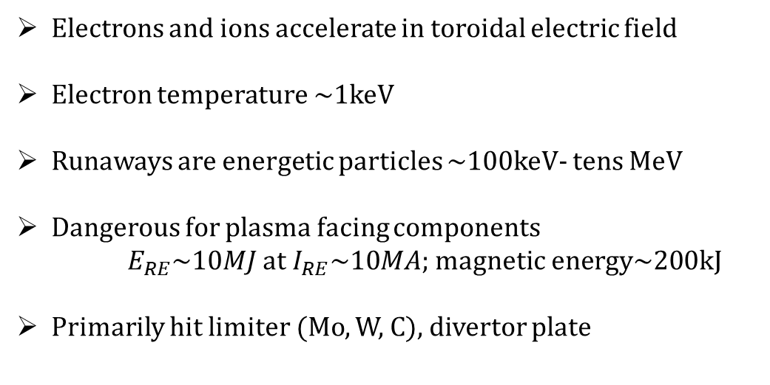
Runaway electrons in Tokamaks
Electrons and ions accelerate in toroidal electric field
Electron temperature ~1keV
Runaways are energetic particles ~100keV- tens MeV
Dangerous for plasma facing components
$E_{RE}\sim 10MJ$ at $I_{RE}\sim 10MA$; magnetic energy~200kJ
Primarily hit limiter (Mo, W, C), divertor plate
[S.Putvinski talk, IAEA TCM- 2011]
In-vessel image of melt damage due runaway electrons in JET
[Matthews, et al-2016]

Slide 4
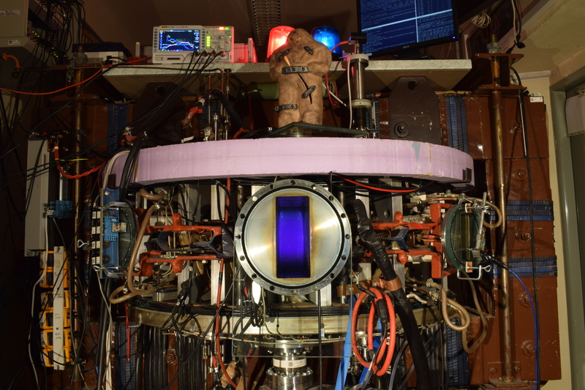
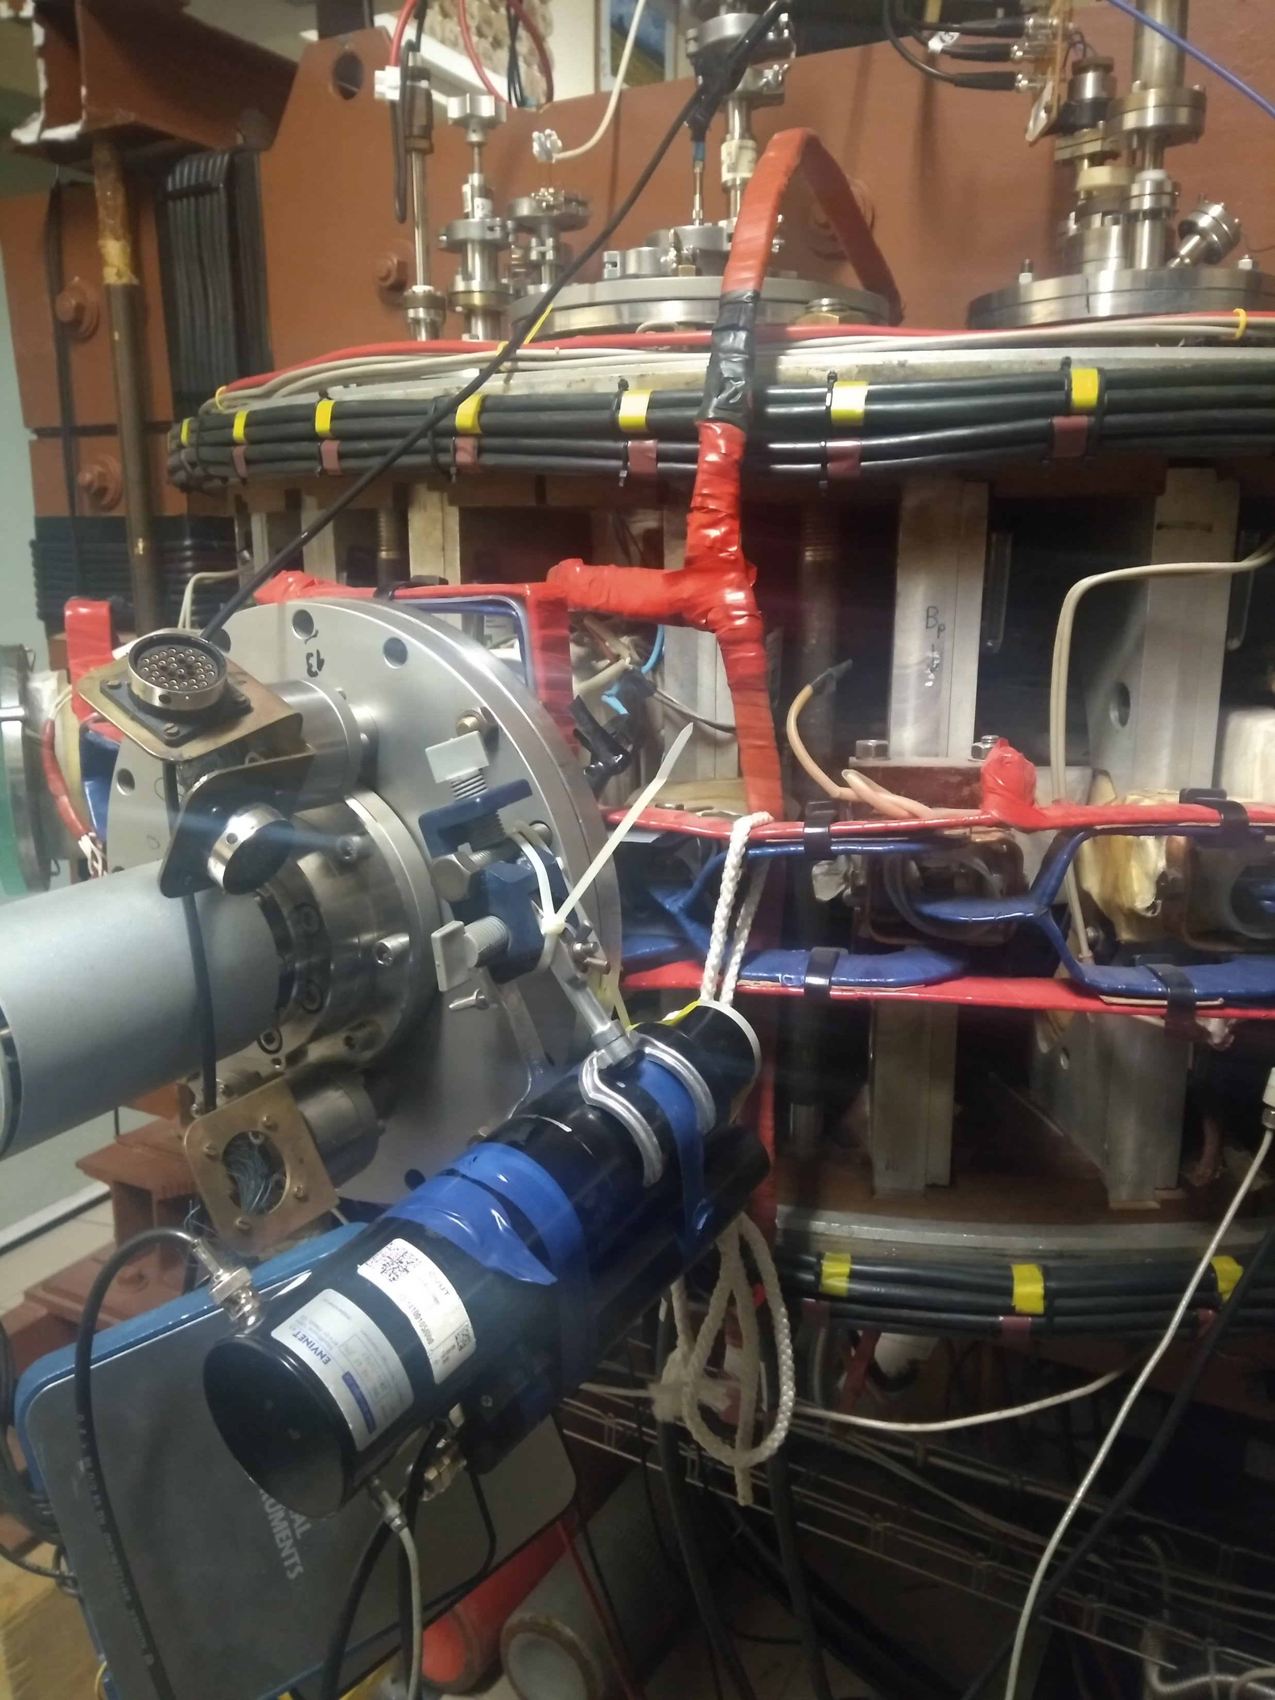

Runaways measurements in GOLEM tokamak
Radiation measurement, indeed!!
Limiter
Top view of torus
0
Limiter
NaI(Tl) probe
NaI(Tl) probe

Slide 5


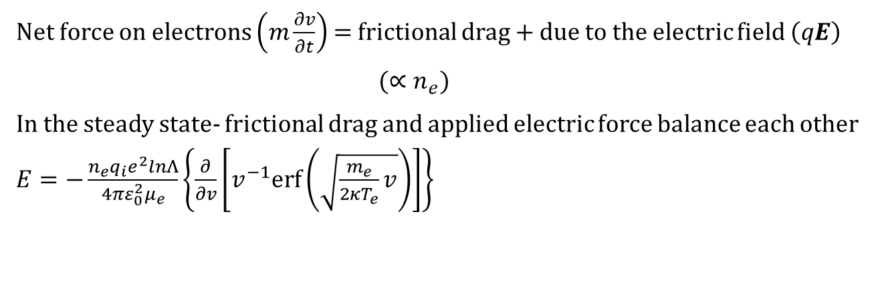


Generation of runaway electrons
Net force on electrons $\left(m\frac{∂v}{∂t}\right)$ = frictional drag + due to the electric field $\left(qE\right)$
$(∝n_{e})$
In the steady state- frictional drag and applied electric force balance each other $E=−\frac{n_{e}q_{i}e^{2}lnΛ}{{4πε}_{0}^{2}μ_{e}}\left\{\frac{∂}{∂v}\left[v^{−1}erf\left(\sqrt{\frac{m_{e}}{2κT_{e}}v}\right)\right]\right\}$
$$\lim_{x≪1}\left(−\frac{d}{dx}\frac{erfx}{x}\right)=\frac{4x}{3\sqrt{π}}$$
$E_{Dreicer}=\frac{n_{e}Ze^{3}lnΛ }{{8πε}_{0}^{2}κT_{e}}$
$$−\frac{d}{dx} \left(\frac{erfx}{x}\right)$$
$$\lim_{x≫1}\left(−\frac{d}{dx}\frac{erfx}{x}\right)=\frac{1}{x^{2}}$$
[M. Vlainic thesis-2018]

Slide 6
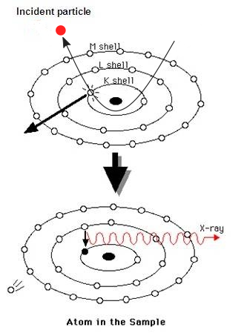
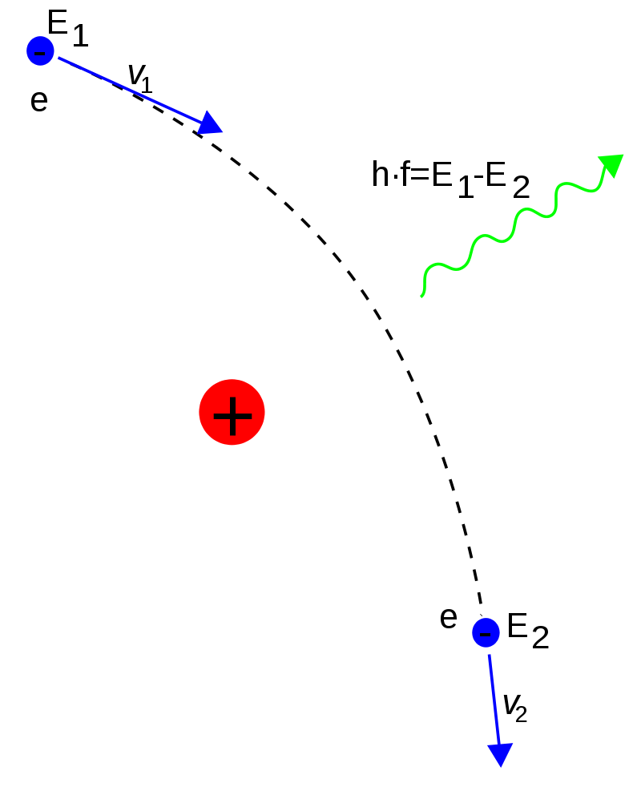


Radiation Generation Due to Energetic Particles
Charged particles acceleration in a curved path
Synchrotron radiation: Relativistic
Cyclotron radiation: Non-relativistic
Cherenkov radiation: emitted when a charged particle passes through a dielectric medium at a speed greater than the phase velocity of light in that medium
$$hν=E_{1}−E_{2}$$
$$+Ze$$
Diagnostic for runaway study
Strip and pixel silicon radiation detectors
Cherenkov detector, ECE diagnostic
Scintillation crystals
Characteric HXRs generation
Bremsstrahlung
(braking radiation)

Slide 7
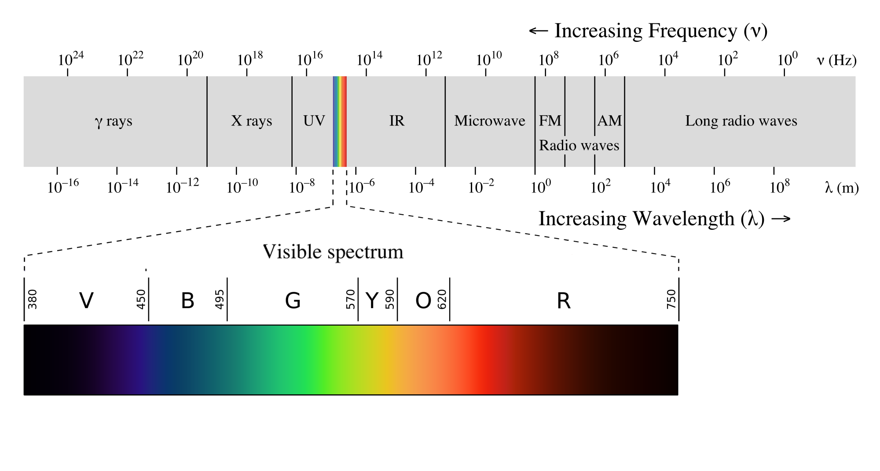
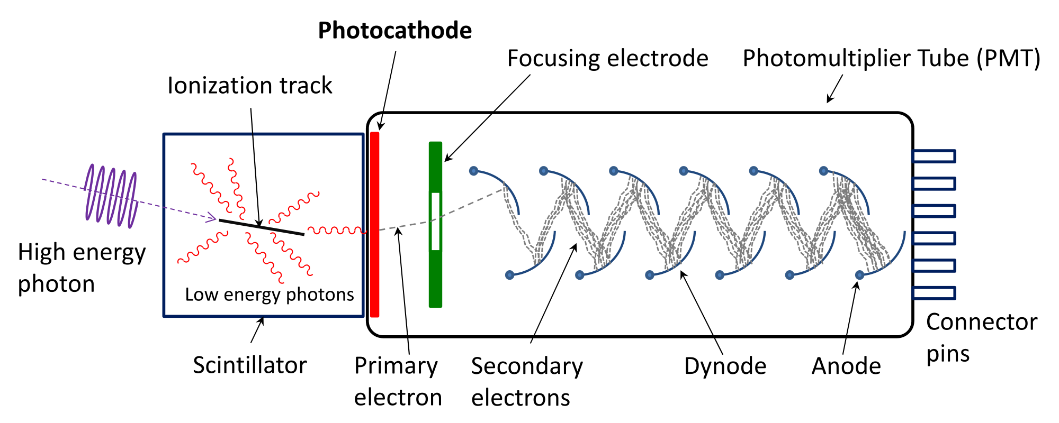
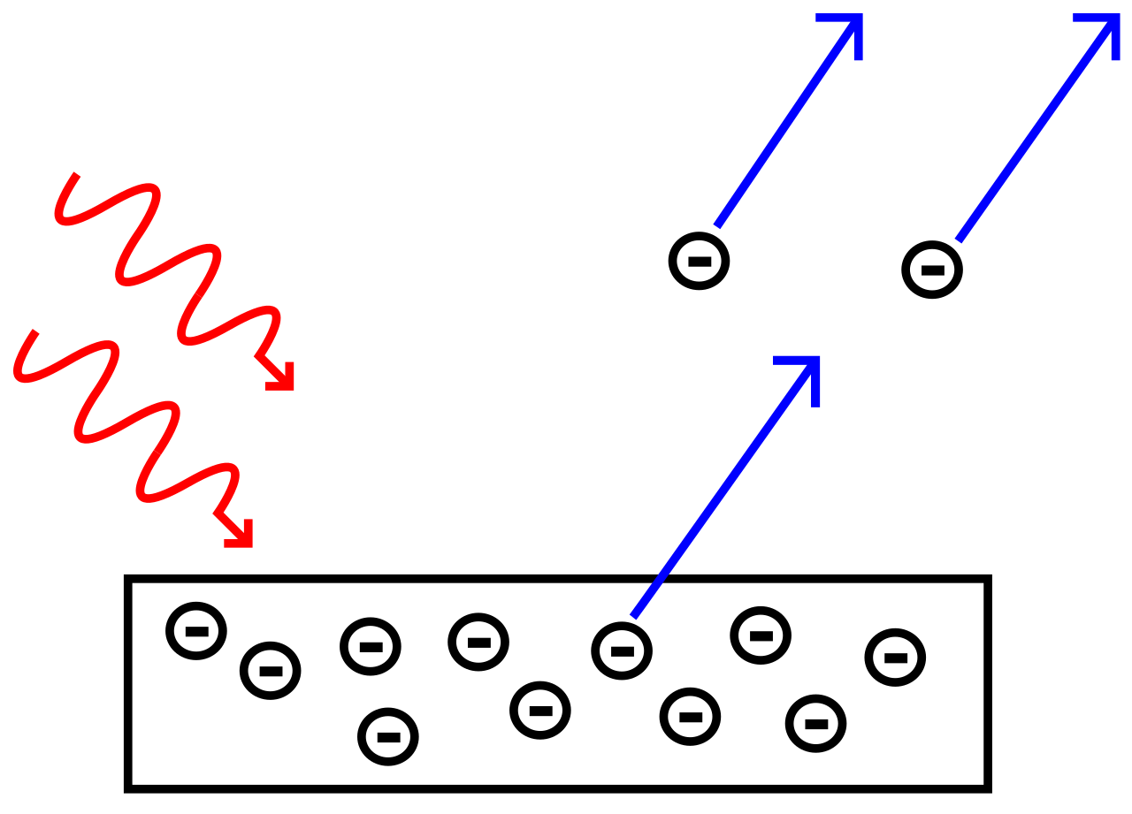










Measurement of runaways using scintillation material
Scintillation Mechanism in NaI(Tl)
Conduction band
$${Gain\sim (10}^{6}−{10}^{7})$$
$$e^{−}$$
Activation Center excited states
$$e^{−}$$
$$hν_{2}$$
$$hν_{2}\sim 3eV$$
X ray$−photon$
($ν_{1}>ν_{2})$
Activation Center ground states
$$\left(hν_{1}\right)$$
$$\sim (hν_{2}−φ)$$
$$e^{−}$$
Valence band
Photoelectric effect

Slide 8
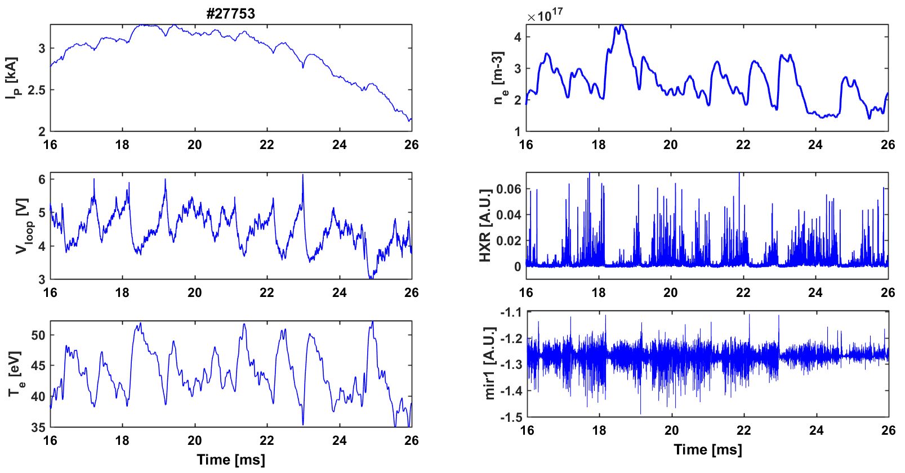

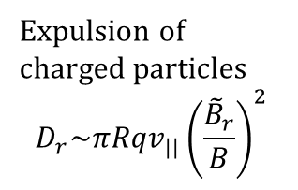




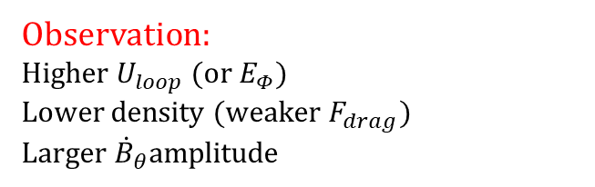
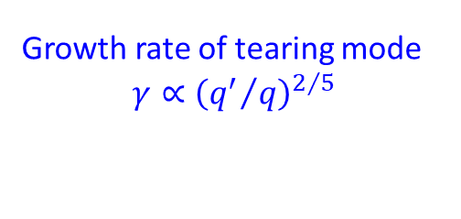
An example of runaway measurements at GOLEM
Observation:
Higher $U_{loop}$ $(or E_{Φ})$
Lower density $(weaker{ F}_{drag})$
Larger ${\dot{B}}_{θ}$amplitude
Higher HXR
amplitude
Possibilities
(1)
Larger ${\dot{B}}_{θ}$
wider islands
Stronger $E_{||}(∝w)$
(2)
Larger ${\dot{B}}_{θ}$
Stochastic field
lines
Expulsion of charged particles
$$D_{r}\sim πRqv_{||}{\left(\frac{{\tilde{B}}_{r}}{B}\right)}^{2}$$
Cause of magnetic fluctuations?
Growth rate of tearing mode
$$γ∝{\left({q^{′}}/q\right)}^{2/5}$$
Change in current density${(j}_{φ})$ profile!!

Slide 9
Thank you !!

Slide 10







Indirect measurement of runaways using scintillation material
HXRs → visible range
HXRs are absorbed by scintillator material and emit radiation in visible range, which is measured by PMTs, current then converted into signals
Scintillation Mechanism in NaI(Tl)
Conduction band
Scintillation process
$$e^{−}$$
Activation Center excited states
$$e^{−}$$
$$\left(hν_{2}\sim 3eV\right)$$
X ray$−photon$
($ν_{1}>ν_{2})$
Activation Center ground states
$$\left(hν_{1}\right)$$
$$e^{−}$$
Valence band

Slide 12
Bharat: Unity in Diversity
India: Map showing states
Population, Languages, religions, rivers, ocean
Hindu religion- Gods and temples
History
Pre-historical civilizations
Different dance forms from different parts of India
Famous places
Tourist places
Festivals
Currency
History of Indian economy, Fastest growing economy
National Anthem, embalem, Prime Minister
Bollywood

Slide 13
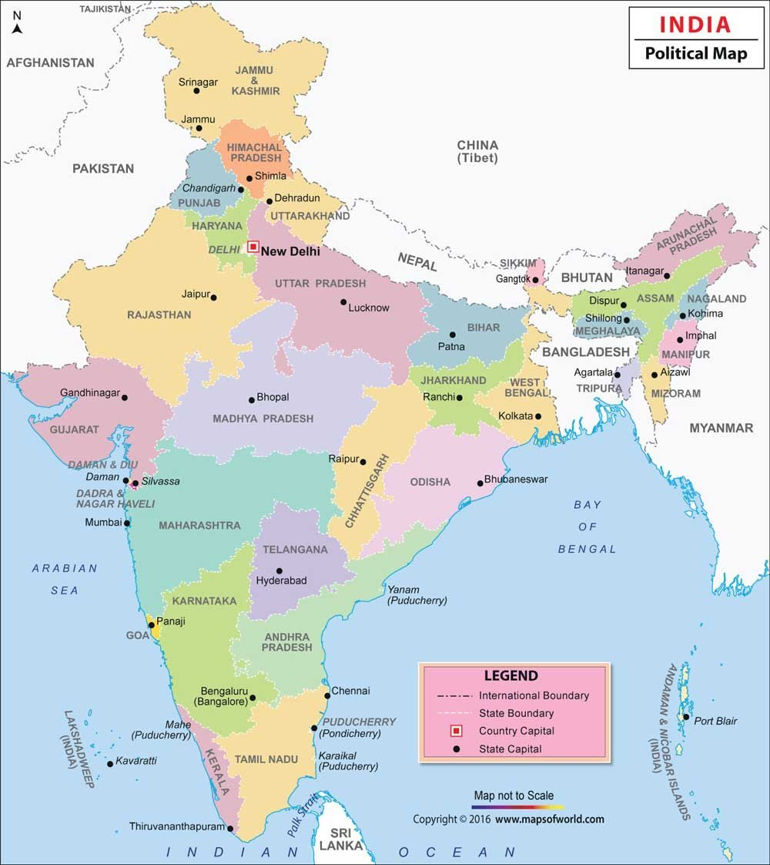
North to South: 3,214 km
East to west: 2,933 km
29 states and 7 union territories
India has 122 major languages and 1599 other languages (dialects)
Official languages: 22
Sanskrit: the mother language
Population: 1.3 billion
Hinduism: 79.80%
Islam: 14.23%
Christianity: 2.3%
Sikhism: 1.72%
Buddhism: 0.70%
Jainism: 0.37%
Other: Zoroastrianism, Persian

Slide 14
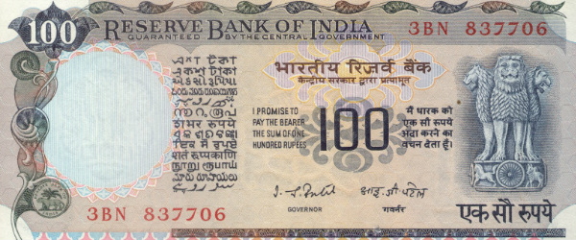

Indian Currency
National Emblem

Slide 15
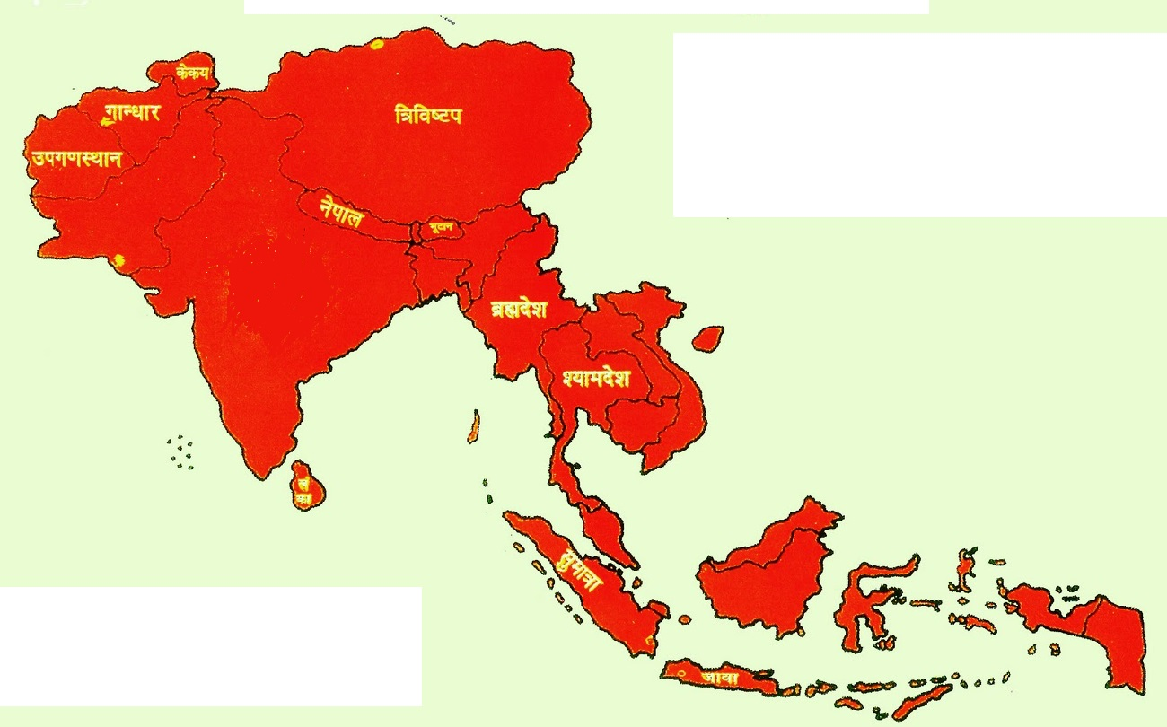
Aryavart
Afghanistan
1876
Hinduism: Originally Sanatan religion
Hindu: derived from the Sanskrit word Sindhu
Aryavart: Hinduism was practiced
Indian division with time
Tibet 1914
Pakistan
1947
Bhutan
1906
Nepal
1904
Burma
1937
Bangladesh
1947

Slide 16
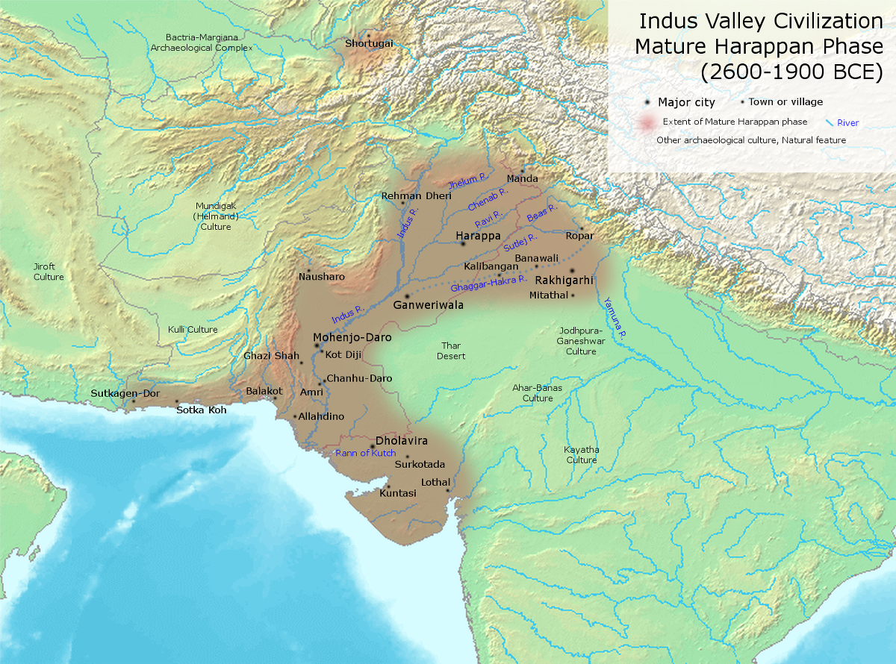
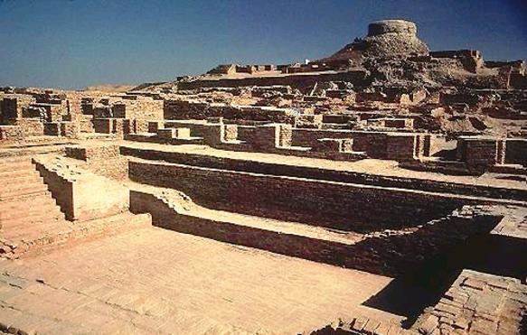
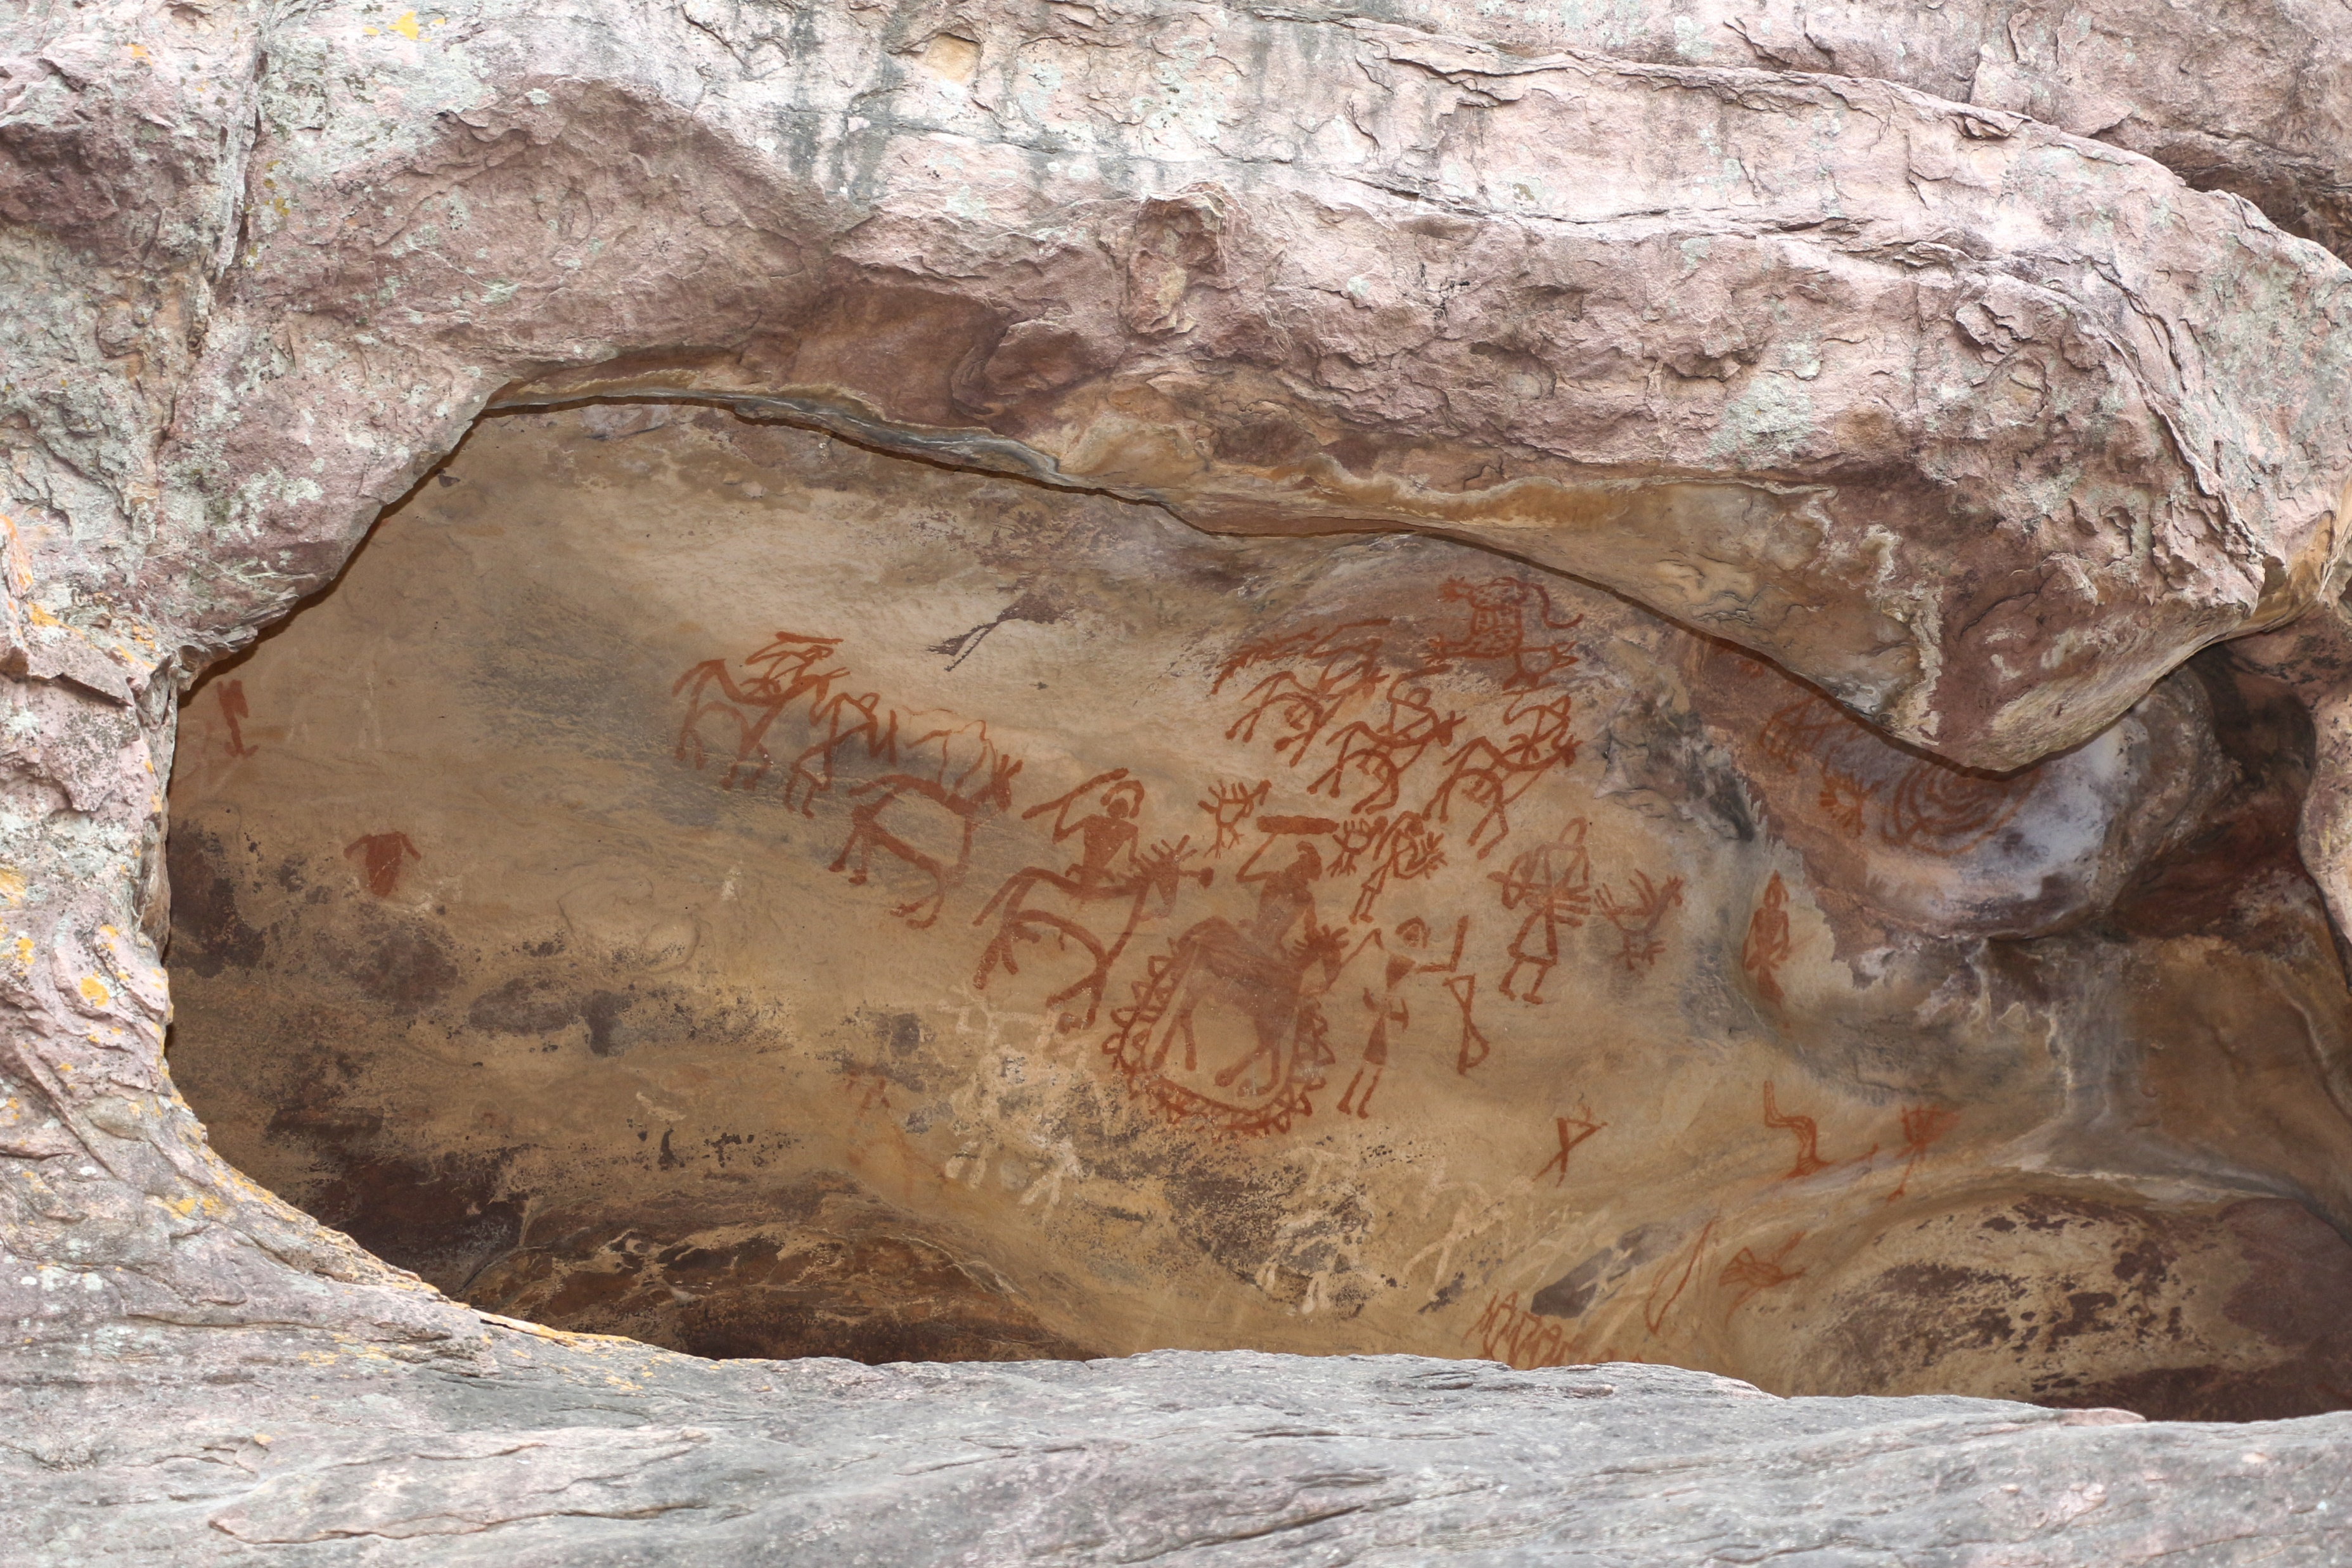
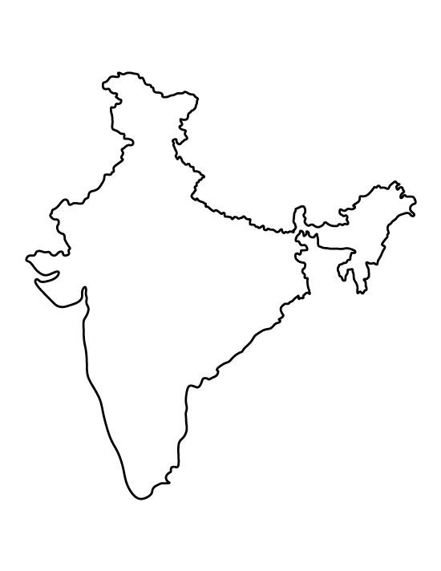
Indus Valley Civilisation (IVC), or Harappan Civilisation
mature period 2600–1900 BCE UNESCO World Heritage site
Excavated ruins of Mohenjo-daro, Pakistan
Bhimbetka rock shelters
UNESCO world heritage site
750 rock shelters distributed over 10 kilometres
100000 years old
feature prehistoric cave paintings and the earliest are about 30,000 years old

Slide 17
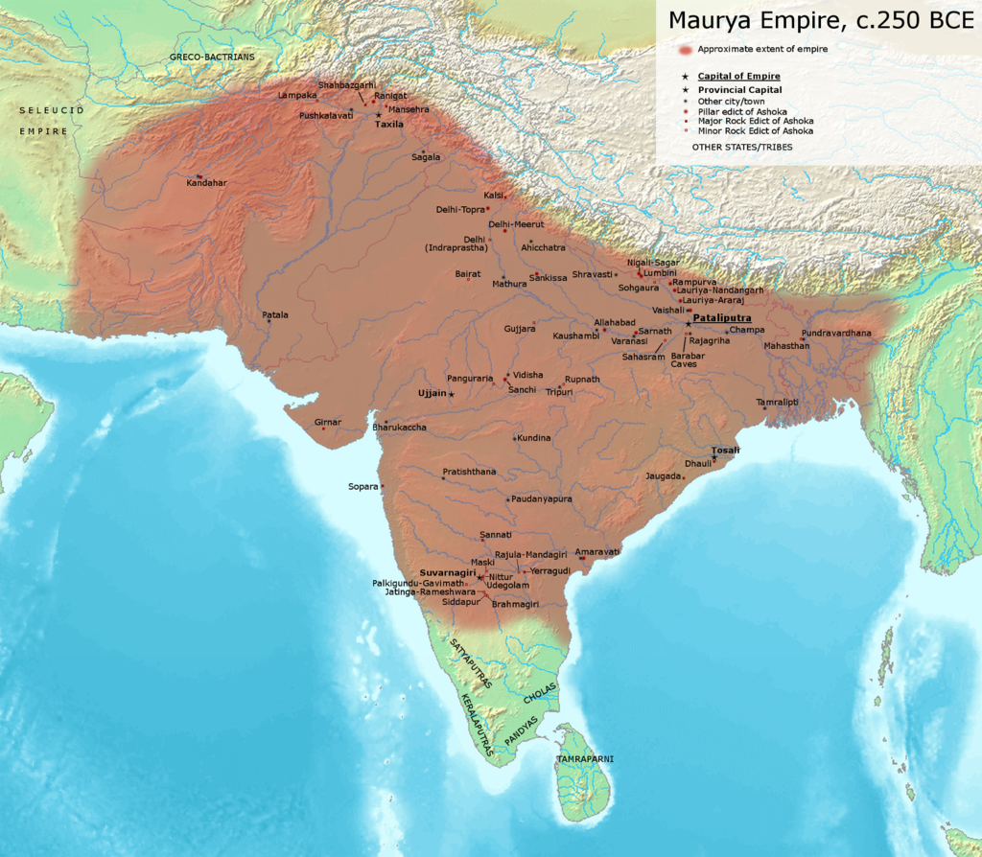
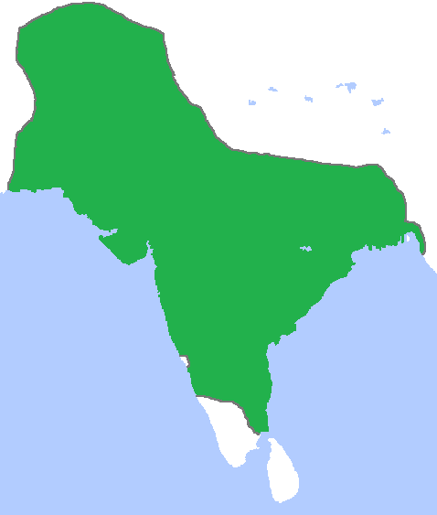
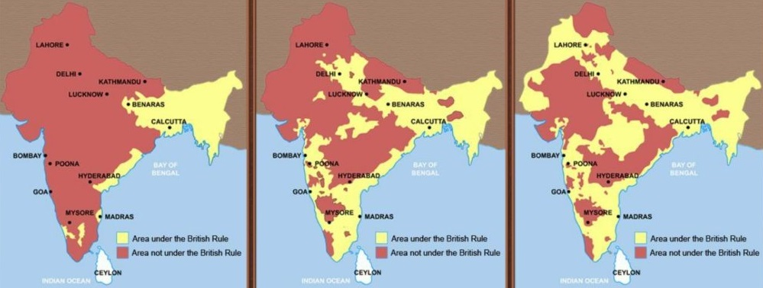
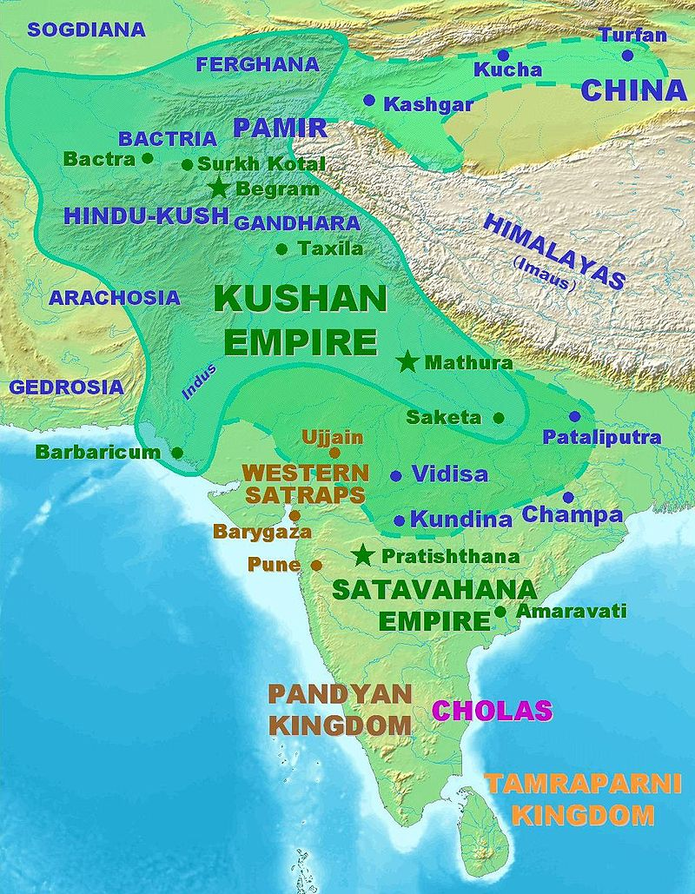
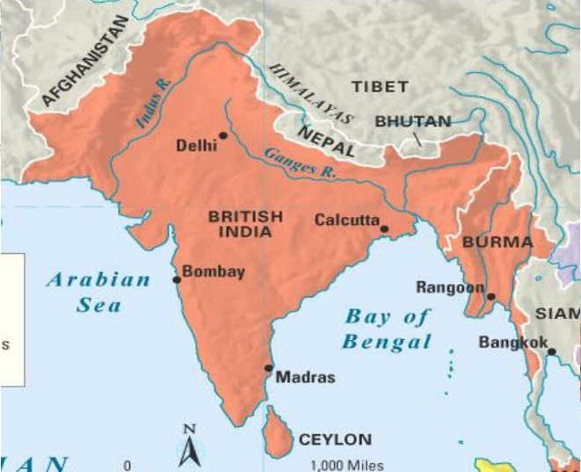
Other muslim Empires (1206-1526 )
Maurya empire
(321 - 180 BCE)
Mughal Empire
(1526-1857)
East India Company
(1757–1858)
Kushan Empire
(30-375AD)
British Empire
( 1857-1947)

Slide 18
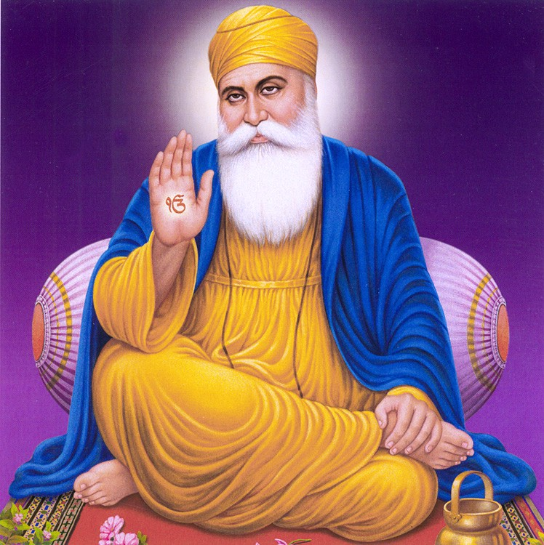
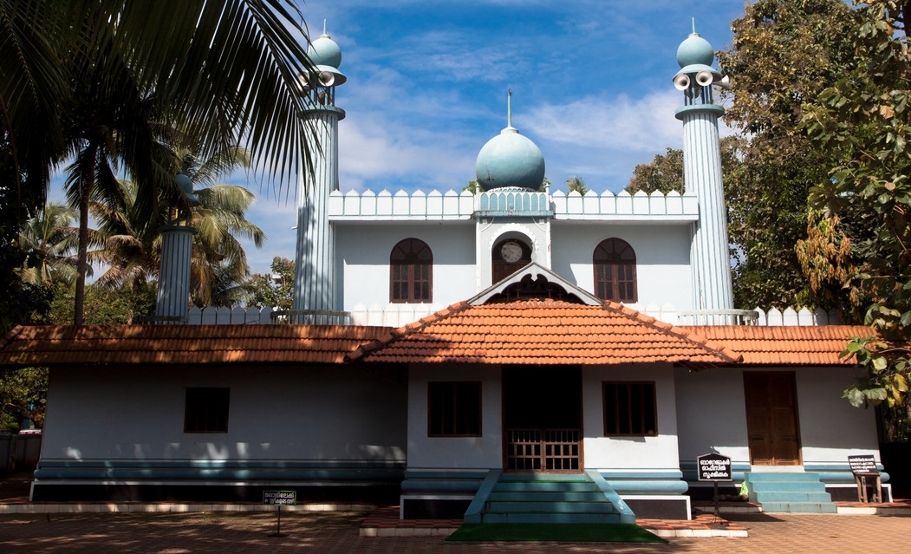
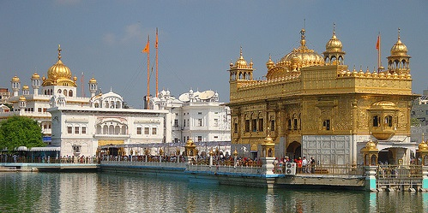
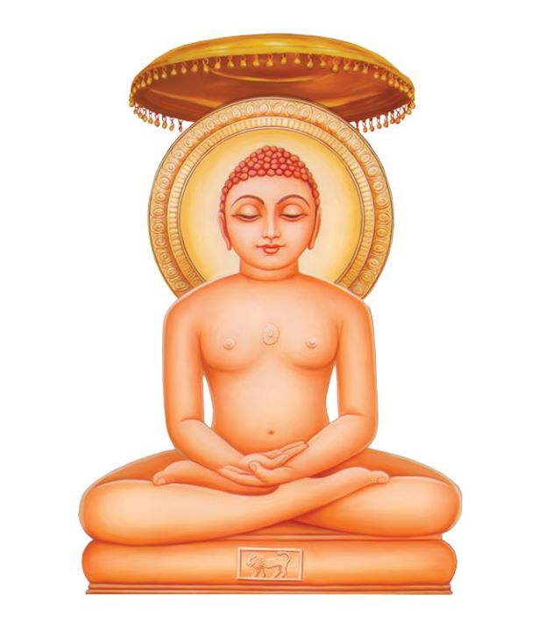
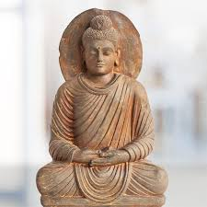
Islam
Shikh
Golden temple
Cheraman Juma Mosque
629 AD, first mosque in Indian continent
First built in 1577
Gurunanak
Jainism
Parsian
Christianity
Budhdhism

Slide 19
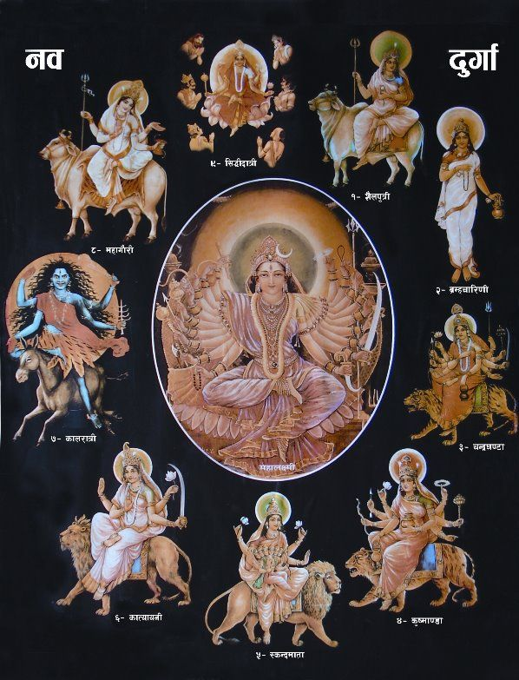
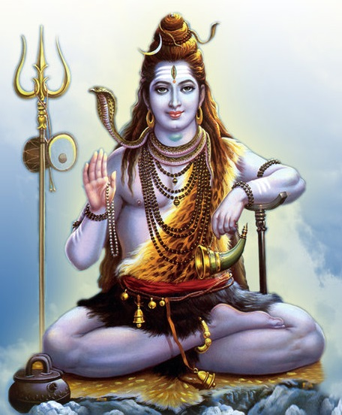
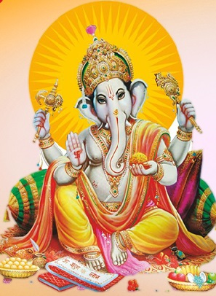
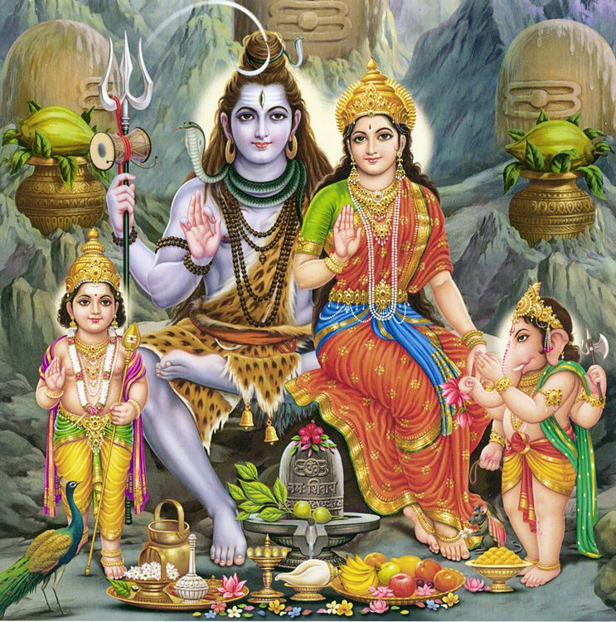
Hindu GODS

Slide 20
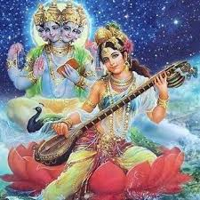
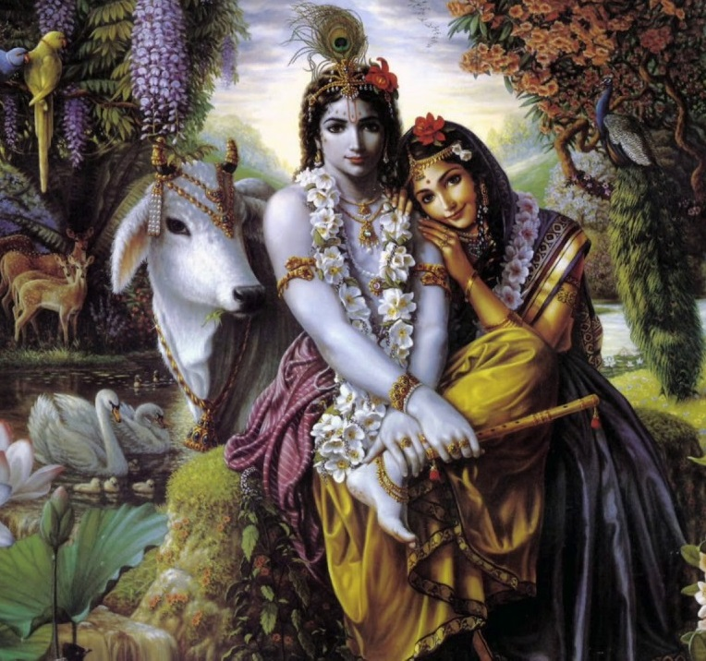
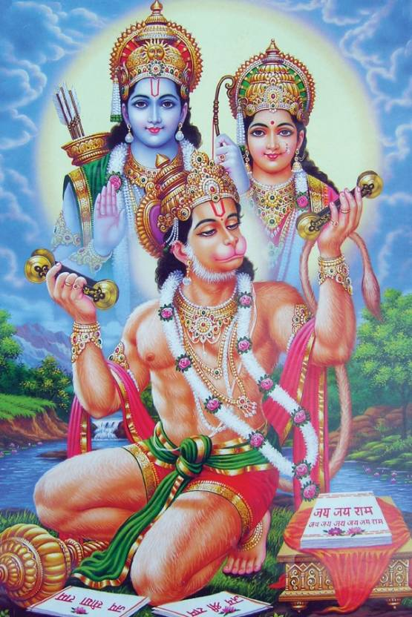
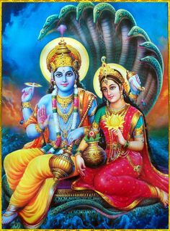
Brahma- Saraswati
Krishna-Radha
Ram-Sita- Hanuman
Vishnu-
Lakshmi

Slide 21
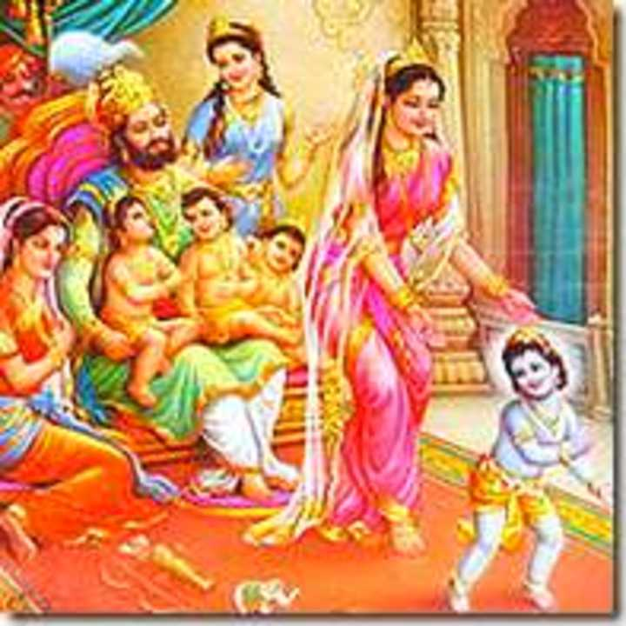
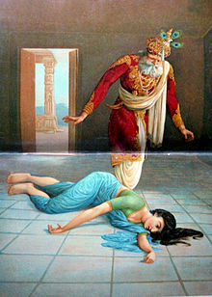
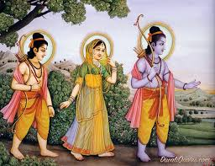
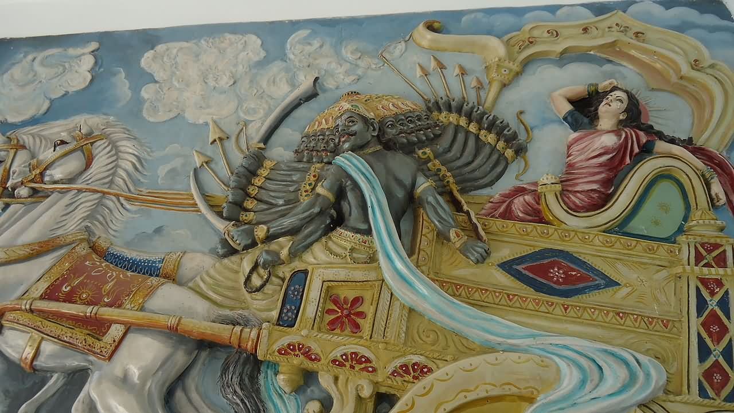
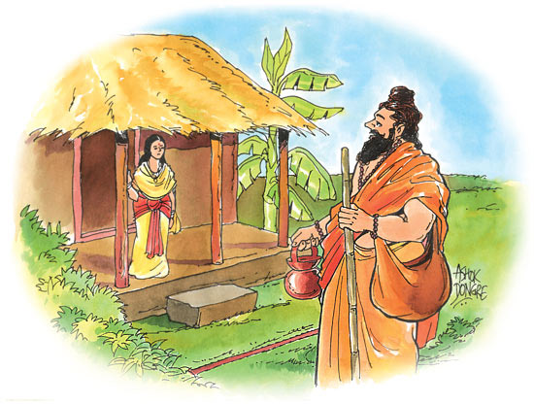
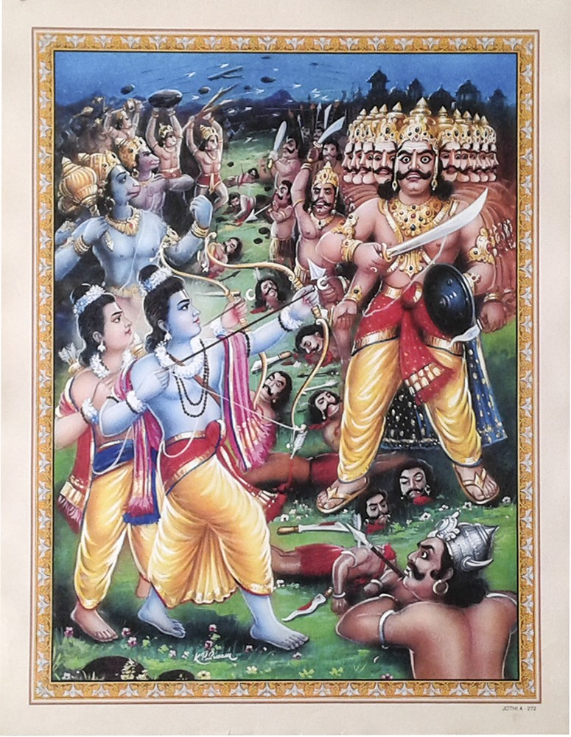
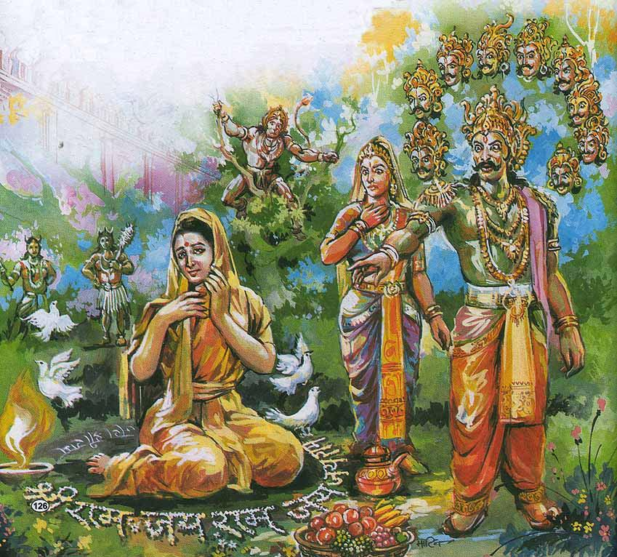


Ramayan

Slide 22







Festivals in India
Garba
2600km
30km
Dussehra
Deepawali

Slide 23



Festivals in India
Holi
Raksha Bandhan

Slide 24








Classical Dance Forms
Bharatnatyam
Kathak
Odissi
Manipuri

Slide 25





Classical Dance Forms
mohiniyattam
Kuchipudi
Kathakali

Slide 26





Rishikesh
Nainital
Laddakh
Darjeeling
Jaisalmer

Slide 27

Economic history of India
Bollywood
250-350 movies per year
Tollywood, Mollywood, etc….
Golden Bird
1947-Indian Independence
Muslim Invadors
(Last quarter of the
12th century)
1858- British rule
1783- Independence of United States of America
1526- Beginning of Mughal empire
Projected growth suggests that GDP of India will be 2nd highest by 2050

