Slide 1
Costa Rica Plasma Laboratory for Fusion Energy and Applications

Slide 2
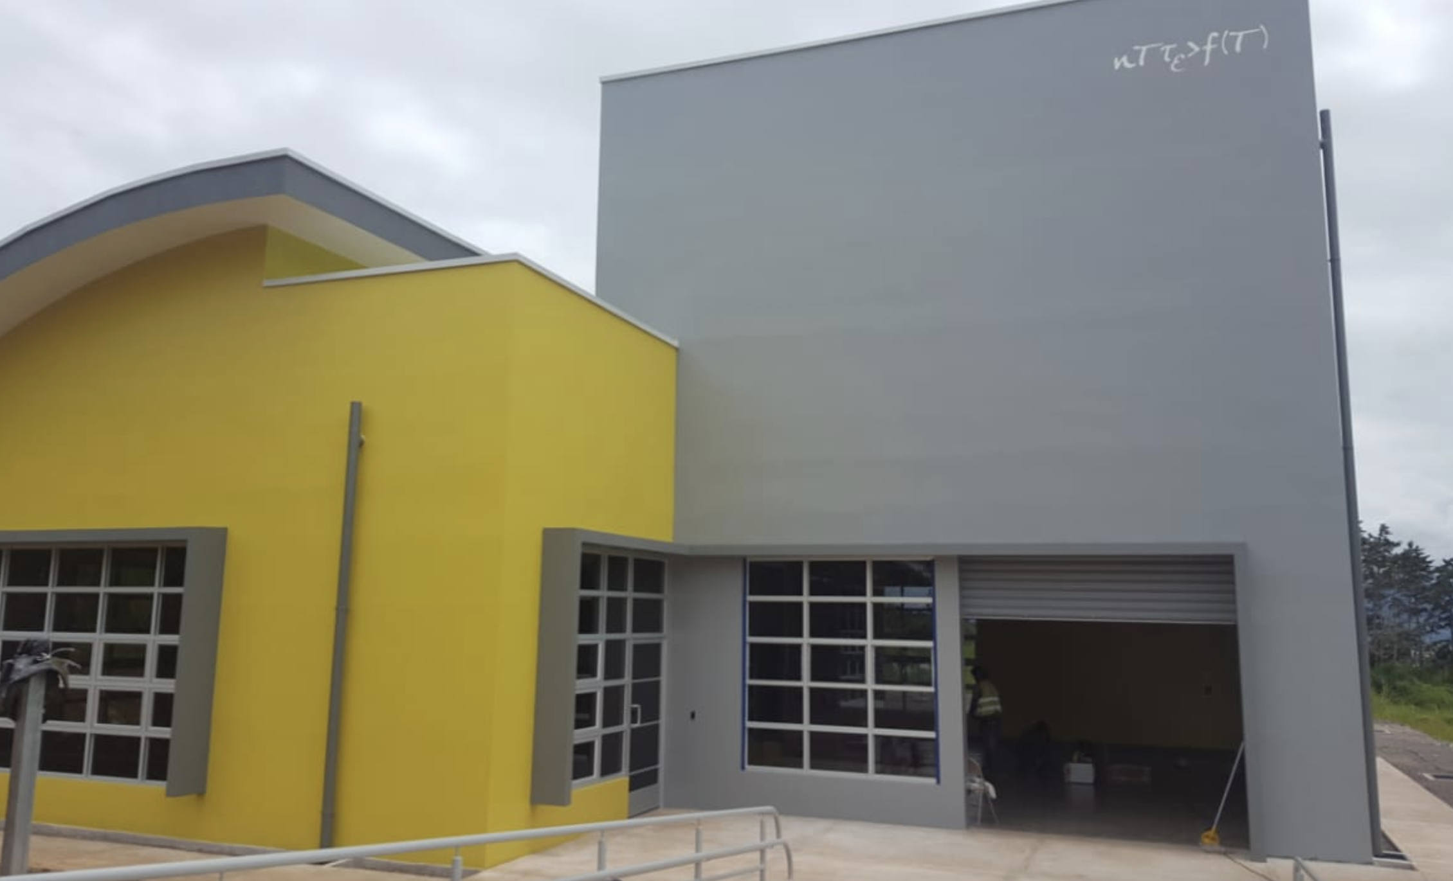
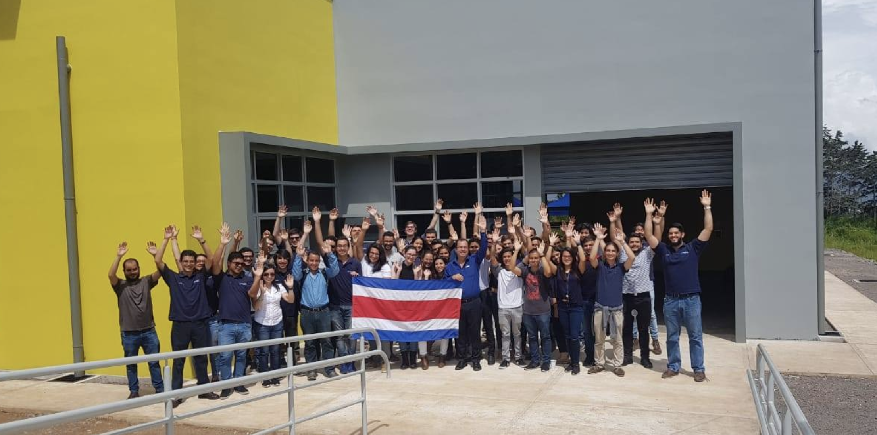
It is a student-focused laboratory located inside the main campus of the Costa Rica Institute of Technology
Aerial view of the Costa Rica Institute of Technology main campus.

Slide 3
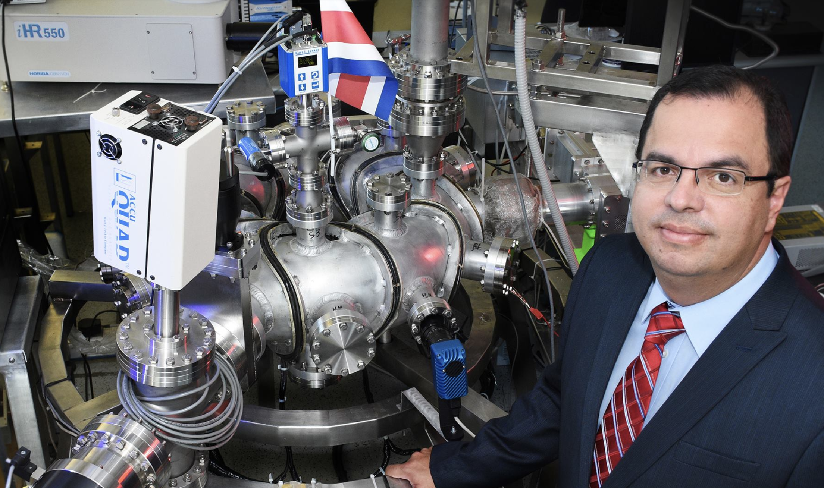
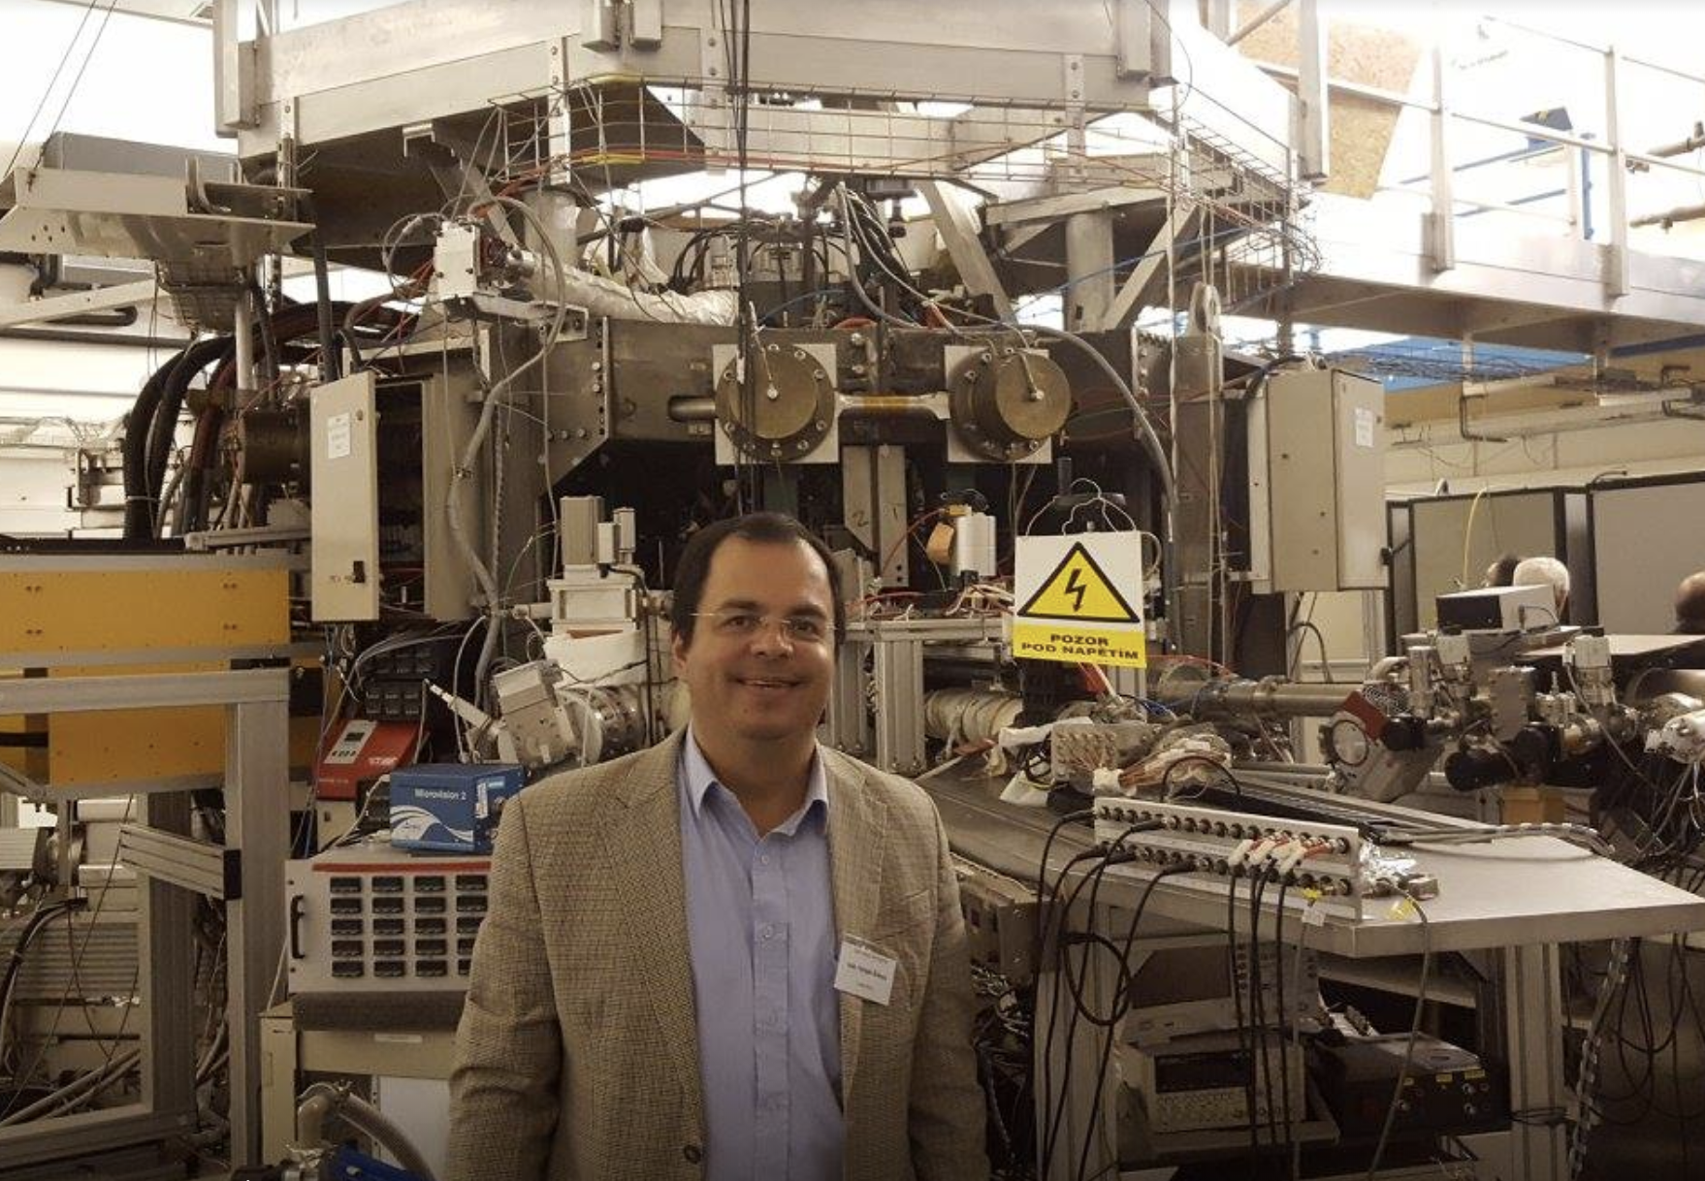
It was founded in 2008 by Prof. Ivan Vargas-Blanco, Phd.
Dr. Ivan Vargas with the SCR-1 stellarator (L) and at COMPASS facilities (R)

Slide 4
Current research areas of the laboratory (Plasmatec)
Plasmatec
Fusion
Industrial Plasmas
SCR-1 stellarator
MEDUSA-CR spherical tokamak
Plasma Medicine
Plasma Agriculture
Plasma for Waste Treatment

Slide 5
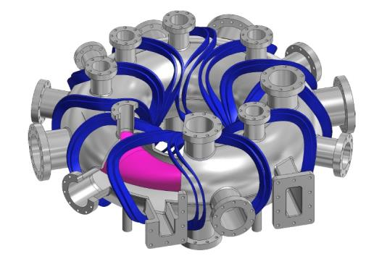
Brief History of the Fusion Project
2008
The laboratory is founded.
An agreement is made with the Center for Energy, Environmental and Technological Research of Spain (CIEMAT) for future collaborations.
2010
First designs of the SCR-stellarator.
Costa Rica Institute of Technology declares the research in plasma physics as a matter of institutional interest.
Costa Rica government declares research in plasma physics a matter of public interest.
2013
Spherical tokamak MEDUSA (Madison EDUcation Small Aspect ratio tokamak) was purchased from the University of Wisconsin-Madison for a total cost of one US dollar ($1) .

Slide 6
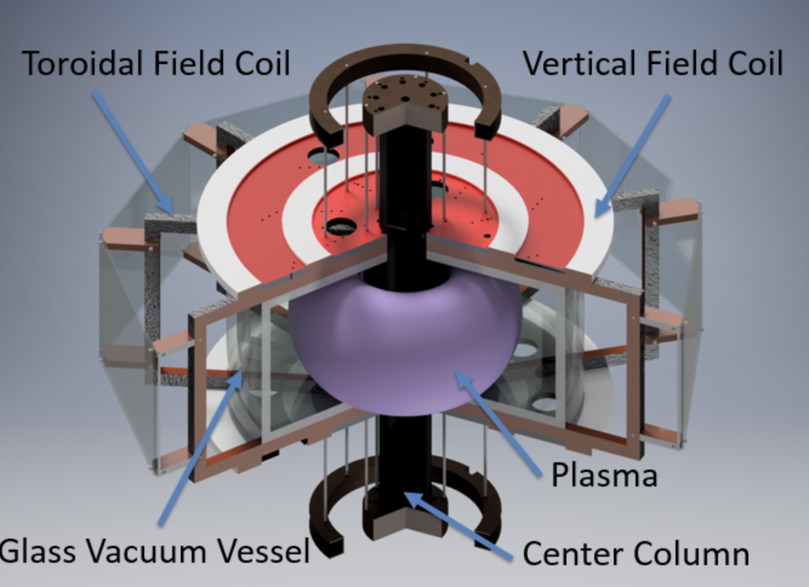
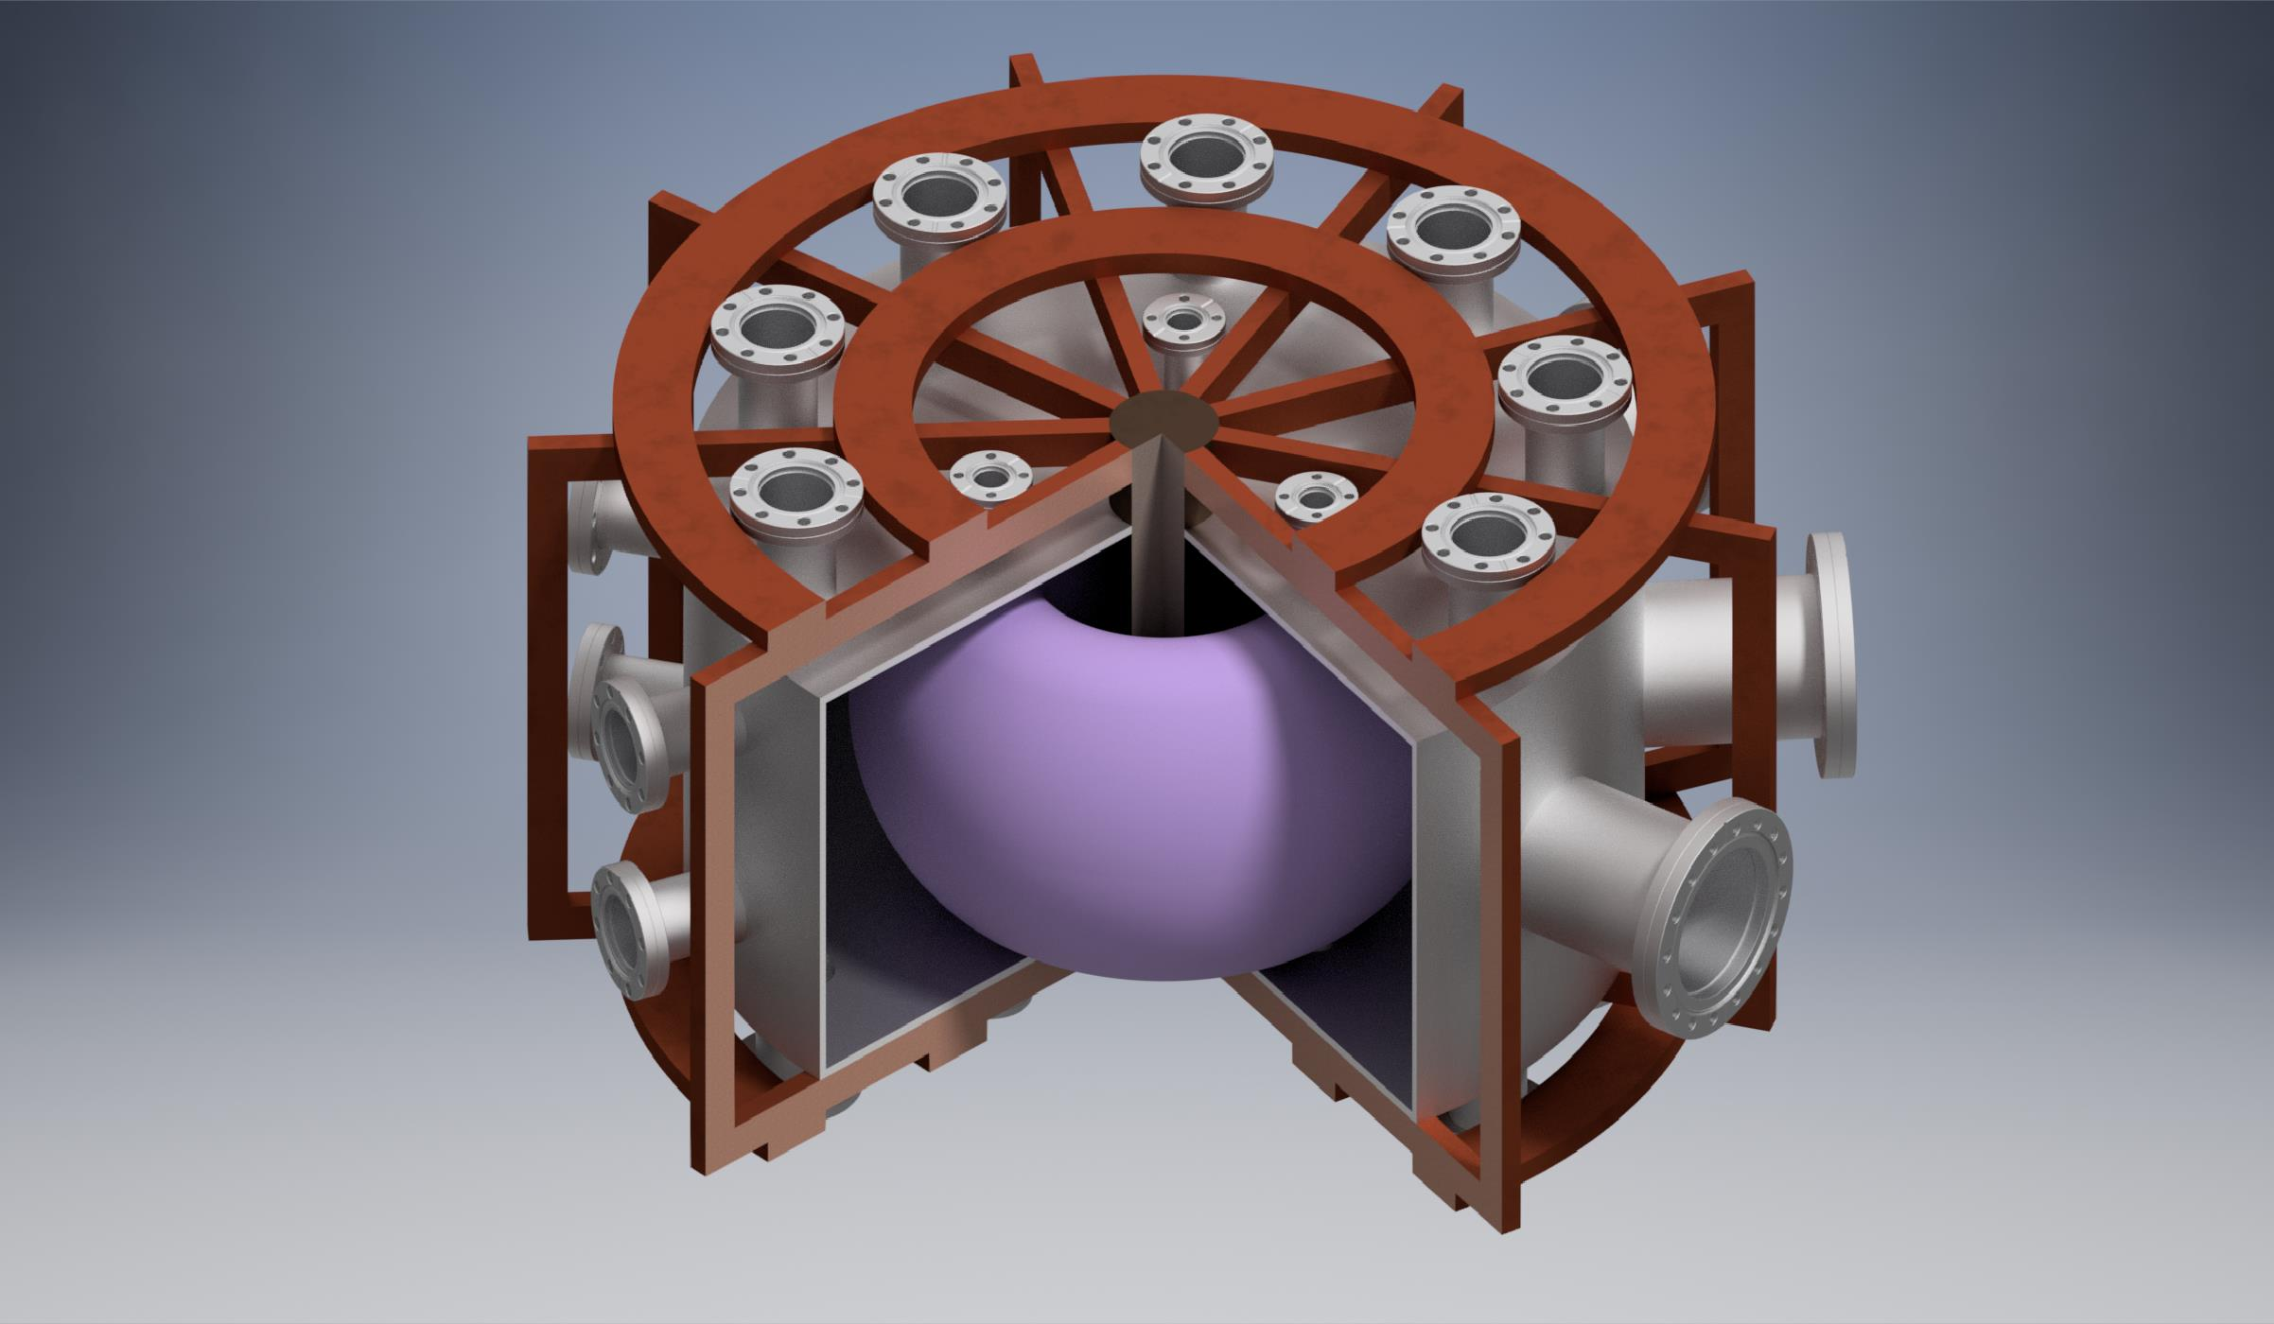
Brief History of the Fusion Project
2015
Construction of SCR-1 stellarator is completed.
The machine was entirely designed and built in Costa Rica.
2016
First plasma discharge made by SCR-1.
Latin America´s first stellarator.
MEDUSA-CR begins recommissioning process.
First vacuum tests in MEDUSA-CR glass vacuum vessel.
2017
Vacuum performance in MEDUSA-CR suggested to replace the old glass vessel with a new stainless-steel chamber.

Slide 7
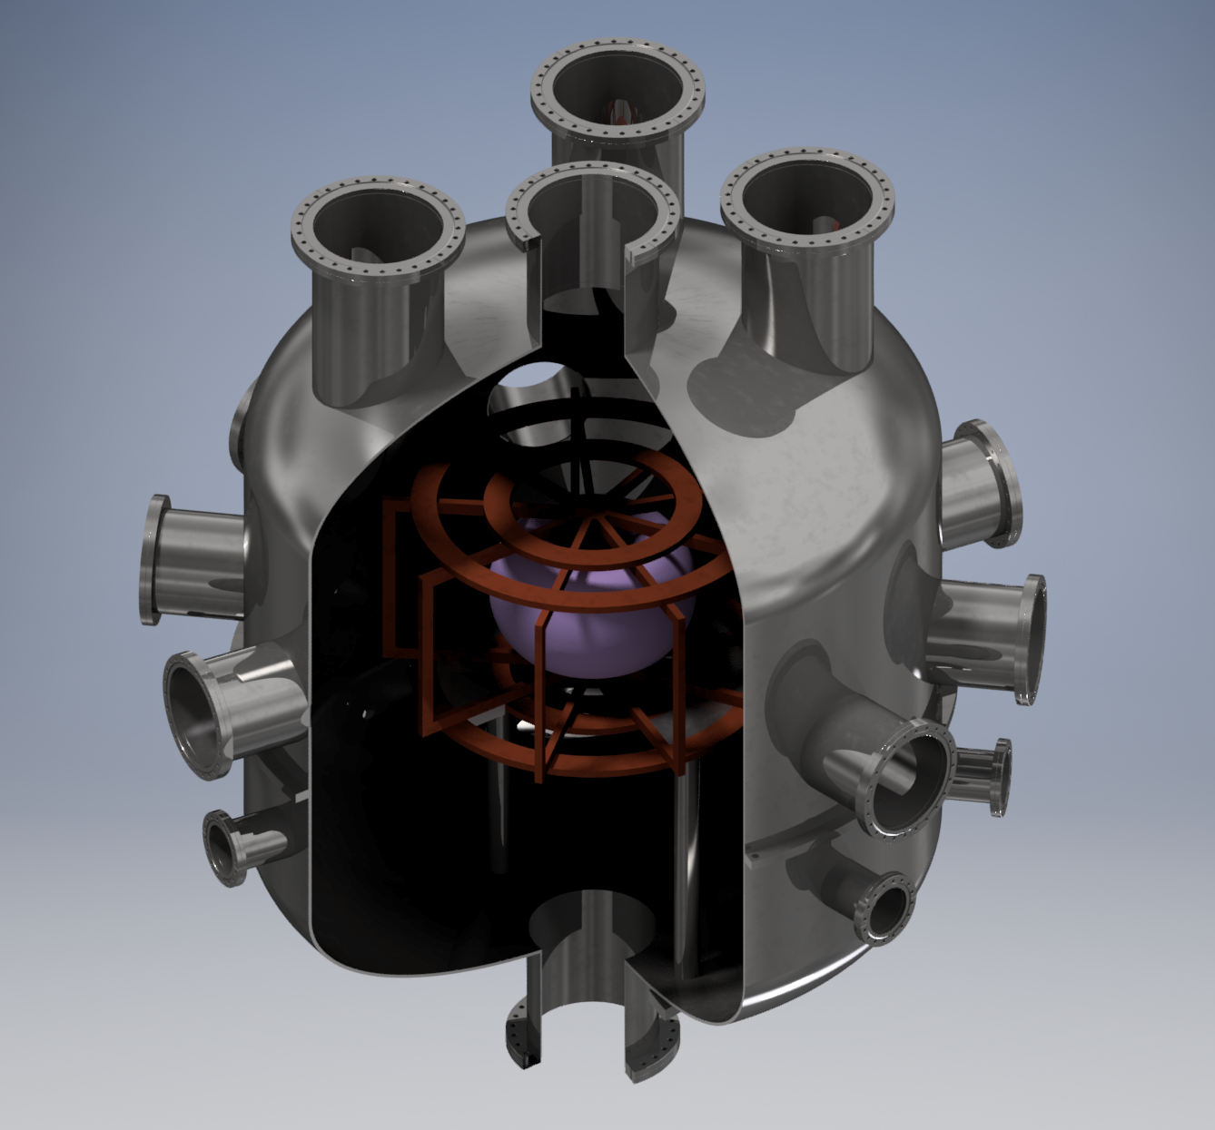
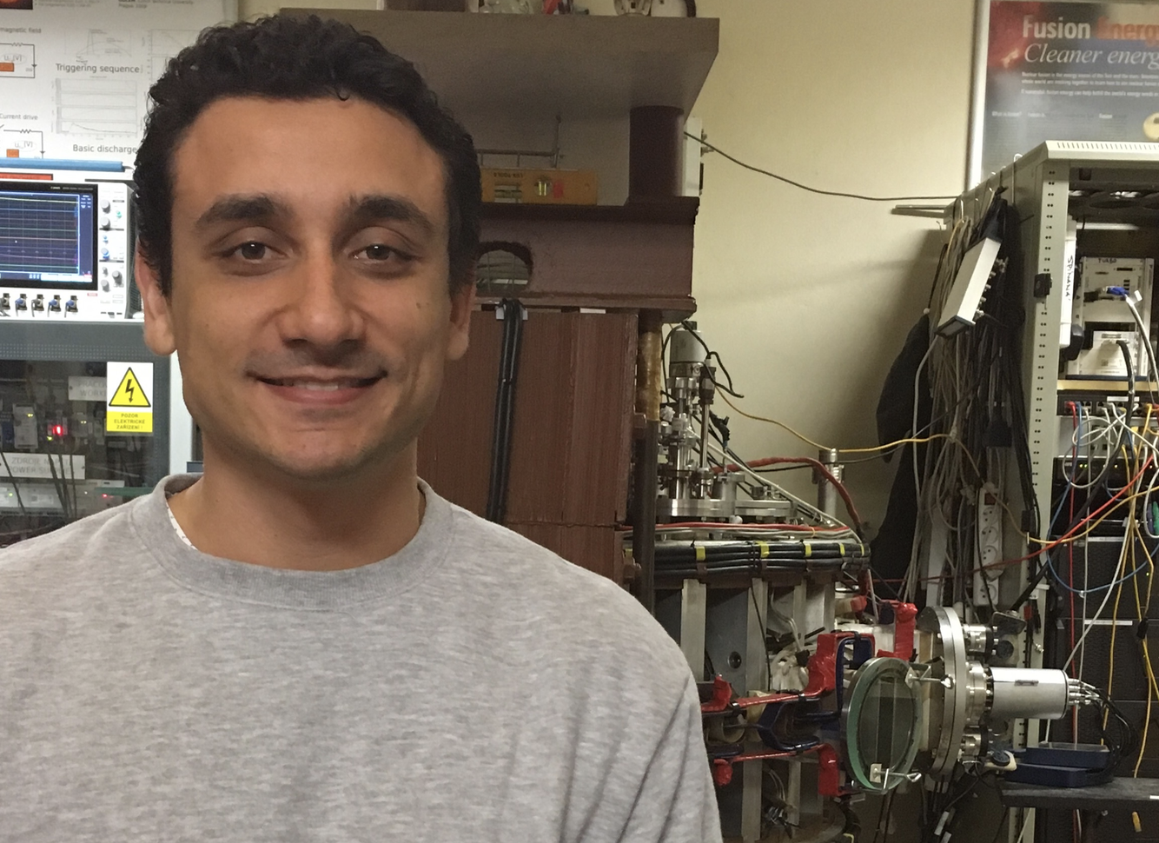
Brief History of the Fusion Project
2017
New laboratory facilities are finished in the Costa Rica Institute of Technology main campus.
An external vacuum vessel is proposed to MEDUSA-CR to avoid Eddy currents.
2018
Design of a bigger stellerator (SCR-2) begins.
The construction of the external vacuum vessel for MEDSUSA-CR is given to a US company.
Design the the magnetic diagnostics for MEDUSA-CR is held in collaboration with GOLEM.

Slide 8
(2016)

Slide 9
Currently there are two machines in the laboratory: The SCR-1 stellarator and the MEDUSA-CR spherical tokamak
SCR-1 (L) and assembled MEDUSA-CR (R)

Slide 10
Operating parameters of the SCR-1
Parameter | Value
Major Radius | 238.1 mm (device) 140 mm (plasma)
Minor Radius | 42.2 mm (device) 100 mm (plasma)
Magnetic Field | 0.043 T
Plasma Life | 3 ms
Plasma Current | 40 kA

Slide 11
Operating parameters of the MEDUSA-CR
Parameter | Value
Major Radius | 0.09 m – 0.14 m
Minor Radius | 0.04 m – 0.10 m
Aspect Ratio | 1.5
Plasma Life | 3 ms
Plasma Current | 20 kA

Slide 12
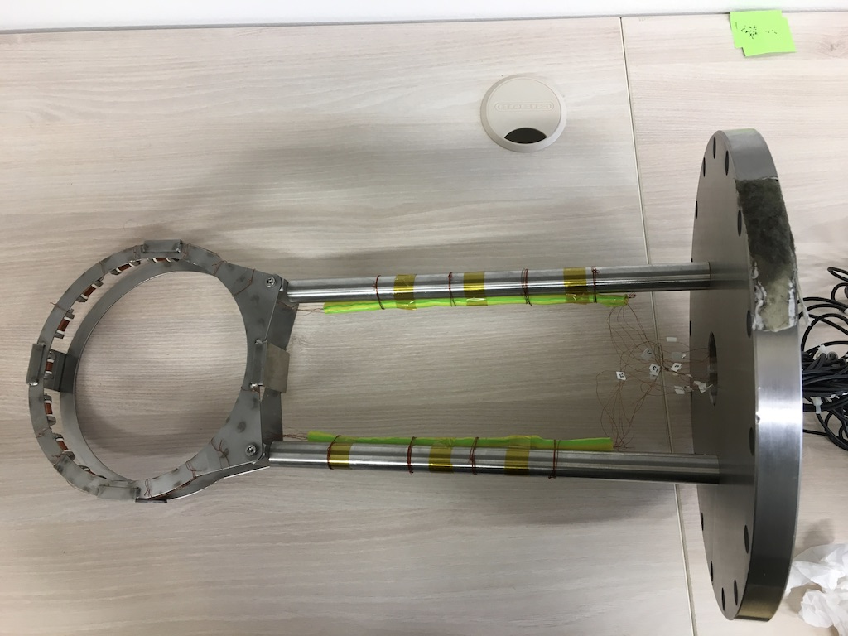
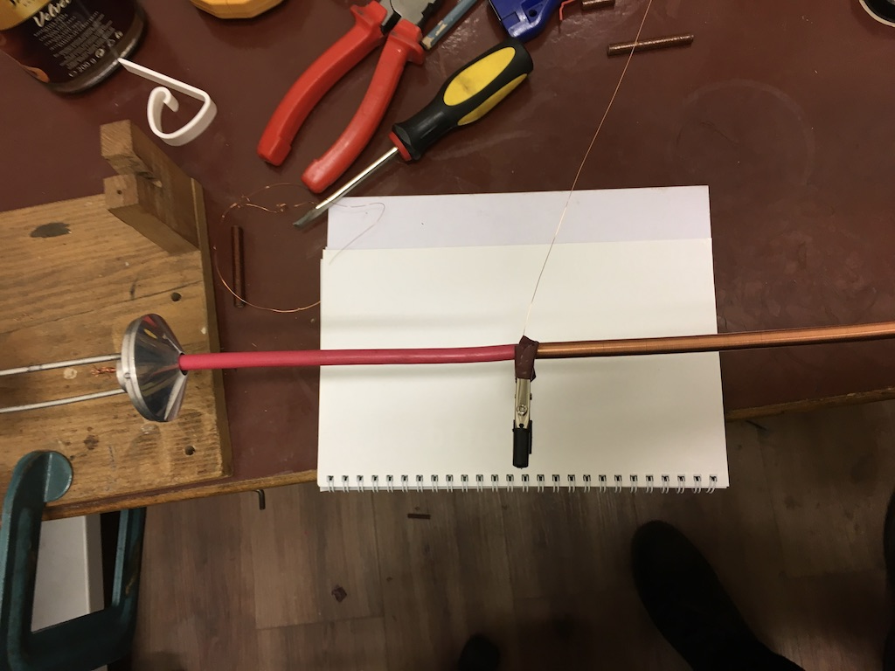
Design of the magnetic diagnostics for MEDUSA-CR
Implemented Mirnov Coils (L) and constructed Rogowski Coil (R)

Slide 13
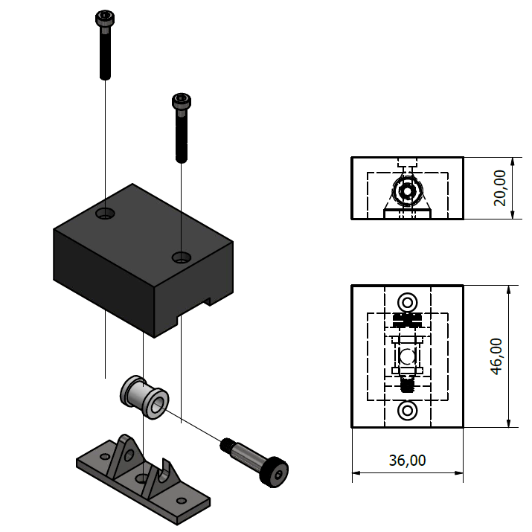
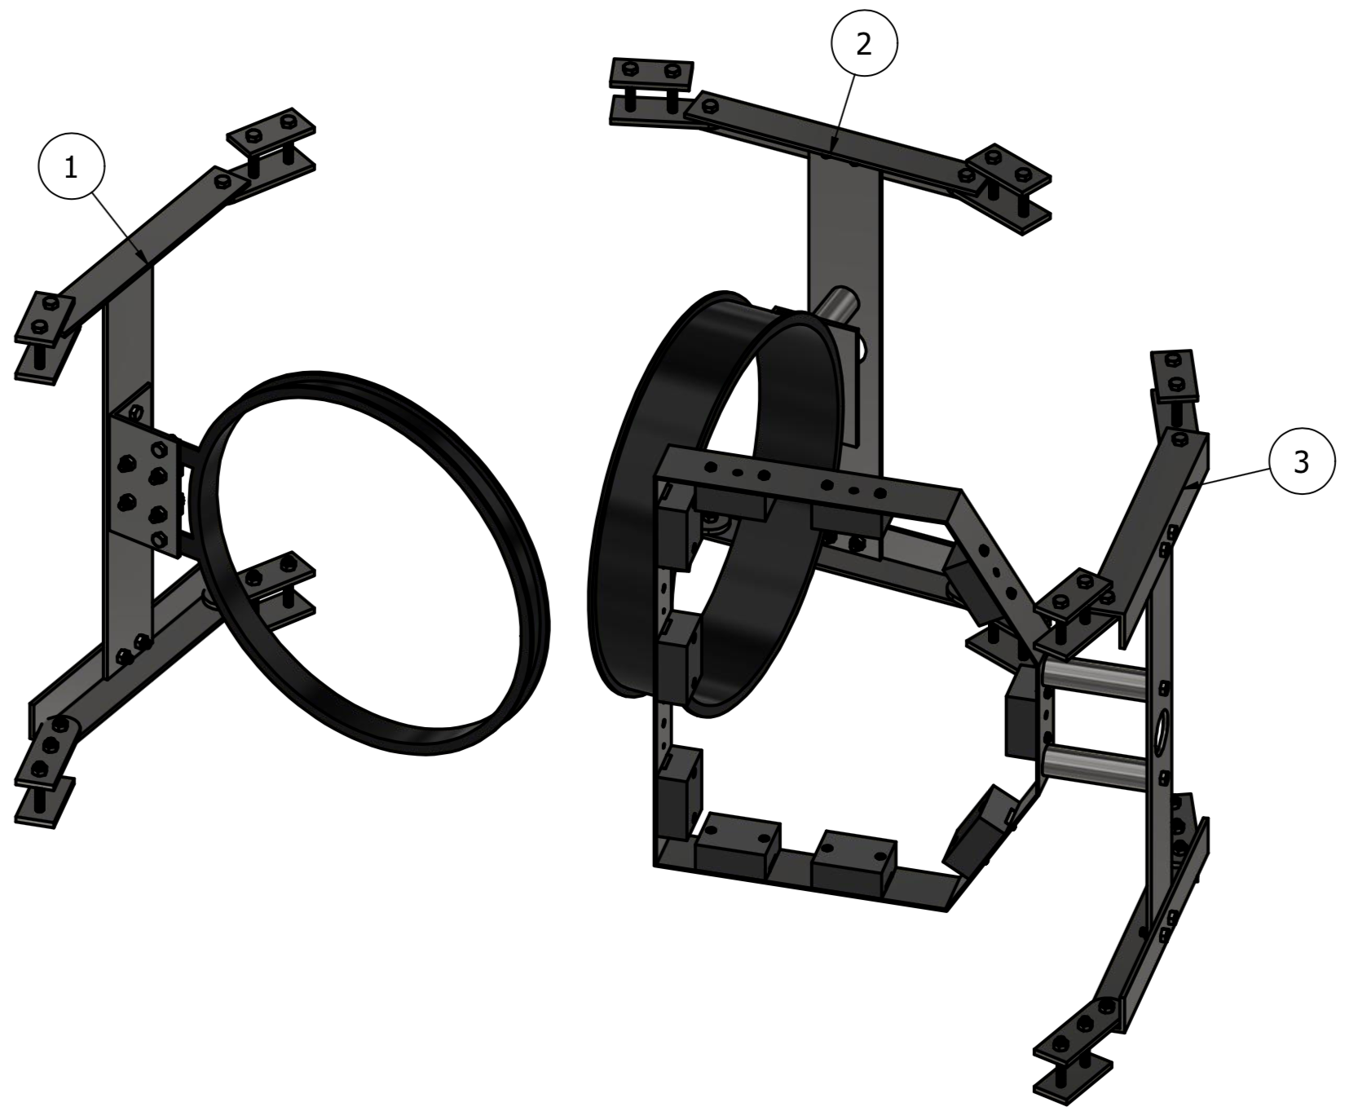
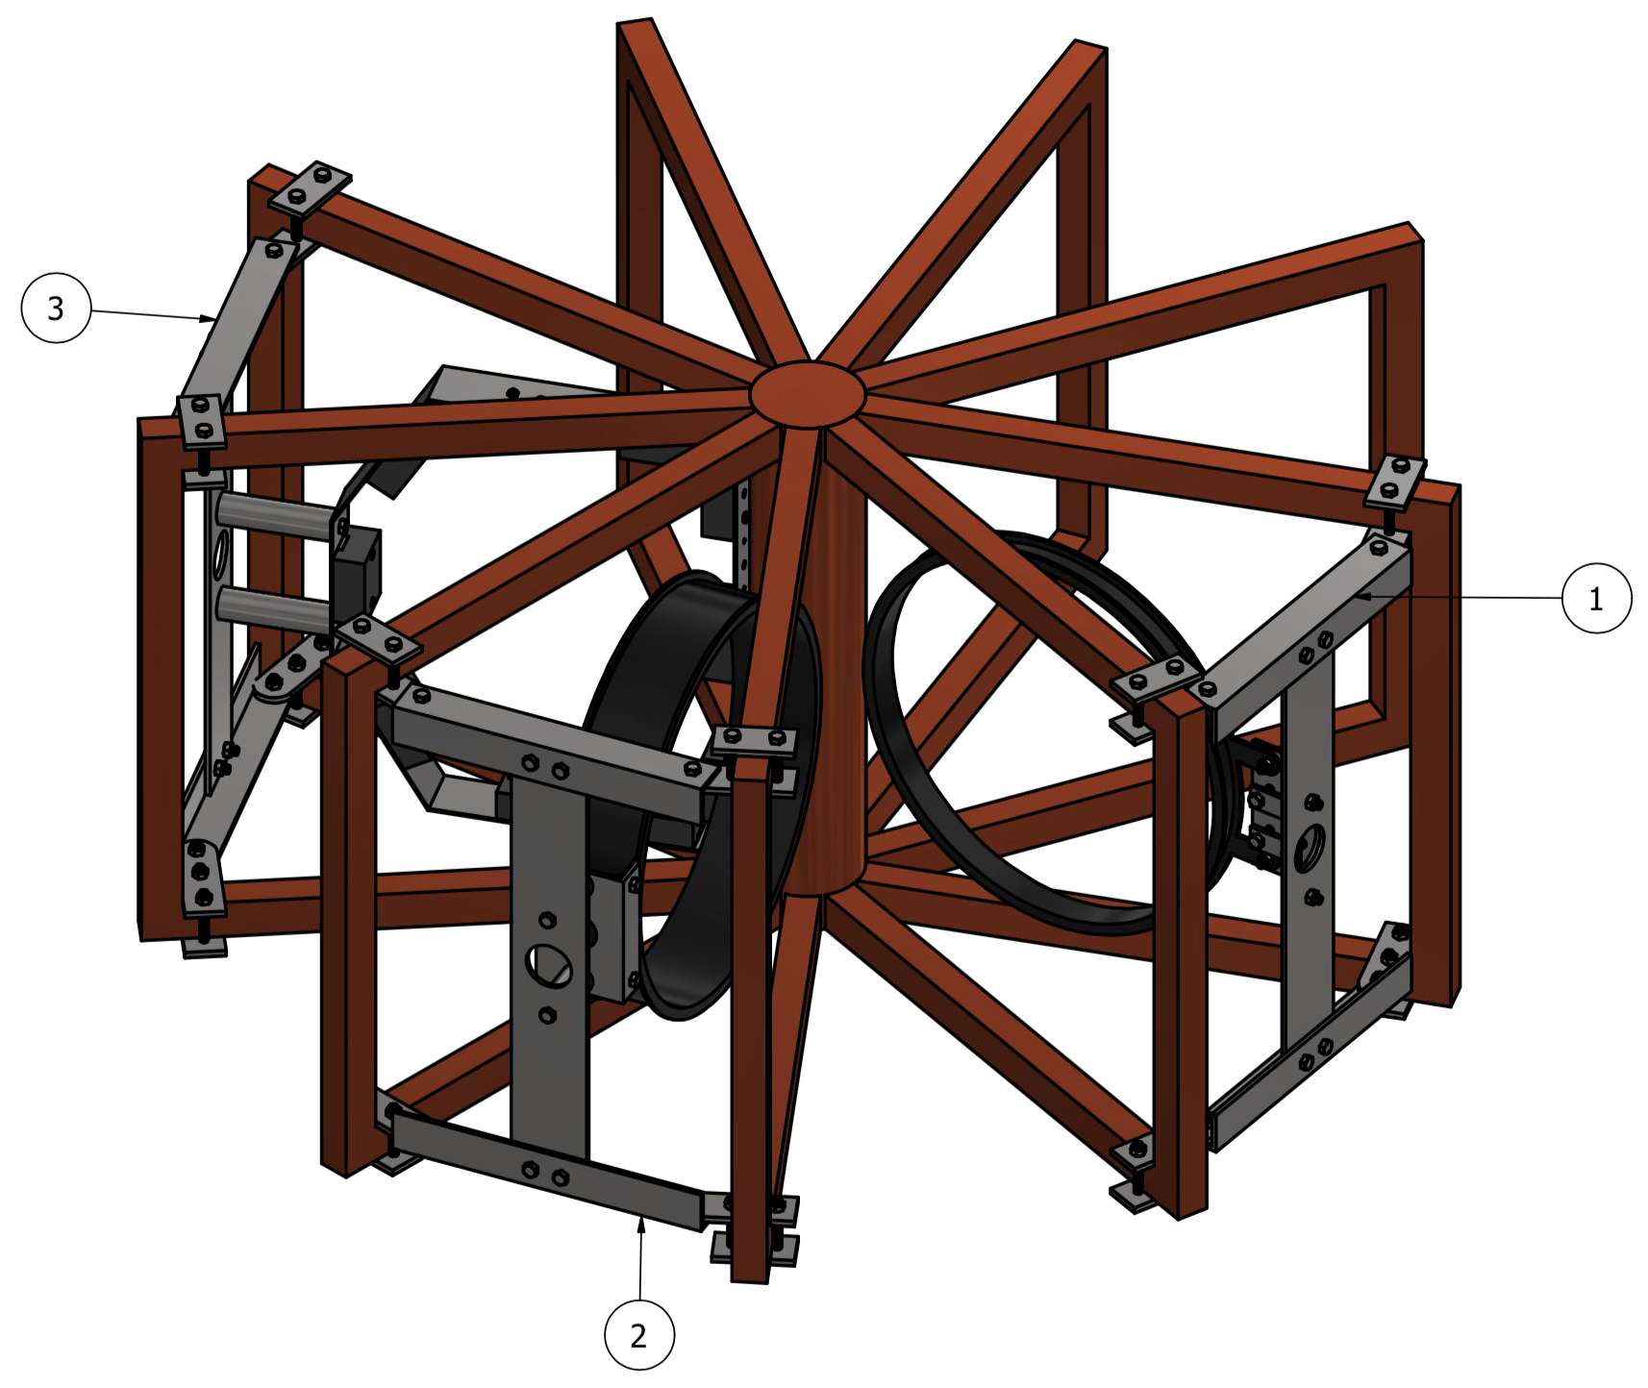
Design of the magnetic diagnostics for MEDUSA-CR

