Slide 1
Miroslav Šos
Diploma thesis
Supervisor : Ing. Petr Böhm Ph.D.
Winter Workshop PTTF – Marianska 22. – 26. 1. 2018

Slide 2
Development and implementation of data processing for TS in Python
Temporal fitting of the fast signal
Incorporation of results from calibration
Determination of electron temperature and density
Proper estimation of errors and saving into database
Check TS calibration routines – alternatively perform newly developed methods
Miroslav Šos: Optimisation of processing raw data of the TS diagnostics / Marianska / 22. – 26. 1. 2018
1/19

Slide 3
Brief theory of Thomson scattering (TS)
Realization of TS on the COMPASS tokamak
Description of data processing algorithm
Implemented methods for optimisation
Plans and goals for the future
Summary
Miroslav Šos: Optimisation of processing raw data of the TS diagnostics / Marianska / 22. – 26. 1. 2018
2/19

Slide 4
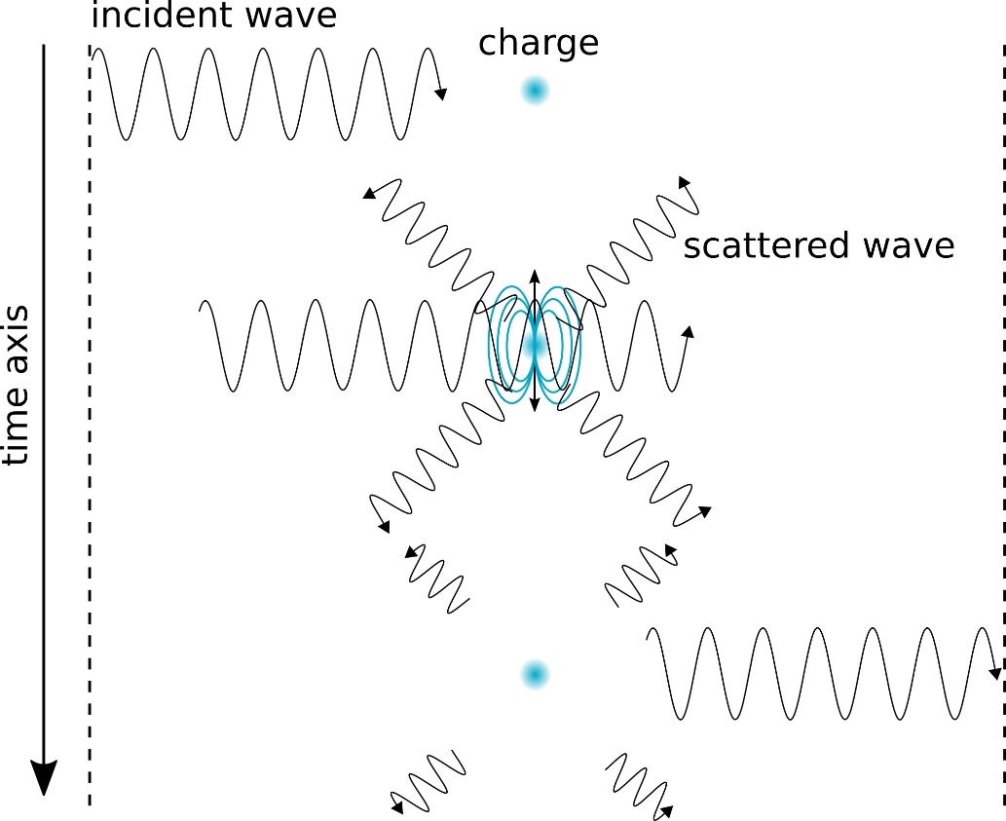
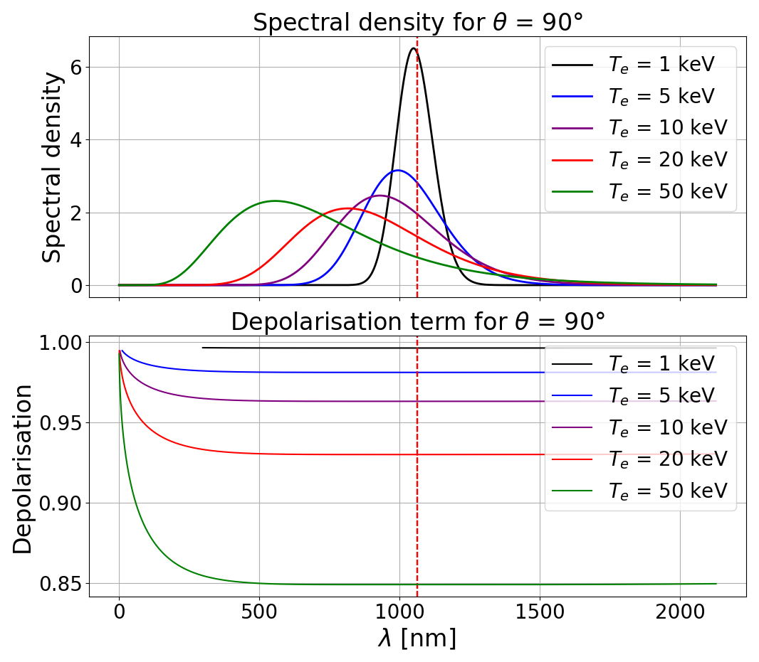
Thomson scattering is the elastic scattering of electromagnetic wave on electrons
Due to Doppler effect radiated spectrum is broadened and shifted towards shorter wavelength
Miroslav Šos: Optimisation of processing raw data of the TS diagnostics / Marianska / 22. – 26. 1. 2018
3/19

Slide 5
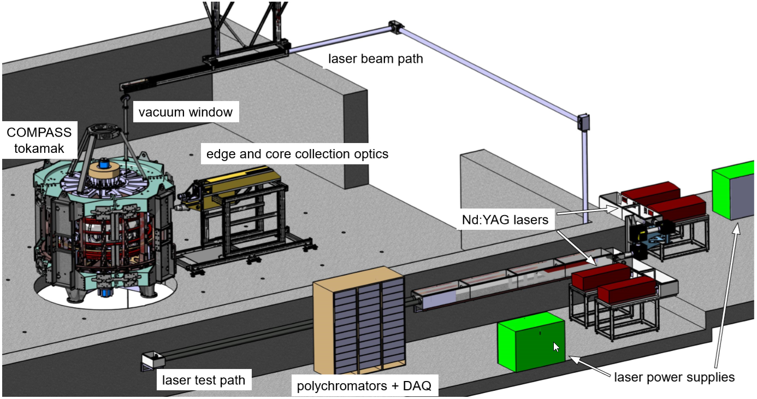
$λ$=1064nm
E = 1.5 J
f = 30 Hz
σ = 7 ns
Thomson scattering on the COMPASS tokamak – overview [Bohm, 2017]
Miroslav Šos: Optimisation of processing raw data of the TS diagnostics / Marianska / 22. – 26. 1. 2018
4/19
Notes:
100 m vysoko, metru za sekundu.

Slide 6
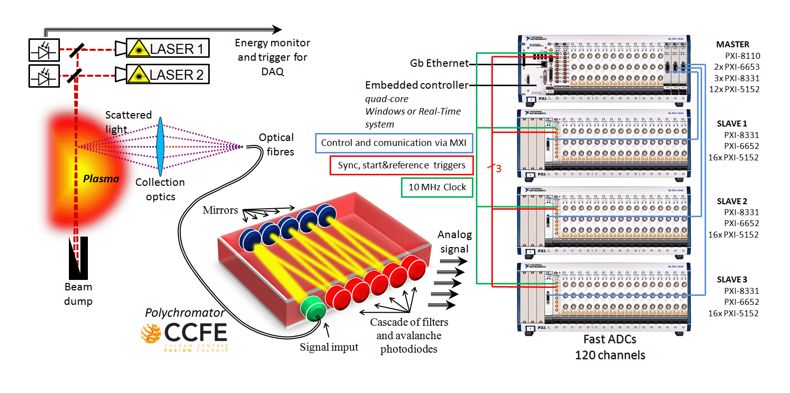
TS Diagnostics scheme on COMPASS tokamak [COMPASS web, 2014]
1 GHz sampling
Duplexing – two spatial point led by different length of fibres (±13 m ≈ 66 ns)
Miroslav Šos: Optimisation of processing raw data of the TS diagnostics / Marianska / 22. – 26. 1. 2018
5/19
Notes:
100 m vysoko, metru za sekundu.

Slide 7
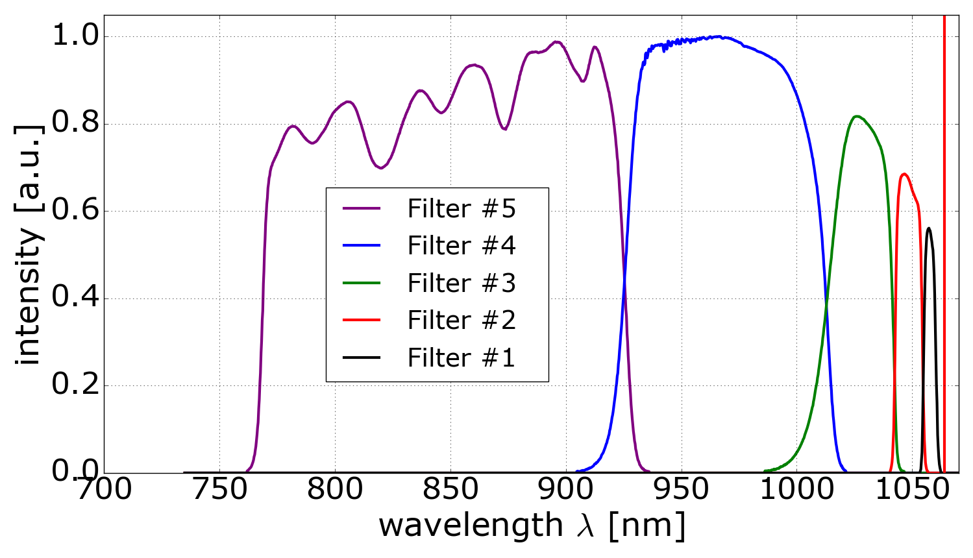
Each polychromator consists of 5 (4) spectral filters, which spectrally divide the signal
Spectrum of the scattered radiation can be reconstructed
Spectral transmisivity of one polychromator
Miroslav Šos: Optimisation of processing raw data of the TS diagnostics / Marianska / 22. – 26. 1. 2018
6/19
Notes:
100 m vysoko, metru za sekundu.

Slide 8
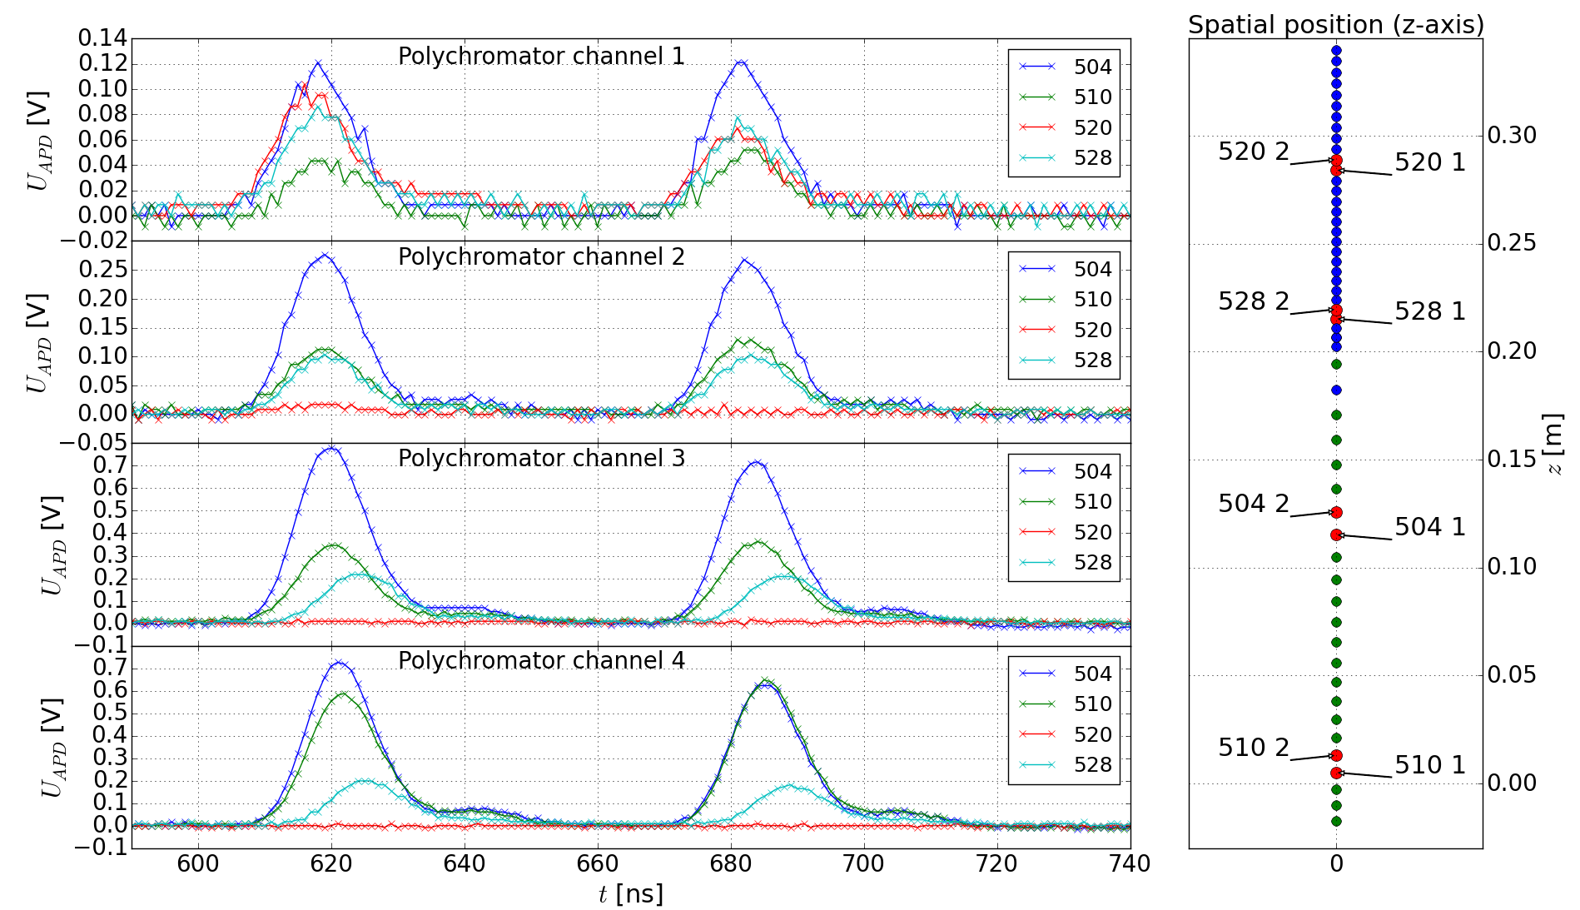
Miroslav Šos: Optimisation of processing raw data of the TS diagnostics / Marianska / 22. – 26. 1. 2018
7/19
Notes:
100 m vysoko, metru za sekundu.

Slide 9
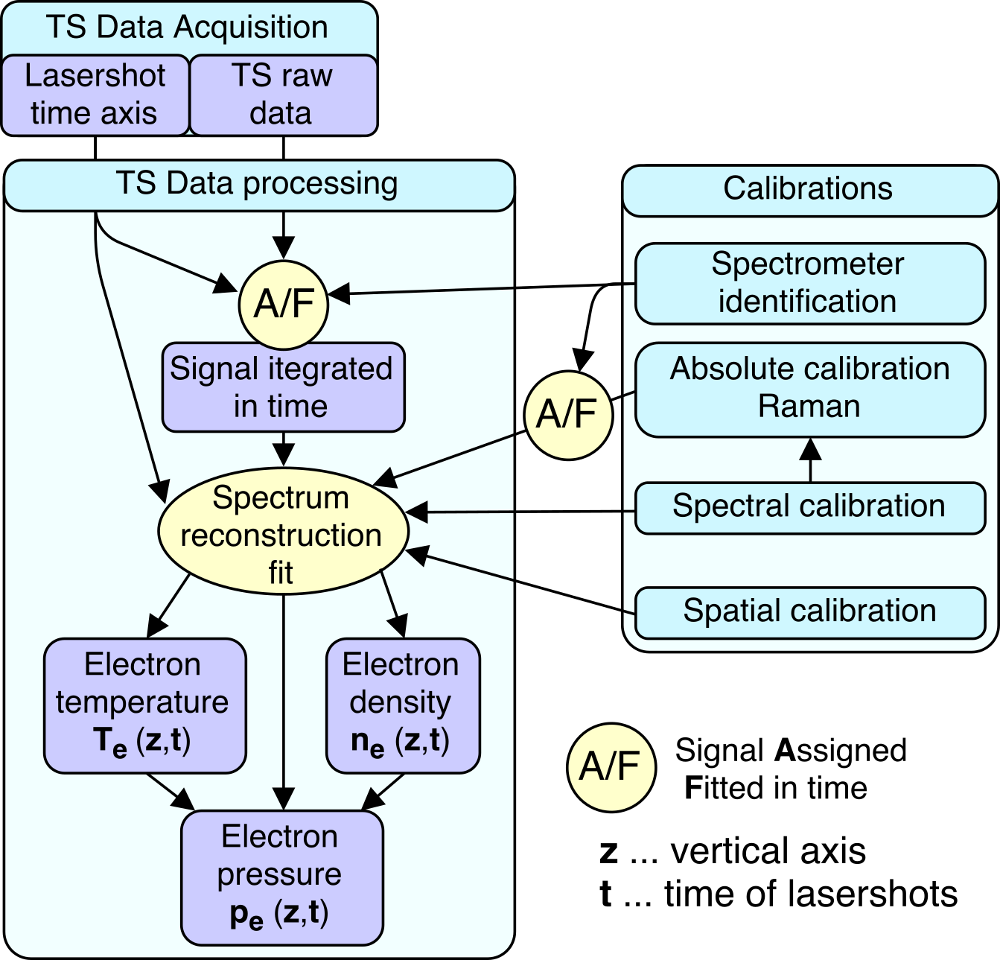
TS raw data – 1 GHz sampling
Lasershot time axis
usually 16 laser trigger marks for each laser
Currently in IDL → transfer to Python
Miroslav Šos: Optimisation of processing raw data of the TS diagnostics / Marianska / 22. – 26. 1. 2018
8/19
Notes:
100 m vysoko, metru za sekundu.

Slide 10
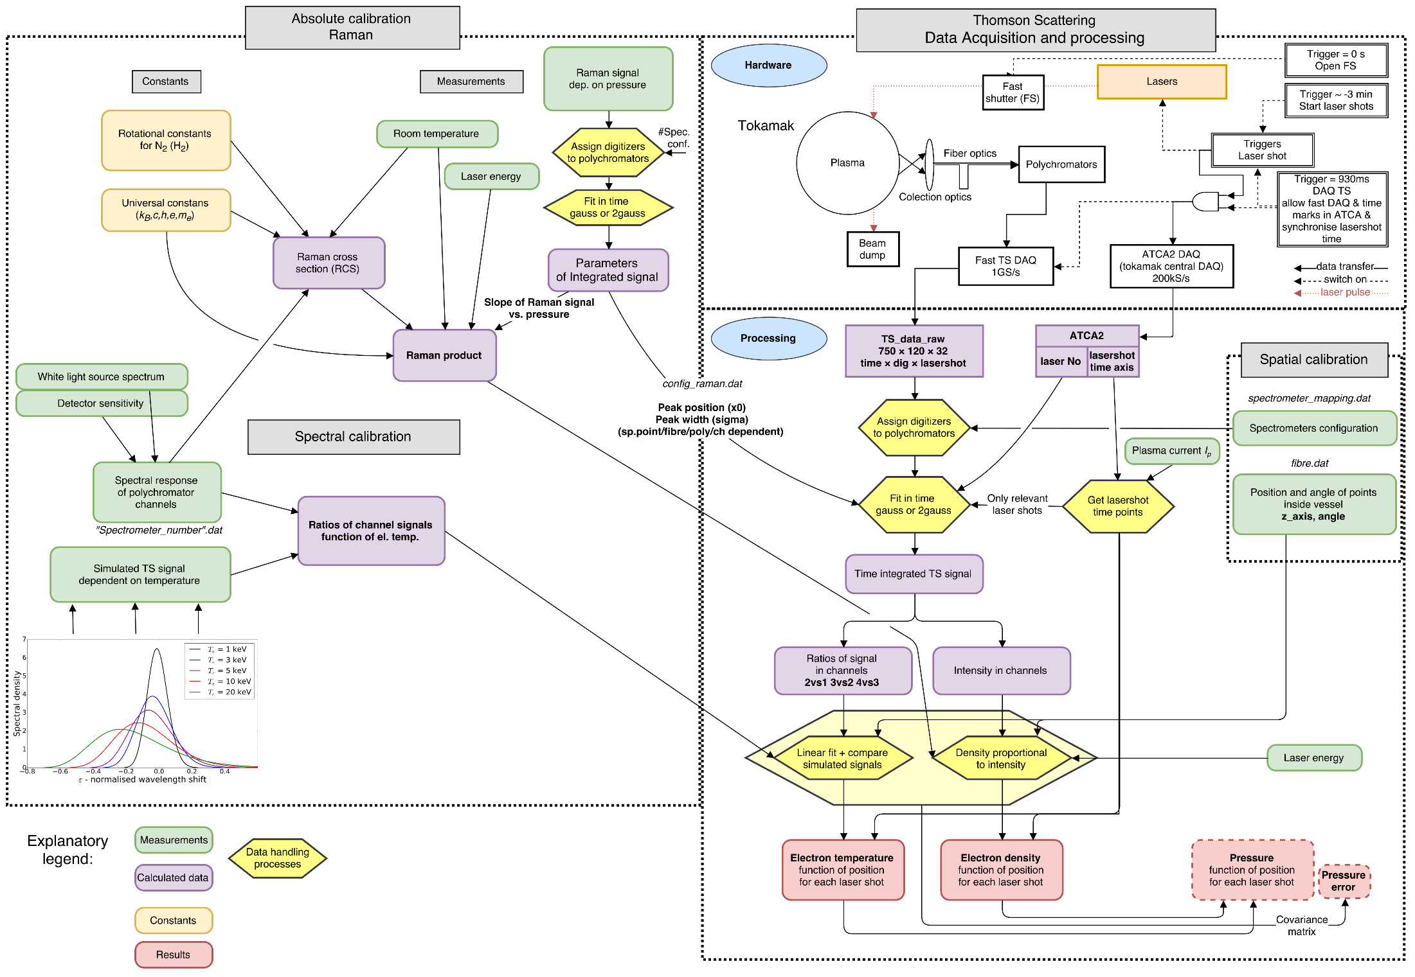
Miroslav Šos: Optimalization of operation of the TS diagnostics / RS defense / 18.9.2017
2/11
Notes:
100 m vysoko, metru za sekundu.

Slide 11
To be implemented
Miroslav Šos: Optimalization of operation of the TS diagnostics / RS defense / 18.9.2017
2/11
Notes:
100 m vysoko, metru za sekundu.

Slide 12
Purpose of optimisation:
Correction of any effects leading to incorrectly determined results
Emphasis on modularity and variability of the system
Higher requirements on robustness during fitting procedures
If possible, simplify the code and make it more clear
Miroslav Šos: Optimisation of processing raw data of the TS diagnostics / Marianska / 22. – 26. 1. 2018
10/19

Slide 13
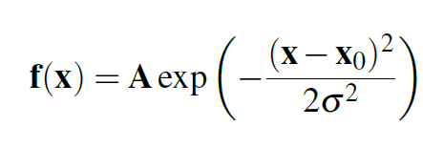
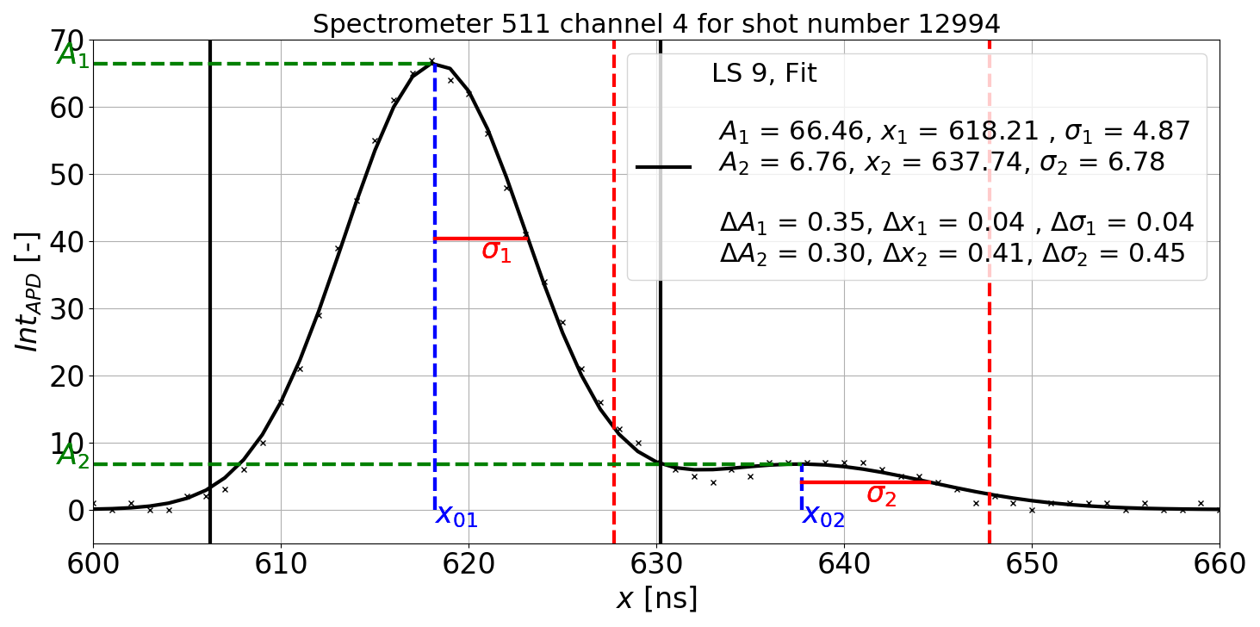
Until now fitting by single Gaussian function
Double Gaussian implemented
Originally mitigation
of the stray light effect
Miroslav Šos: Optimisation of processing raw data of the TS diagnostics / Marianska / 22. – 26. 1. 2018
11/19
Notes:
100 m vysoko, metru za sekundu.

Slide 14
Until now fitting by single Gaussian function
Double Gaussian implemented
Originally mitigation
of the stray light effect
Not stray light
→ feature of detector
[LAPD 2017]
Miroslav Šos: Optimisation of processing raw data of the TS diagnostics / Marianska / 22. – 26. 1. 2018
11/19
Notes:
100 m vysoko, metru za sekundu.

Slide 15
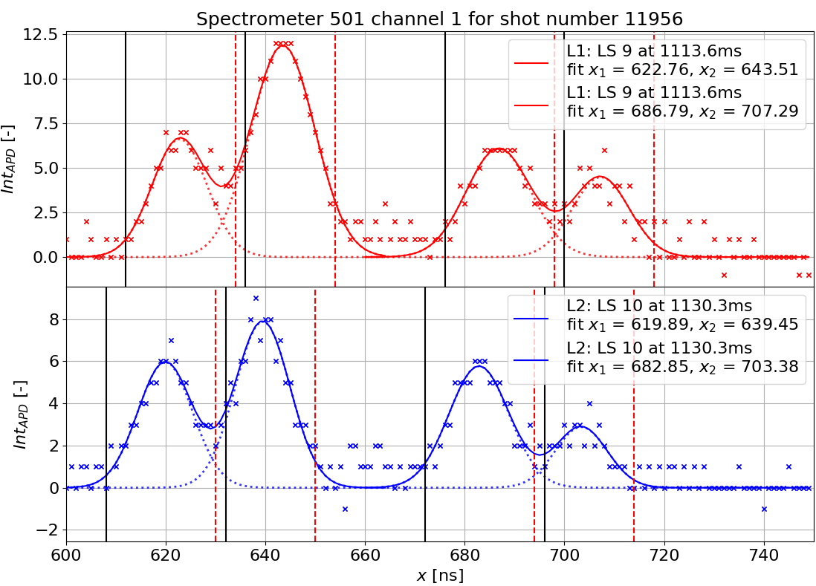
Stray light mitigation → laser misalignment
Distance (temporal) between useful signal and stray light ≈ 20 – 21 ns => 6 m
Miroslav Šos: Optimisation of processing raw data of the TS diagnostics / Marianska / 22. – 26. 1. 2018
12/19
Notes:
100 m vysoko, metru za sekundu.

Slide 16
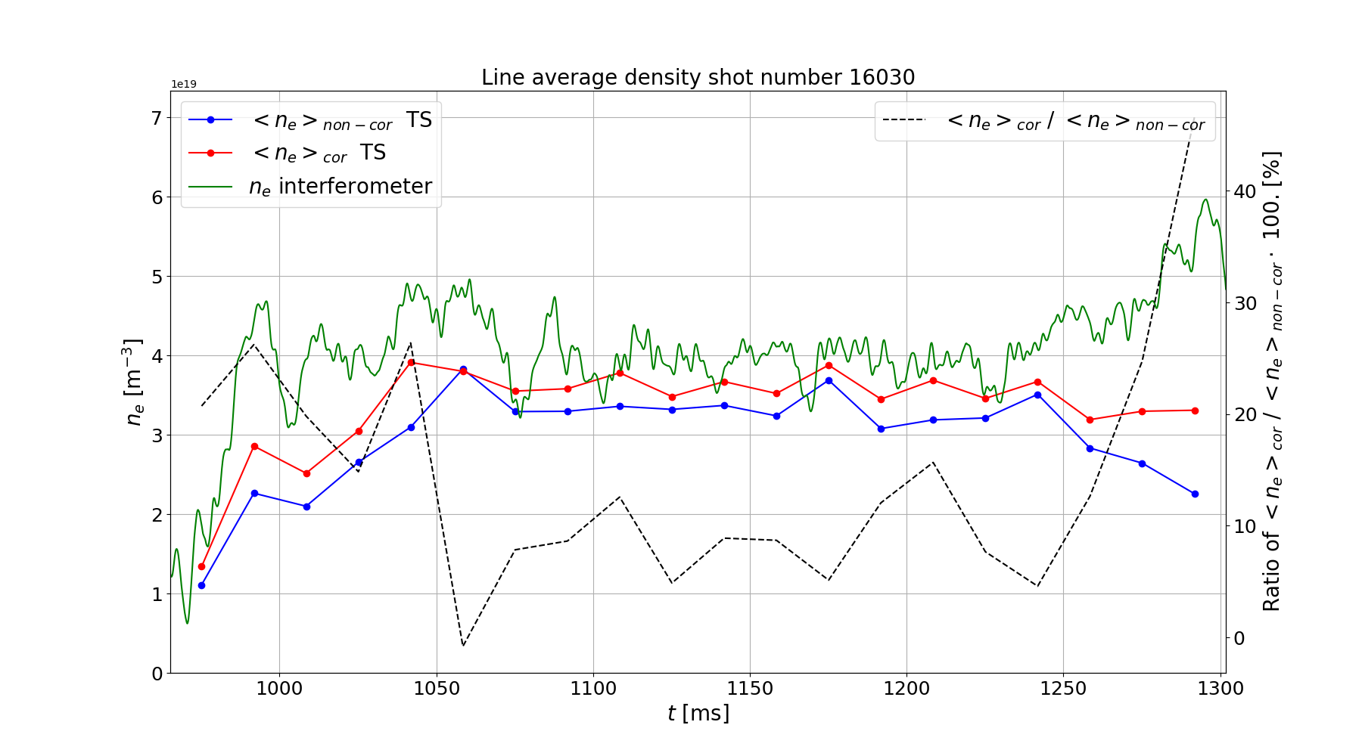
Inconsistency with interferometric measurements
=> corrections on plasma shape (elongation) has been implemented
Miroslav Šos: Optimisation of processing raw data of the TS diagnostics / Marianska / 22. – 26. 1. 2018
13/19
Notes:
100 m vysoko, metru za sekundu.

Slide 17
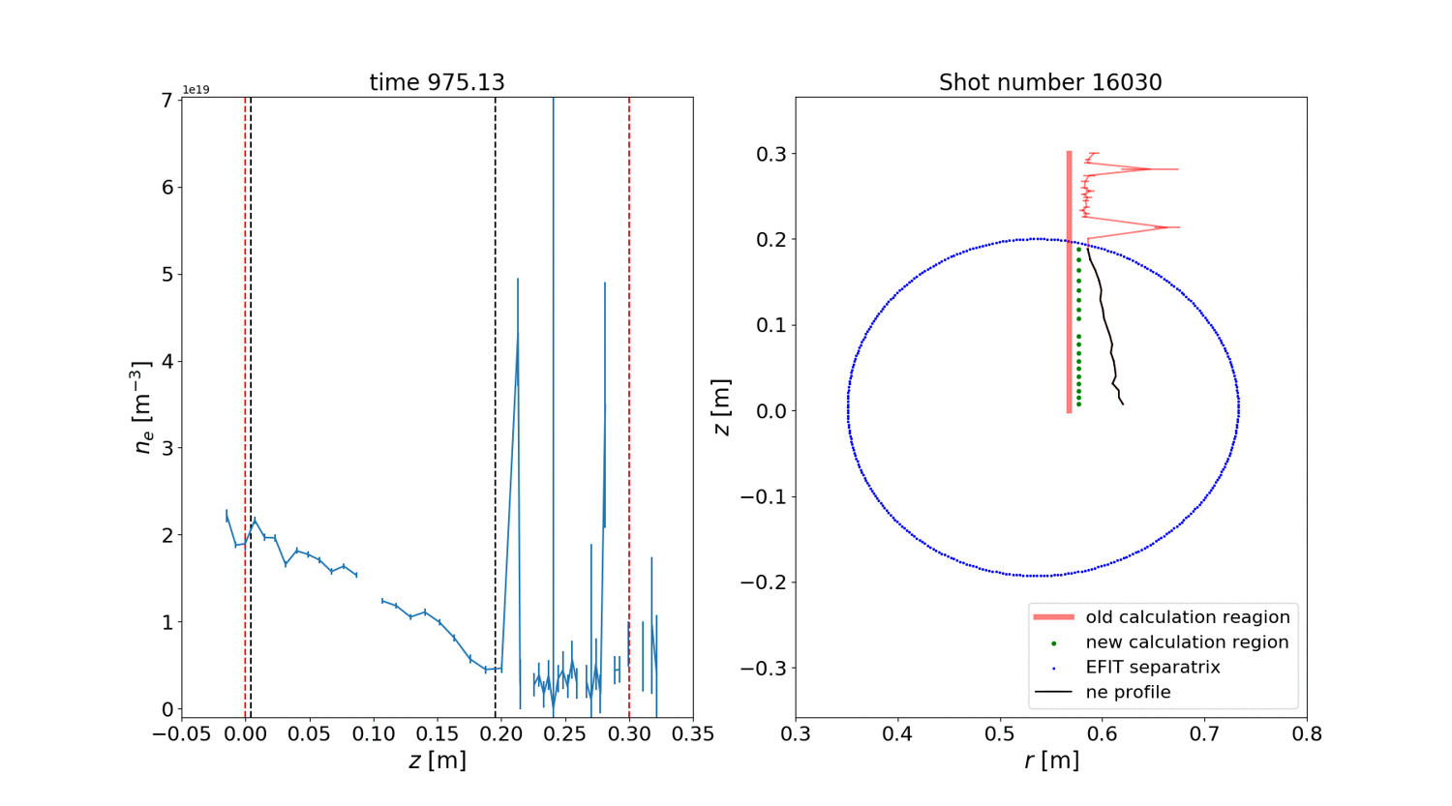
with correction
without correction
Red color = region without correction
Black color = region with correction
Miroslav Šos: Optimisation of processing raw data of the TS diagnostics / Marianska / 22. – 26. 1. 2018
14/19
Notes:
100 m vysoko, metru za sekundu.

Slide 18
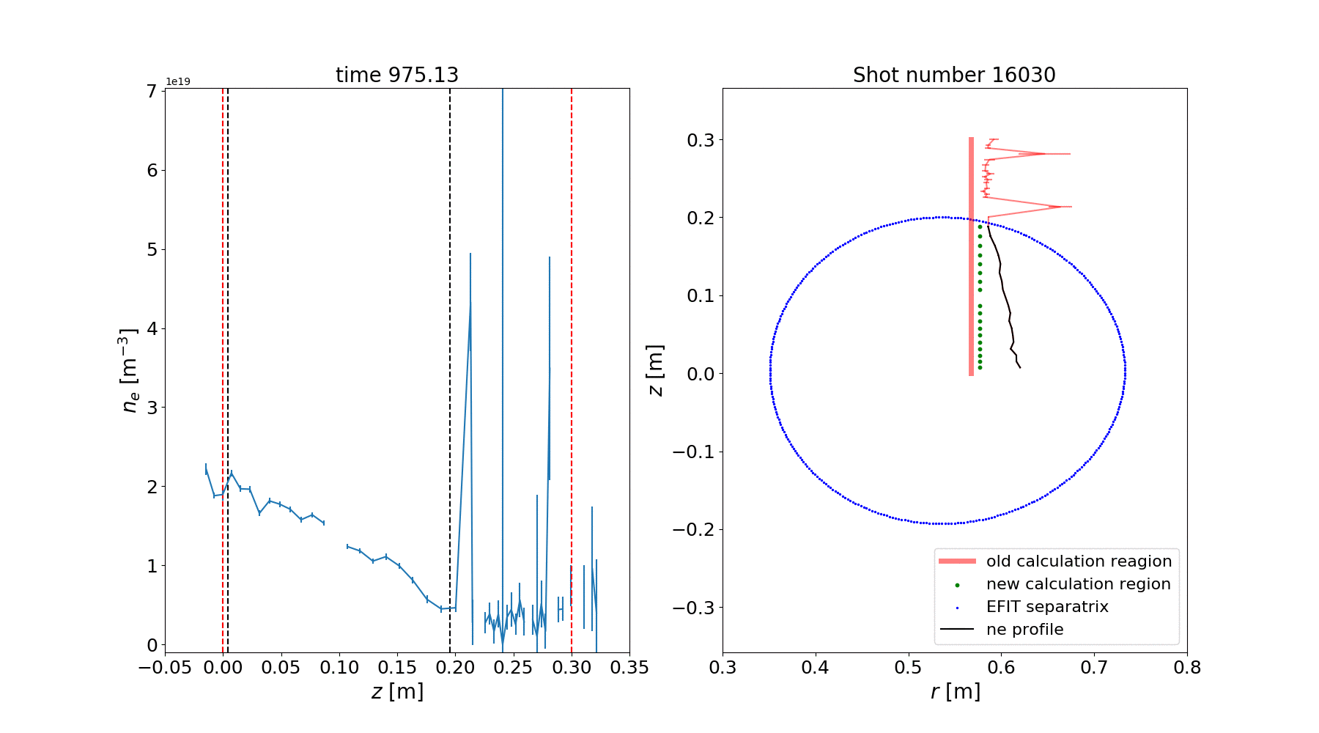
Works fine when for L-mode with standard plasma density
Miroslav Šos: Optimisation of processing raw data of the TS diagnostics / Marianska / 22. – 26. 1. 2018
14/19
Notes:
100 m vysoko, metru za sekundu.

Slide 19
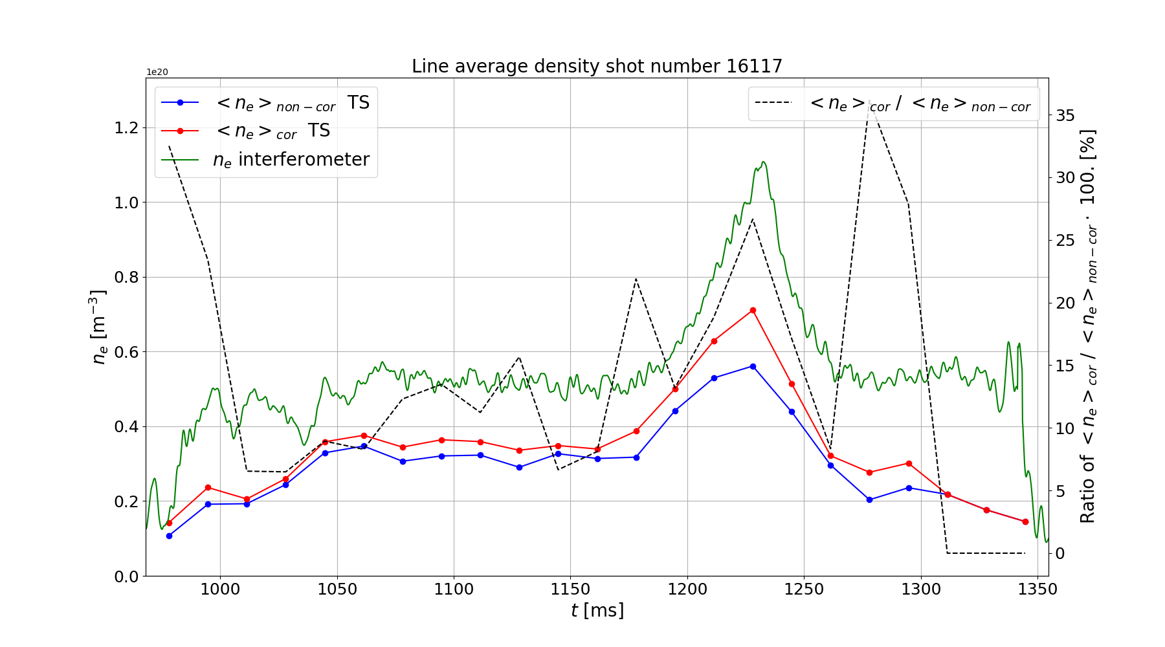
Miroslav Šos: Optimisation of processing raw data of the TS diagnostics / Marianska / 22. – 26. 1. 2018
15/19
Notes:
100 m vysoko, metru za sekundu.

Slide 20
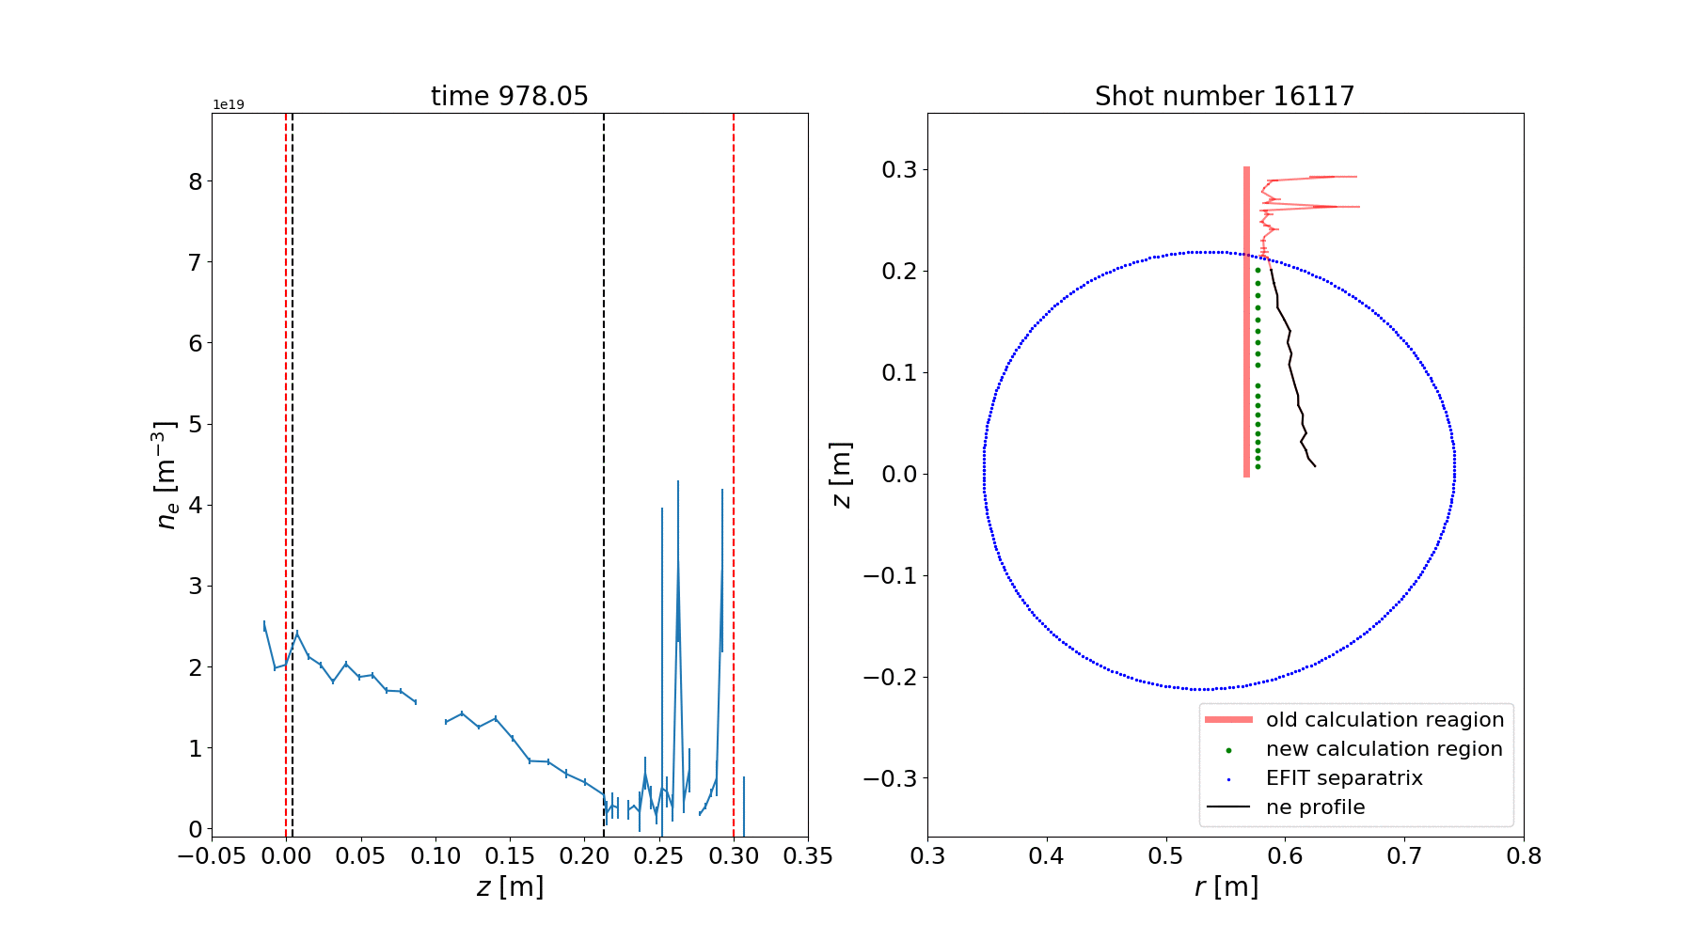
For the case of H-mode → whole pedestal becomes cut off
Strong impact of EFIT calculation
Spatial calibration control and revision
Miroslav Šos: Optimisation of processing raw data of the TS diagnostics / Marianska / 22. – 26. 1. 2018
16/19
Notes:
100 m vysoko, metru za sekundu.

Slide 21
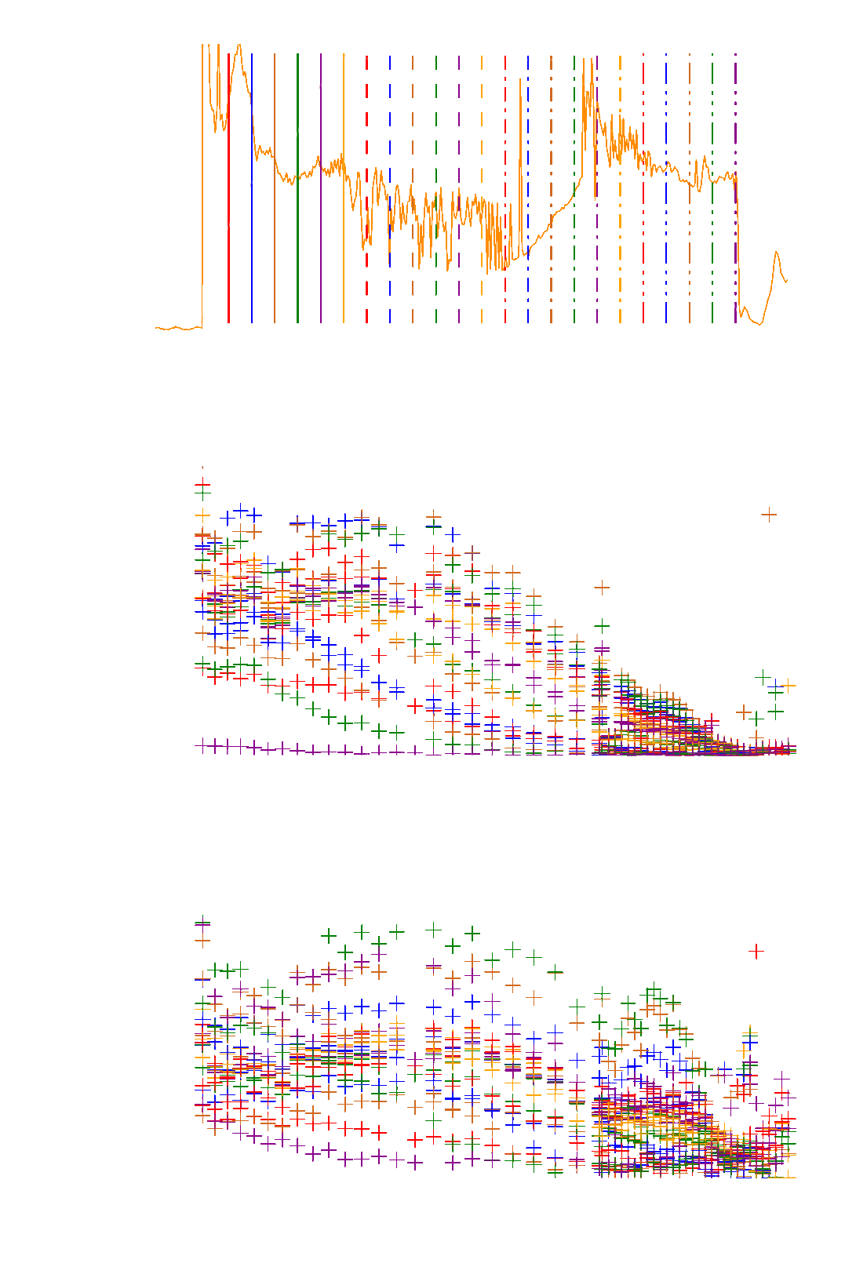
Further directions of optimisation process:
Mitigation of gaps or jumps in electron temperature and density profiles
→ Robust fitting during spectrum reconstruction
→ Saturated or non-functional channels remove from calculation
→ Revision and verification of spectral calibration
Miroslav Šos: Optimisation of processing raw data of the TS diagnostics / Marianska / 22. – 26. 1. 2018
17/19
Notes:
100 m vysoko, metru za sekundu.

Slide 22
Further directions of optimisation process:
Mitigation of gaps or jumps in electron temperature and density profiles
Elimination of configuration within the code and using redundant files
Miroslav Šos: Optimisation of processing raw data of the TS diagnostics / Marianska / 22. – 26. 1. 2018
18/19
Notes:
100 m vysoko, metru za sekundu.

Slide 23
Further directions of optimisation process:
Mitigation of gaps or jumps in electron temperature and density profiles
Elimination of configuration within the code and using redundant files
Correct provisional solutions and non-optimal patches
Miroslav Šos: Optimisation of processing raw data of the TS diagnostics / Marianska / 22. – 26. 1. 2018
18/19
Notes:
100 m vysoko, metru za sekundu.

Slide 24
Further directions of optimisation process:
Mitigation of gaps or jumps in electron temperature and density profiles
Elimination of configuration within the code and using redundant files
Correct provisional solutions and non-optimal patches
Aim to create simplified and clearly arranged data proccesing system
Miroslav Šos: Optimisation of processing raw data of the TS diagnostics / Marianska / 22. – 26. 1. 2018
18/19
Notes:
100 m vysoko, metru za sekundu.

Slide 25
Thomson scattering theory and realization of the diagnostics described
Data acquisition process shown
→ Structure and content of data
Data processing scheme
Some methods of optimisation presented
→ Double Gaussian fitting
→ Line-averaged density
Plans and goals for the future
Miroslav Šos: Optimisation of processing raw data of the TS diagnostics / Marianska / 22. – 26. 1. 2018
19/19

Slide 26
Thomson scattering theory and realization of the diagnostics described
Data acquisition process shown
→ Structure and content of data
Data processing scheme
Some methods of optimisation presented
→ Double Gaussian fitting
→ Line-averaged density
Plans and goals for the future
Thank you for your attention
Miroslav Šos: Optimisation of processing raw data of the TS diagnostics / Marianska / 22. – 26. 1. 2018
19/19

Slide 27
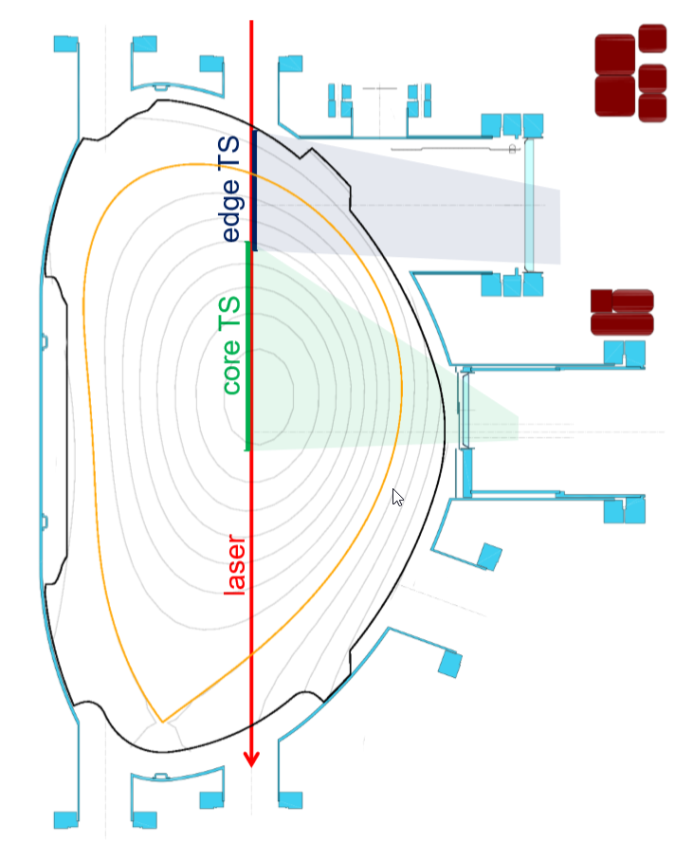
 | Core TS | Edge TS
Field of view | -17 – 211 mm | 215 – 322 mm
Spatial points | 24 | 30
Resolution | 9 – 12 mm | 3.5 – 4.0 mm
Thomson scattering on the COMPASS tokamak – field of view [Bohm, 2017]
Miroslav Šos: Optimisation of processing raw data of the TS diagnostics / Marianska / 22. – 26. 1. 2018
Notes:
100 m vysoko, metru za sekundu.

Slide 28
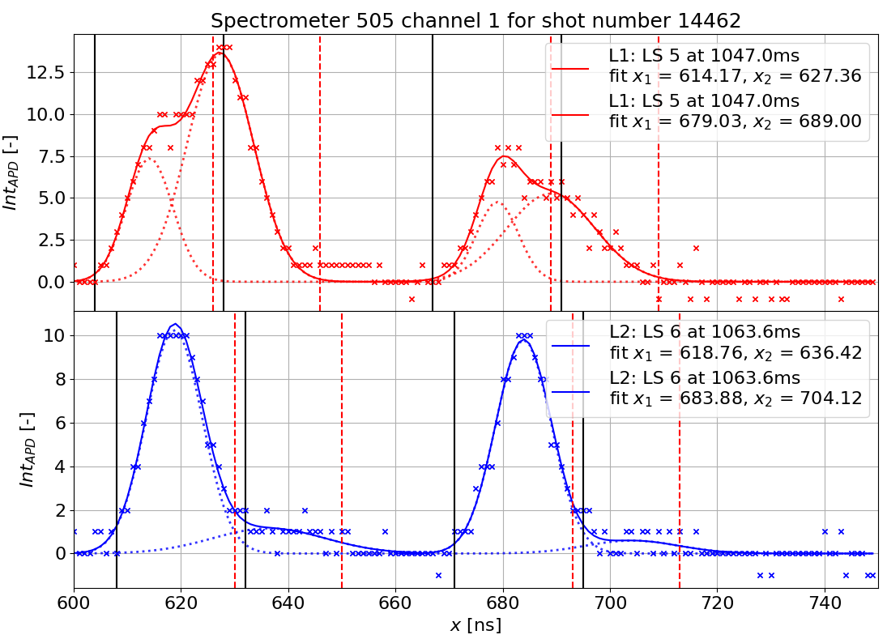
Miroslav Šos: Optimisation of processing raw data of the TS diagnostics / Marianska / 22. – 26. 1. 2018
Notes:
100 m vysoko, metru za sekundu.

Slide 29
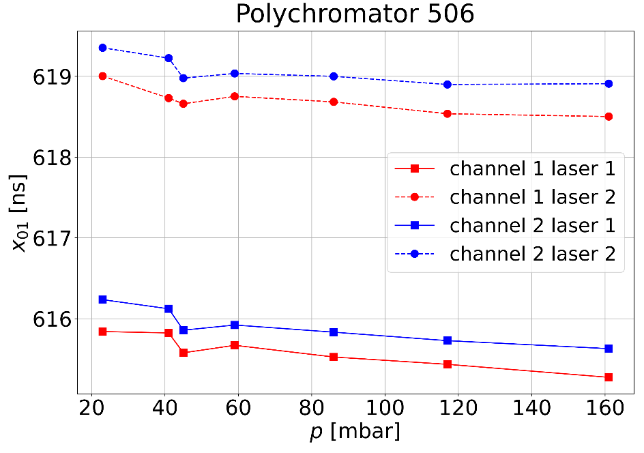
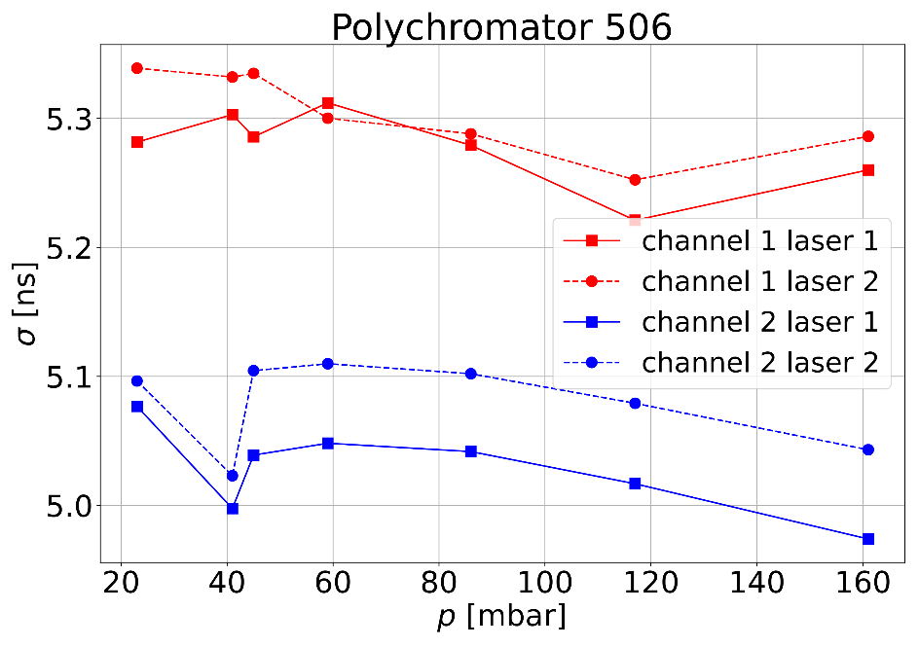
Raman calibration provides tool for absolute calibration
Raman scattering in proper gas (Nitrogen)
Fast signal is similar to TS signal
→ Analysis if fitted parameters from Raman could be used in TS fitting?
Position $x01$and width $σ1$
Channel
dependent
Laser dependent
Miroslav Šos: Optimisation of processing raw data of the TS diagnostics / Marianska / 22. – 26. 1. 2018
Notes:
100 m vysoko, metru za sekundu.

