Slide 1
He-beam diagnostics
J. Krbec, M. Tomeš, J. Seidl Winter workshop PTTF 22. 1. 2018 - 26. 1. 2018
J. Krbec
1/13

Slide 2
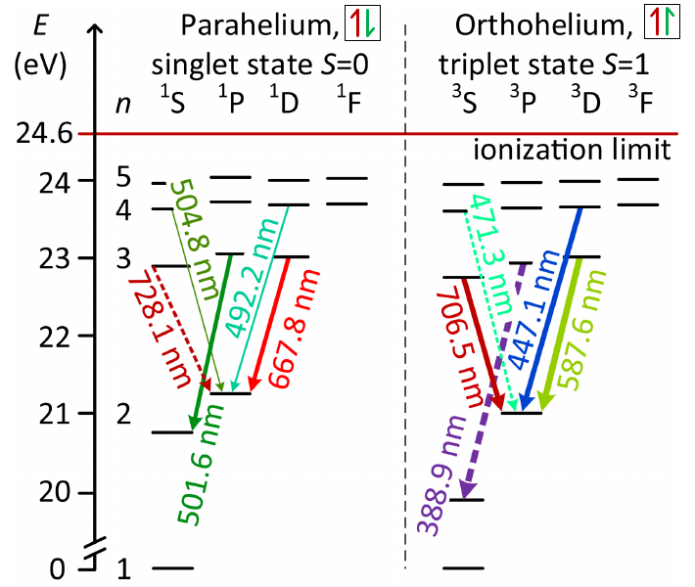
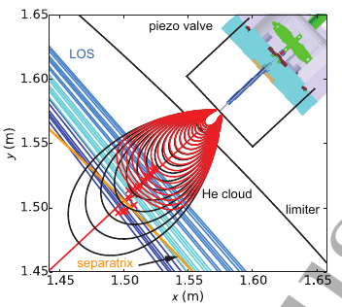
He-beam concept
Helium puff - thermal/supersonic beam (local thermal equilibrium given by relaxation time)
10 transition lines in visible spectra
21 different ratios,3 T/T 12 S/T, 6 S/S
T_{e} ~ singlet/triplet, n_{e} ~ singlet/singlet (no absolute calibration needed)
T_{e} , n_{e} sensitivity analysis done in [1] (for 5 eV<T_{e} <130 eV, 1e18<n_{e}<4e19 m⁻³ [1] choice: T_{e} = 501/587, n_{e} = 501/504 (504 is weakest line) Standart: T_{e} = 728/706, n_{e} = 668/728
[1] Griener, Michael Thomas, et al. "Qualification and implementation of line ratio spectroscopy on helium as plasma edge diagnostic at ASDEX Upgrade." PPCF (2017).
J. Krbec
2/13
Notes:
Paco tabares

Slide 3
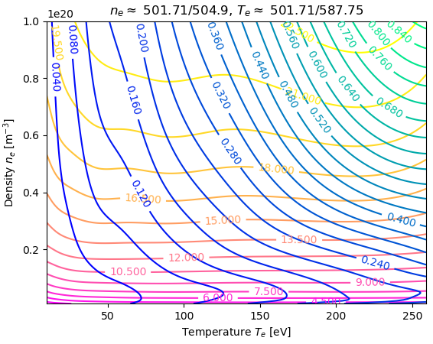
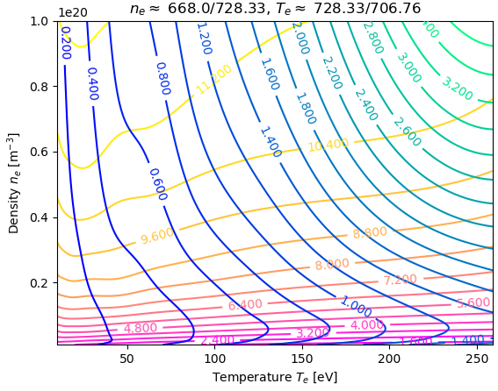
Photon emissivity coefficient
Emissivity for i→j transition: ε_{ij}=n_{He}(x,t)n_{e}(x,t)PEC_{ij}(n_{e},T_{e})
n_{He}(x,t) - given by transport models
PEC stored in ADAS database: pec96#he_pju#he0.dat
Hybrid code exists [2] but only the ADAS produce self consistent ne and Te profiles
[2] Muñoz Burgos, J. M., et al. "Hybrid time dependent/independent solution for the He I line ratio temperature and density diagnostic for a thermal helium beam with applications in the scrape-off layer-edge regions in tokamaks." Physics of Plasmas 19.1 (2012): 012501.
J. Krbec
3/13
Notes:
Nevertheless, only the ADAS results are suitable to describe the n e and T e profiles within one model to deliver self consistent results. In contrast to that, the hybrid code without high Ry is good suitable for T_{e} evaluation whereas the inclusion of the high Ry states in necessary for the n_{e} reconstruction.

Slide 4
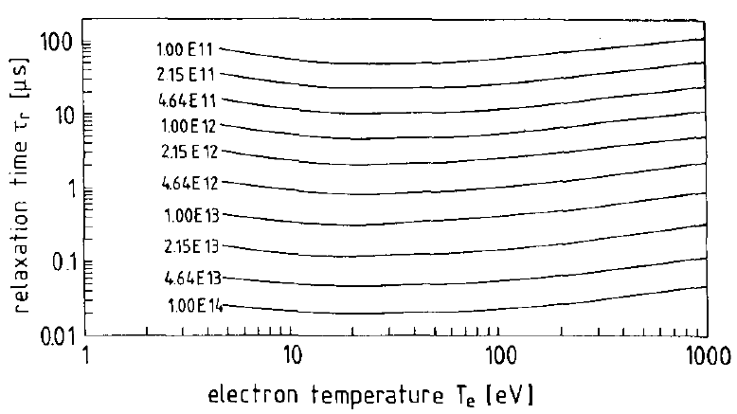
Relaxation time τ_{r}
and penetration depth D_{p}
Temporal resolution given by relaxation time τ_{r} (if signal from He-beam dominates background radiation)
Spatial resolution given by relaxation length l_{r} = v_{b}*τ_{r} where v_{b} is mean velocity of helium atoms (no difference between Maxwellian distribution and monoenergetic beam for 10<T_{e}<1e3 eV, 1e17<n_{e}<1e20 m⁻³ [2])
No recombination processes are taken into account
Density limit: lower limit determined by relaxation length, upper limit by penetration depth
Slowest τ_{r} for 150 °C beam calculated in [3]
[3] Schweer, B., et al. "Electron temperature and electron density profiles measured with a thermal He-beam in the plasma boundary of TEXTOR." Journal of nuclear materials 196 (1992): 174-178.
J. Krbec
4/13

Slide 5
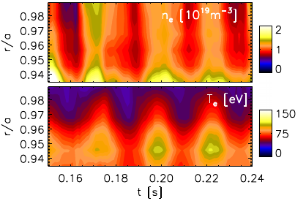
Machines with He-beam
Thermal 150° (TEXTOR 1992) - density and temperature profile:
Temporal resolution 10 ms, spatial resolution up to 1 mm (n_{e} > 5x10¹⁸)
Penetration depth D_{p} = 2x10¹³ cm⁻¹, (current 4x10¹⁸ atoms/s)
Supersonic (TJ-II 2004) - density and temperature profile:
pulsed fast piezoelectric valve
Temporal resolution 5 ms
Fast Thermal for fluctuations (RFX-mod 2015):
Temporal resolution given by relaxation time 5us
Fast thermal (ASDEX 2018):
Temporal resolution 900 kHz, spatial resolution radial 3-7 mm, poloidal 3-4 mm
designed for densities 1x10¹⁸ - 4x10¹⁹ , temperatures 5 - 250 eV, S/BG = 100 (2.3 ms exposition time - spectrometer)
J. Krbec
5/13

Slide 6
Summary
High temporal and spatial resolution
Te and ne simultaneous measurement
No absolute calibration needed
No reconstruction code needed
Low penetration depth
Transport code needed for simulation
CRM needed for penetration depth and relaxation time calculation
J. Krbec
6/13

Slide 7
He-beam
COMPASS-U
J. Krbec
7/13

Slide 8
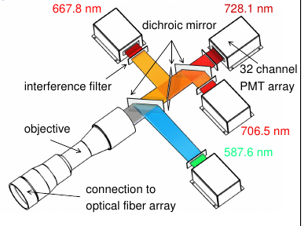
He-beam on COMPASS-U?
Helium puff imaging
Fast 2D simultaneous measurement of electron density and temperature
He puff and Li-beam on the midplane, separated toroidally by small angle
Perpendicular view
1 (Li) + 3 (He) optical filters
I-mode diagnostic? (density limit)
Li-beam
J. Krbec
8/13

Slide 9
He-beam
GOLEM measurement
J. Krbec
9/13

Slide 10
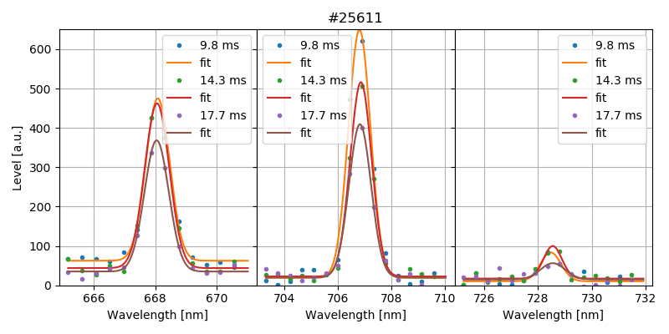
He-beam: GOLEM measurement
Density scan with He + 2 H shots (non-local measurement with spectrometer HR2000+ES)
Shots: 20 in total, 14 successful (70 %)
Task 1: to observe He-lines and estimate intensity ratio during discharge
“ASDEX” lines covered by N II lines (500.5, 504.5) - classic set of lines used
Task 2: Calculate n_{e} and T_{e} and compare it with interferometer and temperature estimate
J. Krbec
10/13

Slide 11
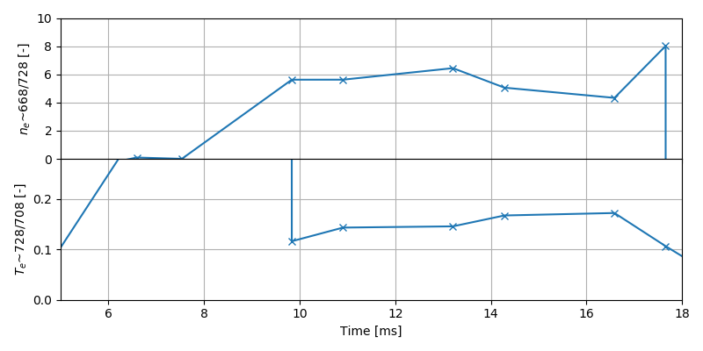
He-beam: GOLEM measurement
Density scan with He + 2 H shots (non-local measurement with spectrometer HR2000+ES)
Shots: 20 in total, 14 successful (70 %)
Task 1: to observe He-lines and estimate intensity ratio during discharge
“ASDEX” lines covered by N II lines (500.5, 504.5) - classic set of lines used
Task 2: Calculate n_{e} and T_{e} and compare it with interferometer and temperature estimate
J. Krbec
11/13

Slide 12
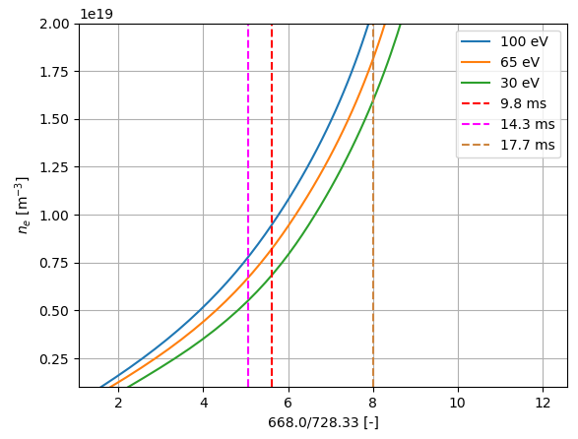
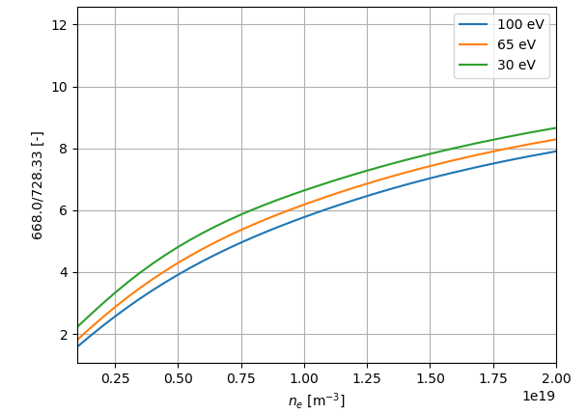
He-beam: GOLEM measurement
Density scan with He + 2 H shots (non-local measurement with spectrometer HR2000+ES)
Shots: 20 in total, 14 successful (70 %)
Task 1: to observe He-lines and estimate intensity ratio during discharge
“ASDEX” lines covered by N II lines (500.5, 504.5) - classic set of lines used
Task 2: Calculate n_{e} and T_{e} and compare it with interferometer and temperature estimate
J. Krbec
12/13

Slide 13
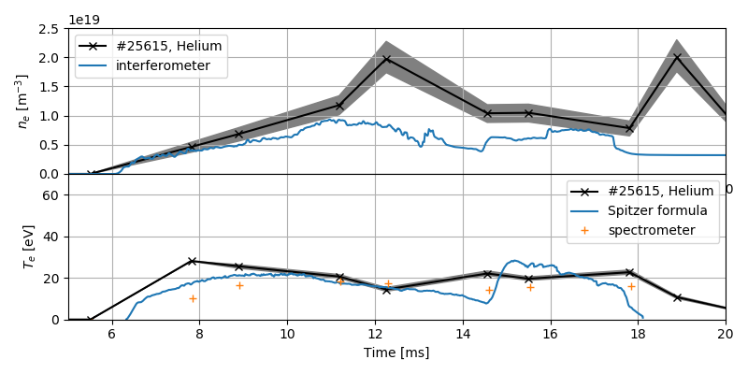
He-beam: GOLEM measurement
Density scan with He + 2 H shots (non-local measurement with spectrometer HR2000+ES)
Shots: 20 in total, 14 successful (70 %)
Task 1: to observe He-lines and estimate intensity ratio during discharge
“ASDEX” lines covered by N II lines (500.5, 504.5) - classic set of lines used
Task 2: Calculate n_{e} and T_{e} and compare it with interferometer and temperature estimate
J. Krbec
13/13

