Slide 1
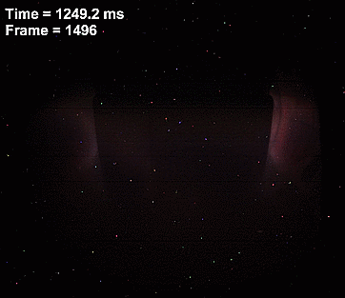
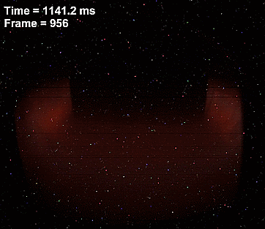
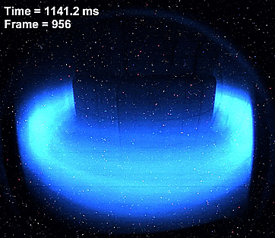
1/2 Runaway electron beams in COMPASS
O Ficker, E. Macúšová, J. Mlynář, RE & COMASS teams
2/2 W impurity influx due to 1,1 mode in JET
O Ficker, J Graves, M Raghunathan, M Imríšek & JET team
^{FTTF workshop – Mariánská 2018}
Notes:
100 m vysoko, metru za sekundu.

Slide 2
Outline
RE beams at COMPASS:
Motivation to study RE & Introduction
Generation mechanisms, Disruptions
RE beams on COMPASS – interesing topics:
Ramp-up MGI scenario
Role of Bt and q_edge, gas species
On the long way to power balance
Impurity influx due to 1,1 mode at JET
Another large issue for ITER, but nice physics ☺
Modelling (J Graves et al, SPC Lausanne)
Analysis of SXR experimental data by our tomography code
Running electron
JET SXR
Notes:
100 m vysoko, metru za sekundu.

Slide 3
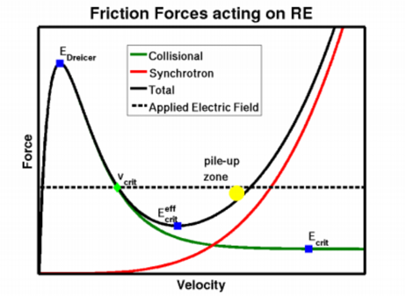
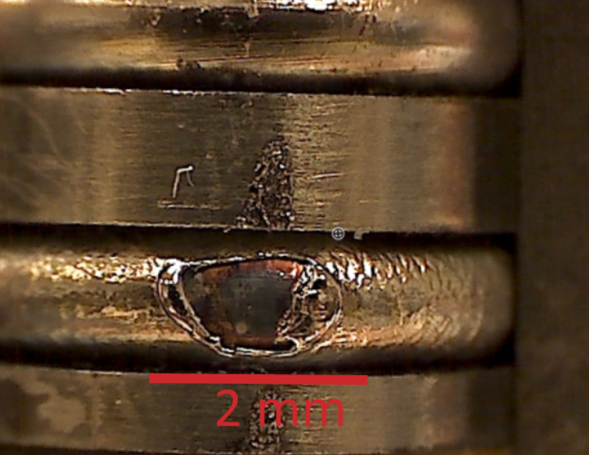
What are runaway electrons?
RE = relativistic electrons present in plasma due to imbalanced acceleration and friction forces
Toroidal E field – present in tokamaks
Collisional friction force – func of n_{e} ant T_{e}
Low density and high electric field is risky
breakdown, disruption, …
MeV energies and large currents achievable
Significant destructive potential -> ITER
Research on almost all tokamaks
Special diagnostic methods (see talks by M. Farník, J. Čeřovský)
Courtesy of M Vlainic
29.01.2018
RE COMPASS O FICKER
3
Notes:
100 m vysoko, metru za sekundu.

Slide 4
Generation mechanisms explained
Typical for small tokamaks
High Electric field
Short time scale
Occurs during large disruptions
The faster T loss – the worse
Exponential multiplication
Longer time scale, large machines
4
Notes:
100 m vysoko, metru za sekundu.

Slide 5
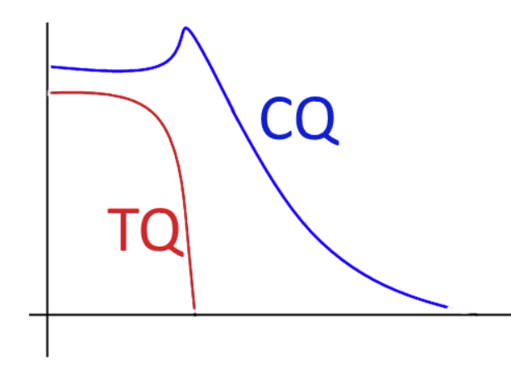
Disruption and RE beams
Disruption = sudden loss of energy confinement, temperature (TQ) and plasma current (CQ)
Common in tokamaks, but in ITER must be avoided or well mitigated
Consequences:
Large forces (-> vessel, support structure, coils)
Local overheating of plasma facing components
Large electric field -> Generation of RE beam (up to 70% of predisruptive current)
Mitigation necessary:
Increase the radiated fraction of energy – inject large amount of gas, pellets, etc.
RE generation avoidance/mitigation not yet solved
Some mitigation methods make RE beam much worse
Mitigation of RE – error fields/RMP may help
Conductive vessel seems to be beneficial
Notes:
100 m vysoko, metru za sekundu.

Slide 6
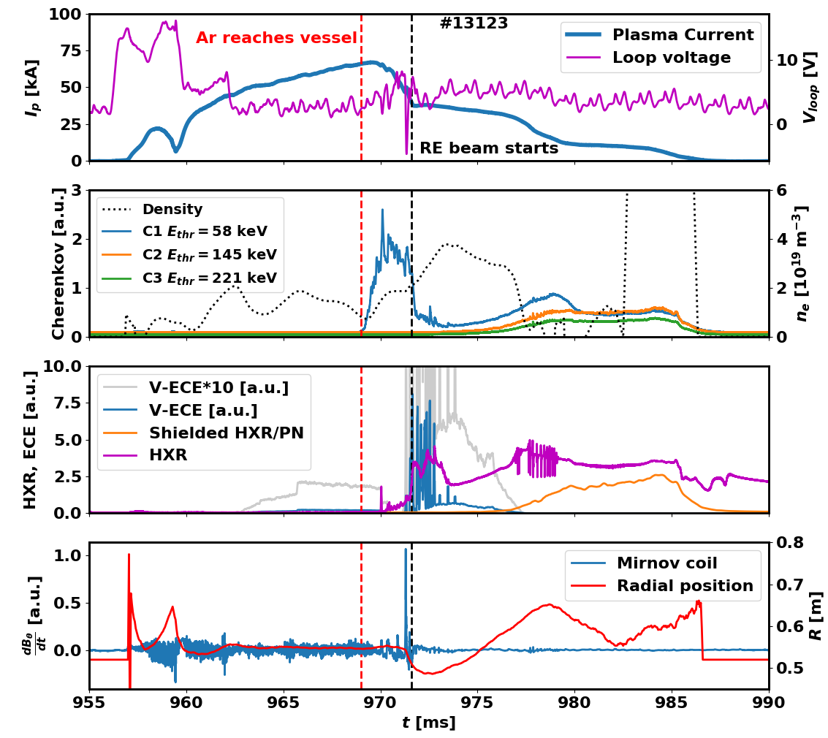
Ramp-up MGI I –
Overview
Observed results of Ar injection
Disruption with no beam
Classical RE plateau
Slow decay of full current RE beam
Parameters
B_{t}=1.15 T, I_{p}=70 kA, q_{a}>5
n_{e}=1e19 m⁻³, T_{e}=500 eV
Interesting features
Large CH1 Cherenkov signal during CQ and drop after beam creation
Mirnov coil, loop voltage, HXR and CH1 spikes during CQ – rational surfaces destroyed?
Gradual increase of Cherenkov signals, decrease of CH1 at 980 ms
ECE, CH1 and Mirnov spikes in early beam phase – filaments – “new” RE?
Notes:
100 m vysoko, metru za sekundu.

Slide 7
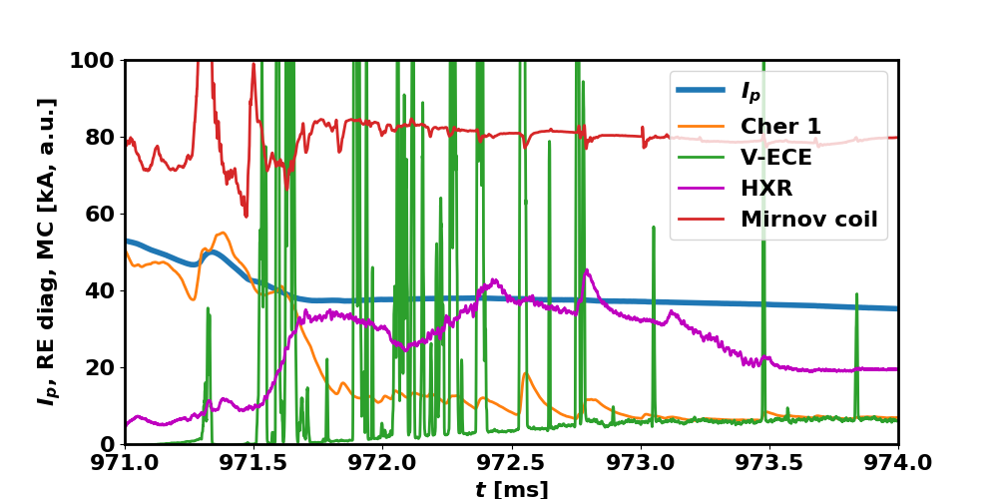
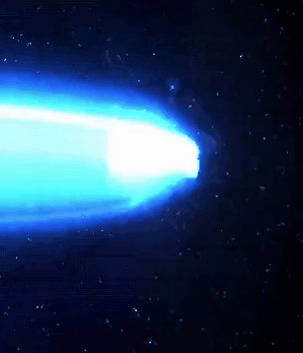
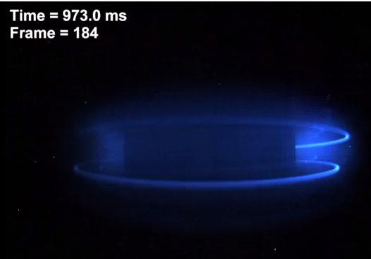
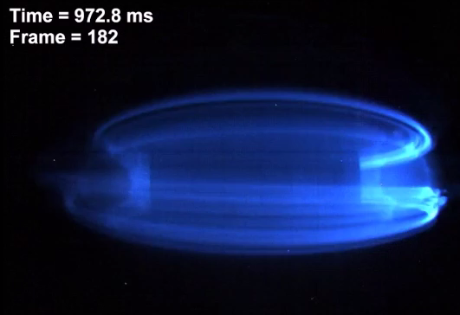
Ramp-up MGI II –
CQ, filaments and beam edge instability
Filaments and spikes in ECE and Cherenkov signals in early beam phase – seems to be correlated
Turbulence-like instability of RE beam edge later in the beam phase – decay mechanism?
Notes:
100 m vysoko, metru za sekundu.

Slide 8
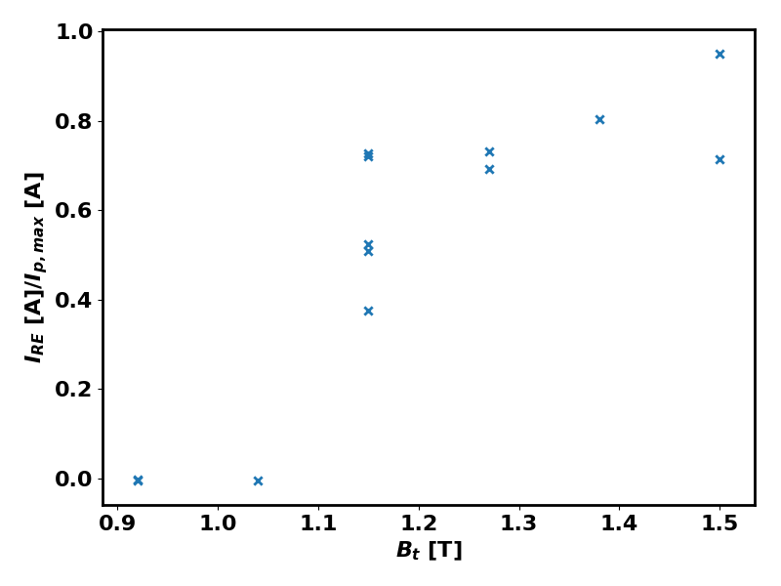
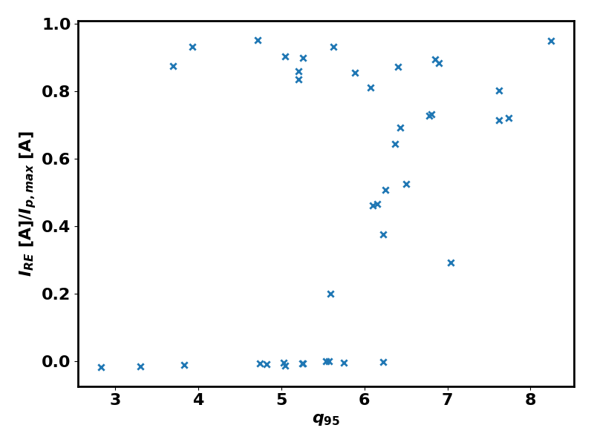
Toroidal field influence – why?
SLOW DECAY
NO BEAM
STRONG BEAM
B_{t} scan in the last campaign
Reliable scenario, no changes
Threshold for beam generation around 1.1 T - unlike 2 T in (Zeng, PRL 2013)
Thresholds very inconsistent among machines…
q₉₅ seems to be an important parameter
Affects the duration of gas penetraition (TCV)
Relative beam current also at JET (Reux, EPS 2017)
MHD turbulence -> promt losses?
Notes:
100 m vysoko, metru za sekundu.

Slide 9
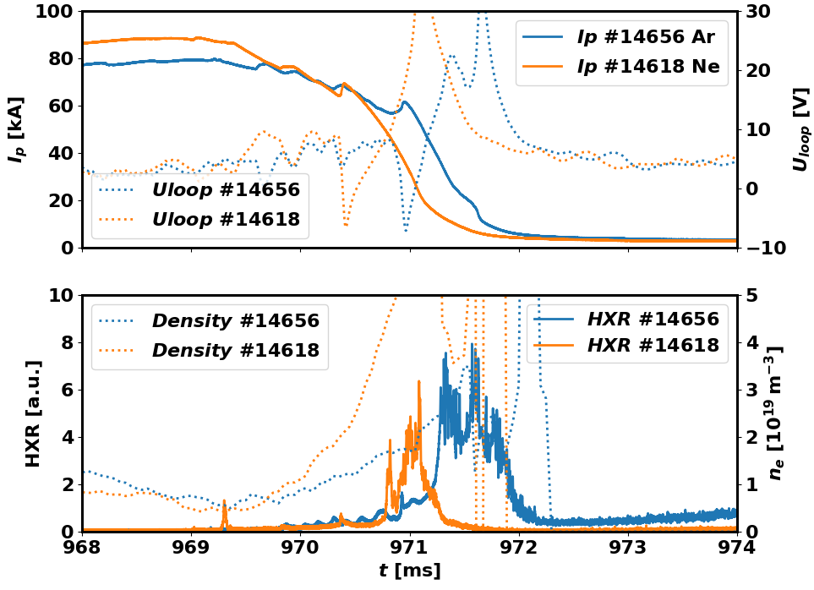
Ramp-up MGI IV:
Ar vs Ne penetration
Ne injection seems to result only in 2 options (disruption without a plateau and full Ip beam) – no classical RE plateau with Ne achieved!
Ne seems to penetrate as a blob while Ar spreads poloidally from the very beginning
Comparison: injection & no plateau generation for both gasses:
Ne
Ar
Notes:
100 m vysoko, metru za sekundu.

Slide 10
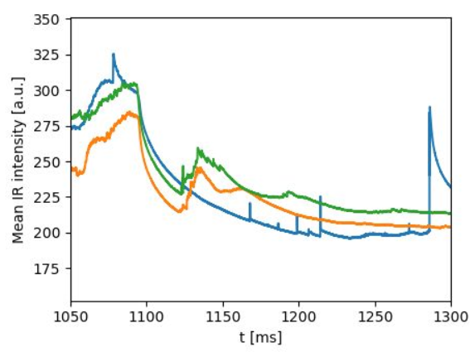
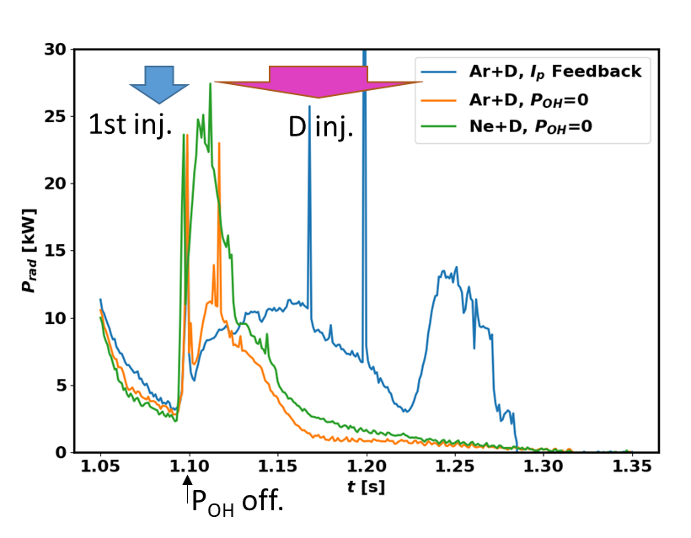
Holy grail – power balance of RE beam
Power in:
Ohmic Power $P_{OH}=U_{L}I_{RE}$
Magnetics but not trivial…
Other possible terms like ECRH etc.
Energy:
Kinetic energy $E_{k}=\int{\left(γ−1\right)m_{e}c^{2}}v^{2}\text{f}\text{(}v\text{)}dv$
Hard… HXR spectroscopy, synchrotron spectroscopy, feedback response, ECE
Magnetic energy $E_{M}=\frac{1}{2}LI_{RE}^{2}$
L is poorly known -> current profile of the beam…
Power out:
Radiated power (Interaction with gas, synchrotron, bremsstrahlung, …) – bolometers and tangential IR camera, HXR from plasma
Lost electrons – heat fluxes on the wall (can be localized – misaligned limiters, intentional movement, etc.) -> IR camera(s)
29.01.2018
RE COMPASS O FICKER
10
Notes:
100 m vysoko, metru za sekundu.

Slide 11
Impurity accumulation due to MHD instabilities in JET
Impurity accumulation – critical performance limiting factor in tokamaks, much worse in metallic wall machines (JET, ITER)
JET: W from divertor often travels to the core – major drop in fusion power, disruption (80+% of JET ILW disruptions due to IA)
Accumulaiton seems to be faster when perutrbations of magnetic equilibria occur – kink modes, fishbones, magnetic islands
Modelling:
Unperturbed MHD -> heavy impurities on LFS – centrifugal force
Perturbed MHD -> 3D effects seem to be able to push the W to core
Experiment:
SXR tomography (reconstruction of 2D radiation profiles) is the tool that can confirm such theory
Can we avoid this? – yes but it will be difficult:
Control of q profile – ramp-up Ip slopes, density, ECRH deposition, etc.
Control of frequency of instabilities – regular small saw-teeth and ELMs may throw out the heavy impurities

Slide 12
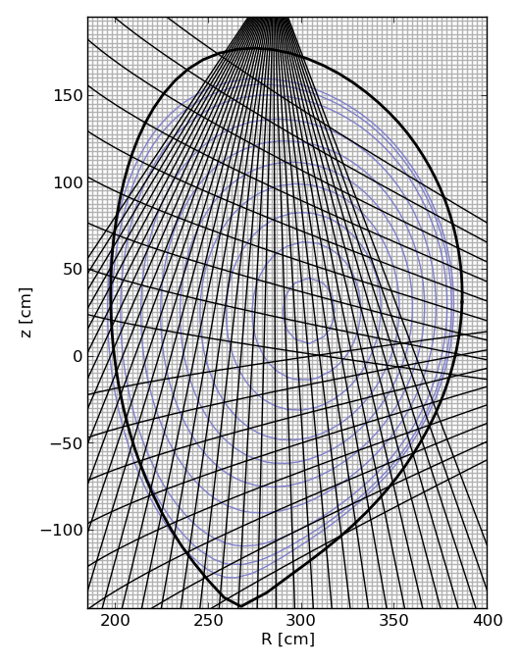
SXR tomography – brief introduction
Inverse problem – reconstruction of poloidal crossection from LOS measument
Applied to various detectors of radiation – SXR (1-20 kev), visible light, AXUV, neutrons, gammas
Analytical methods and numerical (pixel) methods
Numerical methods: ‘Solving of 50 equations with thousands of variables’
More constraints must be used – e.g. smoothness in preferred direction, density profile, etc
Our method: Minimum of Fisher information with preferred smoothing along the contours of mag. Surfaces
See talk by Jakub Svoboda

Slide 13
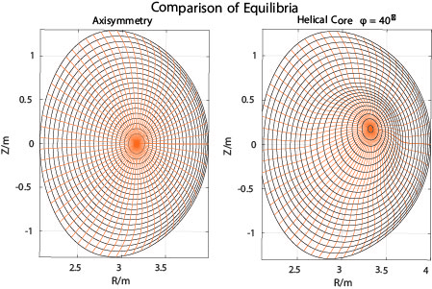
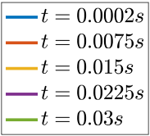
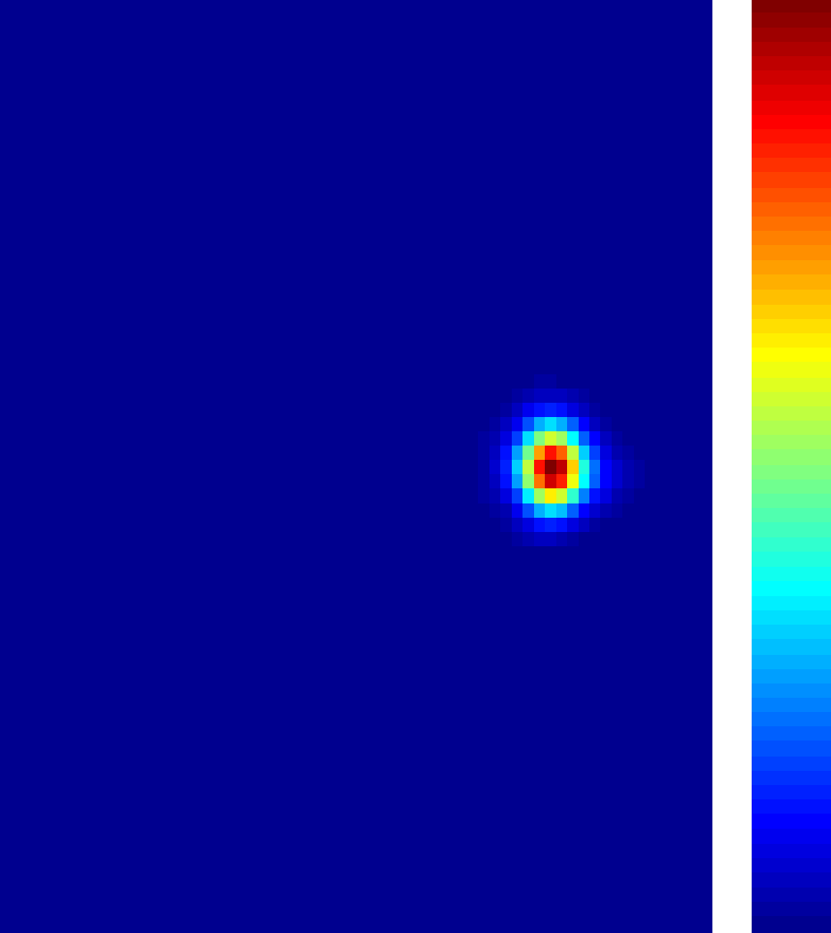
Modelling of Impurity Accumulation (SPC group)
Generate two otherwise similar VMEC fee boundary JET equilibria for comparison:
Axisymmetric
1/1 Kinked
Simulation of Axisymmetric Case
Start with W profile same as background ions
Slowly evolves to off axis peaking (centrifugal effects)
(Raghunathan, PPCF 2017)

Slide 14
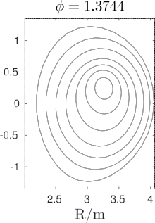
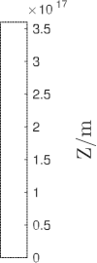
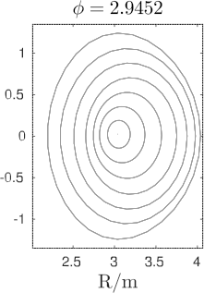
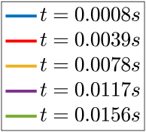
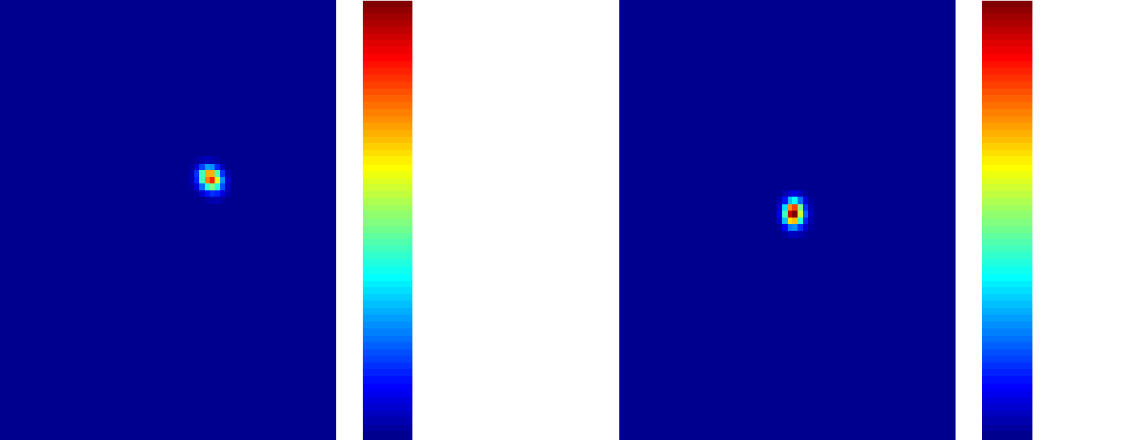
Impurity Accumulation 1/1 cont. mode
Simulation of 1/1 Kink mode Case
Start with W profile same as background ions
Rapidly evolves to on-axis peaking. Speed of evolution is determined by rotation amplitude.
Degree of on-axis peaking determined by amplitude of 1/1 mode and rotation.

Slide 15
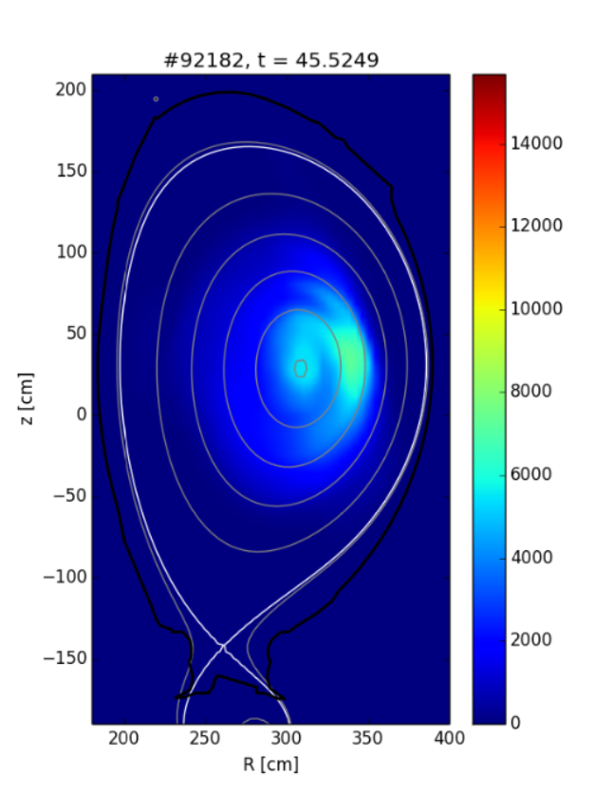
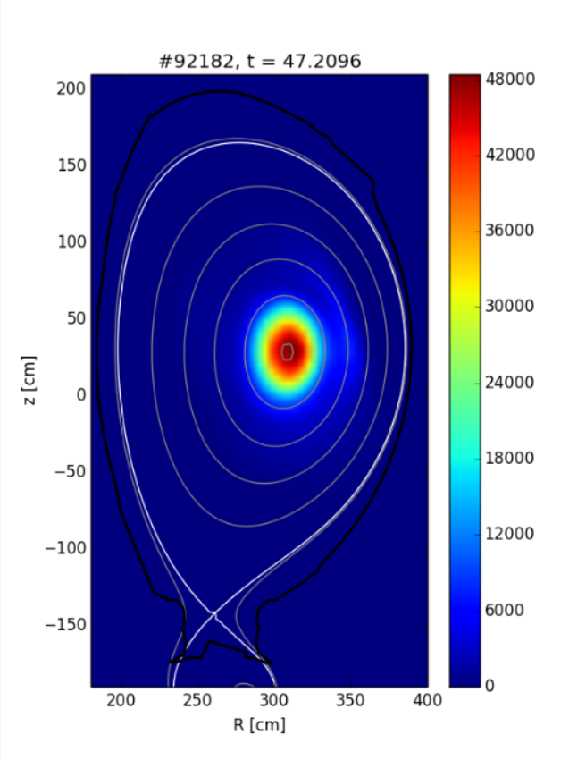
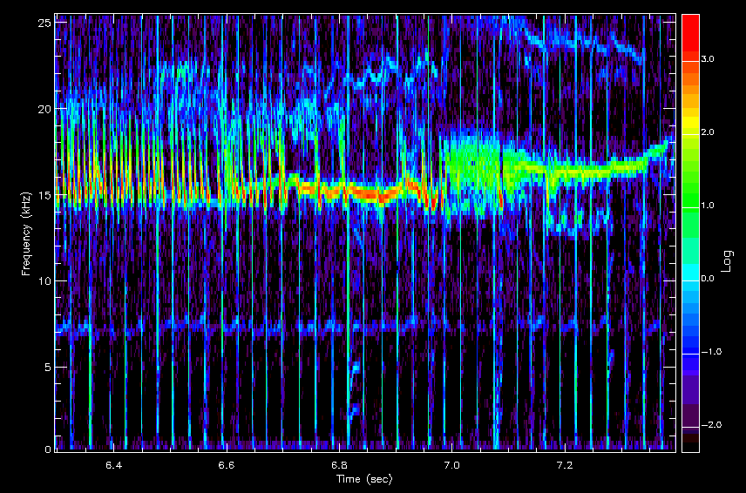
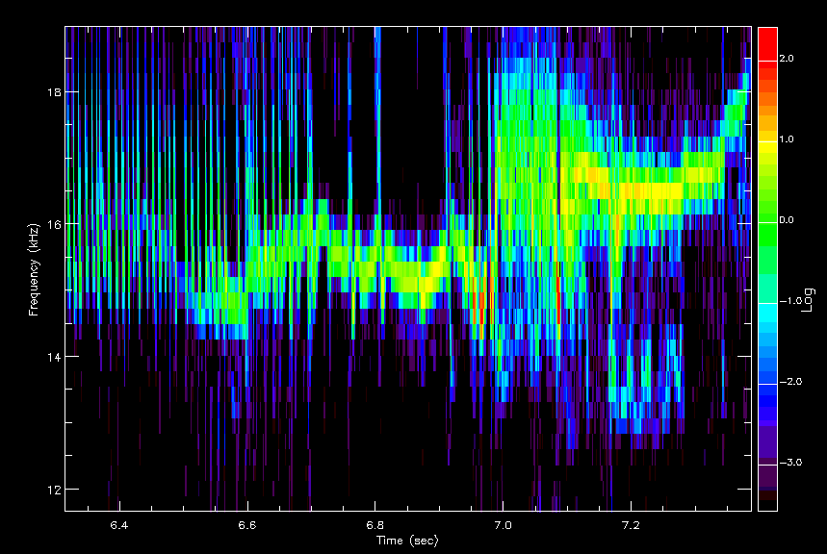
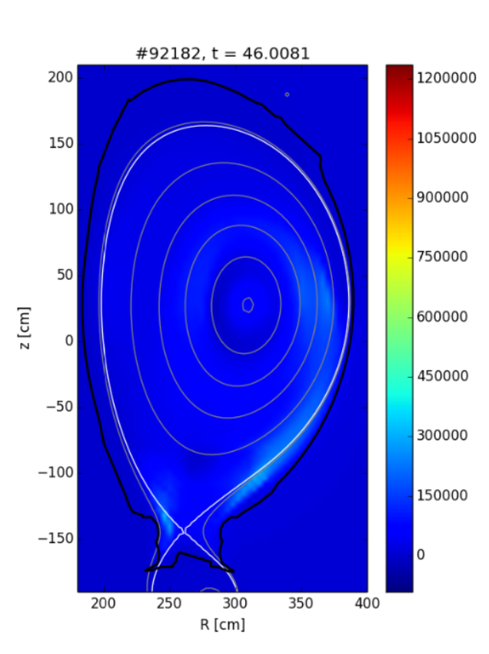
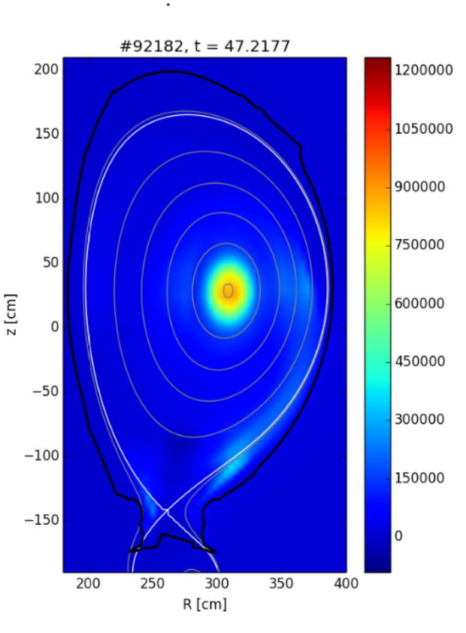
#92182 – influx due to 1,1
Before mode onset
After influx
92182
MHD coil spectrogram
SXR
SXR
SXR spectrogram
Bolo
Bolo
15

Slide 16
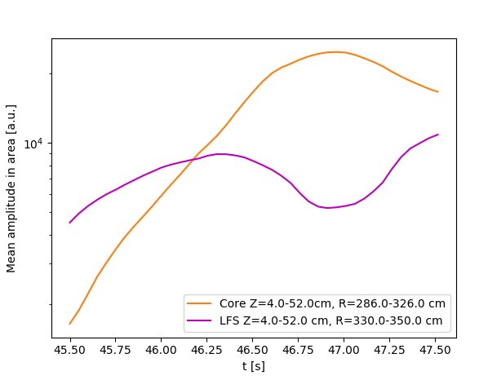
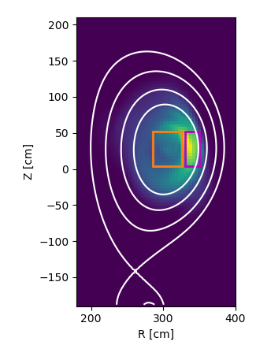
#92181 – influx due to 1,1
Time evolution of radiation from selected area
Useful for comparison of island/kink timing versus impurity influx nature
E.g. Pulse 92181 – SXR amplitude grows in both core and LFS region before 1,1 mode onset but drops on LFS and shoots up in core during the continuous 1,1 mode/fishbone existence
#92181
O Ficker et al | FTTF Mariánská | Page 16

Slide 17
Summary
Runaway electron beams at COMPASS:
RE beams big issue for ITER
COMPASS experiments offer different detailed view (fast cameras, instabilities, large database of discharges, flexible RMP, special diagnostics)
Impurity influx due to 1,1 mode at JET
Another large issue for ITER
Cooperation of modelling and SXR tomographic analysis
3D effects may play key role in tokamaks
Must be solved in future JET campaigns
Notes:
100 m vysoko, metru za sekundu.

