Slide 1
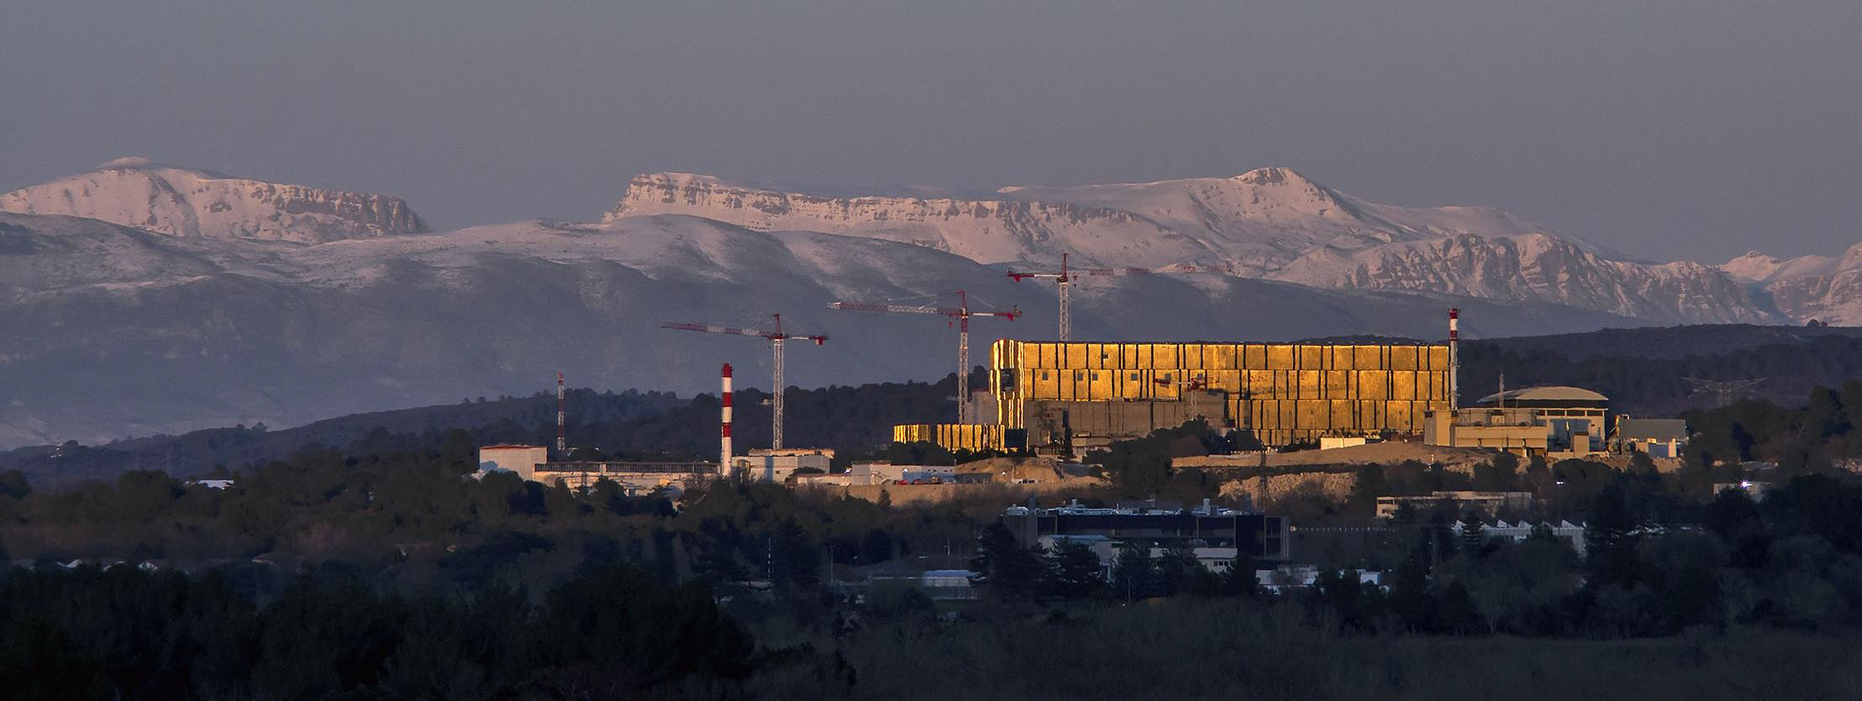

ITER: the next step
R. A. Pitts
Experiments and Plasma Operation Section, Science Division
ITER organization
Czech Technical University Prague, 24 October 2024, Czech Republic
IDM UID: CCUH2M
The views and opinions expressed herein do not necessarily reflect those of the ITER Organization.

Slide 2
Outline
Introduction: what is ITER?
  The ITER machine and main goals
  Partnership and procurement sharing
The ITER site today, delivery of major components and how the tokamak is assembled
  A brief summary in pictures of machine assembly
  Issues found on vacuum vessel sectors and thermal shields
The ITER Research Plan and “re-baselining”
  New schedule to First Plasma and first Burning Plasma

Slide 3
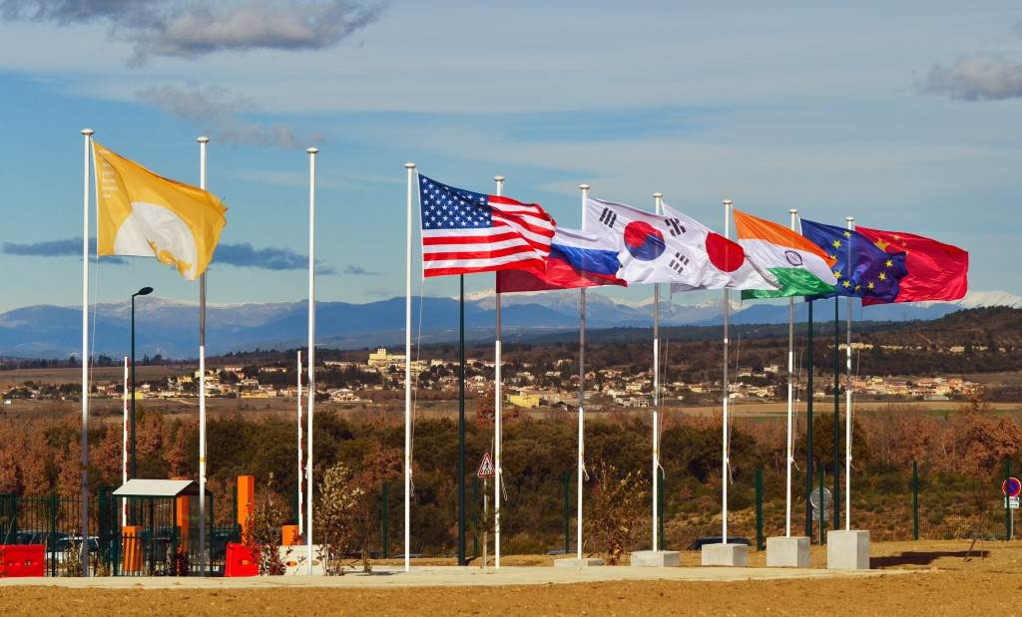
First, what is the ITER Project
Thousands of engineers and scientists have contributed to the design of ITER since the idea for an international joint experiment in fusion was first launched in 1985. The ITER Members: China, the European Union, India, Japan, Korea, Russia and the United States, are now engaged in a 35-year collaboration to build and operate the ITER experimental device, and together bring fusion to the point where a demonstration reactor can be designed
The ITER Organization is an intergovernmental organization, formally established on 24 October 2007
It aims to promote cooperation among the ITER members (Domestic Agencies (DA)) that are involved in the development of ITER.
It also acts as the overall integrator of the project and nuclear operator of the ITER facility.

Slide 4
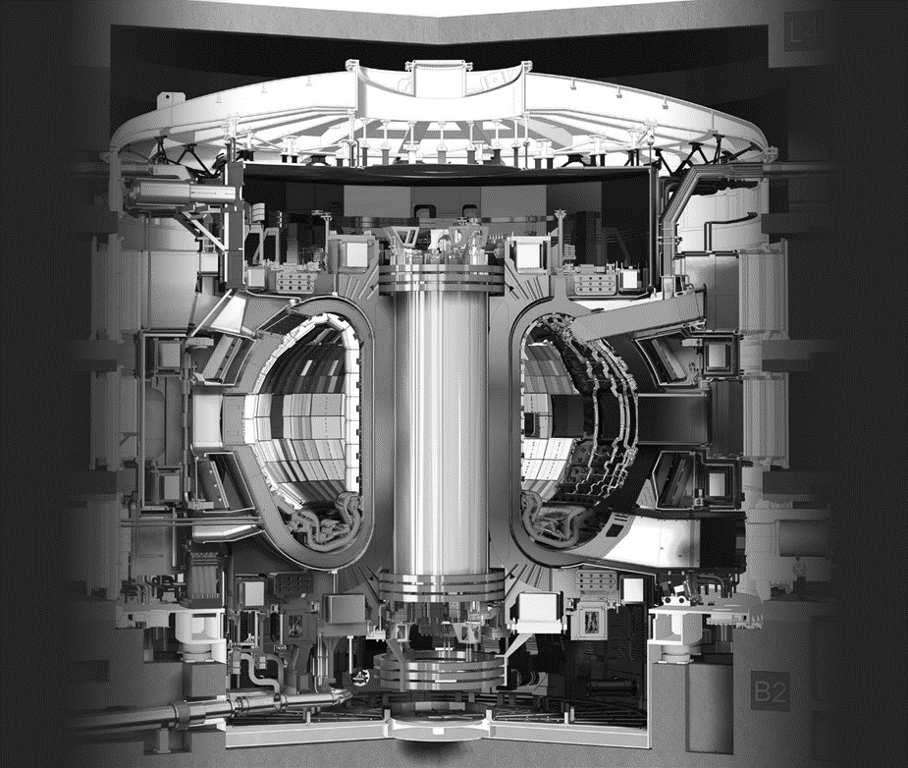
The ITER machine
ITER is the largest tokamak ever built.
It will produce plasmas that create more fusion energy than needed to heat them (Q > 1) and be dominantly heated by the fusion reactions themselves (Q > 5), with a primary target of Q = 10 at a plasma current of 15 MA → burning plasmas:
  Major radius: 6.2 m
  Toroidal field and current: 5.3 T and 15 MA
  Combined stored magnetic energy: ~50 GJ
  Plasma volume: >800 m³
  Nominal auxiliary heating power: 73 MW
  Fusion power: 500 MW
  Vacuum Vessel volume: 1000 m³
  Device weight: ~23,000 tonnes
  Cryostat: 29 m wide, 29 m high, 16,000 m³
R ~ 6.2 m
h ~ 29 m

Slide 5
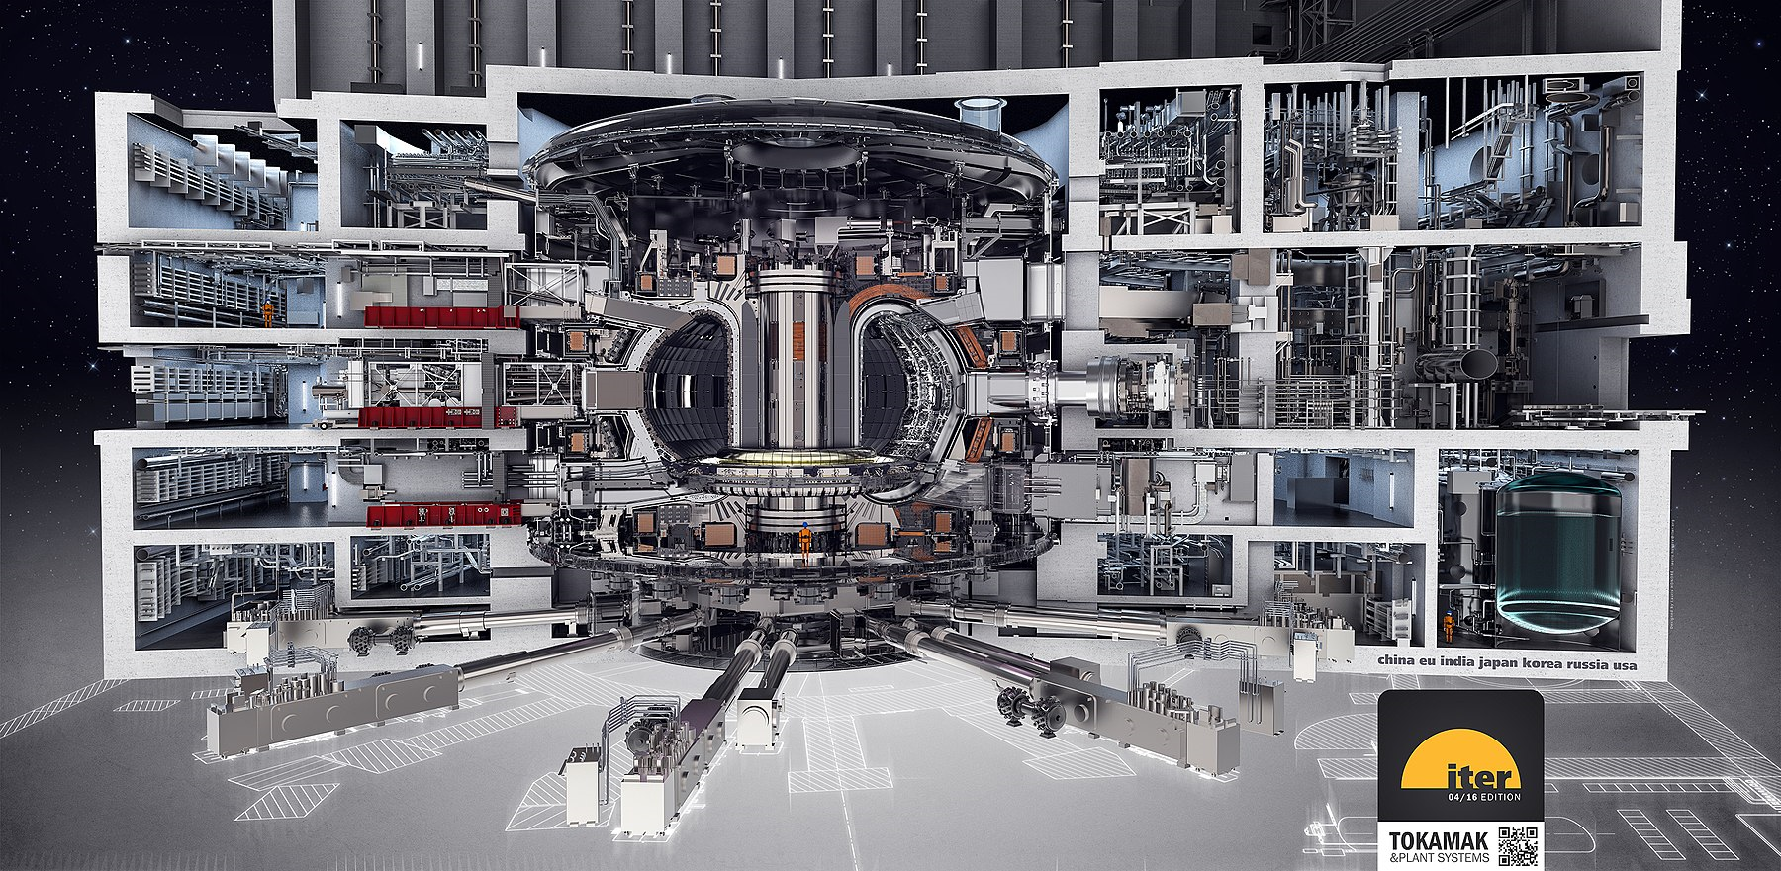
ITER will maintain burning fusion plasmas for long periods of time. It will test the integrated technologies, materials, and physics regimes necessary for the commercial production of fusion-based electricity.

Slide 6
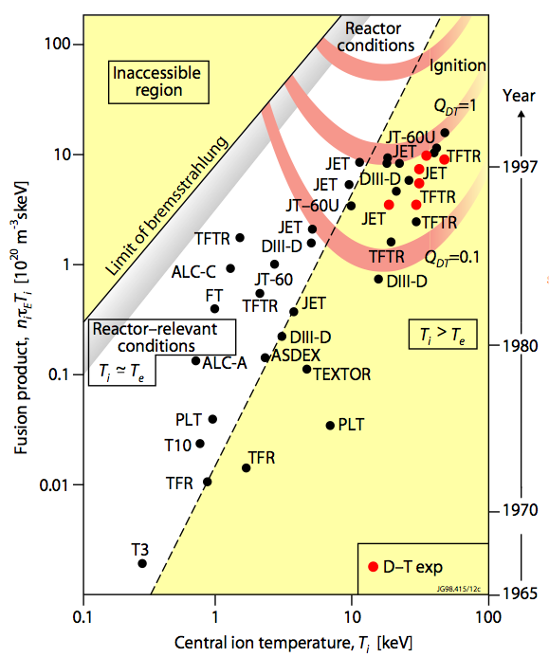
Fusion gain and ITER
Fusion energy gain:
R. A. Pitts et al., Physics World 19 (2006) 20
Q = 1 | f_{α} = 17%
Q = 5 | f_{α} = 50%
Q = 10 | f_{α} = 67%
Q = 20 | f_{α} = 80%
Q = ∞ | f_{α} = 100%
Breakeven
Burning plasma regime
ITER☼
ITER
α-heating fraction:
  ITER is designed to a scale which should yield Q ≥ 10 at a fusion power of 400 – 500 MW for 300 – 500 s → Baseline Scenario

Slide 7
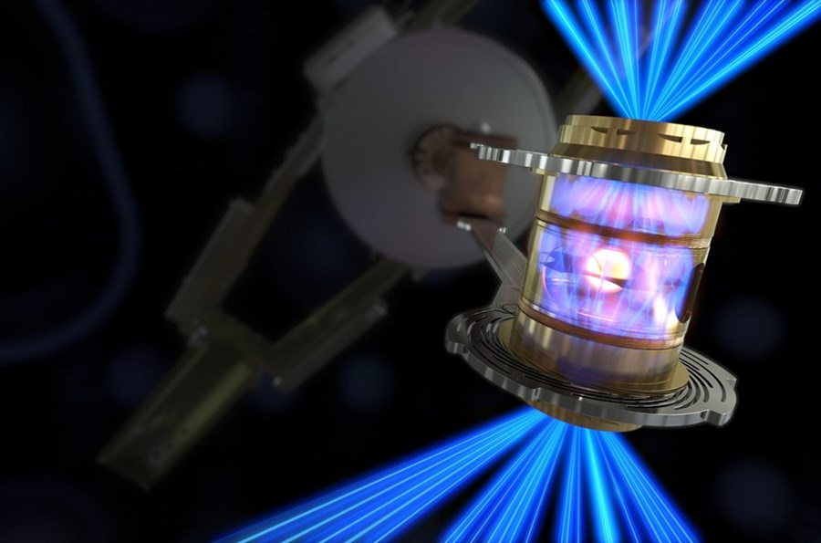
An updated Lawson plot
S. Wurzel, S. Hsu, Phys. Plasmas. 29 (2022) 062103
NIF (Inertial Fusion, LLNL, USA) Milestone in Dec. 2022 with 2.05 MJ laser energy used to produce 3.15 MJ fusion energy → Q = 1.5
(NB: only a small fraction (~1%) of the laser input power is reflected from the walls of the Hohlraum onto the DT target)

Slide 8
An updated Lawson plot
S. Wurzel, S. Hsu, Phys. Plasmas. 29 (2022) 062103
FRC type approaches generally still very far behind the curve in terms of energy breakeven and fusion gain

Slide 9
An updated Lawson plot
S. Wurzel, S. Hsu, Phys. Plasmas. 29 (2022) 062103
New private industry tokamak (https://cfs.energy/) → uses high B_{T} approach and plans to use DT fuel.
P_{fusion} ∝ B_{T}⁴
Competes with ITER in terms of nτT (and Q), but only for very short pulse lengths (few seconds) → major simplification cf. ITER (no active cooling and only small quantities of tritium required)

Slide 10
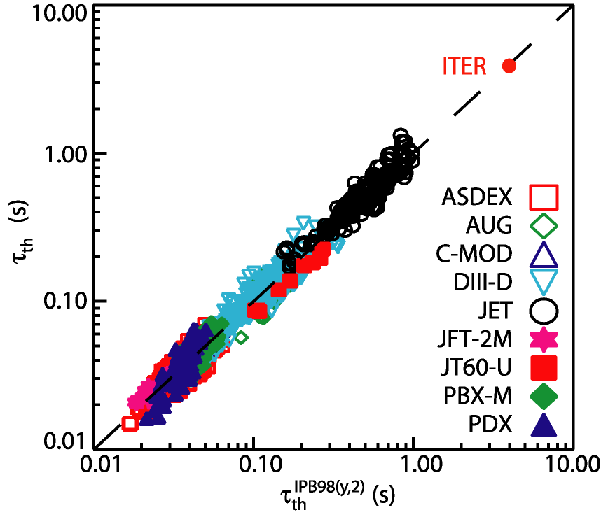
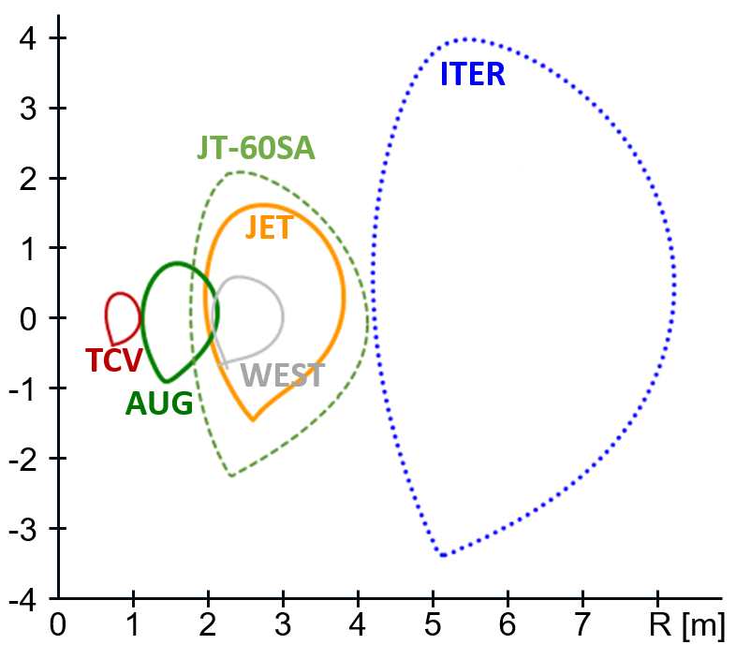
ITER basis: energy confinement
Energy confinement difficult to predict quantitatively → use scalings from experiments + plasma physics limits to dimension ITER to achieve its goals
  Baseline is Type I ELMing H-mode → robust mode of operation in today’s tokamaks
  IPB98(y,2) Type-I ELMing H-mode scaling
τ_{E} ∝ I_{p} R² P^{-2/3}
q₉₅ = 3
R

Slide 11
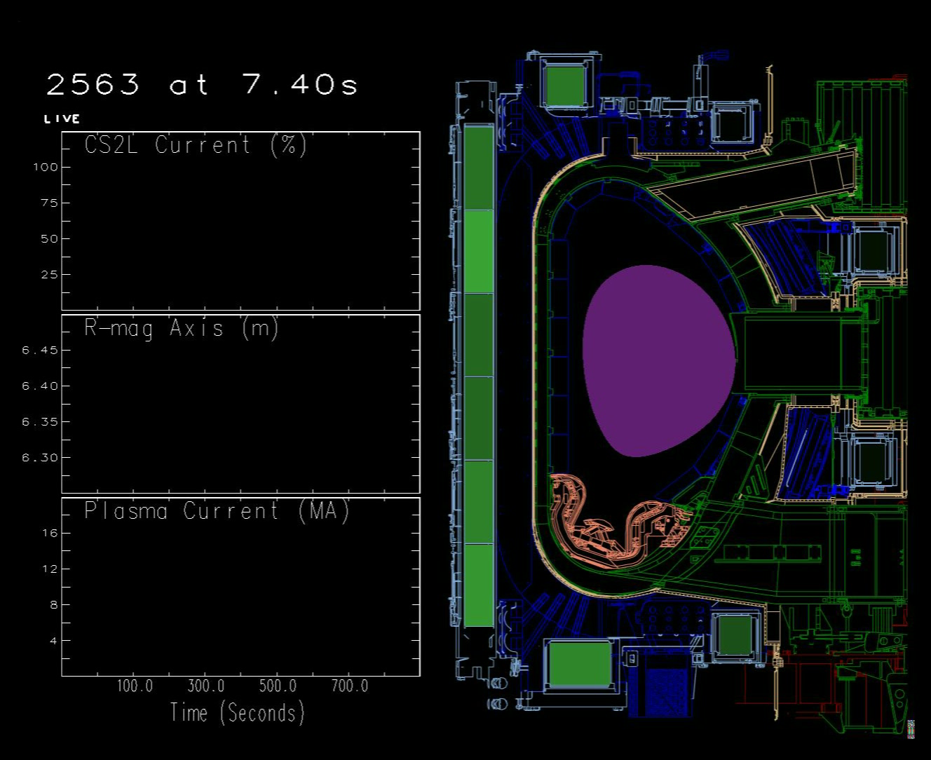
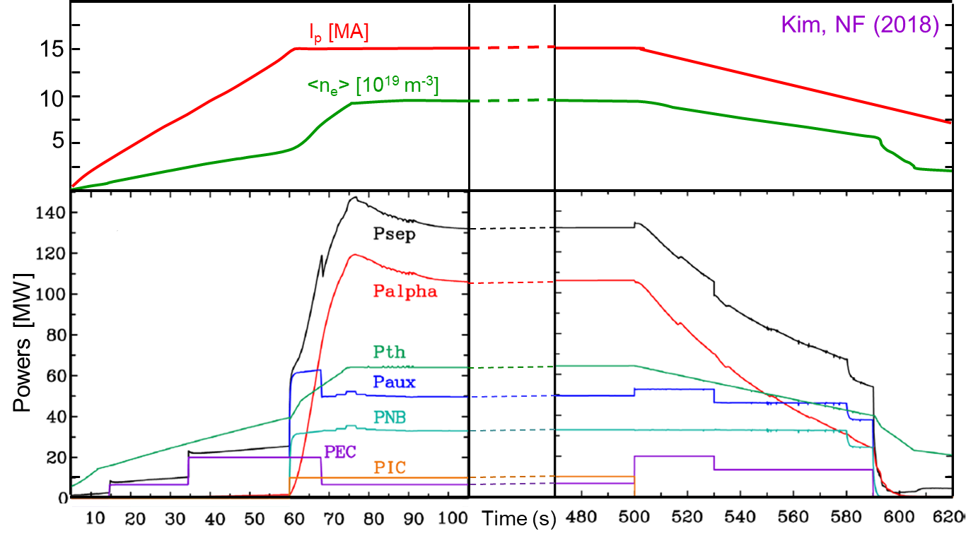
ITER Q = 10 scenario (300 – 500 s burn)
Based on conventional sawthoothing H-mode with H₉₈ = 1 → scenario used for design of magnets and components
P_{aux} = P_{NBI} + P_{ECH} (+P_{ICH}) ~ 50 MW → alpha-heating dominant scenario with ~35% non-inductively driven curent

Slide 12
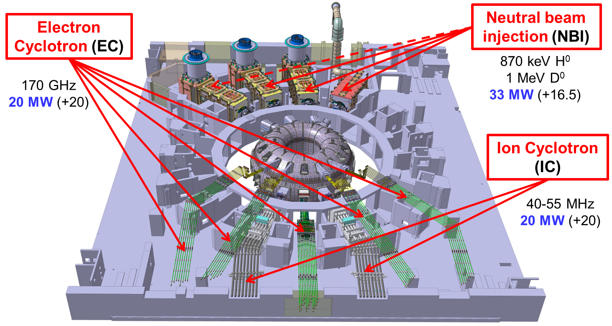
Baseline heating and current drive systems
NB: subject to change in the re-baseline

Slide 13
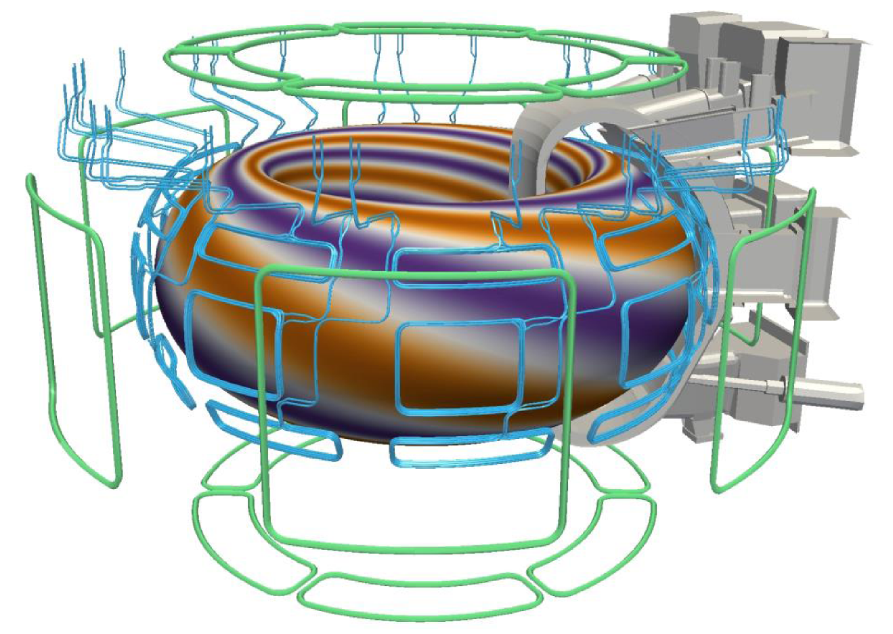
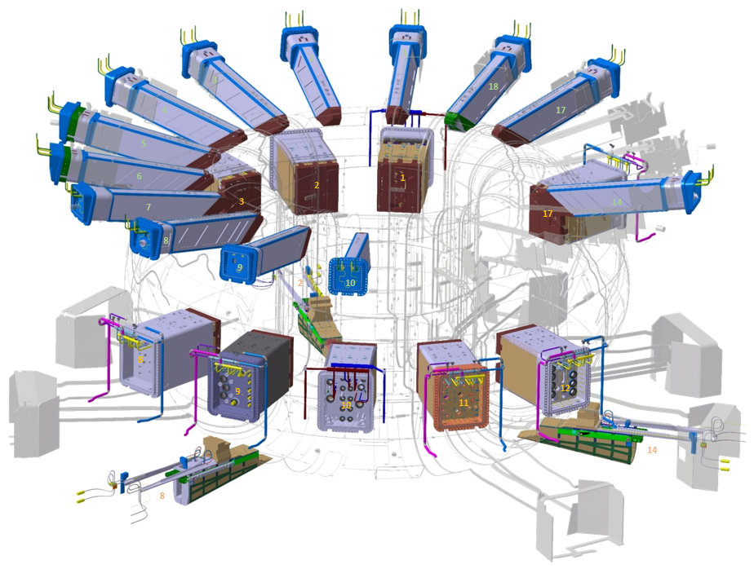
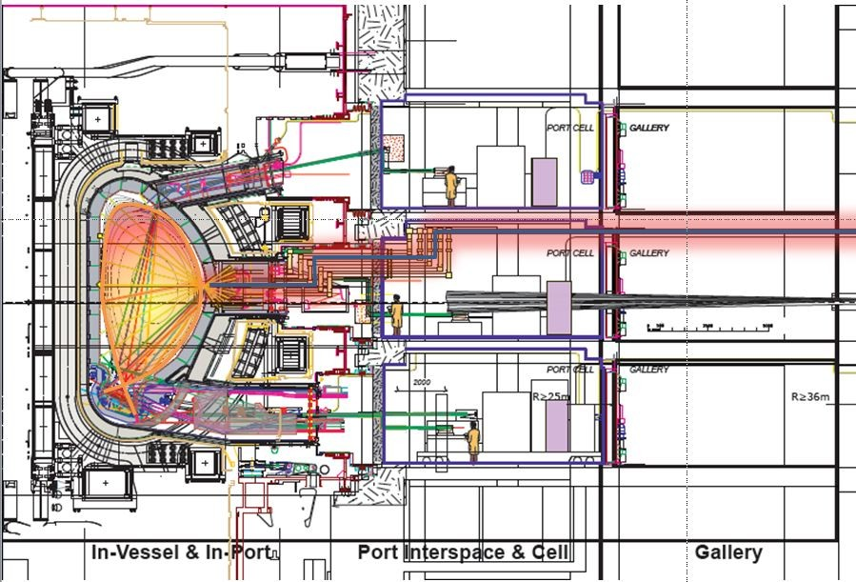
Diagnostics and 3D coils (Error field, ELM control)
Diagnostics: ~60 instruments, measuring ~100 parameters, many used in real time → used as part of a sophisticated, system-engineered plasma control system
External error field correction coils (superconducting) + internal ELM control coils (not superconducting)

Slide 14
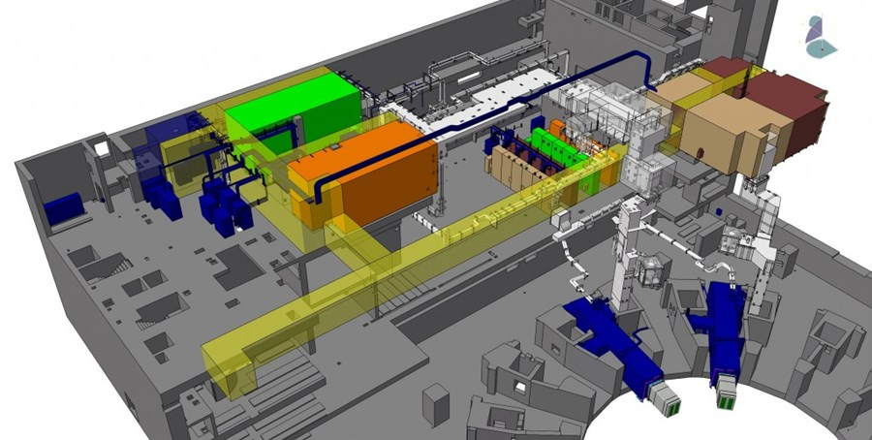
Nuclear operation: tritium breeding modules (TBMs)
Tritium fuel cycle is a major challenge for all DT fusion devices → needs to be produced in-situ (n + Li)
A principal technology goal of ITER is to demonstrate T-production schemes (at small scale)
  Different test blanket systems will be installed to test different combinations of design options:
  Liquid metal breeder
  Solid breeder
  Helium coolant
  Water coolant

Slide 15
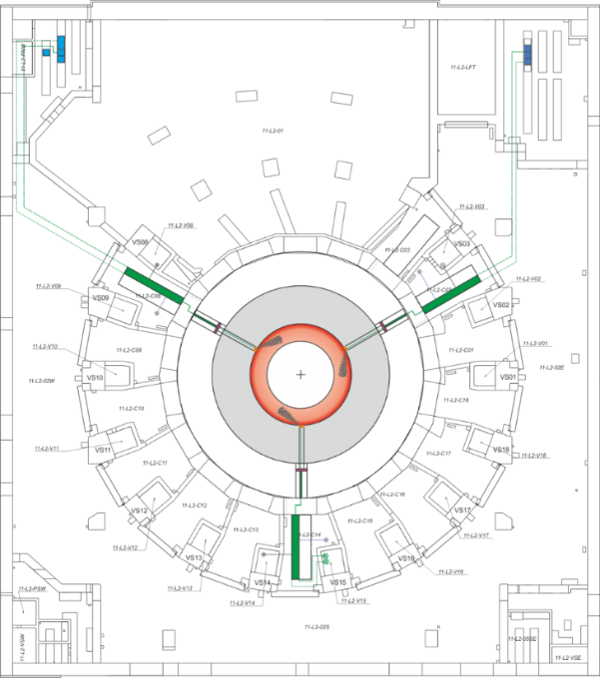
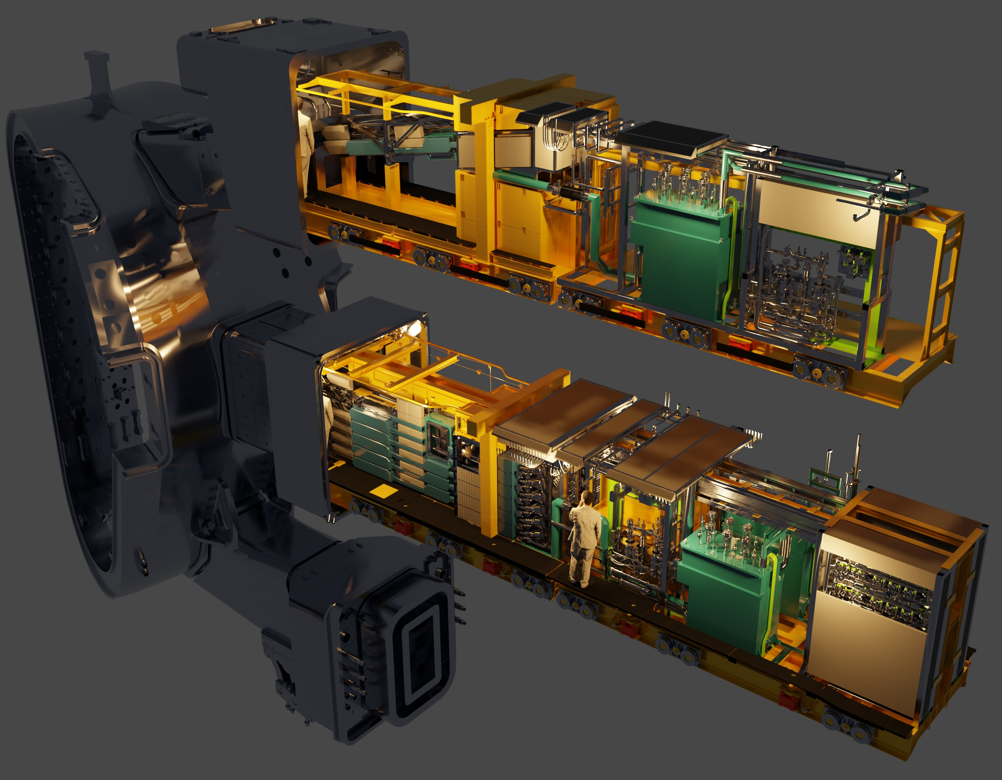
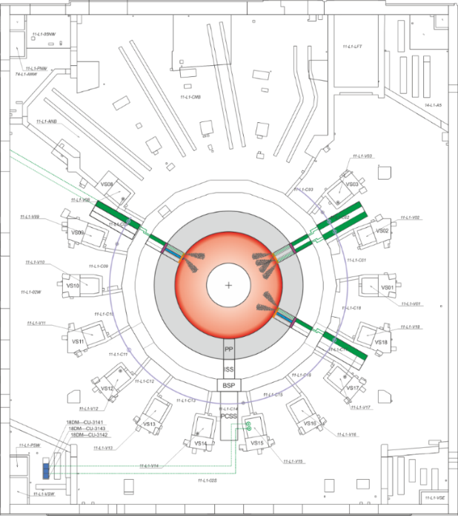
Disruptions a major issue
Massive programme on ITER to design, test and build a reliable and robust “Disruption Mitigation System” (DMS)
  Based on multiple cryogenic (H, Ne) shattered pellet injection (SPI) to dissipate thermal and current quench energies and to prevent the formation of, or kill runaway electron beams
Upper ports
1 barrel
PC08
1 barrel
PC02
PC14
1 barrel
Equatorial ports
6 barrels
12 barrels
PC08
PC02
PC17
6 barrels

Slide 16
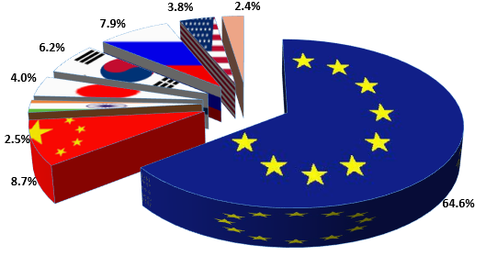
ITER construction sharing
A unique feature of ITER is that almost all (~90%) of the machine will be constructed through in-kind procurement from the Parties
3.8%
2.4%
7.9%
6.2%
4.0%
2.5%
64.6%
8.7%
Overall sharing:
EU: 5/11
Other 6 Members: 1/11 each
IO Staff distribution by Member (December 2023)
Notes:
2022: 1 IUA = 1,822.33 Euro (see https://user.iter.org/?uid=6VUGL9)
1 kIUA =

Slide 17
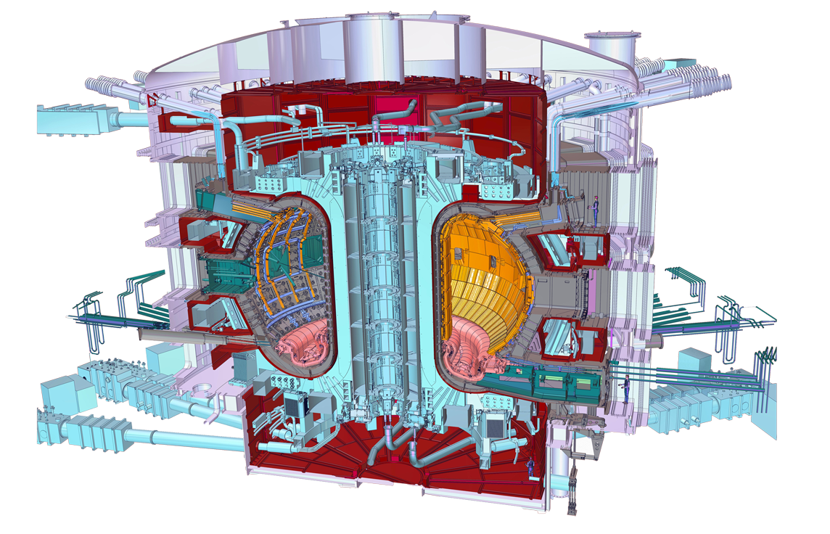







Who manufactures what?
All intellectual property is shared by the seven members
Cryostat
Feeders (31)
Thermal Shield
Toroidal Field Coils (18)
Vacuum Vessel
Poloidal Field Coils (6)
Blanket
Correction Coils(18)
Central Solenoid (6)
Divertor

Slide 18
The ITER site today
(see: https://www.iter.org/news/galleries for much, much more)

Slide 19
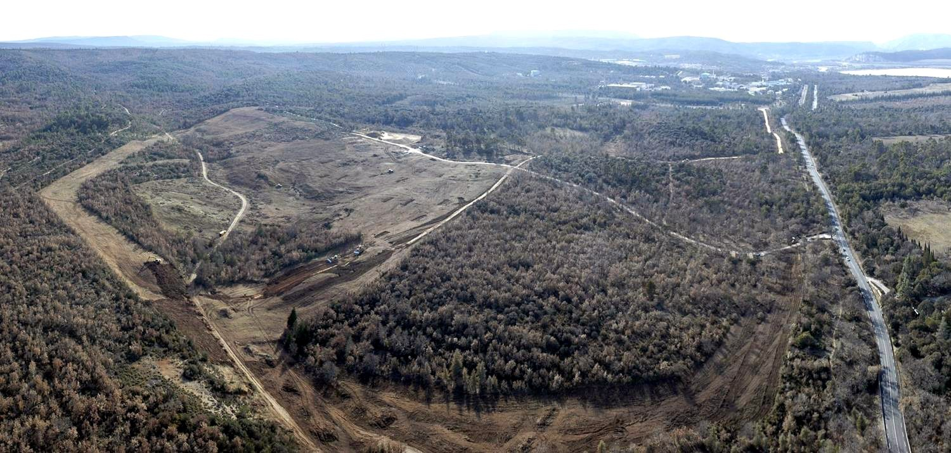
ITER platform: a brief recap
21 Jan. 2007
CEA Cadarache centre
French Alternative Energies and Atomic Energy Commission (CEA) acquires ~180 hectares for the ITER Project, near the CEA Cadarache nuclear research centre

Slide 20
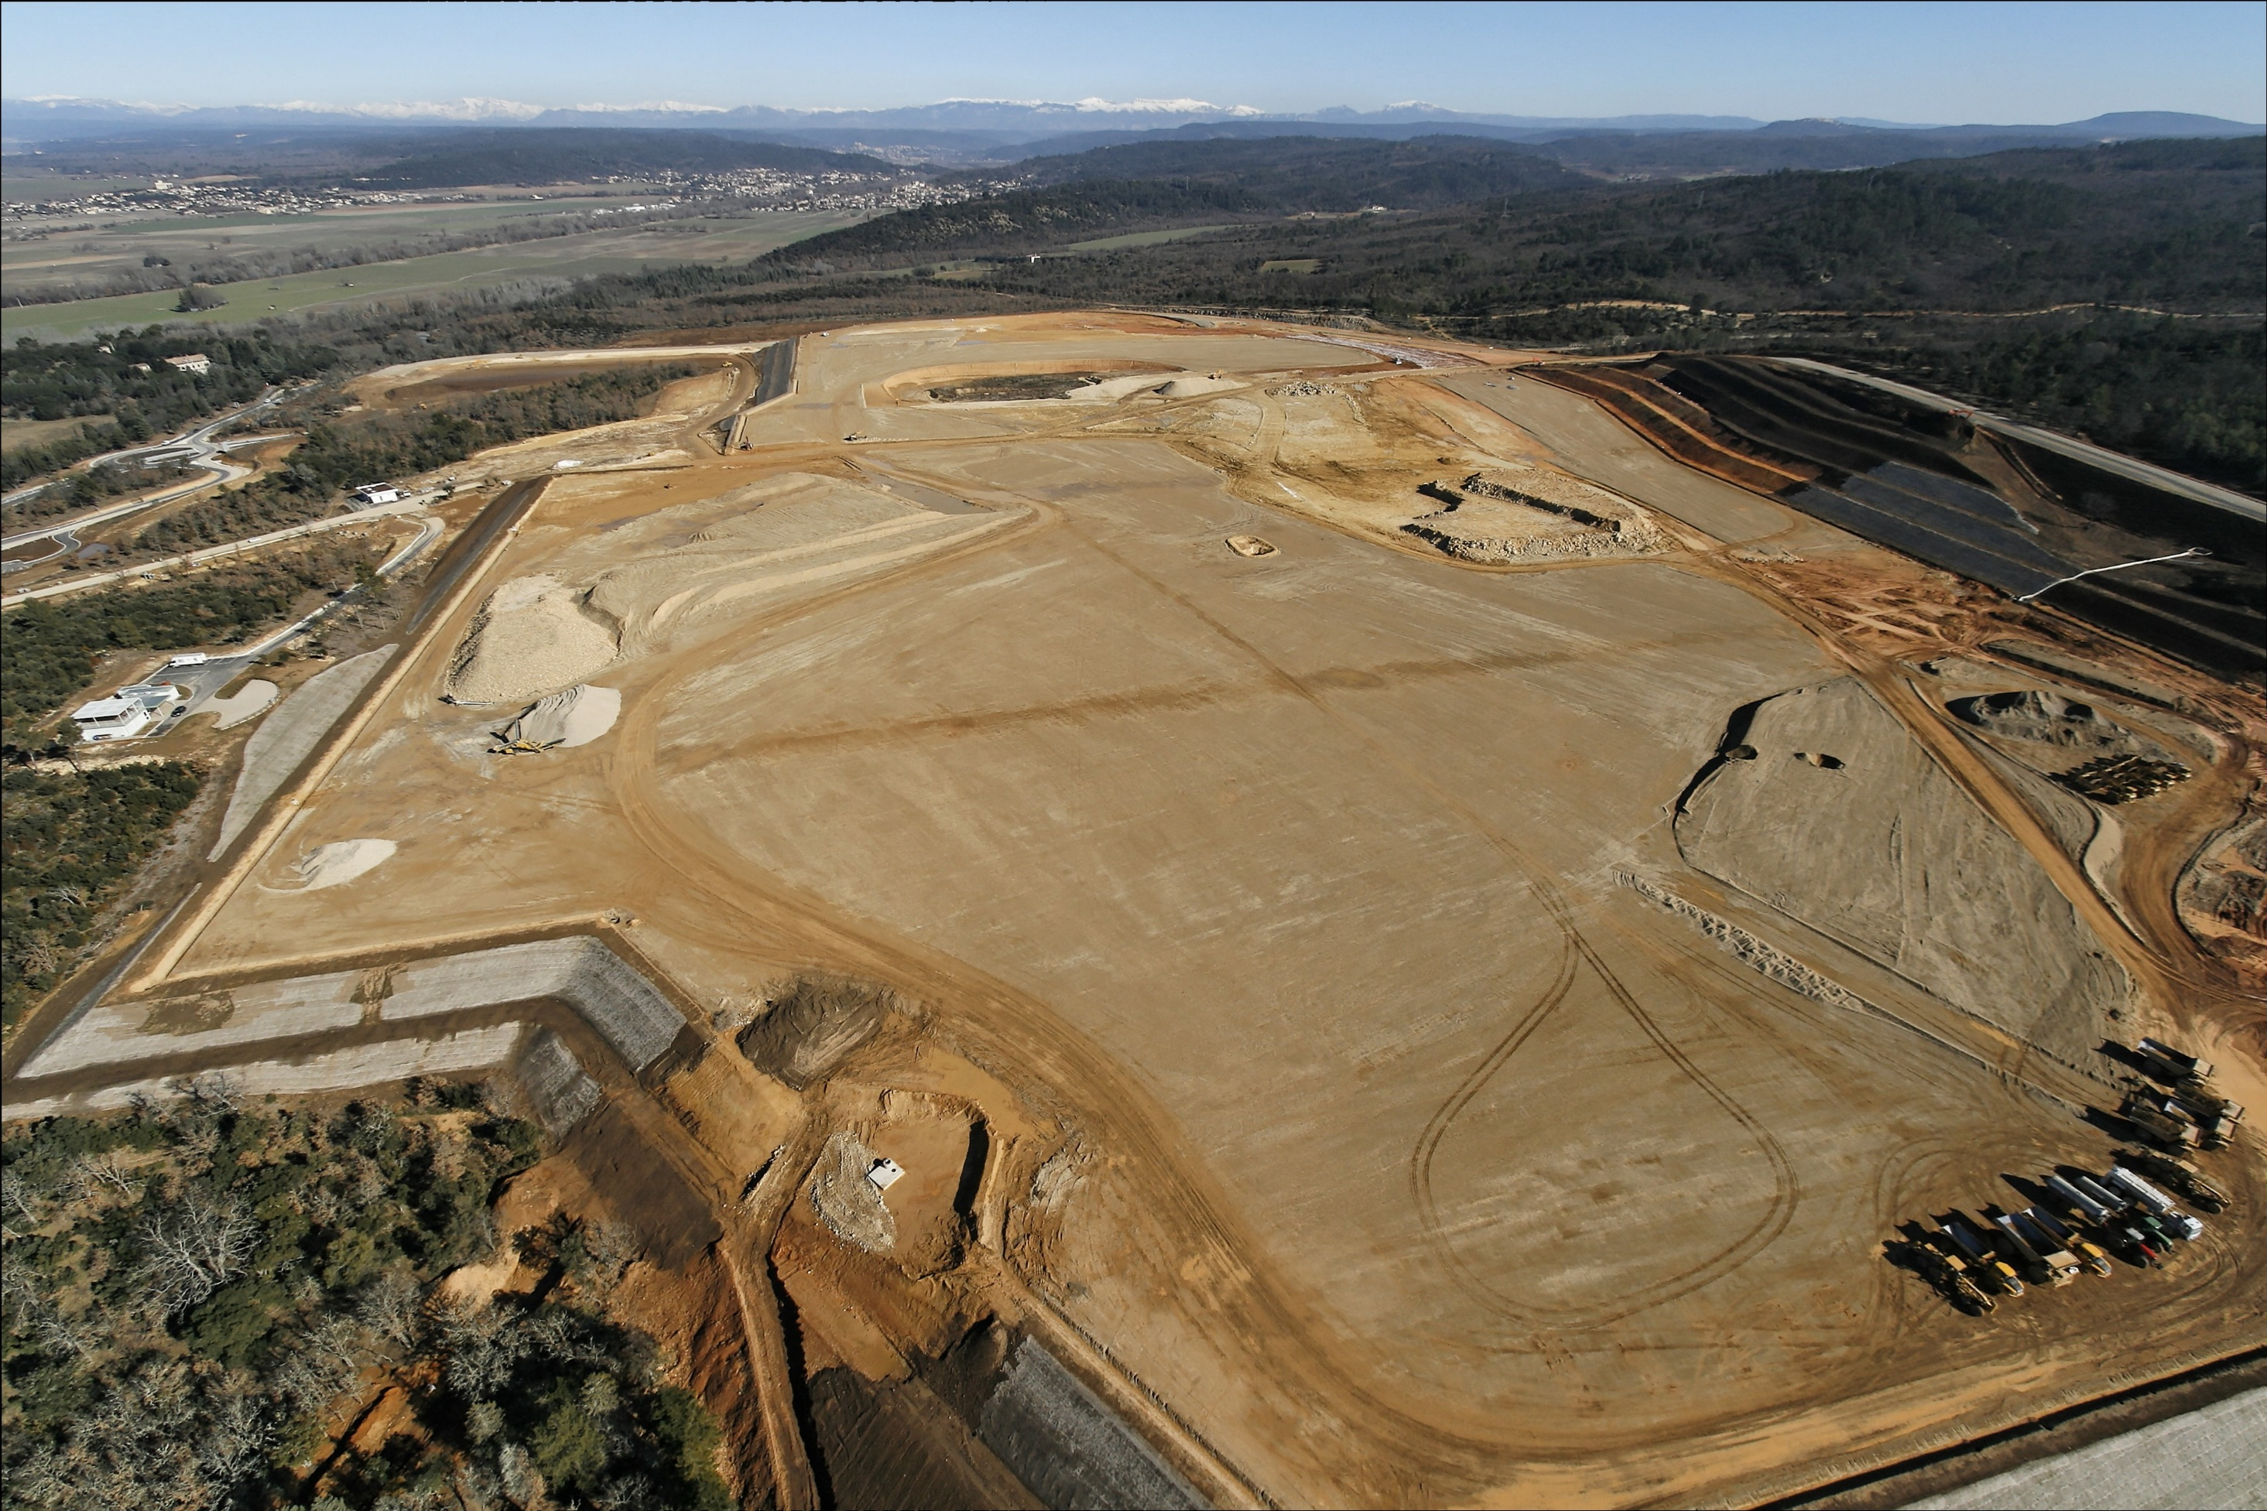
29 Jan. 2009
1000 long, 400 m wide, the ITER platform ready for construction

Slide 21
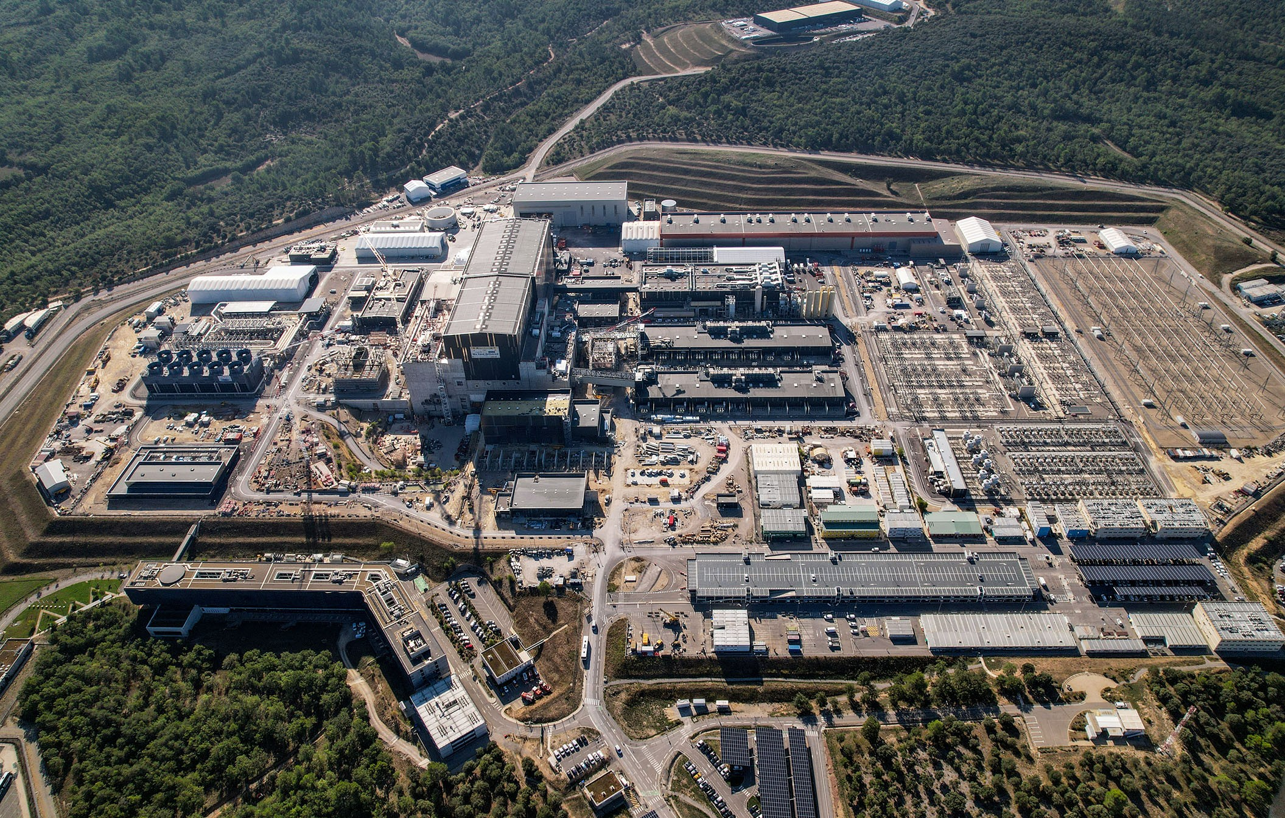
ITER construction site drone view
27 Sept 2023

Slide 22
ITER construction site drone view
27 Sept 2023
Component storage area
Cryostat workshop
Cryostat upper cylinder (temporary storage)
400 kV switchyard
Assembly Hall
PF coil winding facility
RF Building
Heat rejection system
Cryoplant
Tokamak building
Transformers
Tritium building
Diagnostics building
Magnet power conversion buildings
Main control room
ITER Organization HQ

Slide 23
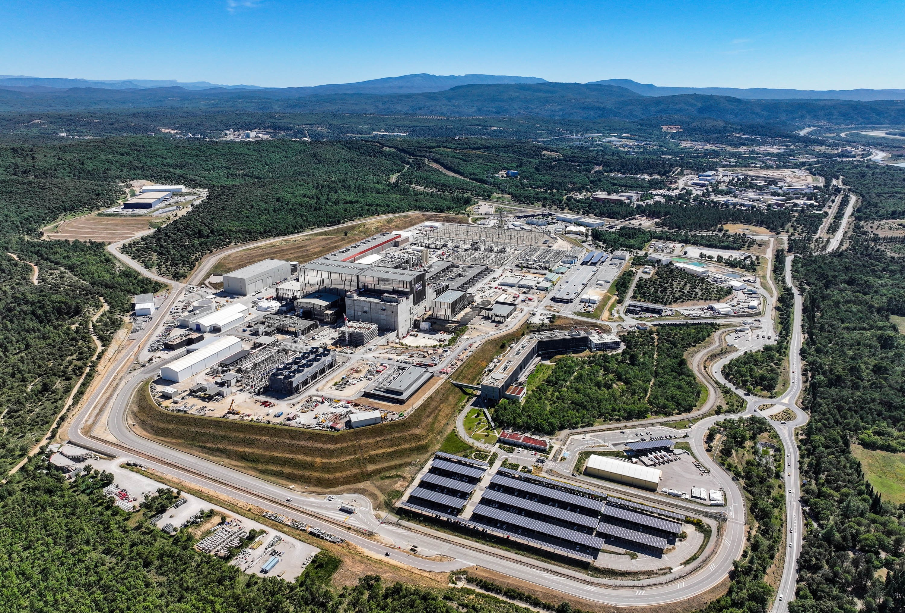
Latest available drone view
20 June 2024

Slide 24
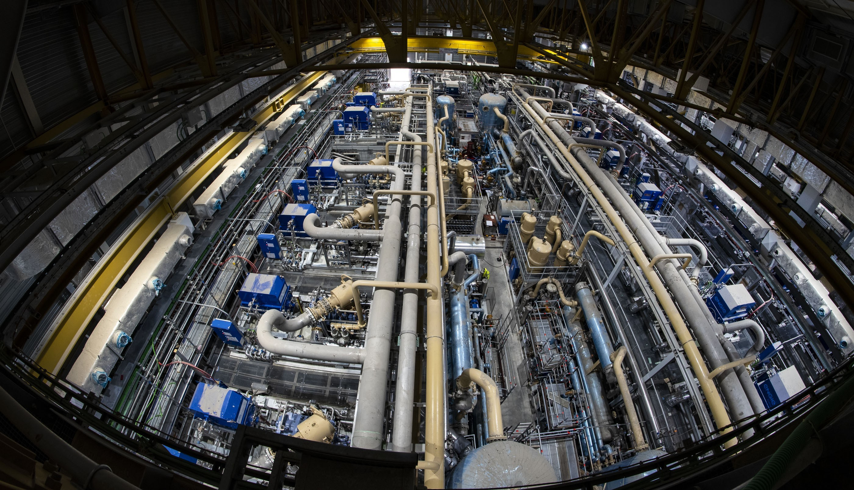
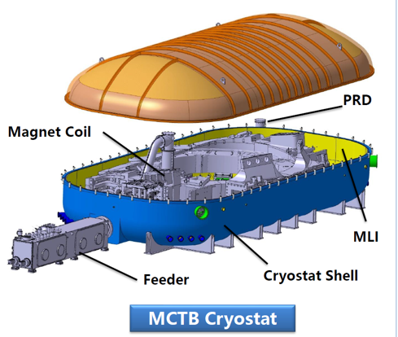
Cryoplant
Largest single unit plant in the world.
Liquid He inventory 25 t
Power:
75 kW at 4.5 K (He)
1300 kW at 80 K (N₂)
25 novembre 2021
He gas compressor and gas distribution network completed functional tests in July 2024 → first liquid He to be made this year → support operation of a Magnet Cold Test Bench (TF coil tests)
Over 5000 t of equipment installed in the cryoplant in 3.5 years
Notes:
tanks, compressors, piping, valves, electrical motors, gas bags

Slide 25
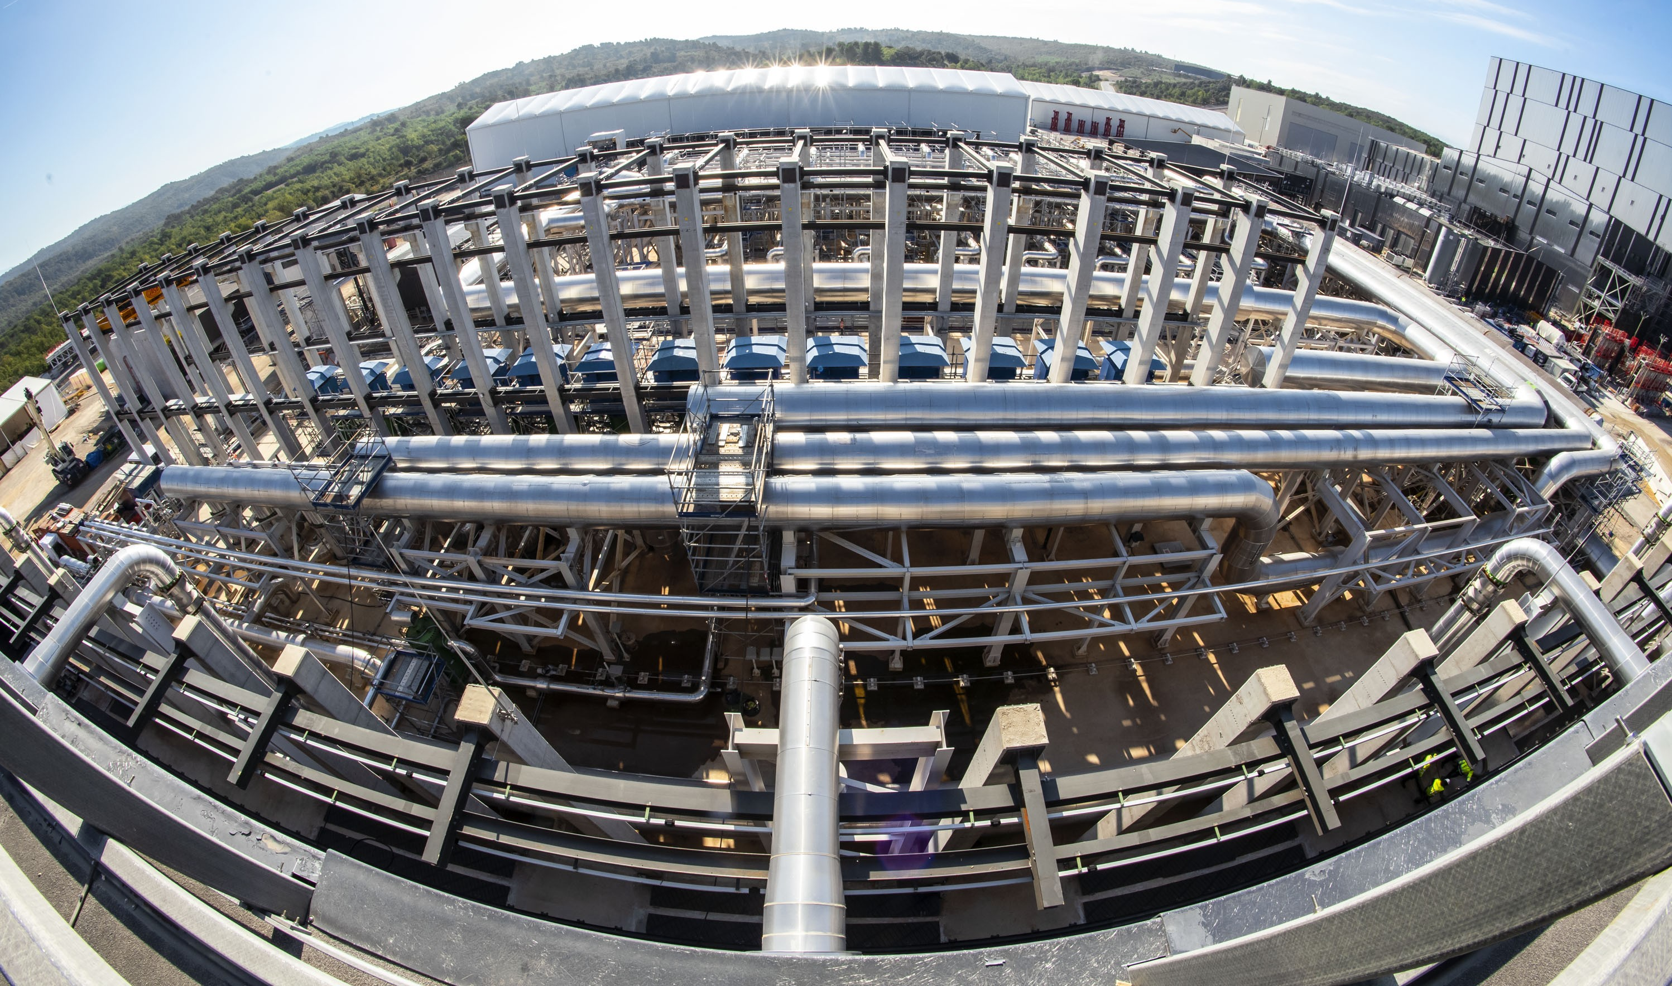
Cooling plant
Optimise management of an intermittent demand (peak: 1145 MW, between pulses: 160 MW)
15 octobre 2021
~6000 t of equipment supplied by IN-DA → commissioning well underway

Slide 26
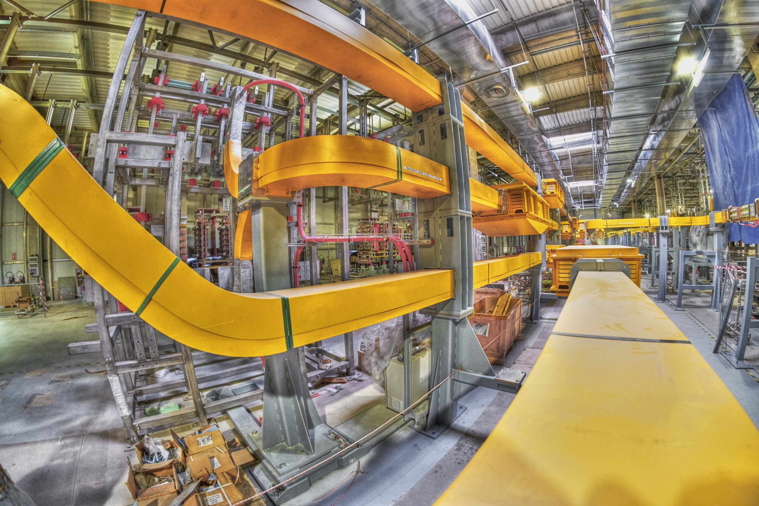
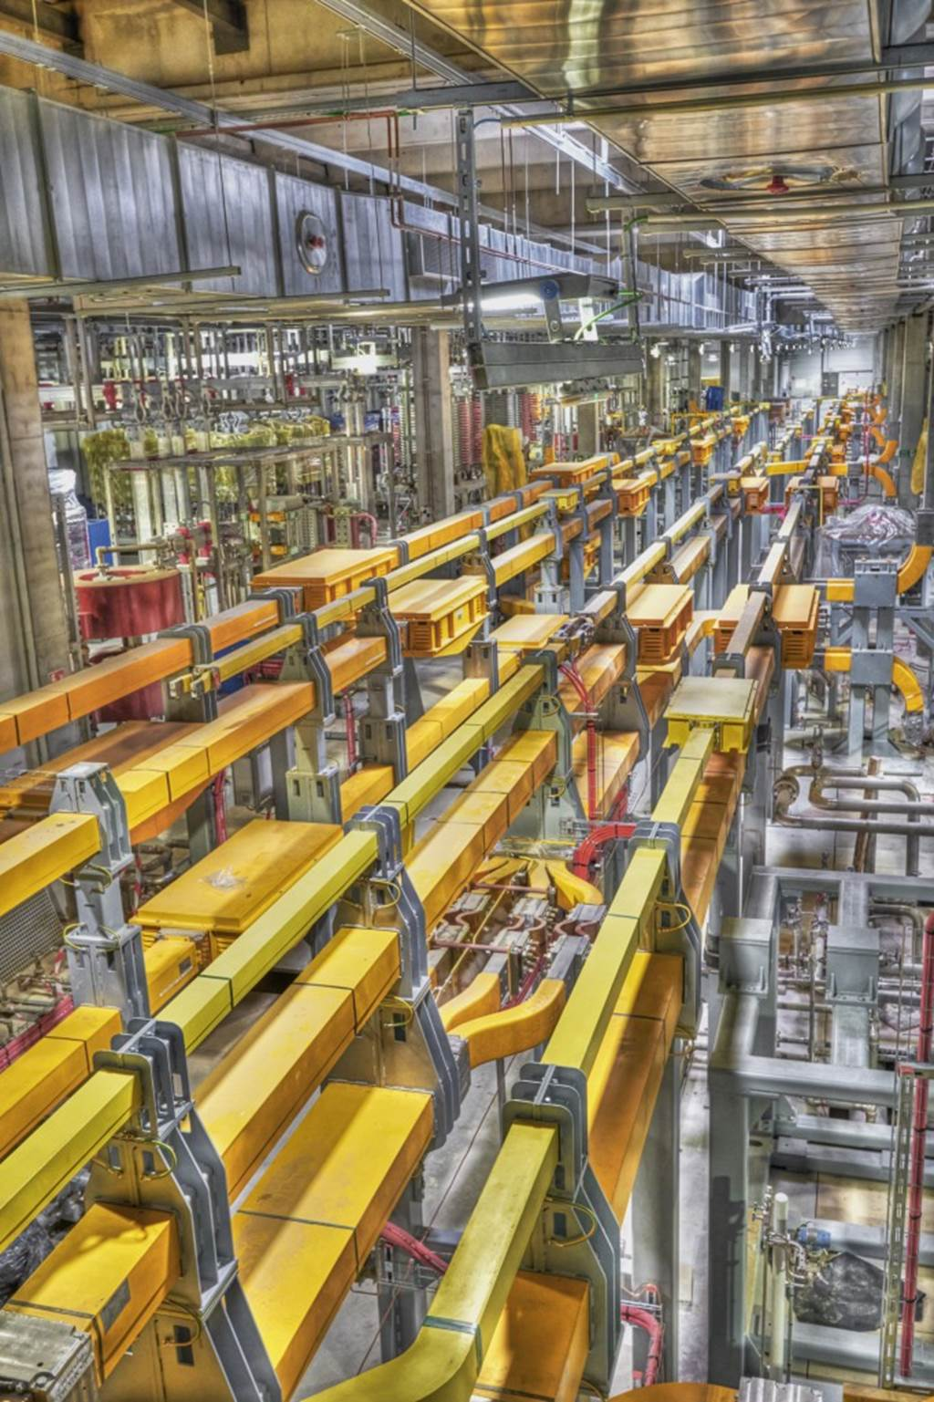
Electrical conversion
~5 km of actively cooled busbars
100% of the equipment necessary for First Plasma installed
25 mars 2021

Slide 27
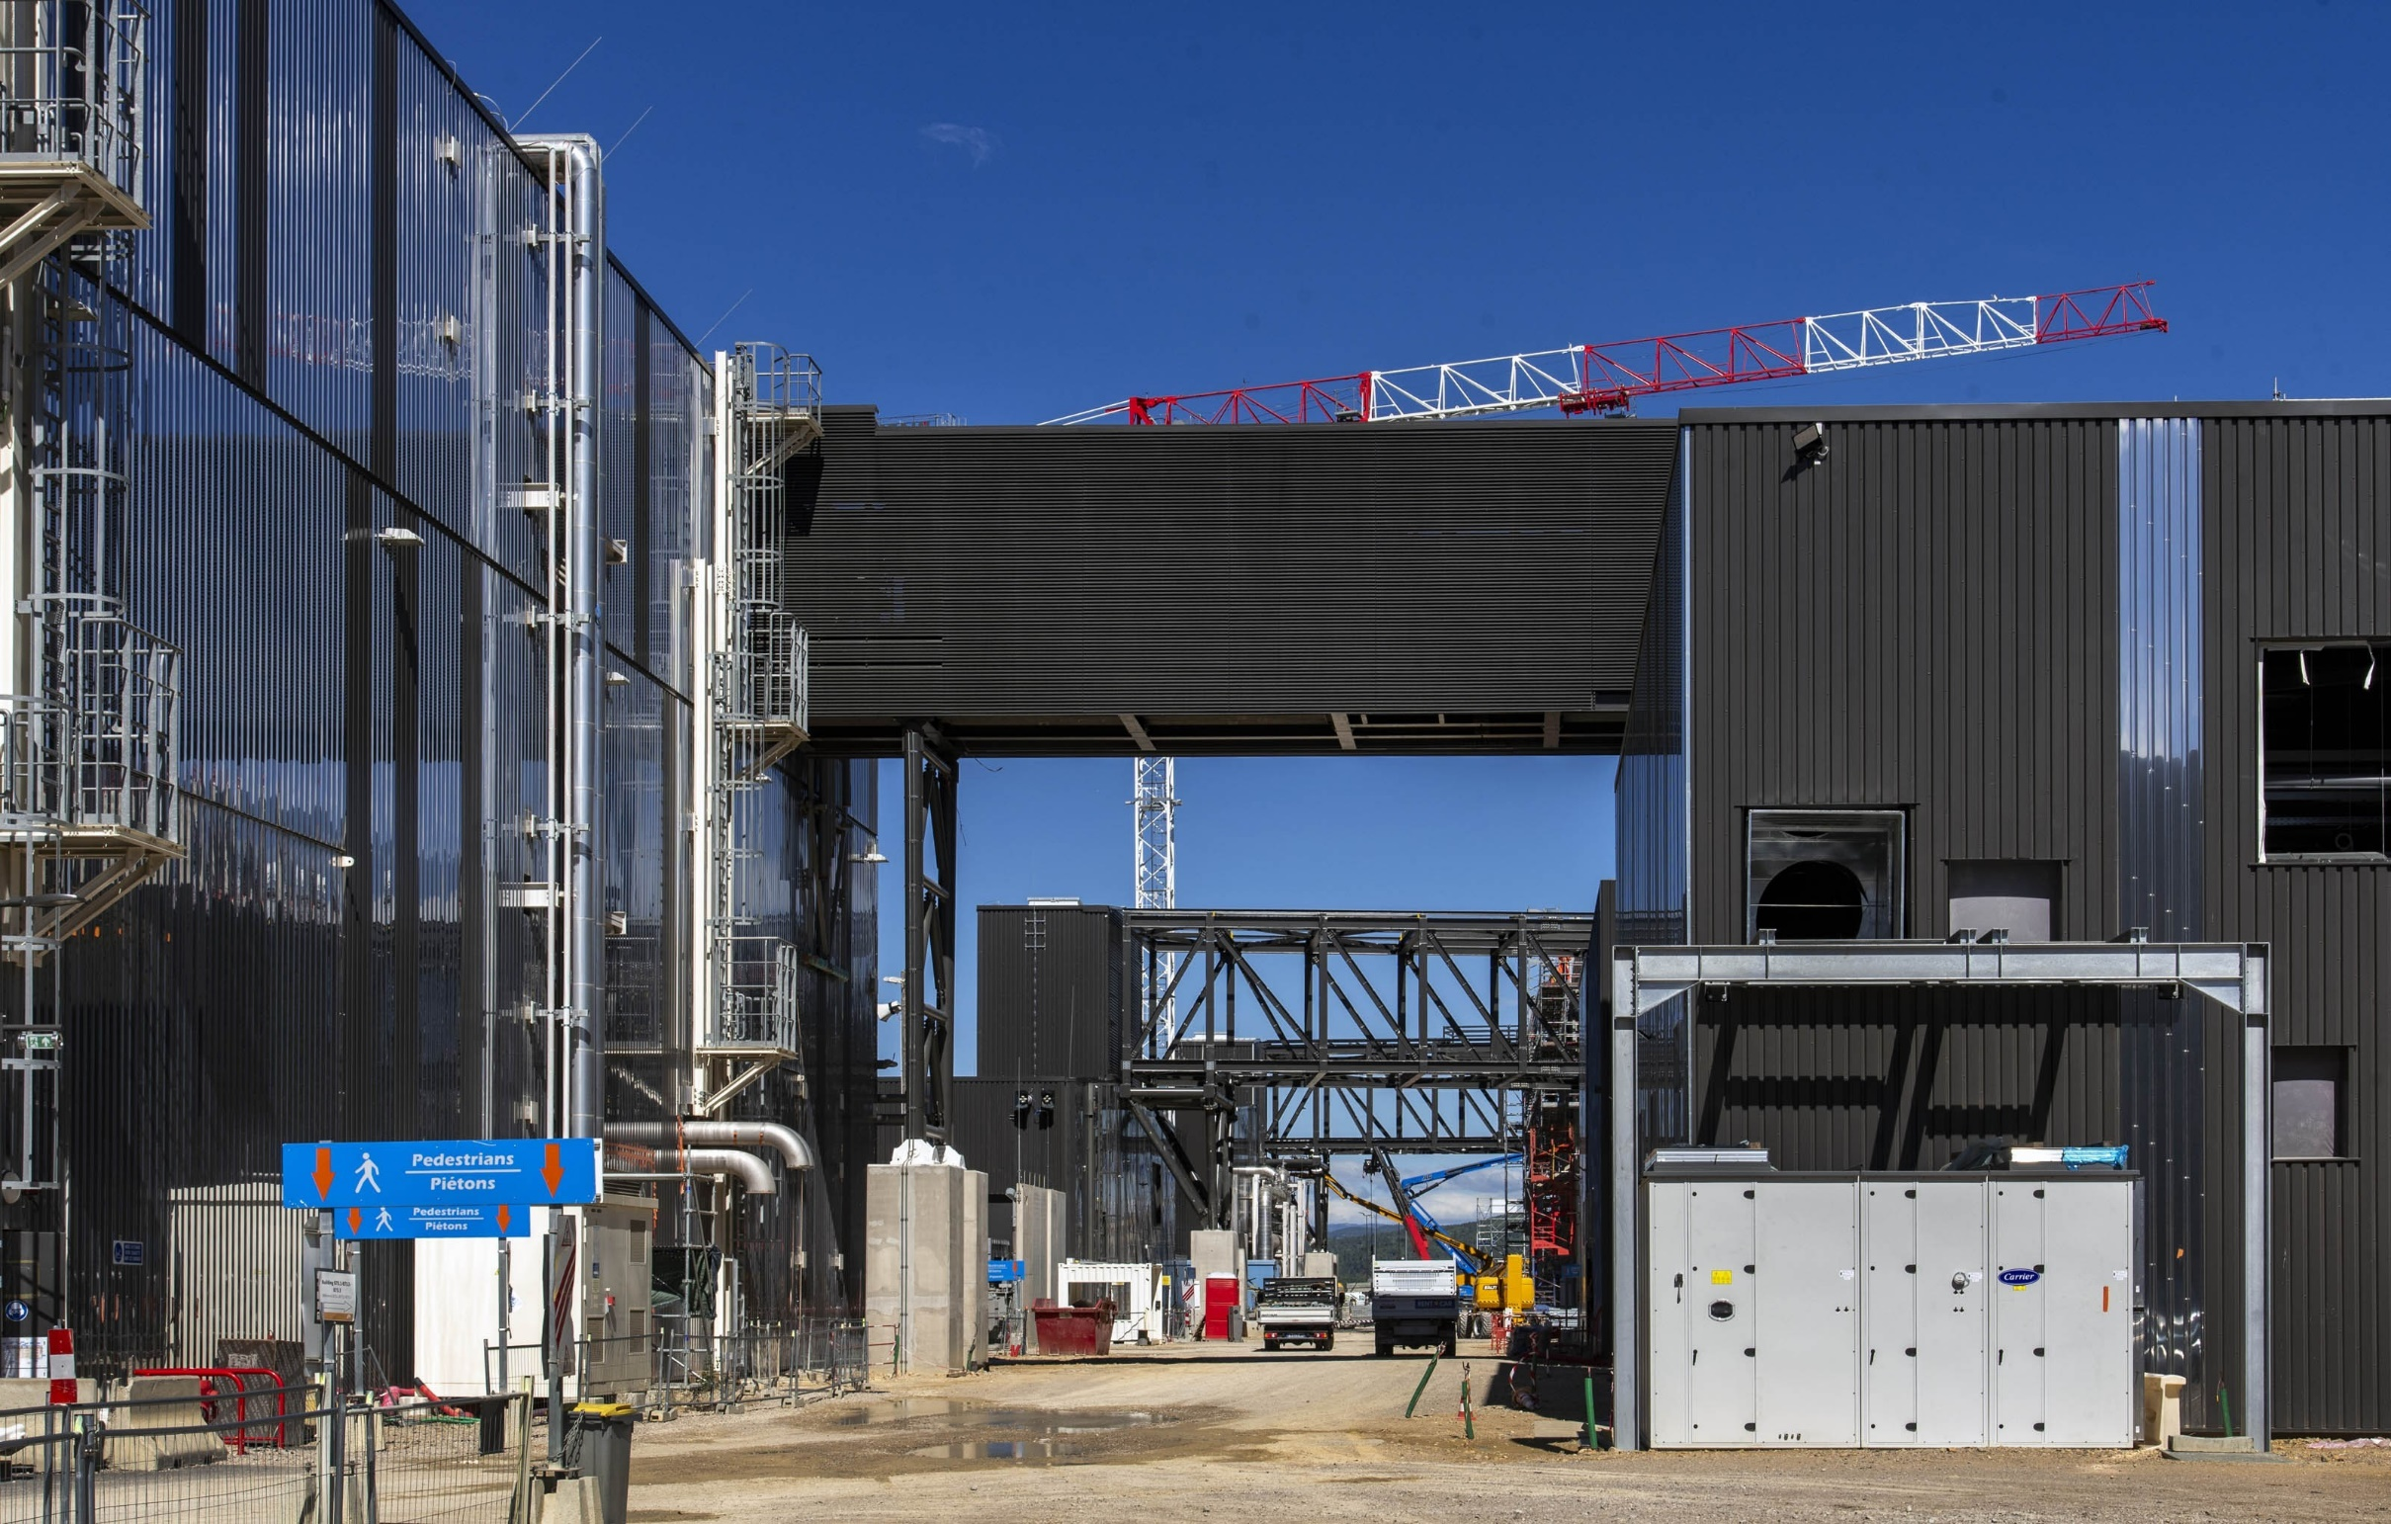
Bridging gaps ….
Cryobridge and busbar bridges for distribution of cryolines and transport of electrical busbars
29 August 2023

Slide 28
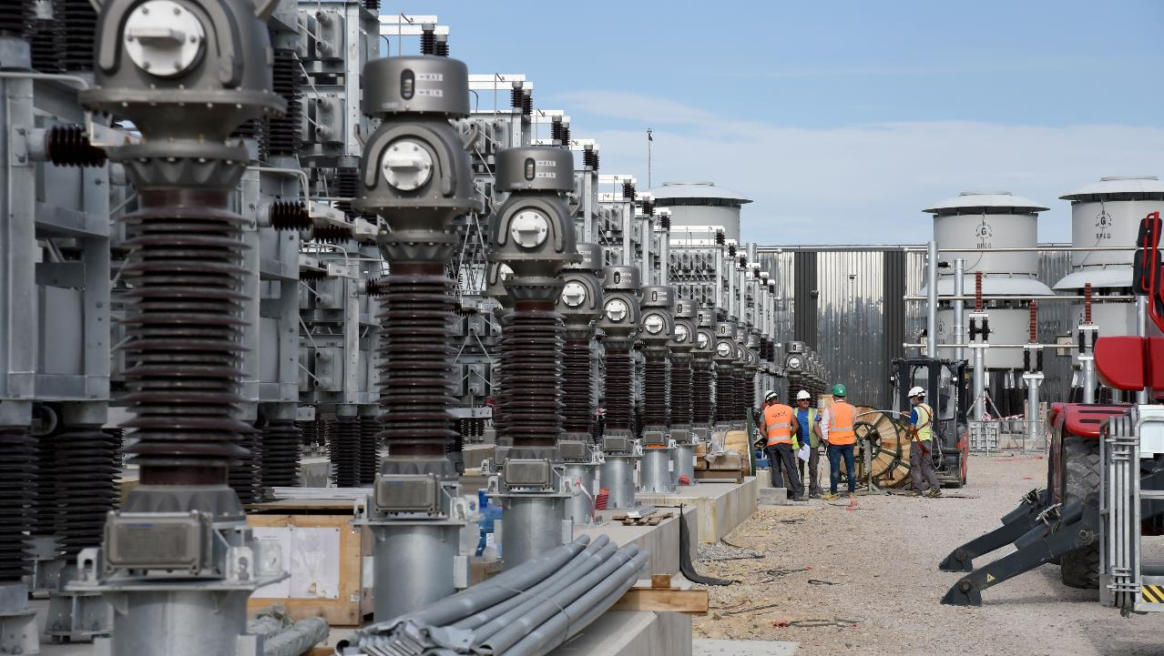
Pulse-power electrical network (PPEN) is in operation
Supplied by two 400 kV lines connected to the French grid
Full energization of the 1st of 3 bays complete
August 2024

Slide 29
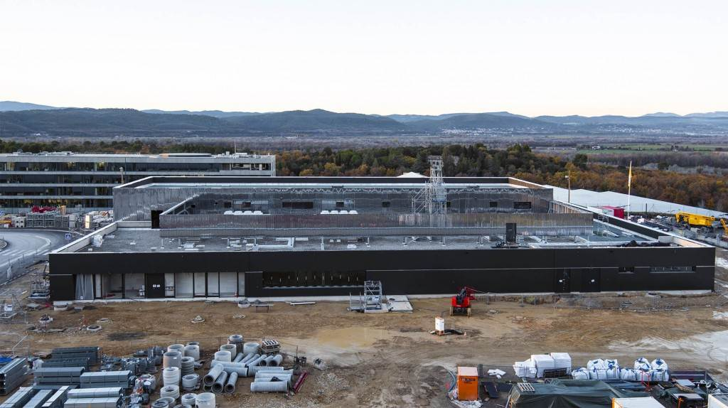
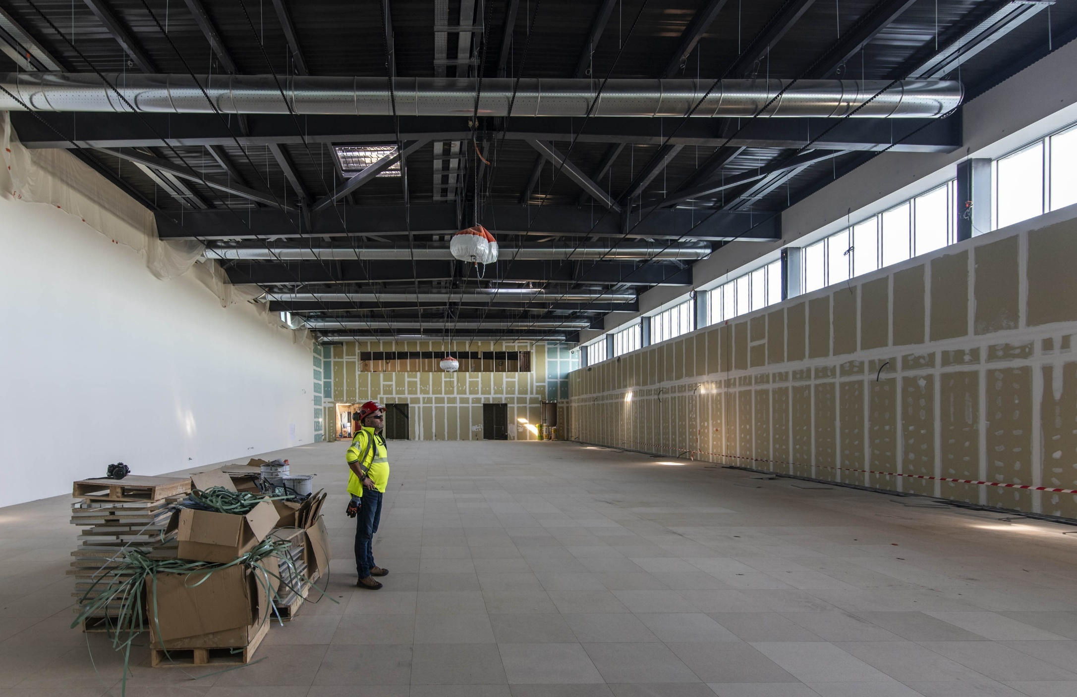
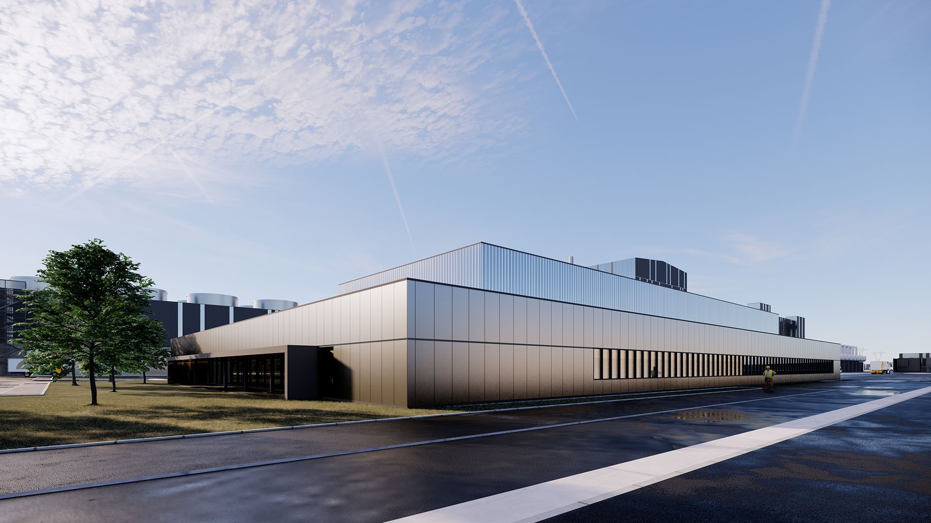
ITER Control Room
Main construction complete
29 August 2023

Slide 30
Status of selected major components

Slide 31
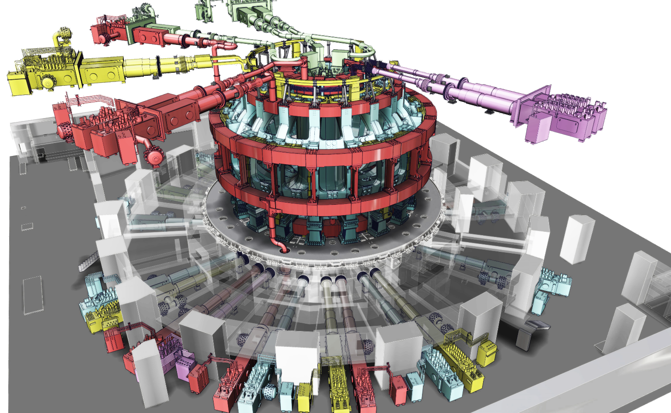
Reminder: the ITER main magnet systems
Nearly 10,000 tonnes of superconducting magnets (niobium-tin, Nb₃Sn or niobium-titanium Nb-Ti)
  Combined total stored energy of 51 GJ
  Highly complex system of cryogenics and coil feeders (31)

Slide 32
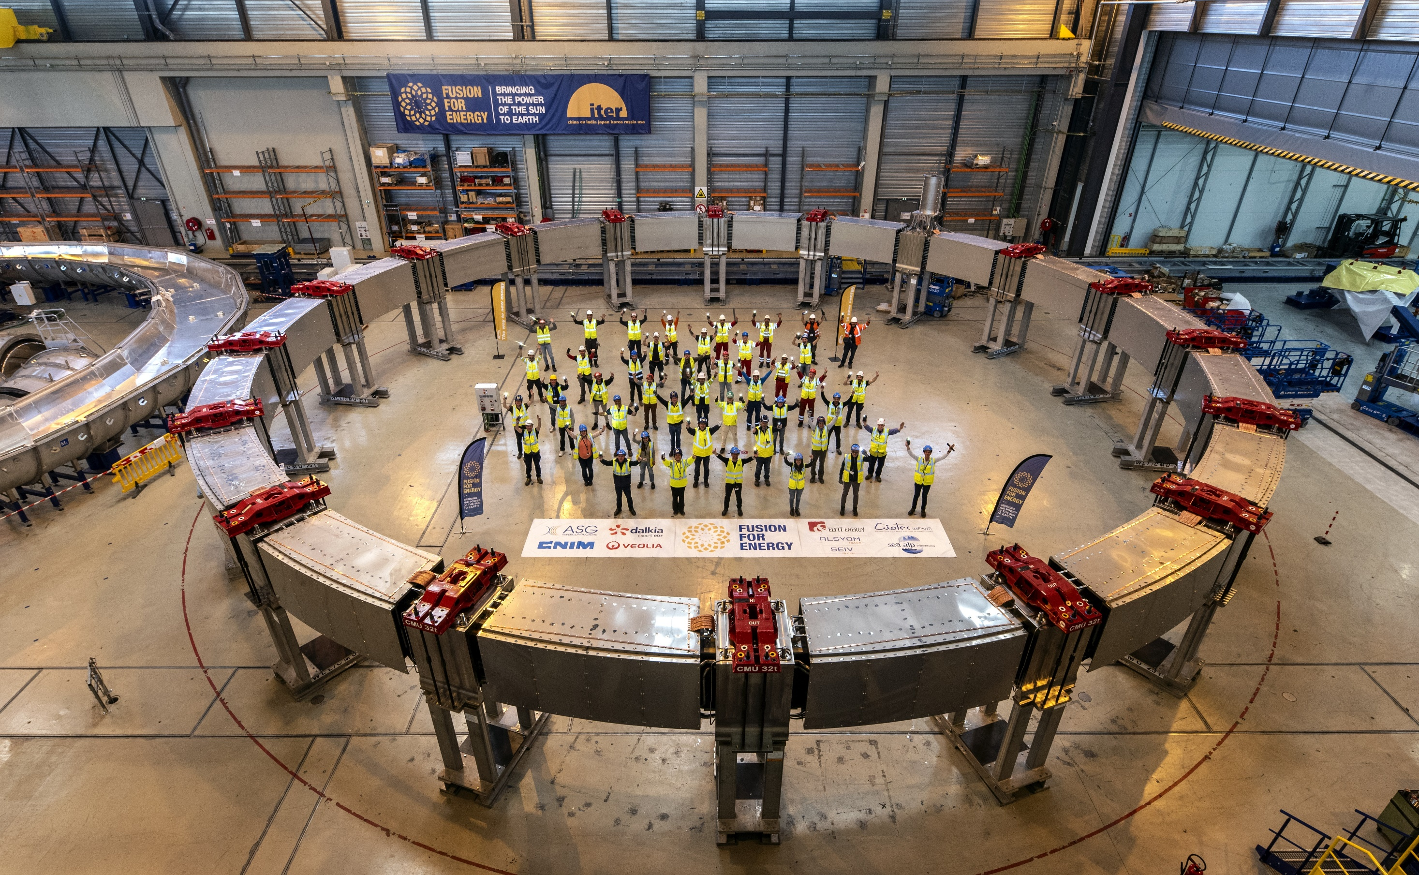
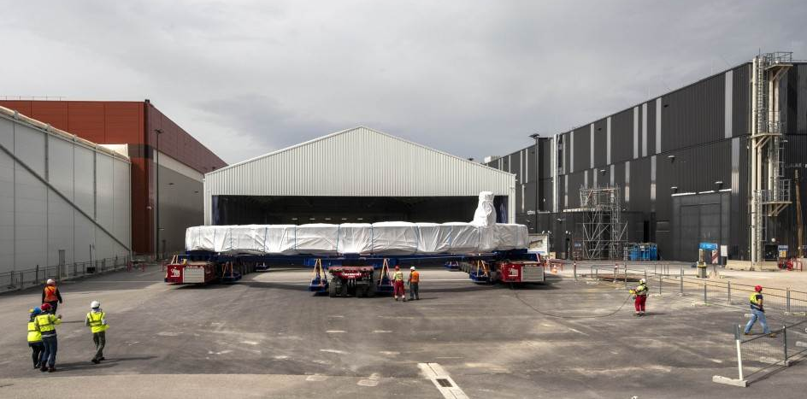
PF coils:
NbTi, 6 T, 45 kA, largest coils (PF 3,4) 24 m diameter, 400 t
PF6 (CN), PF5 (EU): complete and in-pit
PF1, 2 (RF, EU): complete and in storage
PF3,4 (EU): complete and in storage
15 Apr. 2024
PF3: being moved into storage
PF3 completed

Slide 33
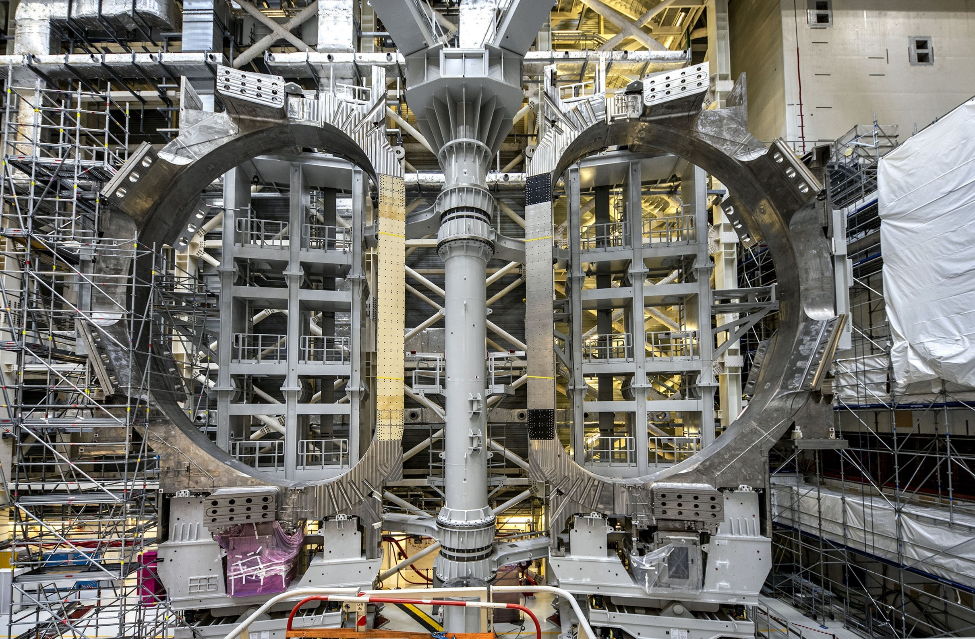
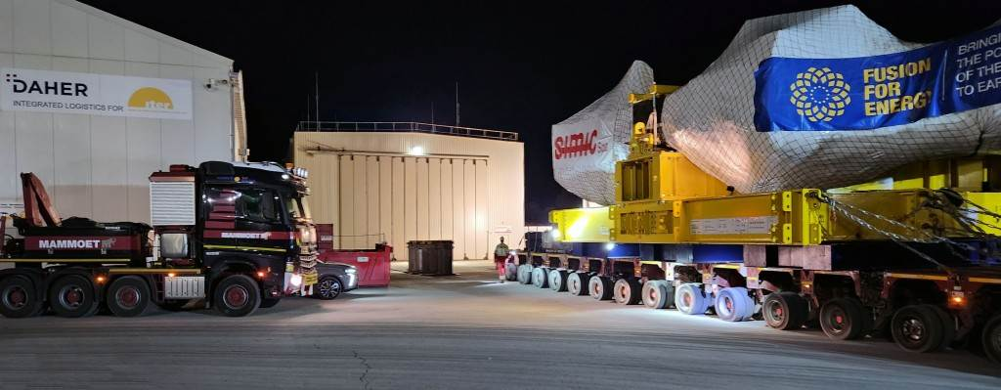
TF coils:
NB₃Sn, 11.8 T, 68 kA, 41 GJ, 9 x 17 m, 360 t each
JA: 9 coils → 9 on-site
EU: 10 coils: 10 on-site
8 July 2022
TF18 – last EU coil arrives on-site
15 Dec. 2023

Slide 34
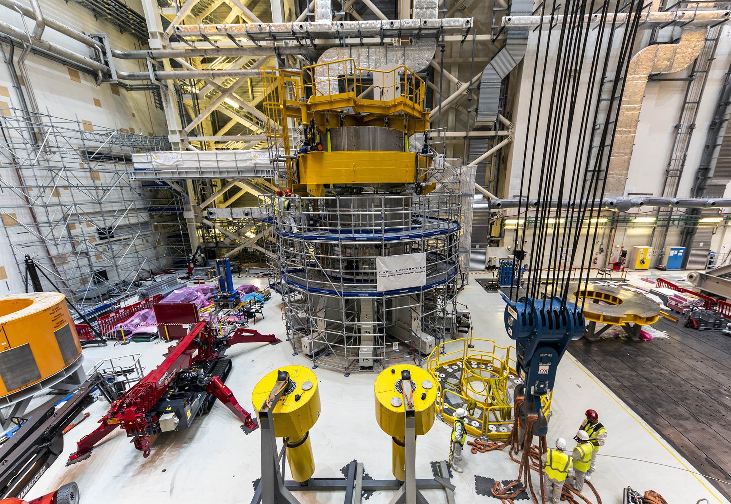
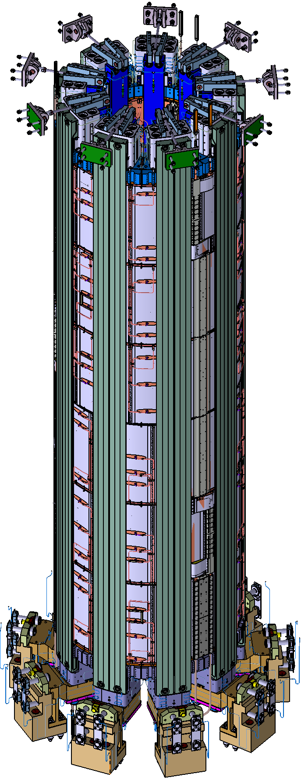
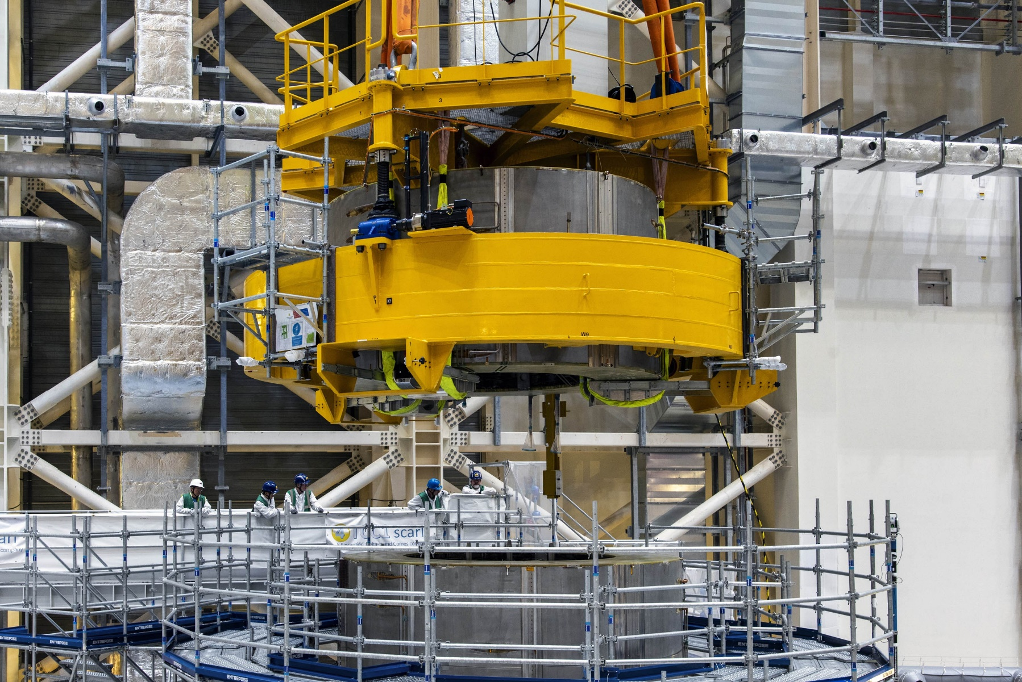
Central solenoid: one of the most massive components of the ITER machine. 6-module stack, mass >1000 t, Nb₃Sn, Stack height ~20 m high, ~4 m wide, max. current ~46 kA
4 modules now on-site (supplied by US-DA (General Atomics)). Last two arrive in 2025.
3rd CS module now added
11 Apr. 2024
Two modules on the stack in Sept. 2023

Slide 35
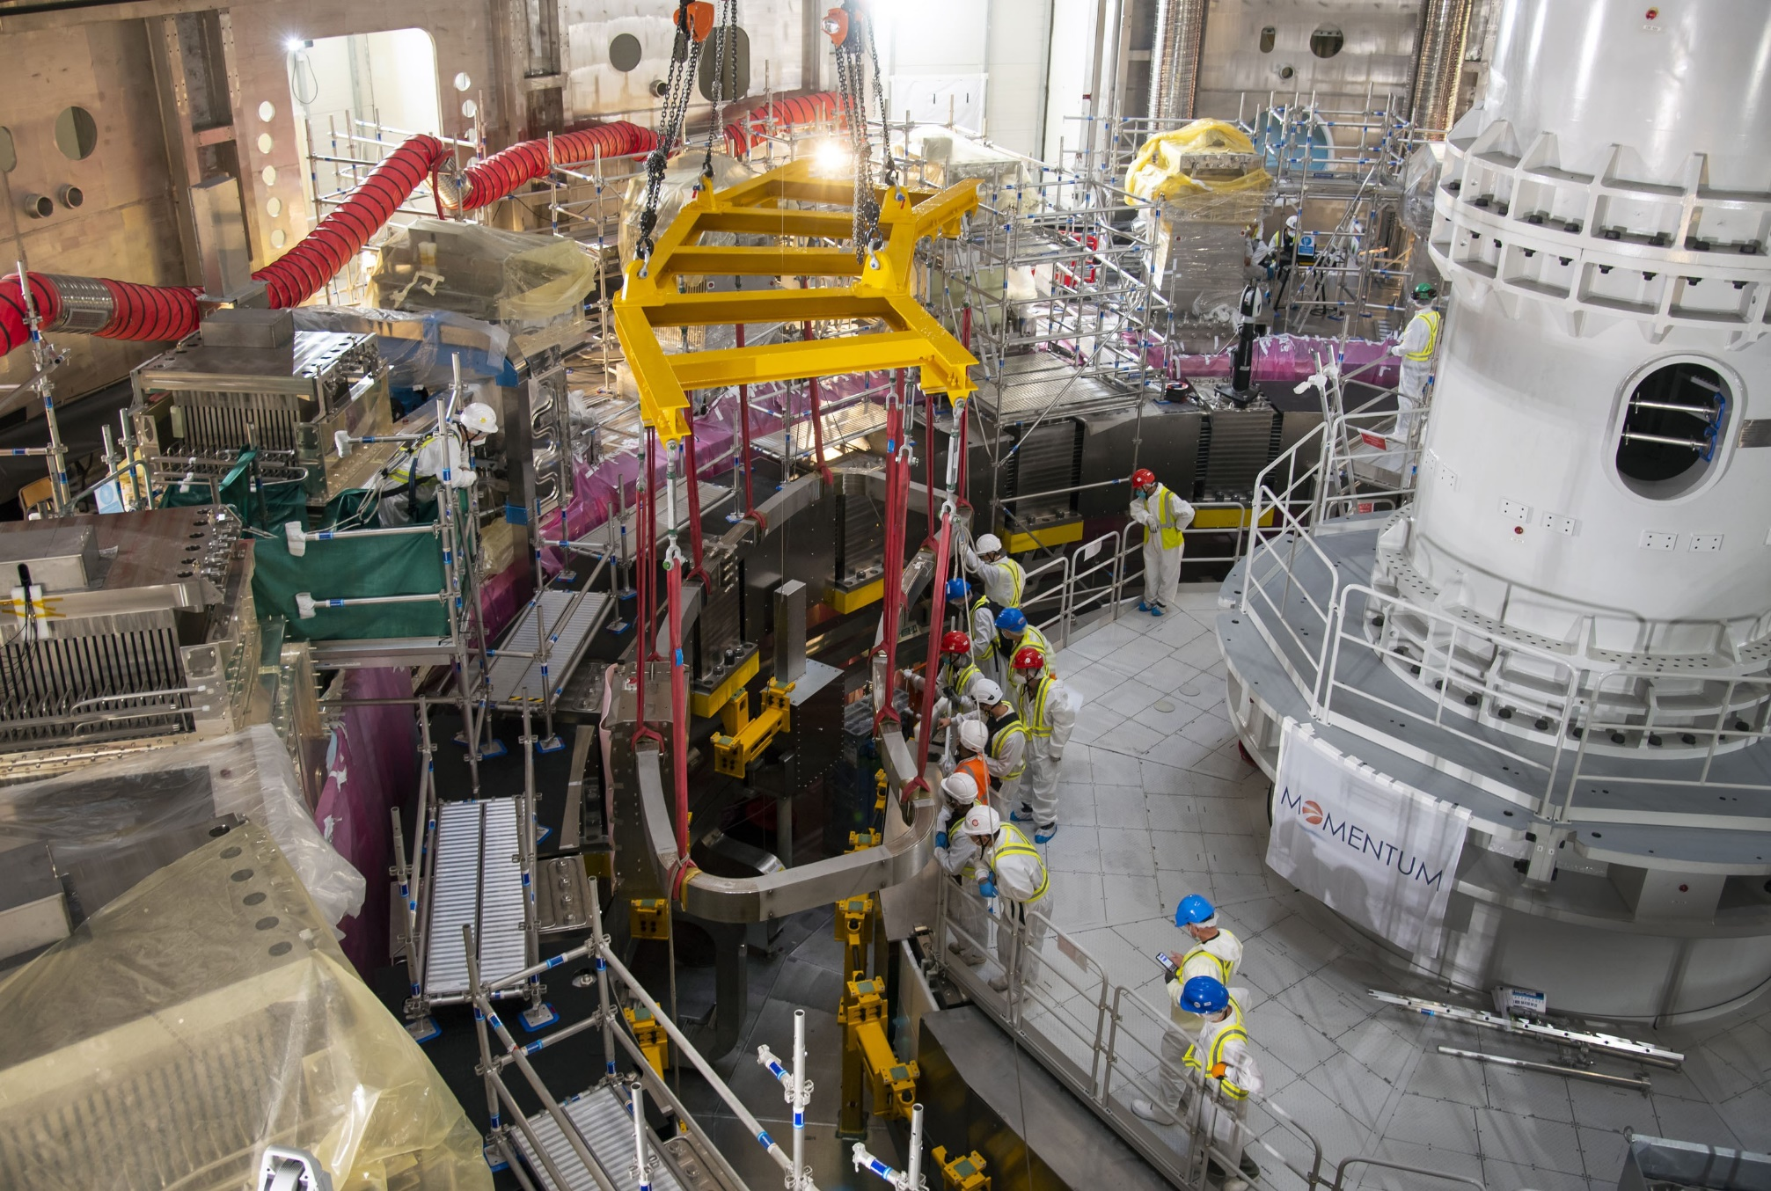
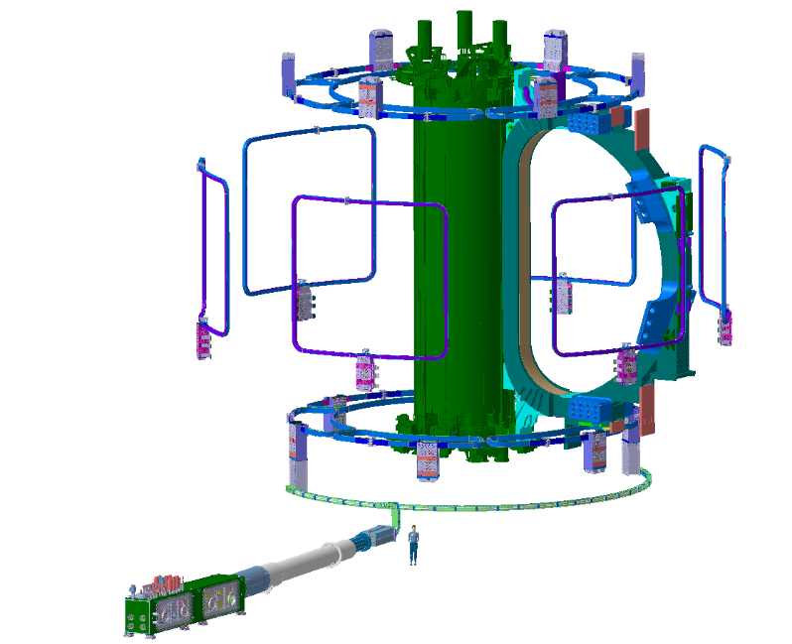
Error field correction coils
NbTi, max current ±10 kA, 6x6 coils, largest 8.4 x 7.2 m, total mass 78 t
All Top and Bottom coils delivered, delivery of 6 side coils in 2026
21 Oct. 2021
Joint manufacturing for SCC4
August 2024
Installation of one of the lower (bottom) correction coils (BCC)

Slide 36
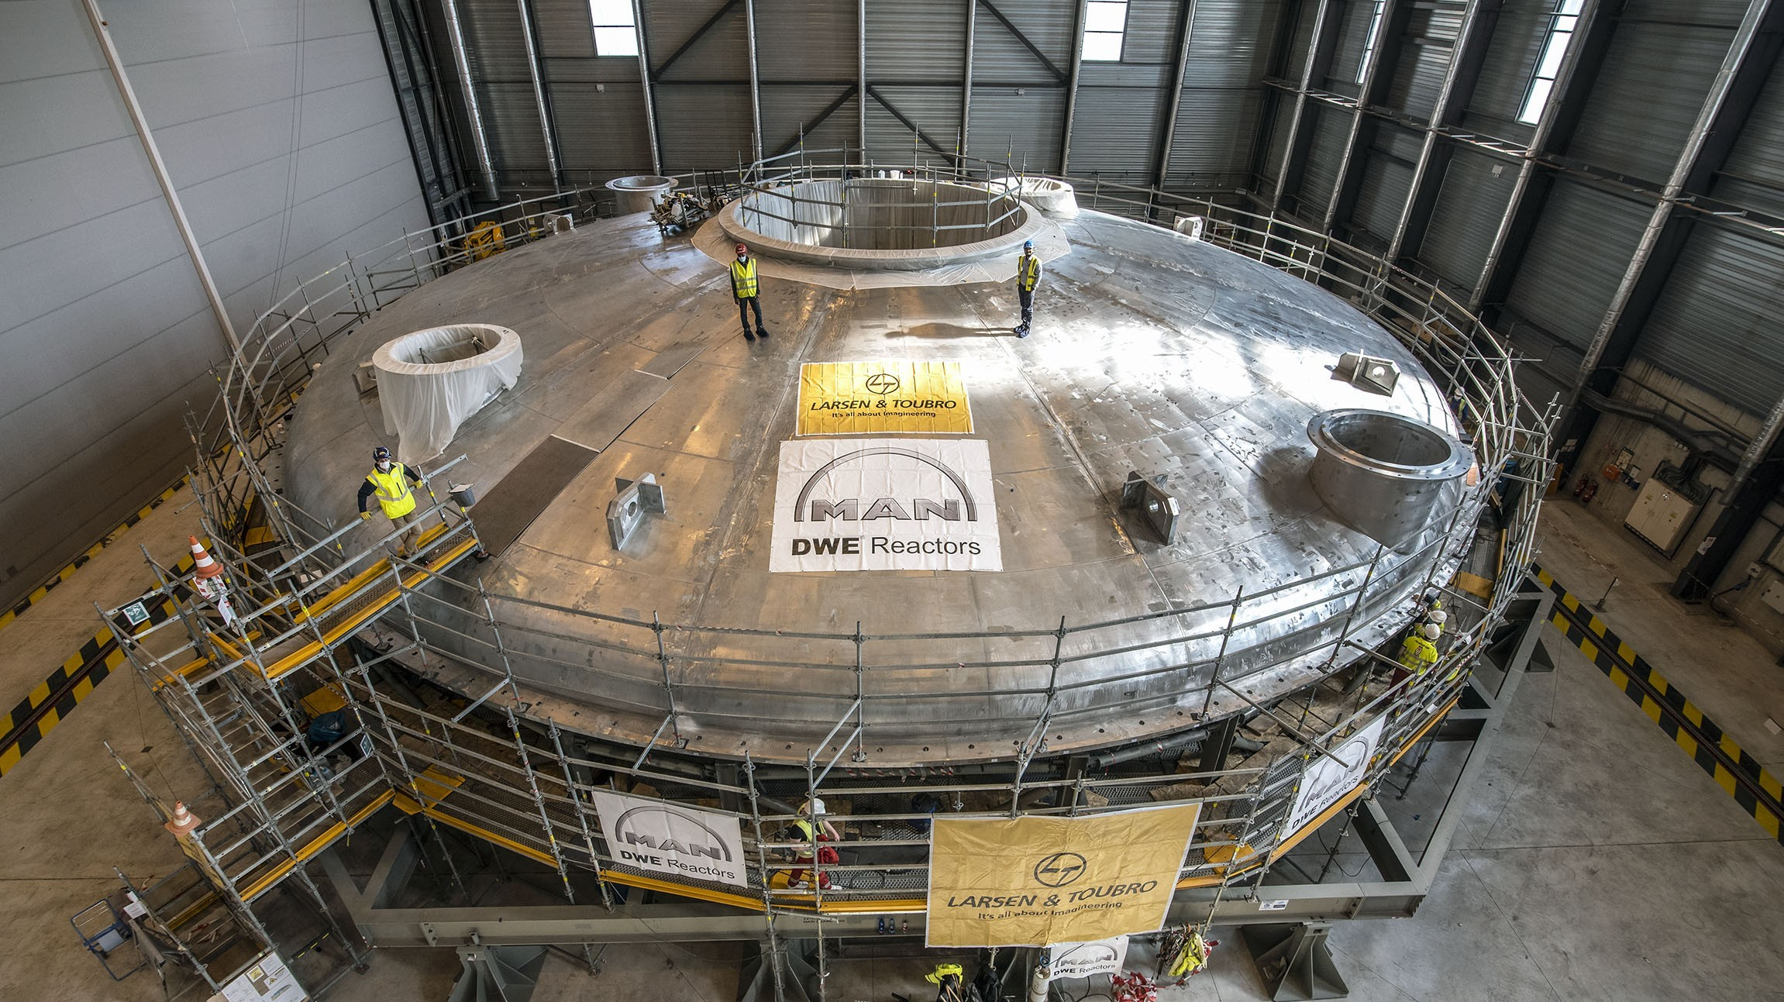
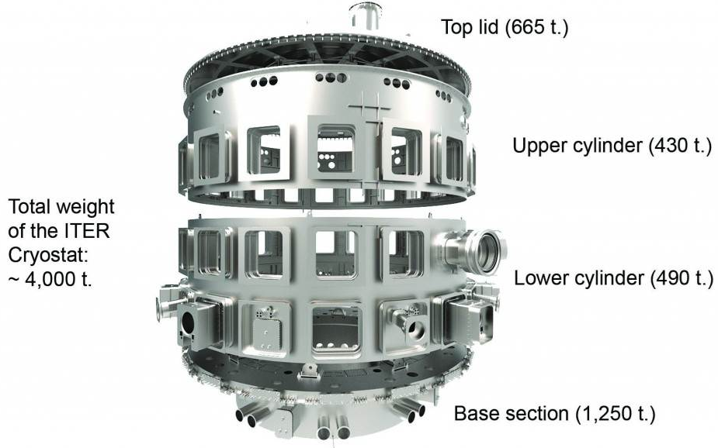
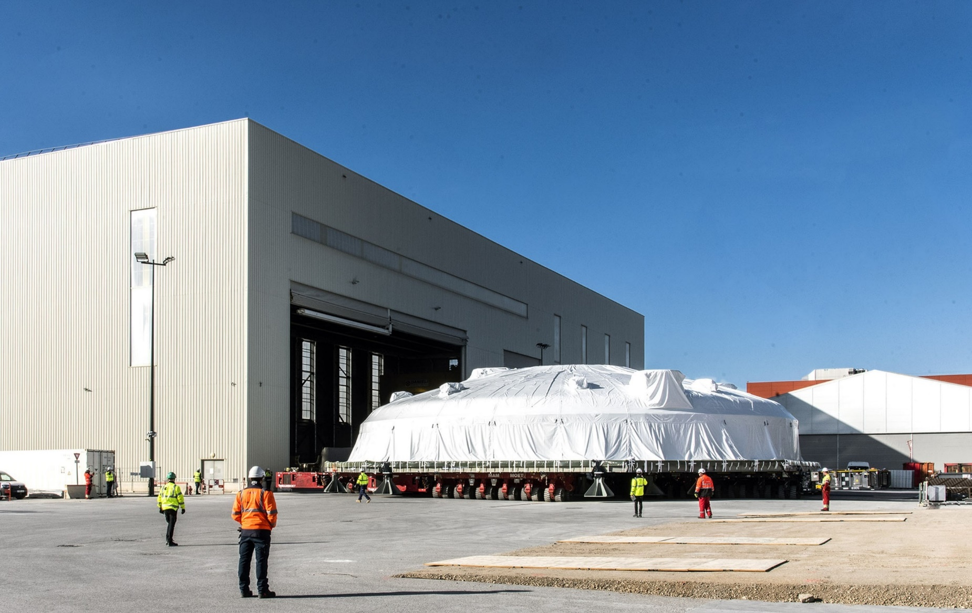
Cryostat: pit assembly completed for Base Section and Lower Cylinder.
Upper Cylinder and Top lid completed and in long term storage
10 March 2022
Being moved to long term storage location

Slide 37
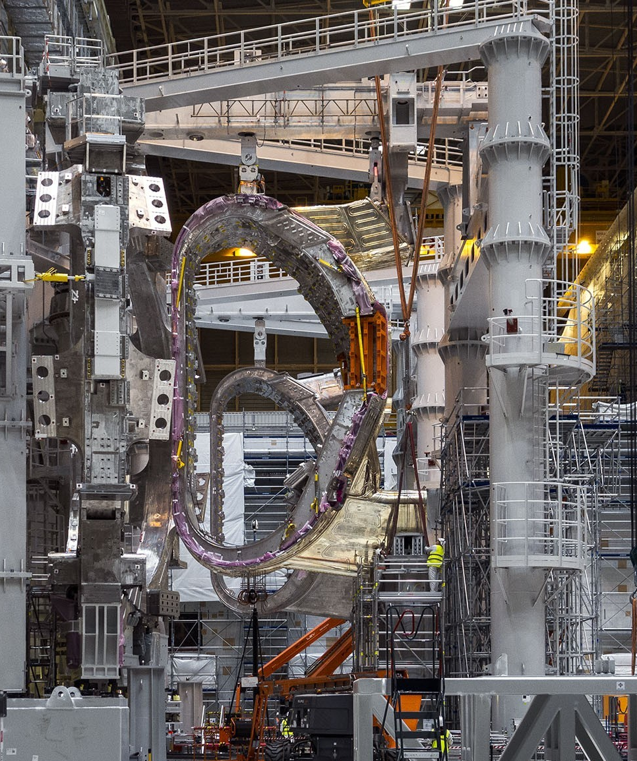
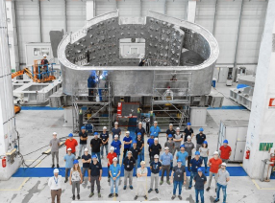
Vacuum Vessel: 9 sectors (KO: 4 sectors, EU: 5 sectors)
24 Sept. 2024
EU: Sector 5 (Walter Tosto, Italy) complete and in France – the first of the EU sectors – arrival at ITER site 25/10 (tomorrow)!
KO: 3 Sectors 6,7,8 at IO
Sector 1 completed and in France
But repairs required – see later

Slide 38
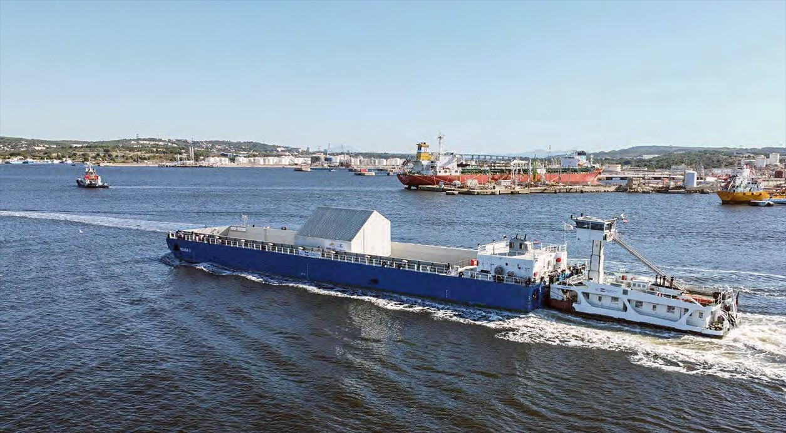

15 Oct. 2024
11 Oct. 2024
KO VV Sector 1 being offloaded at Fos-sur-Mer – expected at the ITER site early November
EU VV Sector 5 being transported by barge across the inland sea Étang de Berre

Slide 39
Very brief resumé of machine assembly activities in the last ~3 years

Slide 40

26 May 2020
Tokamak Pit painted up and ready for first major components

Slide 41

26 May 2020
SSAT-2
SSAT-1
These massive Sub-Sector Assembly Tools (SSAT), supplied by Korea, are used for assembly of complete vacuum vessel sectors weighing ~1400 tonnes
The first big lift: 1250 tonne, 30 m diameter cryostat base on its way to the pit

Slide 42

26 May 2020
The first big lift: 1250 tonne, 30 m diameter cryostat base on its way to the pit

Slide 43

31 August 2020
Next up: 375 tonne lower cryostat cylinder

Slide 44


14 Jaunuary 2021
Lower cylinder thermal shield on its way

Slide 45



27 March 2021
Temporary supports for PF6
17 August 2021
Full assembly
Lower cylinder of in-pit Assembly Tool

Slide 46

21 April 2021
Toroidal field coil gravity supports
First poloidal field coil PF6 inserted onto temporary supports

Slide 47


7 September 2021
Radial beam testing → beams carry each VV sector and must be very precisely positioned

Slide 48

15 September 2021
PF 5 coil lifted into the tokamak pit

Slide 49

8 December 2021
PF6
PF5
Metrology and adjustment

Slide 50

20 December 2021
Tokamak Pit ready for the first VV sector

Slide 51
Assembly and installation of first complete VV sector

Slide 52

28 February 2021
VV Sector 6 being prepped for upending
In February 2021, Assembly Hall being prepared for first VV Sector upending

Slide 53


26 March 2021
Done!
Start of upending sequence to place Sector 6 into the vertical position

Slide 54

6 April 2021
Rail transport structure the same system which is used to hold the sector in place for in-pit installation
Final step: transfer to the SSAT

Slide 55

6 April 2021
And finally, inserted from above into the SSAT

Slide 56

21 June 2021
Inboard thermal shield section clamped to Sector 6

Slide 57

12 August 2021
Full VV thermal shield on, Sector 6 and TF12 now on SSAT-2

Slide 58

30 August 2021
Just prior to final positioning of TF coils

Slide 59

15 November 2021
First complete Sector 6 ready for pit installation

Slide 60

3 January 2022
VV Sectors 6 and 7 both on SSAT tools

Slide 61
The first sector lift and placement – a major milestone for the project

Slide 62

11 May 2022
Sector 6 fully lifted out of SSAT-2 and rotated 90°

Slide 63

11 May 2022
Sector 6 fully lifted out of SSAT-2 and rotated 90°

Slide 64

11 May 2022
Over the tokamak pit wall: 20 cm gap

Slide 65

11 May 2022
Lowering into the tokamak pit

Slide 66

14 June 2022
In-place and alignment procedure underway

Slide 67

Final alignment complete. Sector placed to millimetric precision according to physics specifications
Sept. 2022

Slide 68
And now the bad news …..
Dimensional non-conformities in VV field joint contours on the 3 sectors delivered to IO have turned out to be too large to permit sector-sector welding according to required standards
Chloride stress corrosion cracking (SCC) found on many of the thermal shield cooling pipes
Major issues preventing continued assembly of VV sectors
More details of these issues and their solution were released publicly:
  https://www.iter.org/newsline/-/3818
  and
  https://www.iter.org/newsline/-/3830

Slide 69




SCC on thermal shields: problem found on several VV shields not yet installed on VV sectors → assumed to be present in many locations in VV and cryostat shields

Slide 70


2 June 2023
Some areas of non-conformity on VV field joints, particularly where the individual VV segments are joined

Slide 71
Solutions
For the VV thermal shield → remove old pipes and re-weld new ones (different steel and welding process/material) + re-manufacture of a few panels
For the cryostat thermal shield → leave old pipes (but don’t connect) and re-weld new ones in-situ (different steel and welding process/material)
For VV non-conformity → remove and add material to meet required dimensions (~73 – 400 kg per sector)

Slide 72



VV Thermal Shields: repair and replacement
Repairing 7 VVTS sets (21 panels)
Remanufacturing 2 VVTS sets (6 panels)
  Replace corroded pipes
  2 mm panel machining to eliminate potential panel corrosion risk
  Surface polishing to replace silver coating → roughness < 0.1 μm → low emissivity at 80 K
  Outboard
  Right hand side (OBRH)
  Inboard
  (IB)
  Outboard
  Left Hand side (OBLH)
  Equatorial port
  Shrouds
2nd CCTS OBRH pre-assembly test (INOX, India)
Progressing well

Slide 73




VV bevel joint repairs
Before repair
Sectors 6, 7 repaired in vertical position (SSAT)
Sectors 1, 8 in horizontal position (Cryostat Building)
After repair
SP100
INNER BEVEL
INNER BEVEL
S06
S07
T-RIB
OUTER BEVEL
SP
OUTER BEVEL

Slide 74

5th July 2023
First full sector module coming back out of the pit for dismantling and repair on an SSAT

Slide 75

8 Feb. 2024
Back in the SSAT, TF coils and thermal shields removed. Repairs carried out in parallel by a consortium of Italian firms

Slide 76

18 July 2024
Sector 7
Sector 6
Repairs in-situ on Sectors 6, 7

Slide 77


15 July 2024
Sector 8 under repair (horizontally) in repurposed cryostat workshop

Slide 78

Sector 7: repair complete, re-assembly underway with repaired VVTS
Sector 5 (on-site for 25/10): repaired at supplier
Sector 6 (at ITER): repairs in progress → forecast 15/11/2024
Sector 8 repairs in progress → forecast 25/07/2025
Sectors 2,3,4,9: manufacturing in
progress (at EU
supplier)
15 Sept 2024

Slide 79
The ITER Research Plan and
“re-baselining”

Slide 80
New Baseline rationale
Robust achievement of ITER Project goals, in view of current and past challenges (delays due to the Covid-19 pandemic, technical challenges in completing first-of-a-kind components and in nuclear licensing)
Realistic and reliable assembly – commissioning - operation
Achievement of earliest start of the ITER Nuclear Phase (DD operation) and minimization of technical risks
Stepwise Safety Demonstration
SRO (Start of Research Operation) and DT-1,2 phases
Key elements of the new baseline:
    First Wall: beryllium (Be) → tungsten (W)
    Optimized heating mix + boronization → ease path to Q = 10 with added W

Slide 81
Stepwise Safety Demonstration
ITER is a very large step from present day magnetic confinement devices
Complexity, large uncertainties and very ambitious project goals make a safety demonstration in “one go” very challenging
Phase 1: DT-1
A first phase of safety demonstration of ITER operation developed
Focused on the achievement of specific project goals
Limited neutron fluence (1% of present “end-of-life” Project Specification)
→ ~3 x 10²⁵ neutrons
Phase 2: DT-2
Second phase of safety demonstration with knowledge acquired during DT-1
Attain lifetime neutron fluence → 3 x 10²⁷ neutrons

Slide 82
Why change to a tungsten First Wall?
Physics basis for tokamak operation with W walls is much stronger than it was at start of ITER construction
Several issues with Be as PFC:
Erosion lifetime
    Tritium retention in co-deposits
    Low melting point → lower margin in I_{p} before potential “gap bridging” on FW panels (disruption current quench)
Major benefit in assembly complexity and avoid costly later wall changeout
4
T_{melt} = 1287°C
Be
Beryllium
9.012
74
T_{melt} = 3422°C
W
Tungsten
183.84
BUT: lose low Z material facing the plasma and gettering properties of Be

Slide 83

New Baseline Phases and Research Plan
R. A. Pitts, PSI 2024

Slide 84

Updated timing …. (proposal to ITER Council)

Slide 85

Thanks for your attention
R. A. Pitts
Experiments and Plasma Operation Section, Science Division
ITER organization
Czech Technical University Prague, 24 October 2024, Czech Republic
IDM UID: CCUH2M

