Slide 1
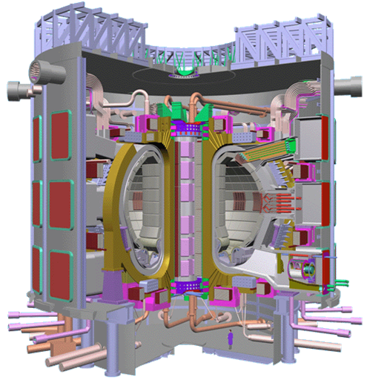
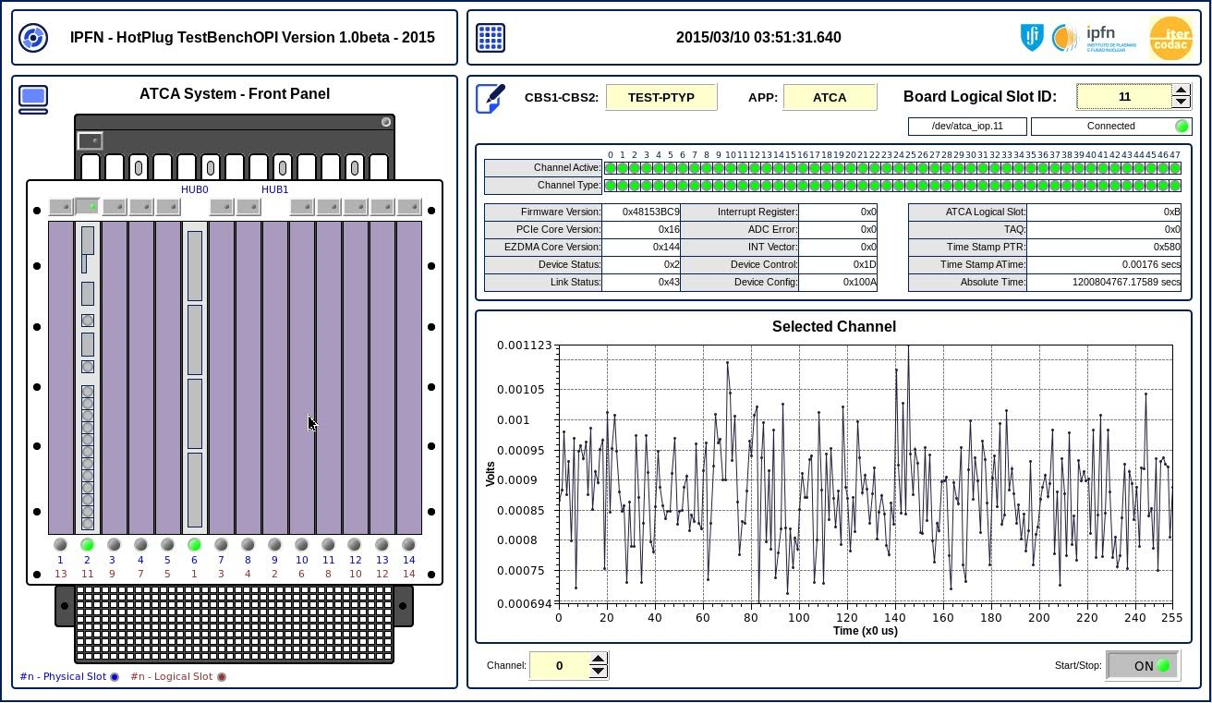
Monitoring of Instrumentation for Critical Nuclear Fusion Plasma Control and Data Acquisition Systems
Name: Paulo Fortuna Carvalho
Email: pricardofc@ipfn.ist.utl.pt
5th PhD Event, Prague, Czech Republic, 15-18 November, 2015

Slide 2
Main Topics
Introduction: Control in Nuclear Fusion Plasmas
Purpose
Why Monitoring?
Why ATCA and uTCA Systems?
ATCA Control and Data Acquisition System
System Components
Software Modules
Hardware Management
External System Management
Conclusions
References

Slide 3
Purpose
Development of a System Manager Application for Monitoring and Management of a Control and Data Acquisition System Hardware.

Slide 4
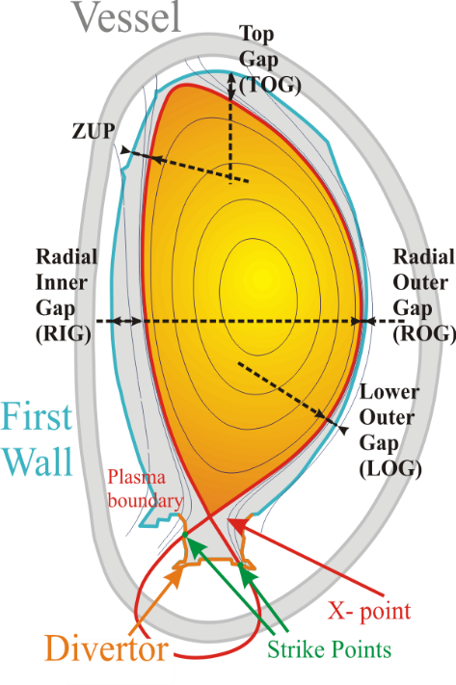
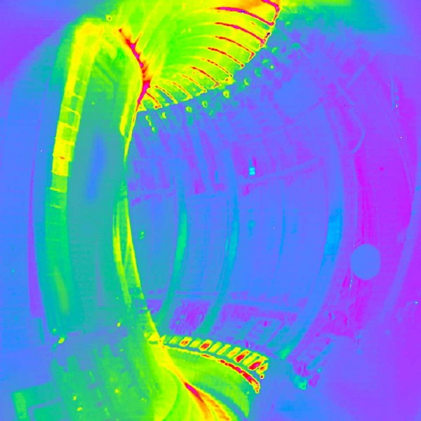
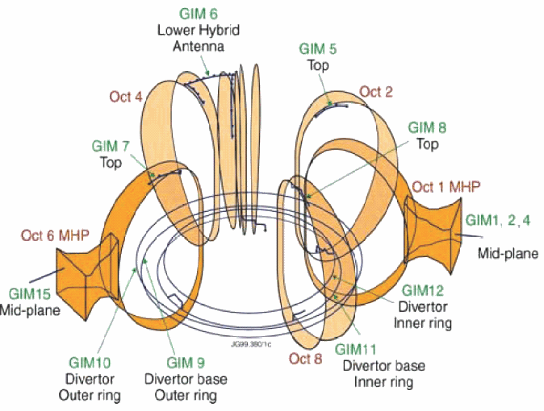
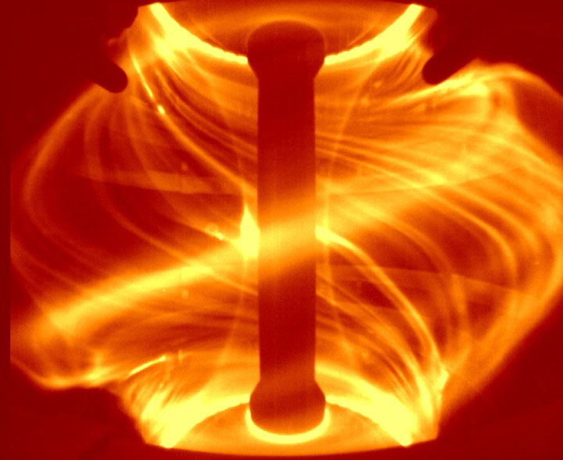
Control in Nuclear Fusion Plasmas is Critical for Safe Operation and to Achieve High Performance
Magnetic control
Position, Shape & Vertical Stabilization
Wall Protection
Malfunction of a single component may originate Critical Damage to entire infrastructure!
Instabilities Mitigation & Control
Density
Control

Slide 5
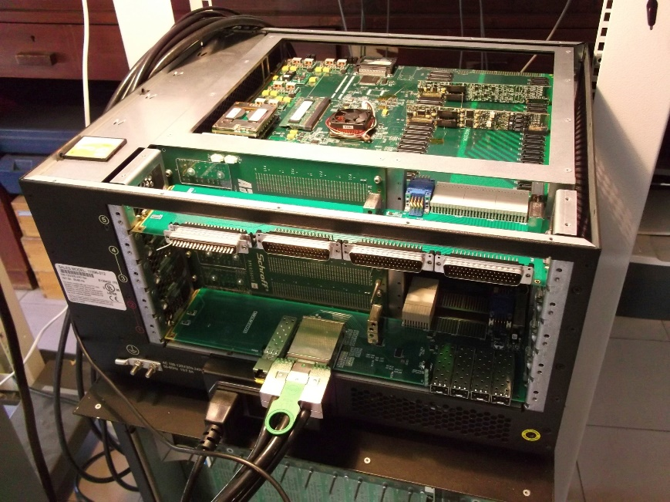
Why Monitoring?
Fusion Reactor
(Tokamak)
Fusion Reaction
Diagnostics
Nuclear Fusion Plasmas Behavior Study and Understanding. How?
Answer: Control and Data Acquisition Instrumentation
Acquisition and Feedback Control
Plasma Shape, Positioning and Vertical Stabilization
Demands Critical Realtime Tasks to Prevent Machine Components DAMAGE and Plasma Termination!
Monitoring and Hardware Management to AVOID Instrumentation Failure!

Slide 6
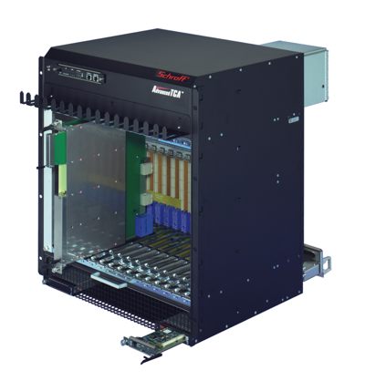
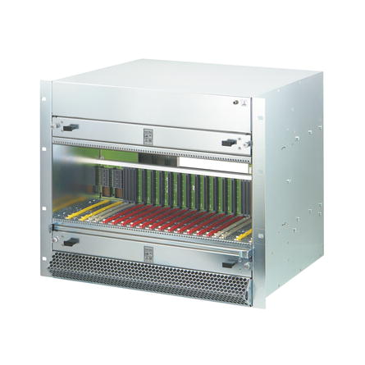
Why ATCA and uTCA Systems? Implementation and tests will take place on ATCA platform (Ref.1) but can be used with other form factors such as uTCA.
s
Provide
High Availability
Serviceability
Redundancy
High Reliability
Modularity
High Data Throughput
Required by diagnostics in these kind of Fusion Experiments!
ATCA 5-slot
Shelf
ATCA 14-slot
Shelf
uATCA Shelf

Slide 7
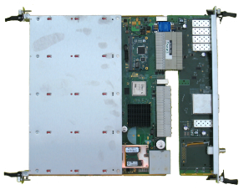
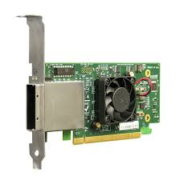
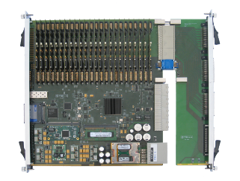
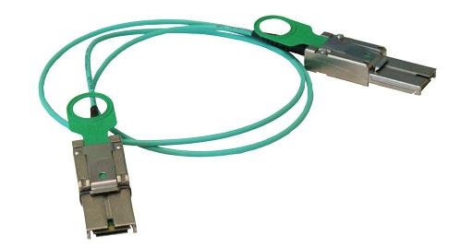
ATCA Control and Data Acquisition System
Host
Computer
RTM Module
ATCA-PTSW-AMC4
PCI Express
Cable
ATCA 14-slot
Shelf
RTM Module
Figure 1. ATCA System Components Overview.
ATCA-IO-PROCESSOR

Slide 8
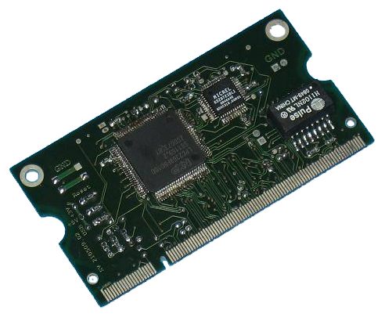
C&DAQ (Ref. 2)
ATCA-IO-Processor
CDaQ Board
CoreIPM OPMA2368 Module
IPMC
Features
48 Channels
48 Inputs (Max.)
48 Output (Max.)
Mixed (I/O)
16 bits Resolution
@ 200MSPS (Max.)
ADC module , 1-2 MSPS, 18 bit
with ADC x2 and chopper mode
RTM Module
DAC module
with DAC x2
Figure 9. ATCA-IO-PROCESSOR Control and Data Acquisition Card.

Slide 9
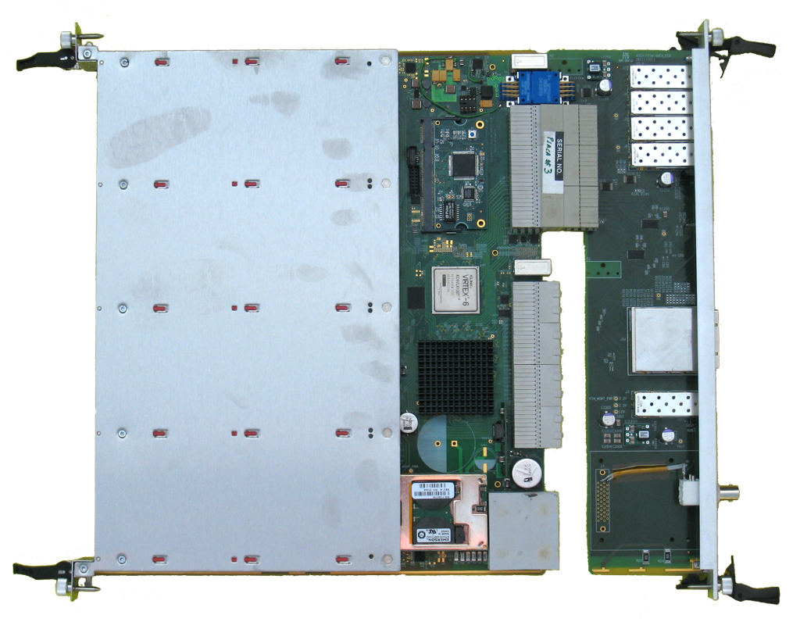
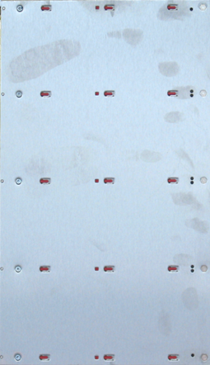
Hub Switch (Ref. 3)
AMC
FMC
Module
AMC
FMC
Module
Benefits
Timing
Synchronism
Endpoints
System Hierarchy
Access
Detection
Host Link
PCI Express
Hotplug
Communication
ATCA Hotswap
RTM Module
AMC
FMC
Module
AMC
FMC
Module
ATCA-PTSW-AMC4
Time Switch Board
Figure 8. ATCA-PTSW-AMC4 Time
Switch Card.

Slide 10
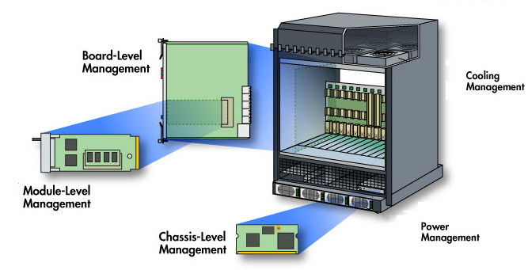
Hardware Management Levels
Monitoring
Sensors reading
Alarm handling
Error detection and correction
System health status
System events logging
Maintenance
Hotplug and hotswap capabilities
System availability
System redundancy
Reliability and serviceability
Safety Operation
Hardware/software electronic keying (e-keying)
System Inventory
FRU information
Sensor data records
Figure 11. ATCA Management
Levels Overview.

Slide 11
Management Interface Platforms
Intelligent Platform Management Interface
IPMI library implementation
IPMC firmware interface (Ref. 4)
Shelf Management (ATCA/MTCA based instrumentation)
ShM management controllers firmware
Hardware Platform Interface
Standard software architecture model
External System Management Application
Including Java/EPICS framework/CSS user interface (End-User)
Including distributed and redundant databases and redundant server PCs.

Slide 12
ATCA Hardware Architecture
Shelf Manager
(Active)
Shelf Manager
(Backup)
Fan Tray
PEM Module
External System
Manager
Shelf Manager Controller
Shelf Manager Controller
IPMC
IPMC
2x Redundant IPMB-0
Board
RTM
Board
RTM
Board
RTM
IPMC
Carrier
IPMC
IPMB-L
Carrier
IPMC
MMC
AMC
IPMB-L
MMC
AMC
MMC
2x Redundant Ethernet (optional)

Slide 13
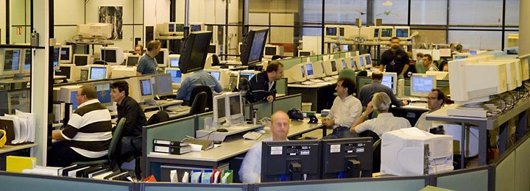
Software Modules
Features
Linux Device Drivers API
System Services
Graphical User Interfaces
Java Applications
Control System Studio OPIs
C/C++ Applications
Firmware
Console Applications
Shell Scripts
ITER-CODAC Interface
EPICS Framework
Benefits
Control Room Operation
System Maintenance
HW Components Status Monitoring
Figure 10. JET Control Room Monitoring, Control and System Operation.

Slide 14
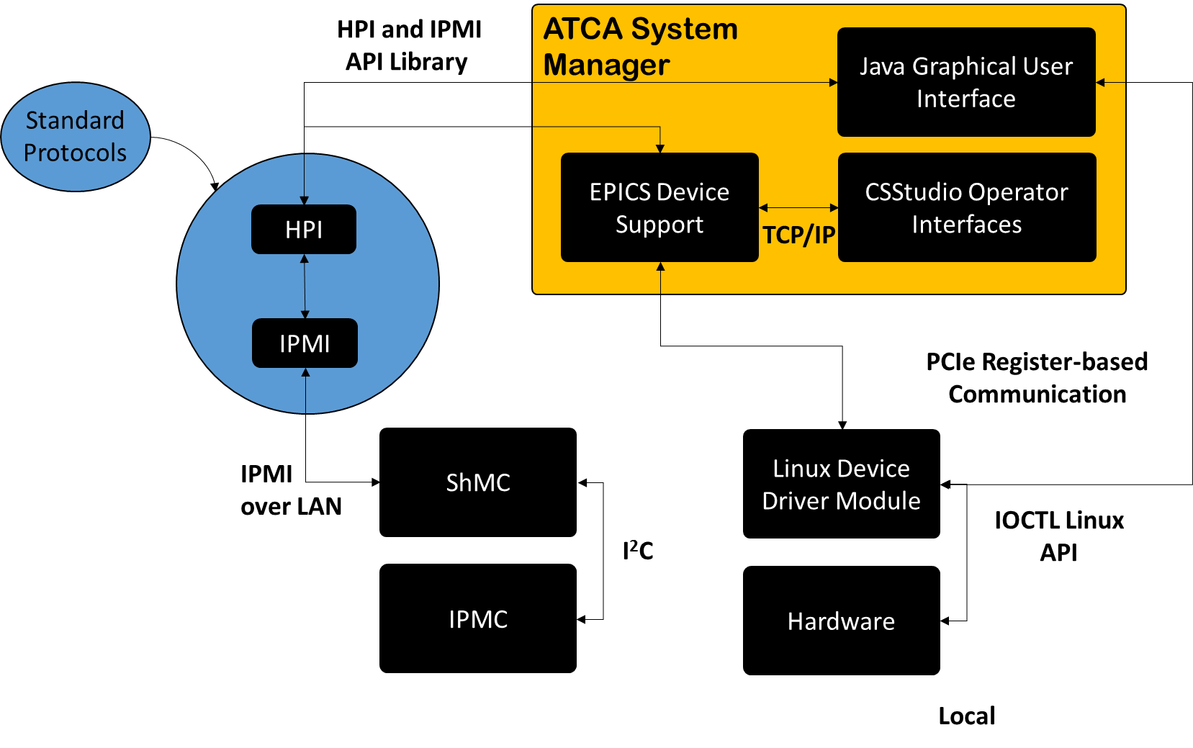
Communication Protocols
Description
External Sys Manager
TCP/IP
IPMI Over LAN
Shelf Manager Controller
I2C (IPM Controller)
PCI Express
Hardware Access
Acquisition
Card Configuration
Figure 13. ATCA External System Manager Software Architecture.

Slide 15
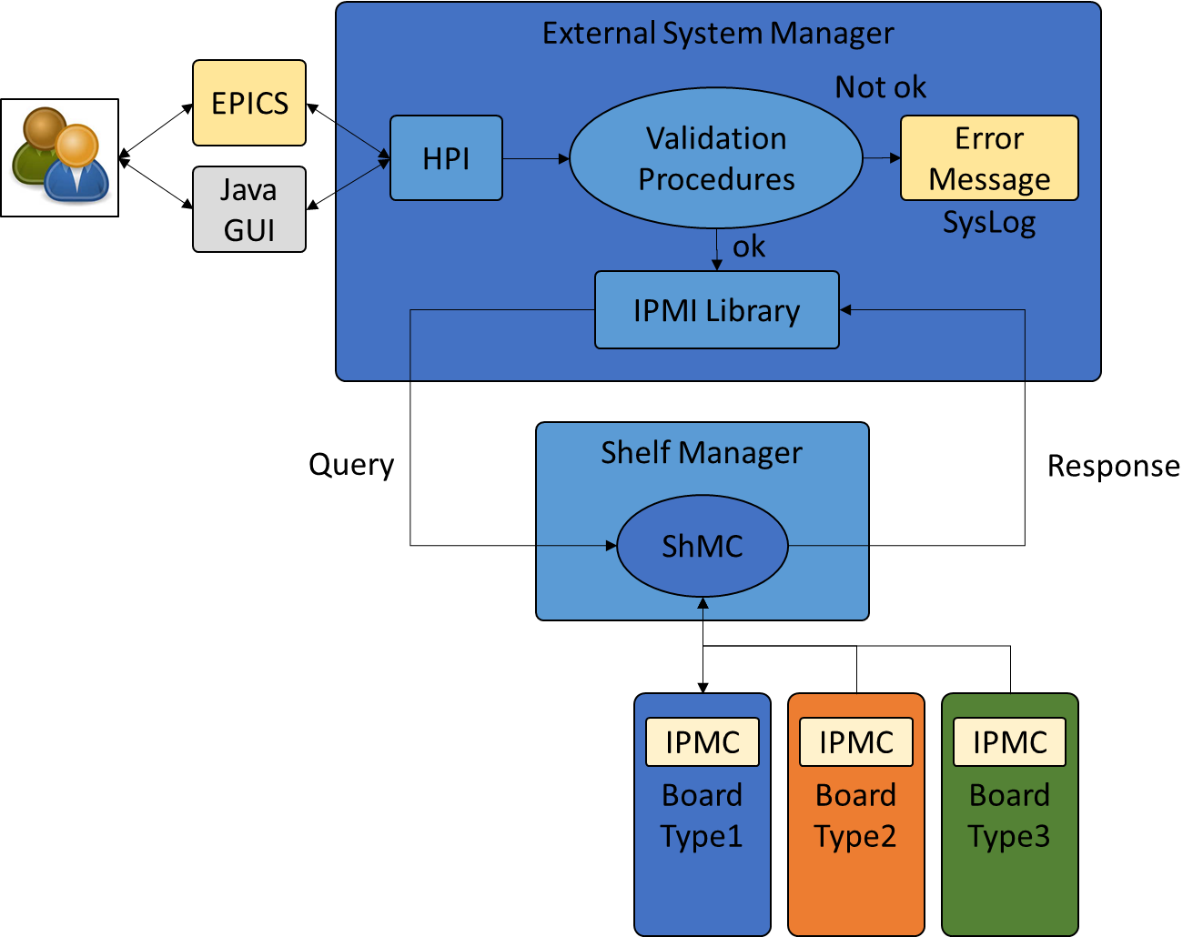
Software Design
External System Manager can use the HPI and IPMI platforms to query the ShMC for system information, status and sensor readings.
Waits for response from IPMCs to inform a control room operator about the system healthy status and notify in case of alarm occurences.
System log to store important realtime events ocurring in the system to provide later analysis and report capabilities.
Figure 11. Software Architecture Internal Mechanism Block Diagram.

Slide 16
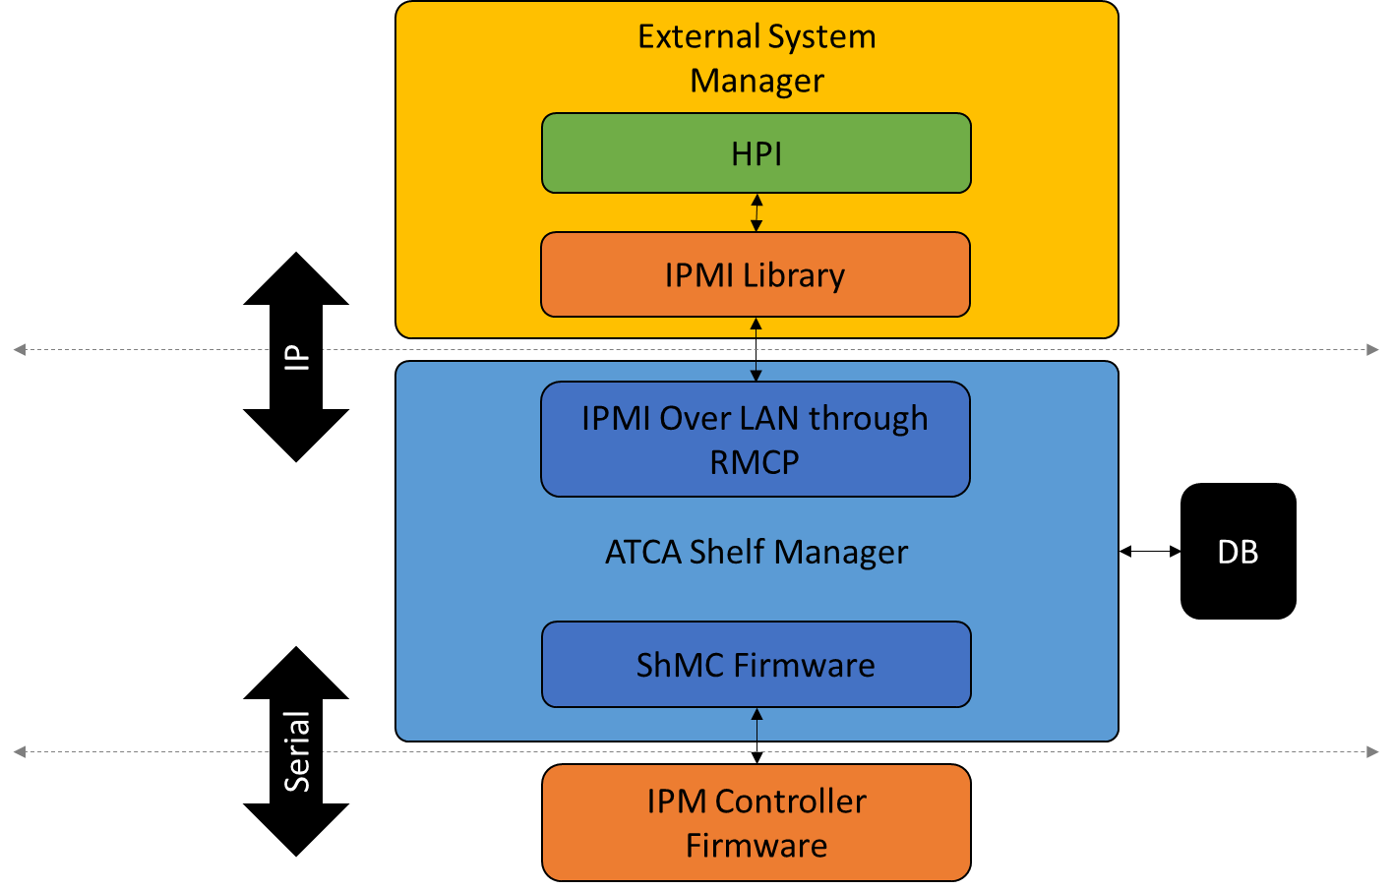
Software Architecture
Inter-layer connection is performed in a top-down perspective using the common standard communication protocols provided by the required instrumentation specifications.
Figure 12. Software Architecture Internal Communication Protocols Block Diagram.

Slide 17
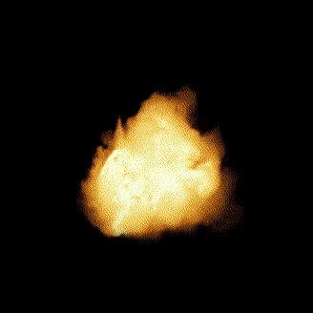
System Maintenance
AMC
Damaged Hardware
Unit Replacement Required
HW Availablility Check
Provide System Operation
Continuous (Reduces Data Losses)
Applications Proper Termination
Provided by Redundancy
In Software Modules
In Hardware Components
AMC
RTM Module
AMC
AMC
ATCA-PTSW-AMC4
Time Switch Board

Slide 18
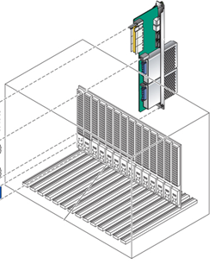
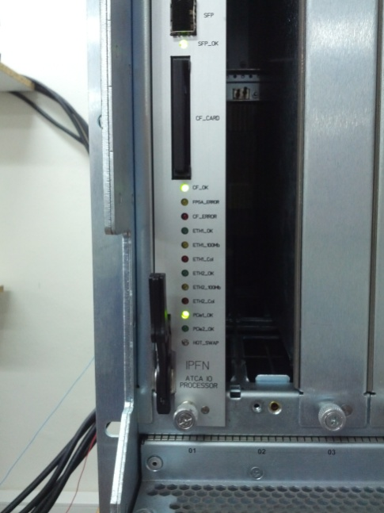
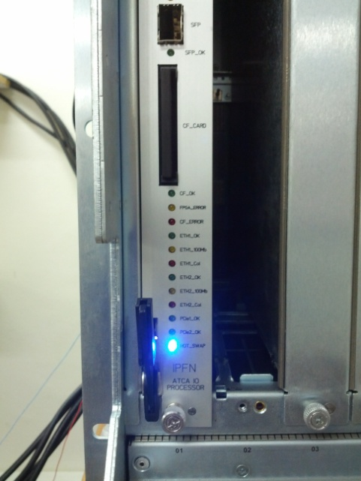
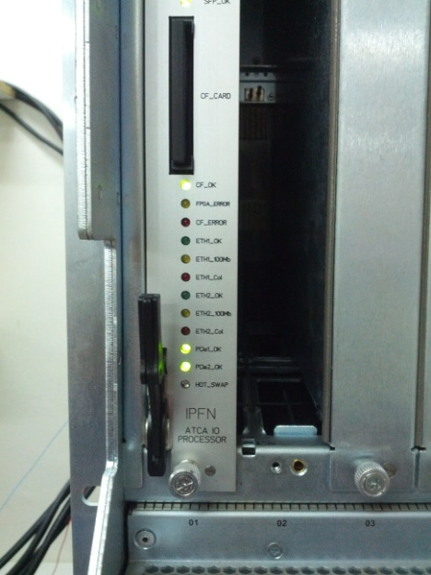
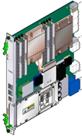
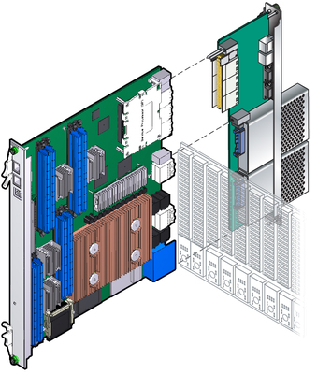
Hotswap Procedure
3
Remove 1st Card
Insert 2nd Card, Switch ON Handle, Wait for Green Led
4
1
Switch OFF Handle
Wait for Hotswap Blue Led
2
5
1st Card Working
Card can be Removed
2nd Card
Ready

Slide 19
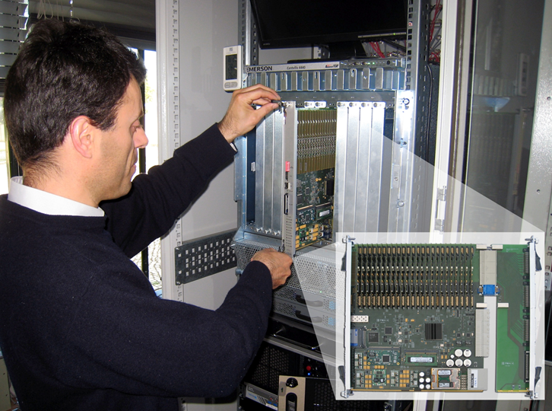
Hotswap Benefits
Damaged Unit Replacement
No Entire System Shutdown Required
Continuous Operation

Slide 20
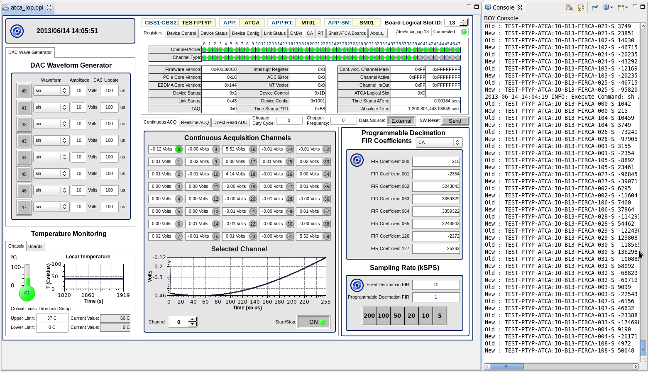

Slide 21
(Ref.5)

Slide 23
Conclusions
Guarantees better response to control and data acquisition systems failures.
Prevents plasma disruptions in nuclear fusion experiments and tokamak machine components damages.
Allows acquisition transfers with less data losses operating in a non-stop environment.
Provides system information, acquisition and configuration, safety operation, simplifies hardware maintenance, allows local or remote software and firmware upgrades and system databases updates.
Ensures fusion power plant preservation, avoids instrumentation failure, grants people and environment protection.

Slide 24
References
ITER prototype fast plant system controller based on ATCA platform, B. Goncalves · J. Sousa · B. B. Carvalho · A Batista · A Neto · B. Santos · A Duarte · D. Valcarcel · D. Alves · M. Correia · [...] · N. Utzel · P. Makijarvi · C Leong · V Bexiga · I C Teixeira · J P Teixeira · A Barbalace · P Lousa · J Godinho · P Mota, Proc. IEEE Nuclear Science Symp. and Medical Imaging Conf. (NSS/MIC); 01/2011
Control and data acquisition ATCA/AXIe board designed for high system availability and reliability of nuclear fusion experiments, A.J.N. Batista · C. Leong · V. Bexiga · A.P. Rodrigues · A. Combo · B.B. Carvalho · P.F. Carvalho · J. Fortunato · B. Santos · P. F. Carvalho · M. Correia · J.P. Teixeira · I.C. Teixeira · J. Sousa · B. Goncalves · C.A.F. Varandas
Timing distribution and synchronization of an ATCA fast controller for fusion devices, M. Correia · J. Sousa · B.B. Carvalho · A. Combo · A.P. Rodrigues · A.J.N. Batista · B. Santos · P.F. Carvalho · B. Goncalves · C.M.B.A. Correia · C.A.F. Varandas, Real Time Conference (RT), 2012 18th IEEE-NPSS; 01/2012
Intelligent Platform Management Controller Software Architecture in ATCA Modules for Fast Control Systems, A. P. Rodrigues · Miguel Correia · A. Batista · P. R. Carvalho · Bruno Santos · B. B. Carvalho · J. Sousa · B. Gonçalves · C. M. B. Correia · C. A. F. Varandas, IEEE Transactions on Nuclear Science 01/2012; 61(4). DOI:10.1109/RTC.2012.6418387
The ITER Fast Plant System Controller ATCA prototype Real-Time Software Architecture, B.B. Carvalho · B. Santos · P.F. Carvalho · A. Neto · L. Boncagni · A.J.N. Batista · M. Correia · J. Sousa · B. Gonçalves

Slide 25
Thank You!

