Slide 1
Thermal Hydraulics and Safety Analyses for Fusion Reactors Primary Heat Transfer Systems
Dario Carloni
Email: dario.carloni@kit.edu
FUSENET PHD EVENT
Prague 15th -18th November 2015

Slide 2
Why Fusion?

Slide 3
ITER Cooling Water System
Notes:
Ref 1

Slide 4
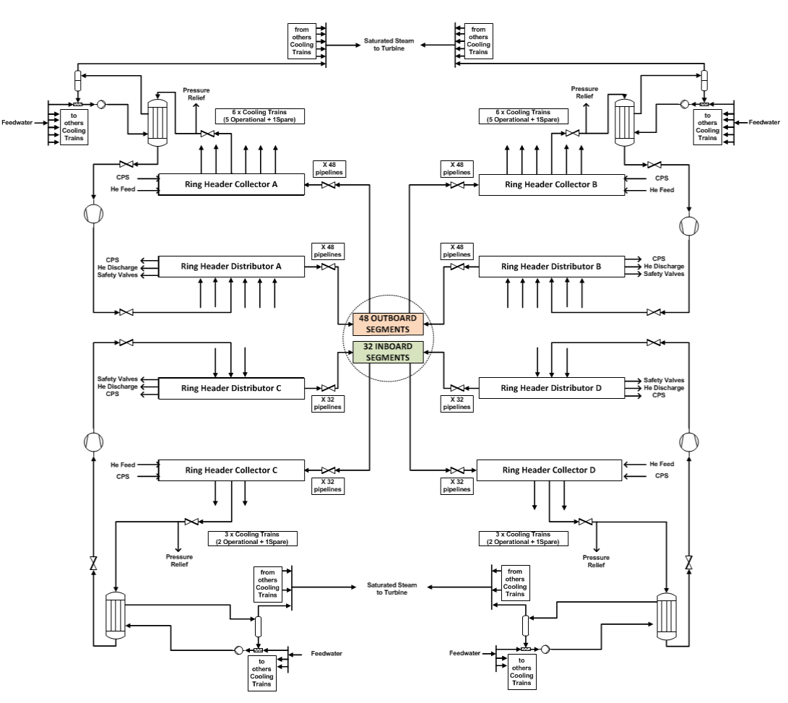
DEMO Helium BB PHTS
Notes:
Ref 1

Slide 5
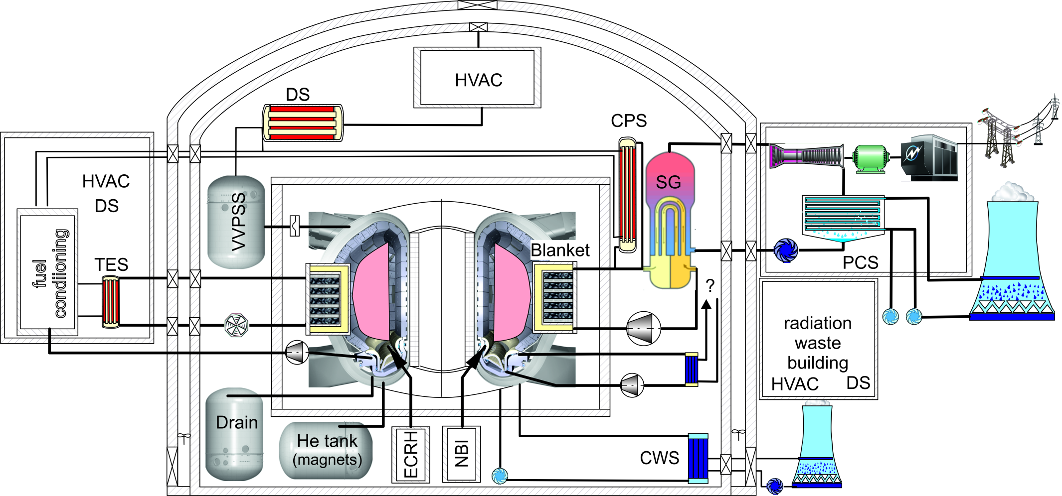
Fusion safety approach
Postulated initiating events (internal events)
Similar as in nuclear power plants such as
Loss of flow accident (LOFA), Loss of offsite-power (SBO), Leaks (VV, Primary System, …), Fire & explosion
Fusion specific events: loss of cryogenic system, arcing , magnet system faults  affecting barriers

Slide 6
PHTS description: Reference design
Reference design from [4].
Two independent coolant loops for the Out-Board (OB) segments and the In-Board (IB) segments.[4]
He as coolant at 8.0 MPa in the temperature range of 300 – 500 °C. He inventory ~7000 kg each OB coolant loop. [5]
Each OB loop removes 910.5 MW.[5]
6 Cooling trains (CTs) with one helicoidal steam generator each (5 operational and 1 spare)
Notes:
Ref 4 and 5

Slide 7
Safety Approach in the DEMO Design
“ Therefore, send not to know For whom the bell tolls, It tolls for thee.”
(John Donne)

Slide 8
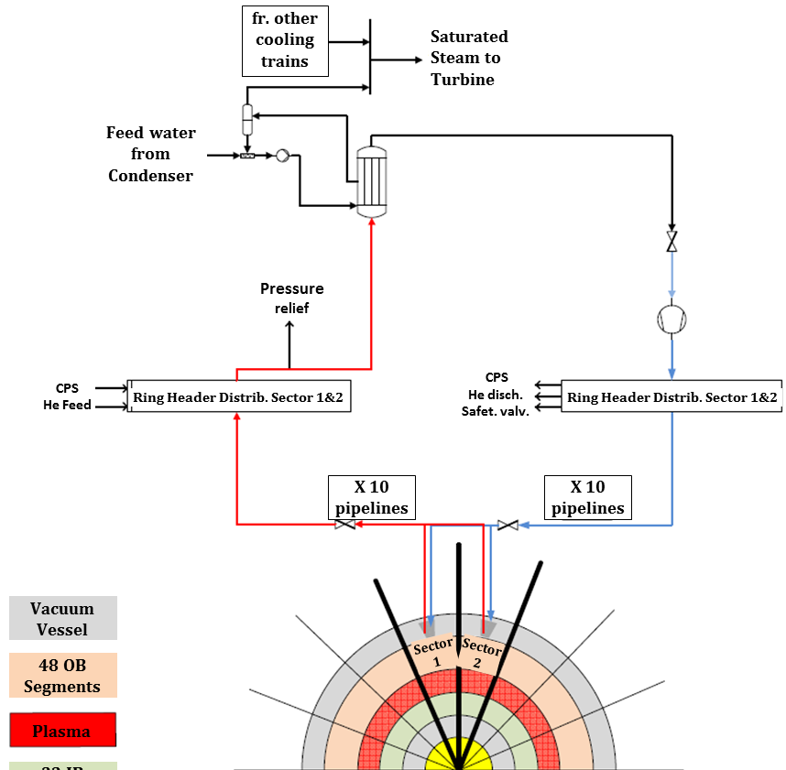
PHTS description: Alternative design
Sixteen independent coolant loops for the Out-Board (OB) segments and the In-Board (IB) segments.
He as coolant at 8.0 MPa in the temperature range of 300 – 500 °C. He inventory ~1100 kg each coolant loop.
Each coolant loop removes 162.0 MW.
Notes:
Ref 6

Slide 9
Ex-Vessel LOCA: Approach
Release of helium coolant inside the Expansion Volume (EV)
Parametric study
Different break position
Different rupture area
200 % (LB)
10.0 % (IB)
1.0 % (SB)
0.1 % (VSB)
Outlet blanket pipes
Main coolant pipes after the SGs
Main coolant pipes before the SGs
Inlet blanket pipes
>40 cases investigated

Slide 10
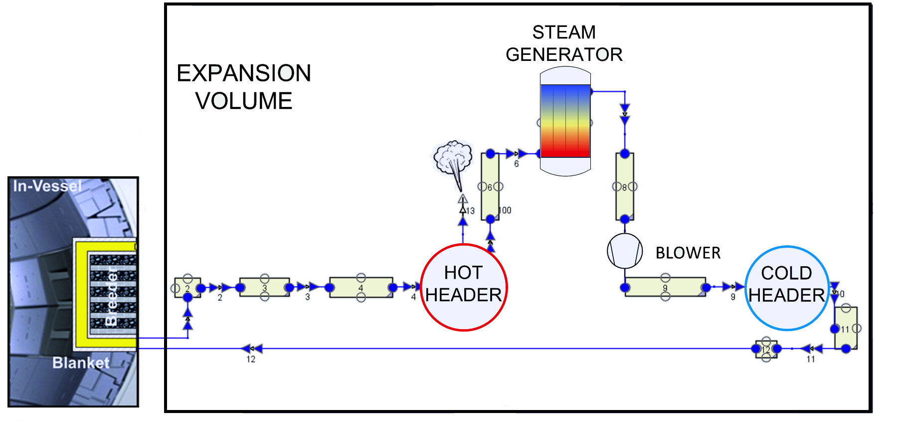
Employed models: 48 model (ref. design)
13 CVs (12 – PHTS, 1 - EV).
12 Flow Junction (FJs).
2 HSs (1 – blanket, 1 – SG).
The rupture happens 100.0 s after the beginning of the simulations
Characteristics | MELCOR
PHTS He mass [kg] | 6795.0
EV Volume [m³] | 70000.0
Heat transfer area [m²] | 15000.0
Blanket HS temp. [K] | 773.15
SG HS temp. [K] | 573.15
Total mass flow [kg/s] | 872.6
Characteristics | MELCOR
EV Temperature [K] | 313.35
Blanket temp. [K] | 771.55
SG temp. [K] | 573.55
Total pressure drop [MPa] | 0.38
Heat flow [W/m²] | 60700.0
Decay heat Flow [W/m²] | 3035.0

Slide 11
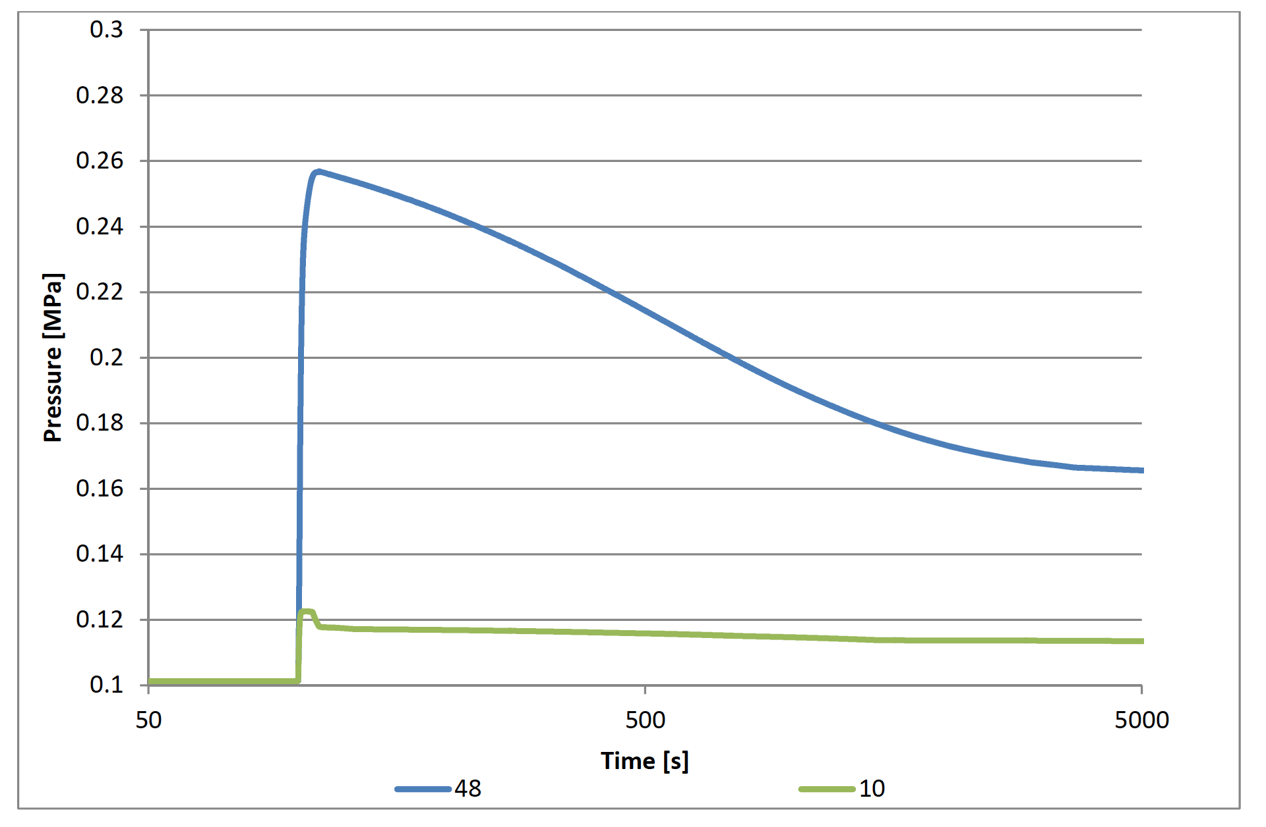
Building Pressure comparison (48 VS 10)

Slide 12
Building Pressure comparison (48 VS 10)
Case | Area [m²] | 48 model |  | 10 model
 |  | Time [s] | P [MPa] | Time [s] | P [MPa]
C1 | 1.83218 | 112.0 | 0.26 | 102.0 | 0.12
C4 | 0.09161 | 165.0 | 0.27 | 115.0 | 0.12
C7 | 0.00916 | 810.0 | 0.27 | 460.0 | 0.12
C8 | 0.00092 | 6600.0 | 0.30 | 1255.0 | 0.12

Slide 13
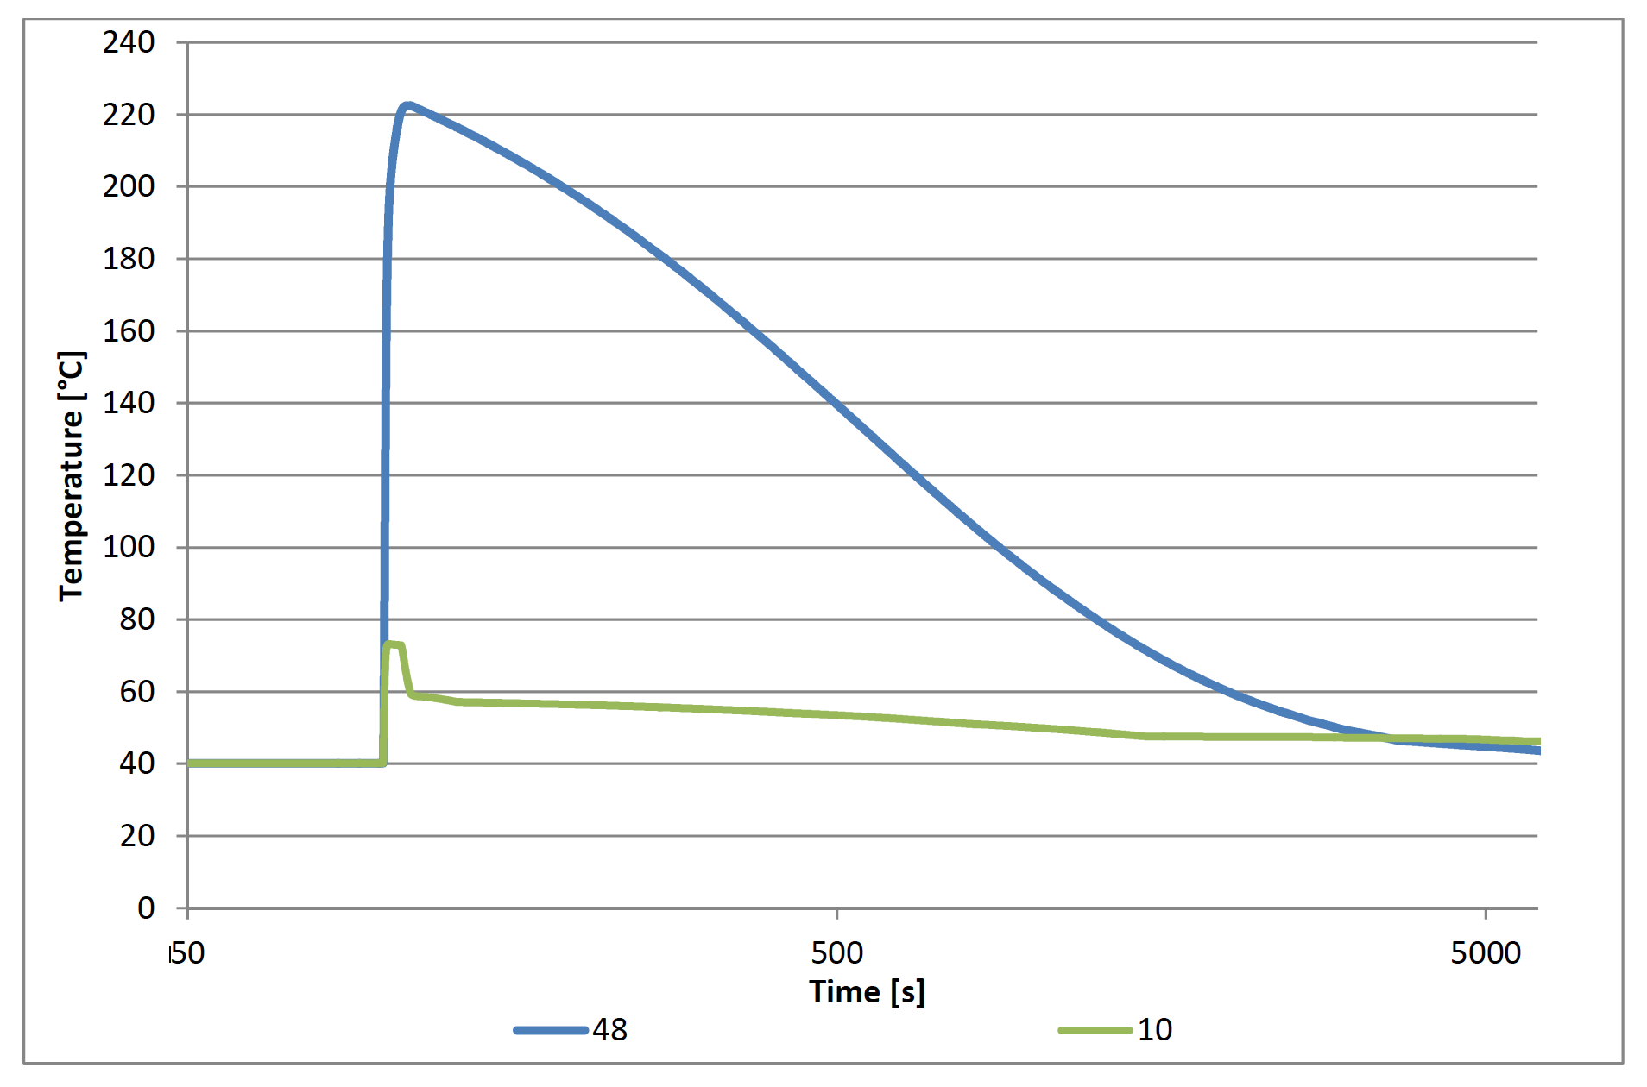
Building Temperature comparison (48 VS 10)

Slide 14
Conclusions
It is not possible to isolate the circuit through safety isolation valves during LB-LOCA.
In case of LB LOCA of the reference design both pressure and temperature rapidly reach critical values
The alternative design provides smaller loads to the EV and the temperature never overpasses 100 °C
Preventive Safety Features can (and shall) be integrated since the very beginning of the conceptual design

Slide 15
Nelson Mandela (1918-2013)

Slide 16
THANK YOU!

Slide 17
Temperature behavior summary (°C)
Case | 48 model | 10 Model
C1 | 222.5 | 73.2
C4 | 224.7 | 71.7
C7 | 191.7 | 70.1
C8 | 125.3 | 72.9

Slide 18
ITER IBED PHTS Thermal Hydraulic Analysis
Notes:
Ref 1

Slide 19
EV Pressure comparison (48 VS 10)

Slide 20
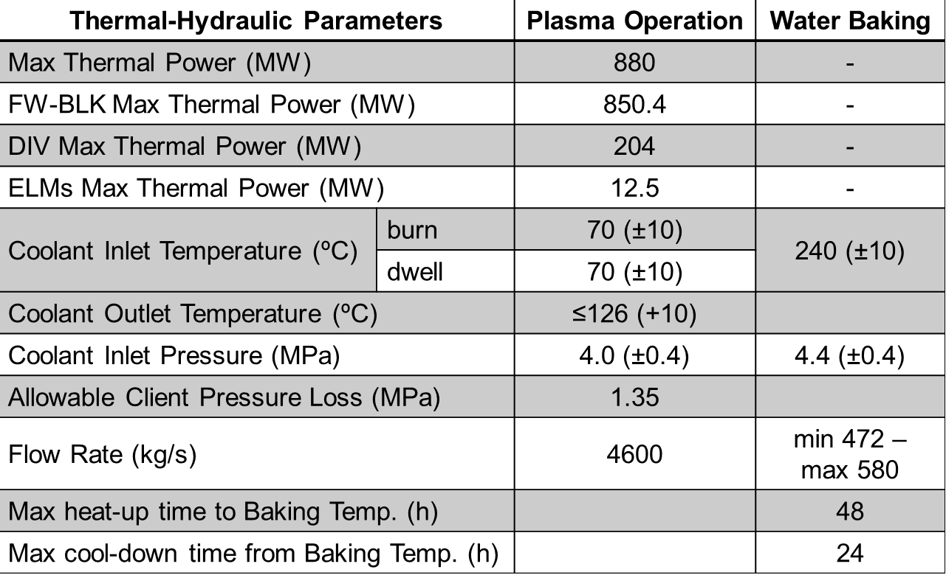
ITER IBED PHTS
Notes:
Ref 1

Slide 21
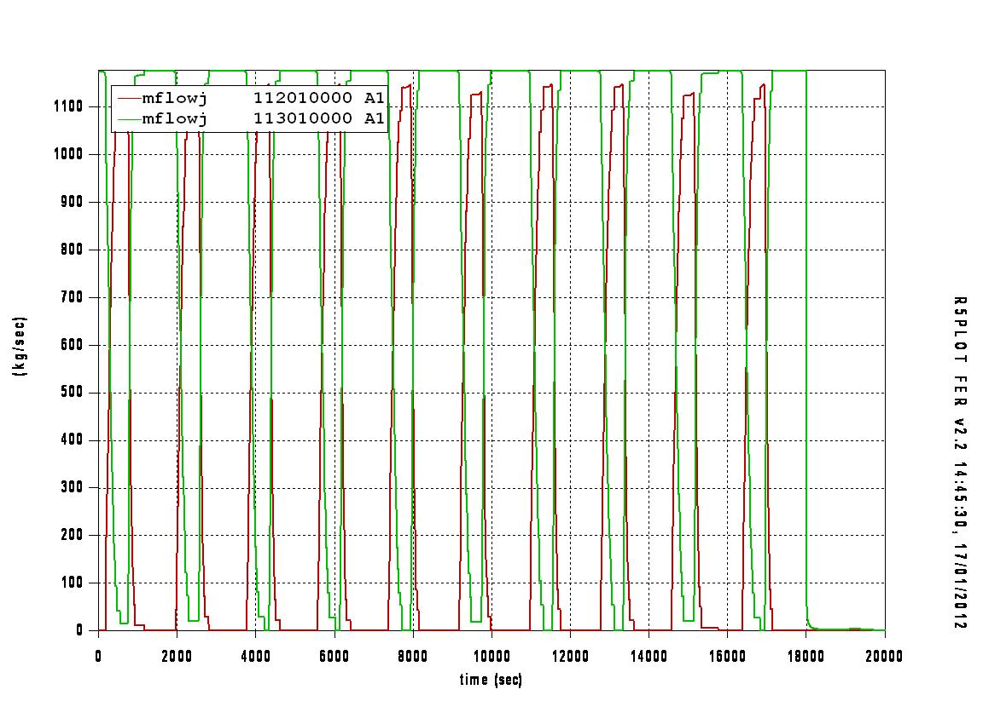
Flow Rate in one Cooling Train
Notes:
Ref 1

Slide 22
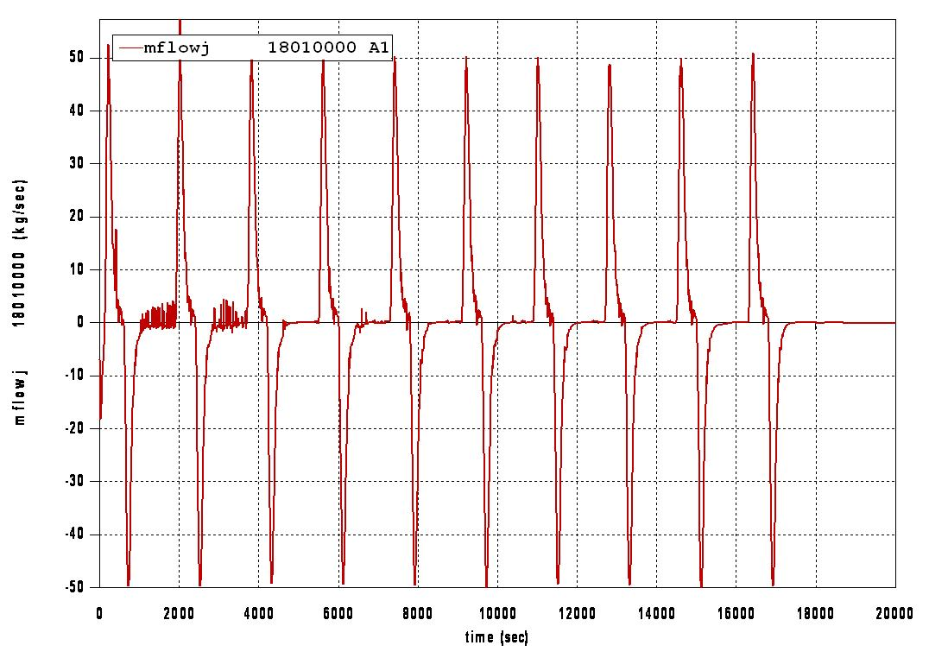
Flow Rate across the PRZ surgeline
Notes:
Ref 1

Slide 23
IBED PHTS Thermal Hydraulic Analyses: Conclusions
The current analysis shows that the proposed IBED PHTS temperature can be accurately controlled by opening/closing the bypass of the heat exchangers, i.e. by varying the flow rate across the HXs in function of the power to be removed
Also the pressure of the system can be controlled within a narrow range of fluctuation if specific actions during the plasma pulses are performed:
1. Spray injection of water from the CVCS
2. The Level Control of the Pressurizer by CVCS
3. The PRZ electrical heaters permit the reduction of pressure decrease during the outsurge of water and hence to re-establish the value of pressure at set-point during the Dwell in order to permit another Burn cycle.
Notes:
Ref 1

Slide 24
Functional Failure Mode and Effects Analiss for DEMO HCPB concept

Slide 25
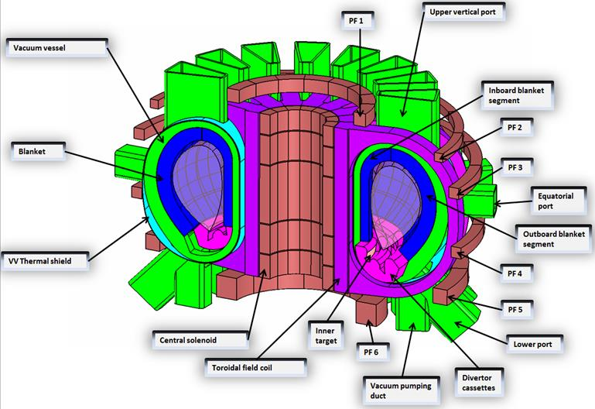
DEMO
Notes:
Ref 1

Slide 26
Introduction
Fusion reactors development impose the design of safe and reliable primary heat transfer systems (PHTSs) along all the Fusion Roadmap activities
Pulsed operation of ITER reactor induces challenging requirements for the In-vessel components PHTS, also in terms of safety
ITER water cooled PHTS has been investigated though RELAP5 © version 3.3 during plasma operation scenarios
Basis on ITER experience a Failure Mode and Effects Analyses has been carried on for DEMO He cooled PHTS
Finally two DEMO PHTS layouts have been compared trhough MELCOR version 1.8.2 analyses during Ex-Vessel LOCA scenario
MELCOR version 1.8.2 was employed due to the code capabilities to implement He as coolant in the primary circuit.
Notes:
Ref 1

Slide 27
FFMEA Analysis for DEMO HCPB Concept
The preliminary safety analysis of a fusion power plant is one of the key activity within the overall design process
In DEMO, due to the pre-conceptual design status of the most of the systems, the available systems data are not detailed enough to justify a Failure Mode and Effect Analysis (FMEA)
Therefore, a Functional FMEA at component level has been conducted to:
Define a list of Postulated Initiating Events (PIEs)
Discuss the possible accidental sequences arising from the PIEs
Notes:
Ref 1

Slide 28
Ex-Vessel LOCA
The ex-vessel LOCA can be caused by piping leak/rupture; instrument leak/rupture, valve leak/rupture, circulator leak/rupture, or SG tube leak/rupture. Following PIEs have been identified:
LBO1 LOCA out-VV because large rupture of He manifold feeder inside PHTS vault
LBO2 LOCA out-VV because small rupture of He manifold feeder inside PHTS vault
LBO3 LOCA out-VV because rupture of tubes in a SG
TBO2 Small rupture from CPS process line connected to PHTS inside the PHTS vault (outside the VV)
Notes:
Ref 1

Slide 29
DEMO HCPB PHTS Ex-Vessel LOCA Scenario
Notes:
Ref 1

Slide 30
Conclusion
Safety:
It is not possible to isolate the circuit through safety isolation valves in both designs during LB-LOCA.
IB-LOCA, smaller LOCAs can be mitigated thanks to safety isolation valves.
The heat transfer trhough the TB walls as a positive effect both in reducing atmosphere pressure and temperature
In case of LB LOCA of the reference design both pressure and temperature rapidly reach critical values
The alternative design provides smaller loads to the EV and the temperature never overpasses 100 °C

Slide 31
References
Bestele, J., & Klein-Heßling, W. (2000). Containment Thermalhydraulics and Aerosol- and Fission Product Behaiour.
Bocaccini, L. V., Salavy, J. F., Bede, O., Neuberger, H., Ricapito, I., Sardain, I., et al. (2009, June). The EU TBM systems: Design and development programme. Fusion Energy and Design, 333 - 337.
Carloni, D., & Kecskes, S. (2013). Helium Cooled Blanket Design Development. Karlsruhe: EFDA - European Fusion Development Agreement.
Dalle Donne, M. (1994). European DEMO BOT Solid Breeder Blanket. Karlsruhe: Kernforschungszentrum Karlsruhe.
Gauntt, R. O., Cole, R. K., Erickson, C. M., Gido, R., Gasser, R. D., Rodriguez, S. B., et al. (2000). MELCOR Computer Code Manuals - Vol.2: Reference Manuals, Version 1.8.5 May 2000. U.S. Nuclear Regulatory Commission.
Giancarli, L., Dalle Donne, M., & Dietz, W. (1997). Status of the European breeding blanket technology. Fusion Engineering and Design, 36(1), 57-74.
Hermsmeyer, S., Malang, S., Fischer, U., & Gordeev, S. (2003). Lay-out of the He-cooled solid breeder model B in the European power plant conceptual study. Fusion Engineering and Design, 69, 281 - 287.
Idel'cik, I. E. (1986). Mémento des pertes de charges. (Eyrolles, Ed.)
Jin, X., Carloni, D., Boccaccini, L. V., Pinna, T., & Dongiovanni, D. (2013). Definition of DEMO safety requirements and compilation of preliminary safety design guidelines D1-FFMEA for the DEMO HCPB concept. Karlsruhe: EFDA - European Fusion Development Agreement.
Paci, S. (2003). Analysis of the external radioactive releases for an in-vessel break in the power plant conceptual study using the ECART code. Università di Pisa, Dipartimento di Ingegneria Meccanica, Nucleare e della Produzione, Pisa.
Paci, S., & Porfiri, M. T. (2006). Analysis of an ex-vessel break in the ITER divertor cooling loop. Fusion Energy and Design, 81, 2115 - 2126.
Piar, L., Trégourès, N., & Moal, A. (2011). ASTEC V2 code: CESAR physical and numerical modelling (Rev 0).
Siemens-KWU. (1992). Conceptual design of the cooling system for a DEMO fusion reactor with helium cooled solid breeder blanket, and calculation of the transient temperature behaviour in accidents. Karlsruhe: KfK Contract No. 315/03179710/0102.
Taylor, N. (2014). Confinement strategy for DEMO - Points of Discussion. Culham Centre for Fusion Energy.

Slide 32
Summary
Fusion reactors development impose the design of safe and reliable primary heat transfer systems (PHTSs) along all the Fusion Roadmap activities
Pulsed operation of ITER reactor induces challenging requirements for the In-vessel components PHTS, also in terms of safety
ITER water cooled PHTS has been investigated though RELAP5 © version 3.3 during plasma operation scenarios
Basis on ITER experience a Failure Mode and Effects Analyses has been carried on for DEMO He cooled PHTS
Finally two DEMO PHTS layouts have been compared trhough MELCOR version 1.8.2 analyses during Ex-Vessel LOCA scenario
MELCOR version 1.8.2 was employed due to the code capabilities to implement He as coolant in the primary circuit.
Notes:
Ref 1

Slide 33
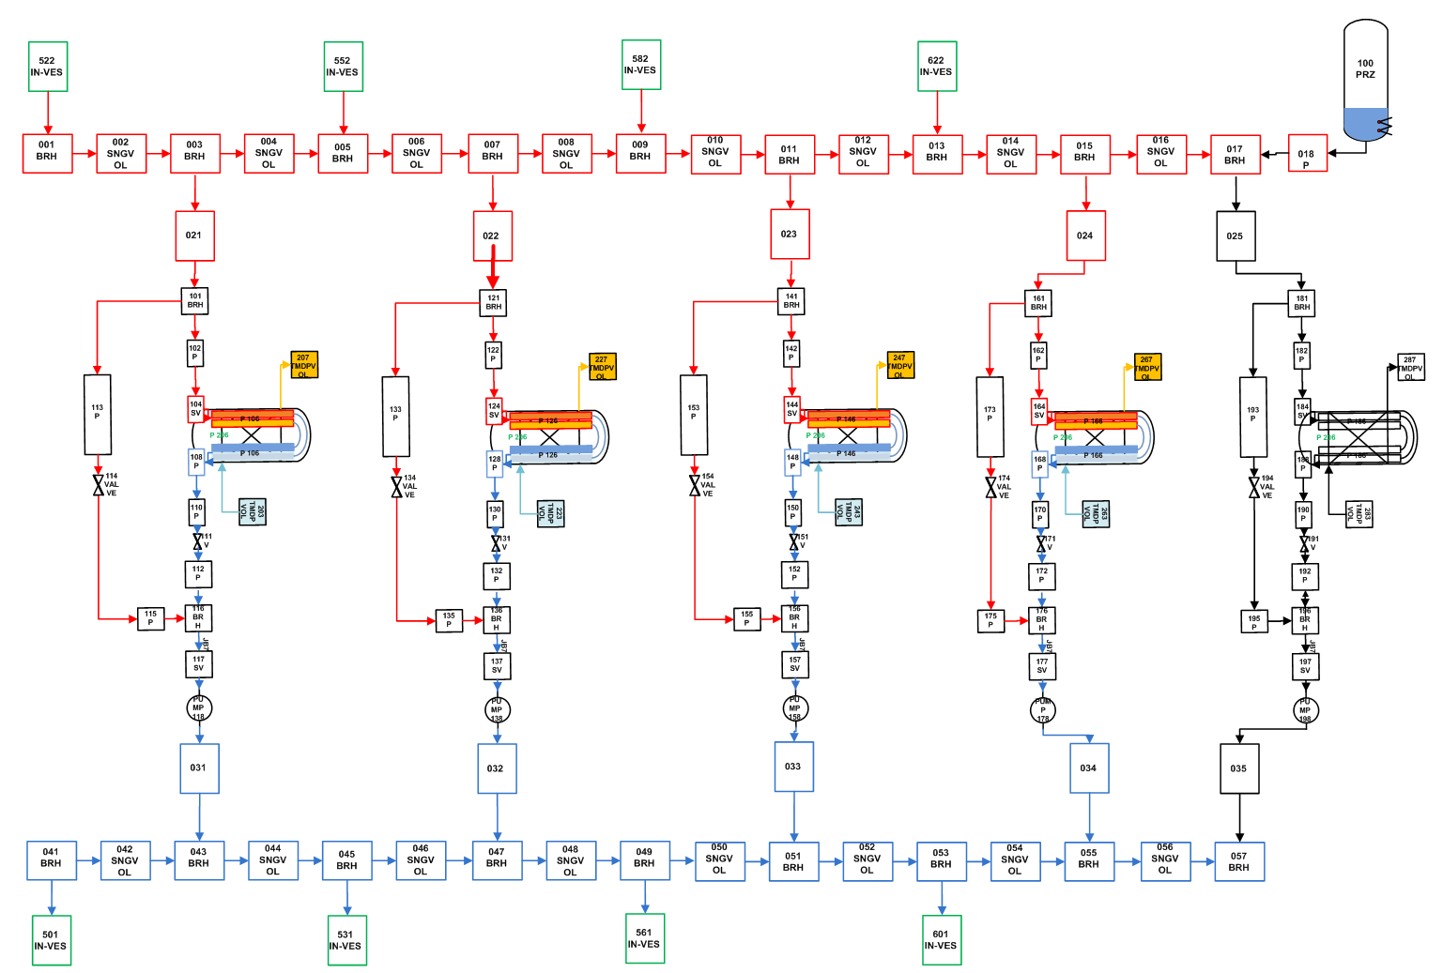
IBED PHTS Detailed RELAP5 model
Notes:
Ref 1

Slide 34
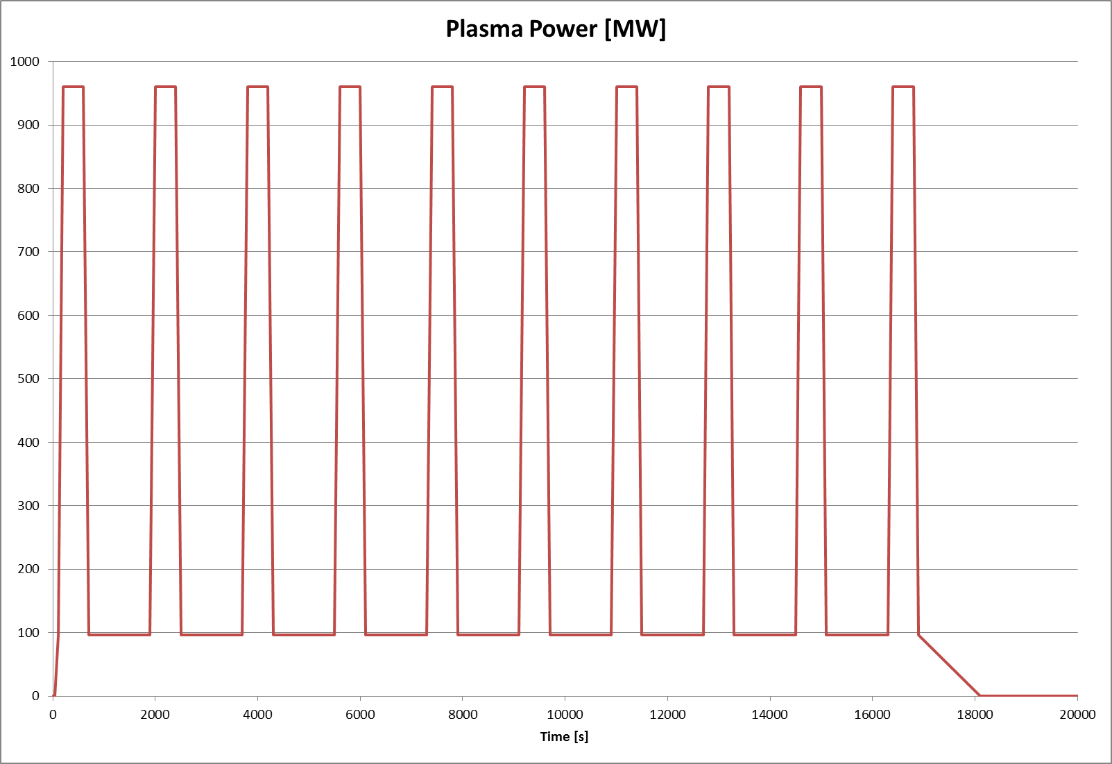
Simulated Plasma Pulses
Notes:
Ref 1

Slide 35
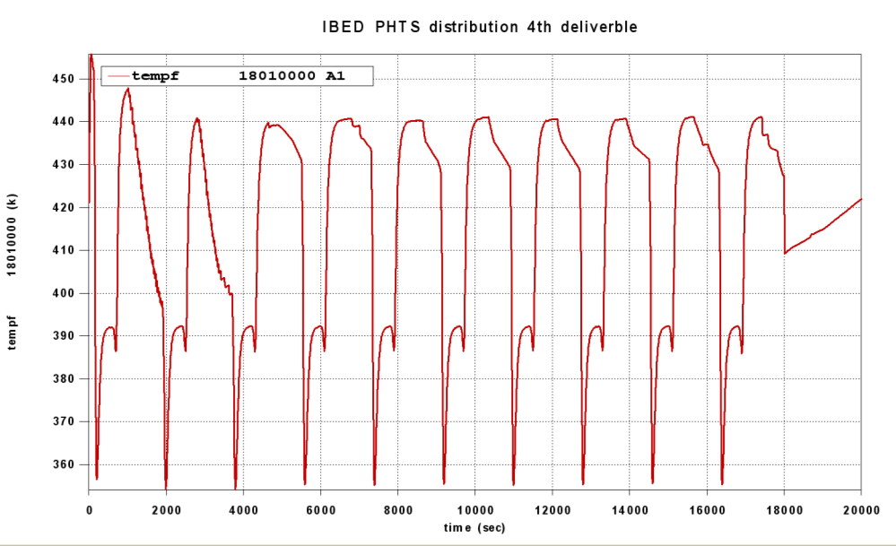
Temperature across the PRZ surgeline
Notes:
Ref 1

Slide 36
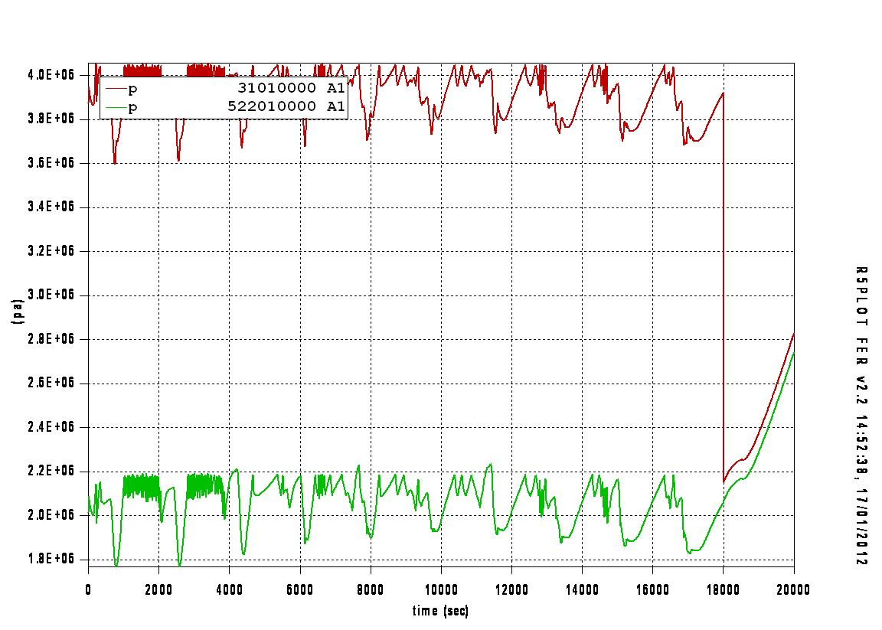
Pressure Behavior at inlet and outlet of the Blanket
Notes:
Ref 1

Slide 37
DEMO System Analyzed
HCPB Blanket
HCPB PHTS
Coolant Purification System
Secondary Cooling System
Notes:
Ref 1

Slide 38
Large Ex-Vessel LOCA Scenario (1/2)
LOCA out-VV because large rupture of He manifold feeder inside PHTS vault
A double-ended manifold break in a large size during plasma burn induces the discharge of He coolant into the PHTS vault
The vault pressurizes
The broken cooling loop will be emptied soon and 50% heat removal capability of the blanket-PHTS is lost due to the redundant design
The maximum time allowed for the intervention of the FPSS has to be assessed to assure the integrity of the FW-BK structures, well before reaching the critical conditions of the materials
If the plasma fails to shut down, PFC and blanket box can be overheated:
Swelling of ceramic breeder and Be pebbles occurs.
Exceeded thermo-mechanical stress on the blanket structures can affect the integrity of blanket box towards the VV
Notes:
Ref 1

Slide 39
Large Ex-Vessel LOCA Scenario (2/2)
He pressure drops to the room pressure, air enters the blanket-PHTS and to the channels of blanket box:
If the channels have a collapse for the thermal stress, air can get in touch with Be pebbles. Be reactions with air and water from moisture contained in air are possible. H2 production from Be-water reaction is a risk for explosion hazard
If the FW loses its integrity by plasma burn, He remained in the loops and air ingress into the VV, a major plasma disruption is triggered, and the VV pressurizes (in-vessel LOCA, see section 6.3). Bleed lines to the EV open if the pressure overcomes setting points. PFC can react with air and moisture at high temperature. Be pebbles are lost into VV due to dynamic effects (e.g. VV suction, He flowing). This makes more complicated recovery actions inside VV to clean vacuum chamber before restart
About radioactive releases, mobilised dust and tritium in the VV can be released to the EV due to differential pressure inversion and tritium in He coolant into the PHTS vault. Radiological consequences need to be estimated
Notes:
Ref 1

Slide 40
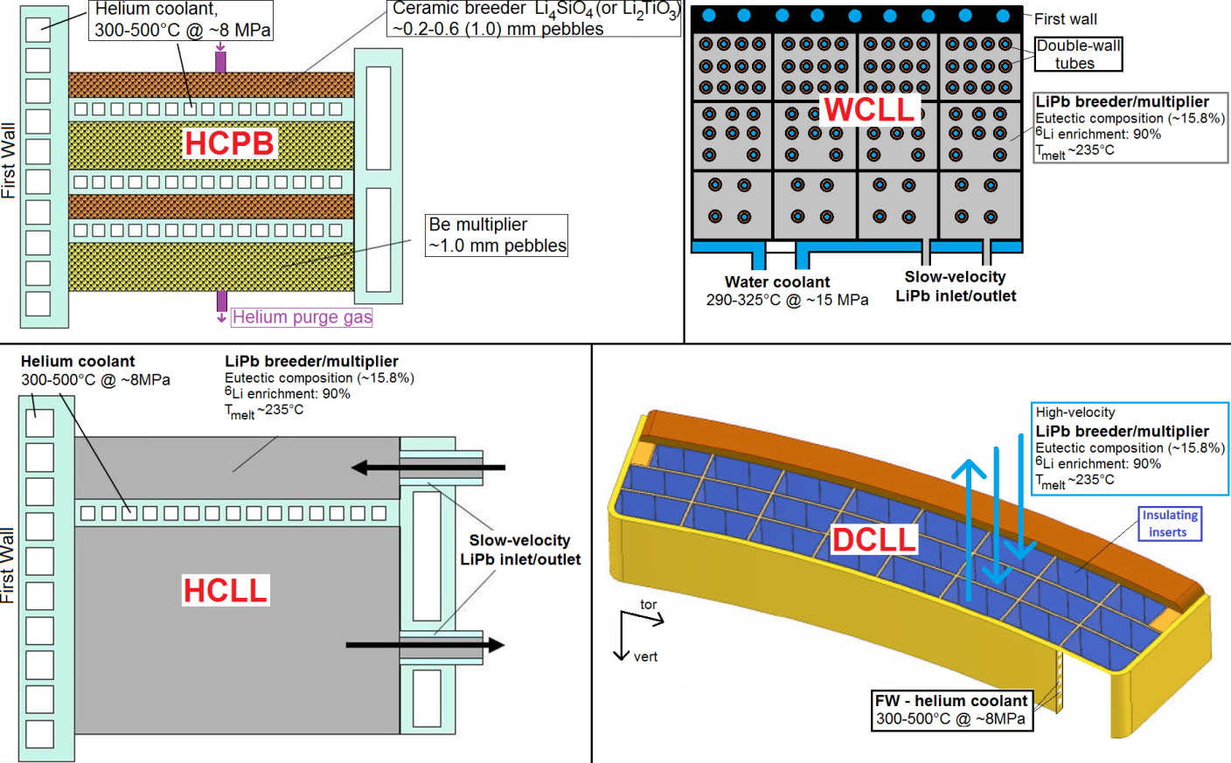
DEMO Breeding Blanket Concepts
DEMO (DEMOnstration Power Plant) is a generic name for proposed nuclear fusion power plants that intend to build upon the expected success of ITER
The main goals of the project are to produce 500 MWe and ensure tritium self-sufficiency (TBR > 1)
Four different Breeding Blanket concepts are currently under conceptual design
HCPB: Helium Cooled Pebbles Bed
HCLL: Helium Cooled Lithium Lead
WCLL: Water Cooled Lithium Lead
DCLL: Dual Coolant Lithium Lead
The DEMO Helium Cooled Pebbles Bed concept has been selected for the present study
Notes:
Ref 1

Slide 41
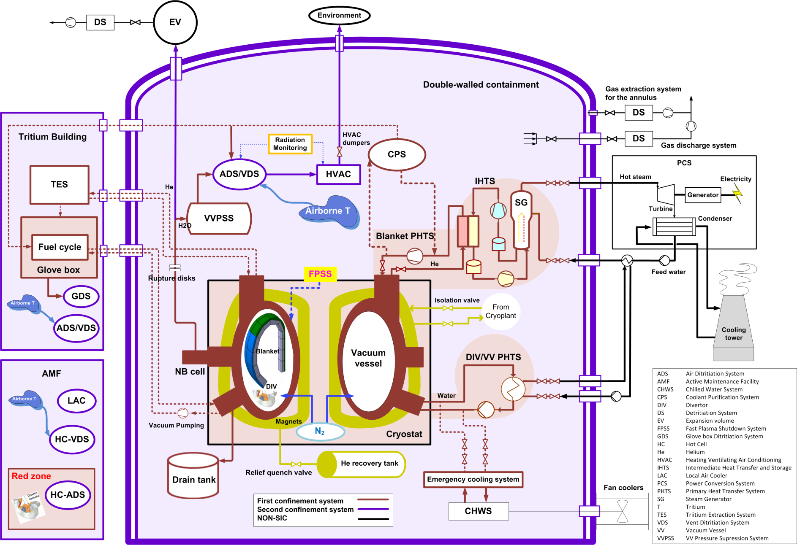
DEMO Confinement (HCPB)
Notes:
Ref 1

Slide 42
Large Ex-Vessel Mitigating Actions
Monitoring of the mass flow rate and pressure in the ring headers
FPSS actuation to avoid aggravating in-vessel LOCA
Opening the VV rupture disk to the EV
Design of the EV size due to over-pressurization in the VV
Isolation of HVAC
Vault atmosphere detritiation by Vent Detritiation System (VDS)
Notes:
Ref 1

Slide 43
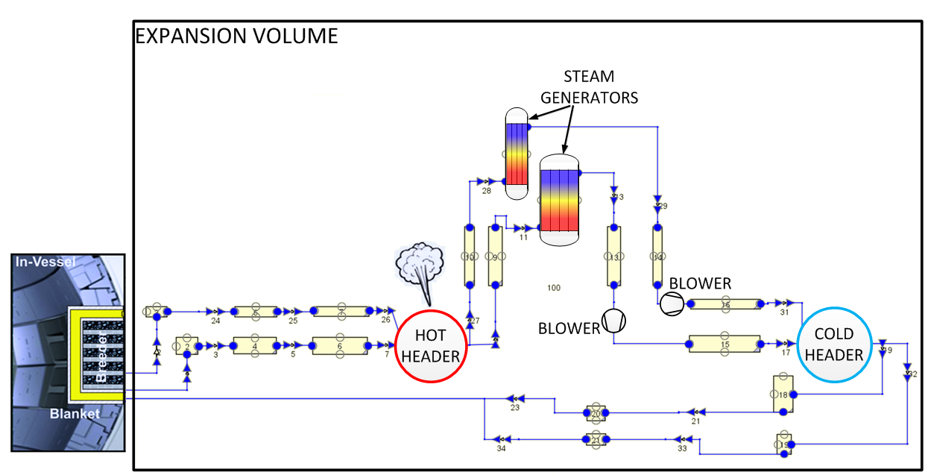
Employed models: 47+1 model (ref. design)
22 CVs (21 – PHTS, 1 - EV).
24 Flow Junction (FJs).
3 HSs (1 – blanket, 2 – SG).
The rupture happens 100.0 s after the beginning of the simulations
Characteristics | MELCOR
PHTS He mass [kg] | 6795.3
EV Volume [m³] | 70000.0
Heat transfer area [m²] | 15000.0
Blanket HS temp. [K] | 773.15
SG HS temp. [K] | 573.15
Total mass flow [kg/s] | 872.7
Characteristics | MELCOR
EV Temperature [K] | 313.35
Blanket temp. [K] | 771.55
SG temp. [K] | 573.75
Total pressure drop [MPa] | 0.38
Heat flow [W/m²] | 60700.0
Decay heat Flow [W/m²] | 3035.0 (5%)

Slide 44
Employed models: 10 model (alt. design)
As the 48 model (13 CVs, 12 FJs, 2 HSs) but scaled down to fit the new design.
Only the hot and cold header LOCAs were analysed.
The blower trip happens at 100.0 s
A more realistic decay heat slope was employed.
Characteristics | MELCOR
PHTS He mass [kg] | 1071.0
EV Volume [m³] | 70000.0
Heat transfer area [m²] | 3000.0
Blanket HS temp. [K] | 773.15
SG HS temp. [K] | 573.15
Total mass flow [kg/s] | 153.5
Characteristics | MELCOR
EV Temperature [K] | 313.35
Blanket temp. [K] | 772.01
SG temp. [K] | 572.05
Total pressure drop [MPa] | 0.36
Heat flow [W/m²] | 54000.0
Decay heat Flow [W/m²] | 2700.0 – 540.0
Time [s] | Heat flow [W/m²]
0.0 | -54000.0
100.0 | -54000.0
110.0 | -2700.0 (5 %)
3600.0 | -2700.0
7200.0 | -540.0 (1 %)
1.0E10 | -540.0

Slide 45
Accident Matrix
Pipe involved | CV name | Case name | Break Area [m²] | Diameter [m] | Diameter [%]^{[1]}
1/48 outlet pipe (before the enlargement) | BP011 | BP001_C1 | 0.09048 | 0.33941 | 200.0
 |  | BP001_C4 | 0.00452 | 0.07589 | 10.0
 |  | BP001_C7 | 0.00045 | 0.024 | 1.0
 |  | BP001_C8 | 0.00005 | 0.00759 | 0.1
1/48 outlet pipe (after the enlargement) | BP012 | BP002_C1 | 0.15646 | 0.44633 | 200.0
 |  | BP002_C4 | 0.00782 | 0.0998 | 10.0
 |  | BP002_C7 | 0.00078 | 0.03156 | 1.0
 |  | BP002_C8 | 0.00008 | 0.00998 | 0.1
Hot header | HD001 | HD001_C1 | 1.83218 | 1.52735 | 200.0
 |  | HD001_C4 | 0.09161 | 0.34153 | 10.0
 |  | HD001_C7 | 0.00916 | 0.108 | 1.0
 |  | HD001_C8 | 0.00092 | 0.03415 | 0.1
1/5 pipe from the header to the SG | MP011 | MP001_C1 | 1.83218 | 1.52735 | 200.0
 |  | MP001_C4 | 0.09161 | 0.34153 | 10.0
 |  | MP001_C7 | 0.00916 | 0.108 | 1.0
 |  | MP001_C8 | 0.00092 | 0.03415 | 0.1
1/5 pipe from the SG to the blower | MP012 | MP002_C1 | 1.83218 | 1.52735 | 200.0
 |  | MP002_C4 | 0.09161 | 0.34153 | 10.0
 |  | MP002_C7 | 0.00916 | 0.108 | 1.0
 |  | MP002_C8 | 0.00092 | 0.03415 | 0.1
1/5 pipe from the blower to the header | MP013 | MP003_C1 | 1.83218 | 1.52735 | 200.0
 |  | MP003_C4 | 0.09161 | 0.34153 | 10.0
 |  | MP003_C7 | 0.00916 | 0.108 | 1.0
 |  | MP003_C8 | 0.00092 | 0.03415 | 0.1
Cold header | HD002 | HD002_C1 | 1.83218 | 1.52735 | 200.0
 |  | HD002_C4 | 0.09161 | 0.34153 | 10.0
 |  | HD002_C7 | 0.00916 | 0.108 | 1.0
 |  | HD002_C8 | 0.00092 | 0.03415 | 0.1
1/48 inlet blanket pipe | BP013 | BP003_C1 | 0.1311 | 0.40857 | 200.0
 |  | BP003_C4 | 0.00656 | 0.09136 | 10.0
 |  | BP003_C7 | 0.00066 | 0.02889 | 1.0
 |  | BP003_C8 | 0.00007 | 0.00914 | 0.1
^{[1]} Refers to the percentage respect to the nominal diameter. 200 % means that the rupture is a double guillotine rupture, 10 % means that the rupture cover only the 10% of the nominal inner diameter, etc.

Slide 46
PHTS Pressure comparison (48 VS 10)

Slide 47
Ex-Vessel LOCA: Limitations
Rupture area < 1.0E-3 m² should be simulated also with CFD tools.
A more realistic helium blower trip control logic should be employed.
The absence of heat sinks in the EV is not acceptable for long transient.
A more realistic decay heat slope should be employed (ref. model).
Notes:
Ref 7 and 8

Slide 48
EV Temperature comparison (C1)

Slide 49
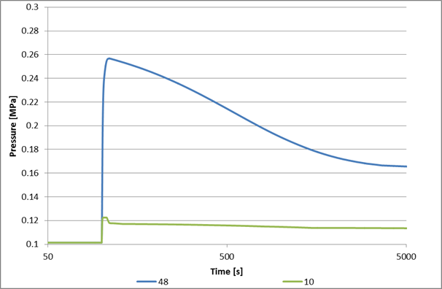
EV Pressure comparison : C1

Slide 50
Max EV Pressure summary (MPa)
Case | 48 model | 47+1 model | 10 Model
C1 | 0.26 | 0.26 | 0.12
C4 | 0.25 | 0.25 | 0.12
C7 | 0.23 | 0.23 | 0.12
C8 | 0.18 | 0.18 | 0.12

