Slide 1
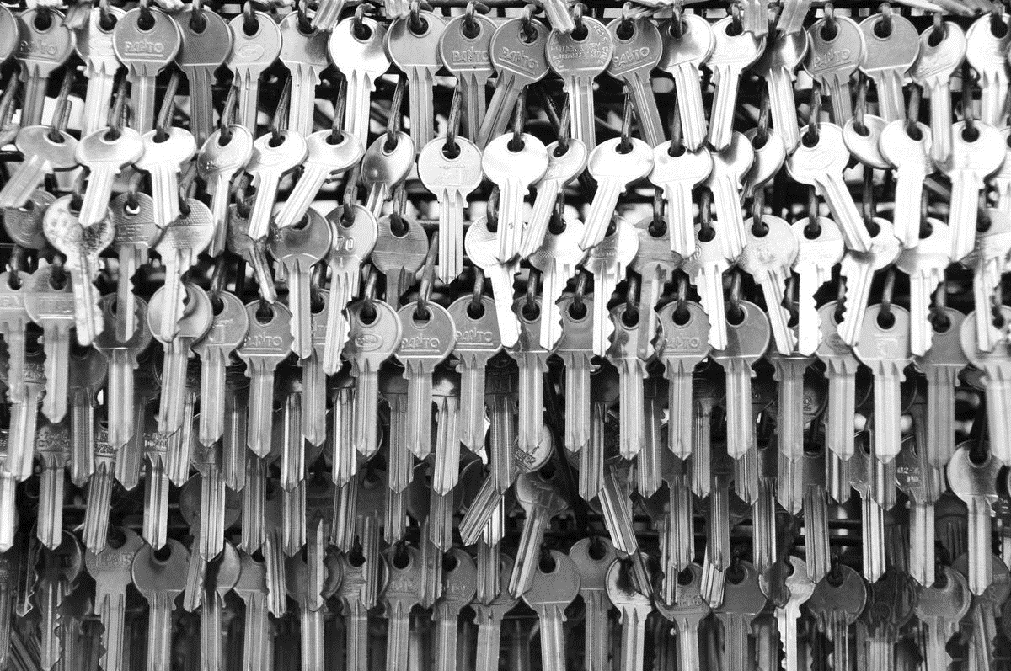
The mystery of the17th November
Why are there no regular courses in the building today?
by Jan Mlynář
who is not a specialist - but all real experts are so busy today
FuseNet PhD event 2015, Prague, 17th November 2015
Notes:
Weigth on shoulders
Předem – kdo ví, že je dneska váš den? International students’ day
Ano – je public holiday. A to je u nás kvůli studentům public holiday?

Slide 2
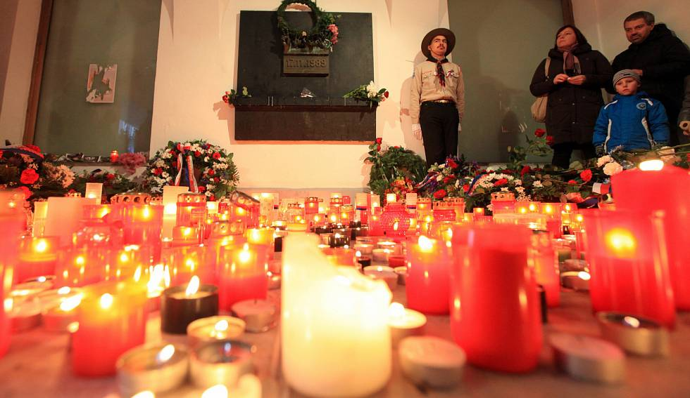
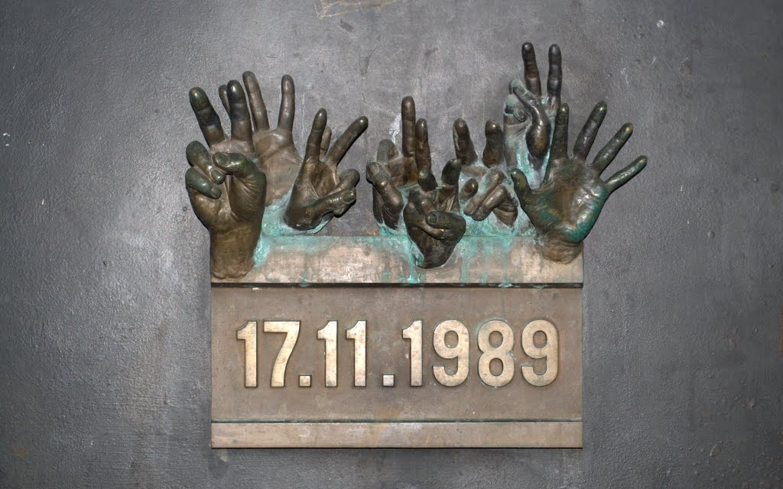
Struggle for Freedom and Democracy Day
Notes:
Nope not students, the calender says „Struggle for Freedom and Democracy Day
So is it a pure coincidence?

Slide 3
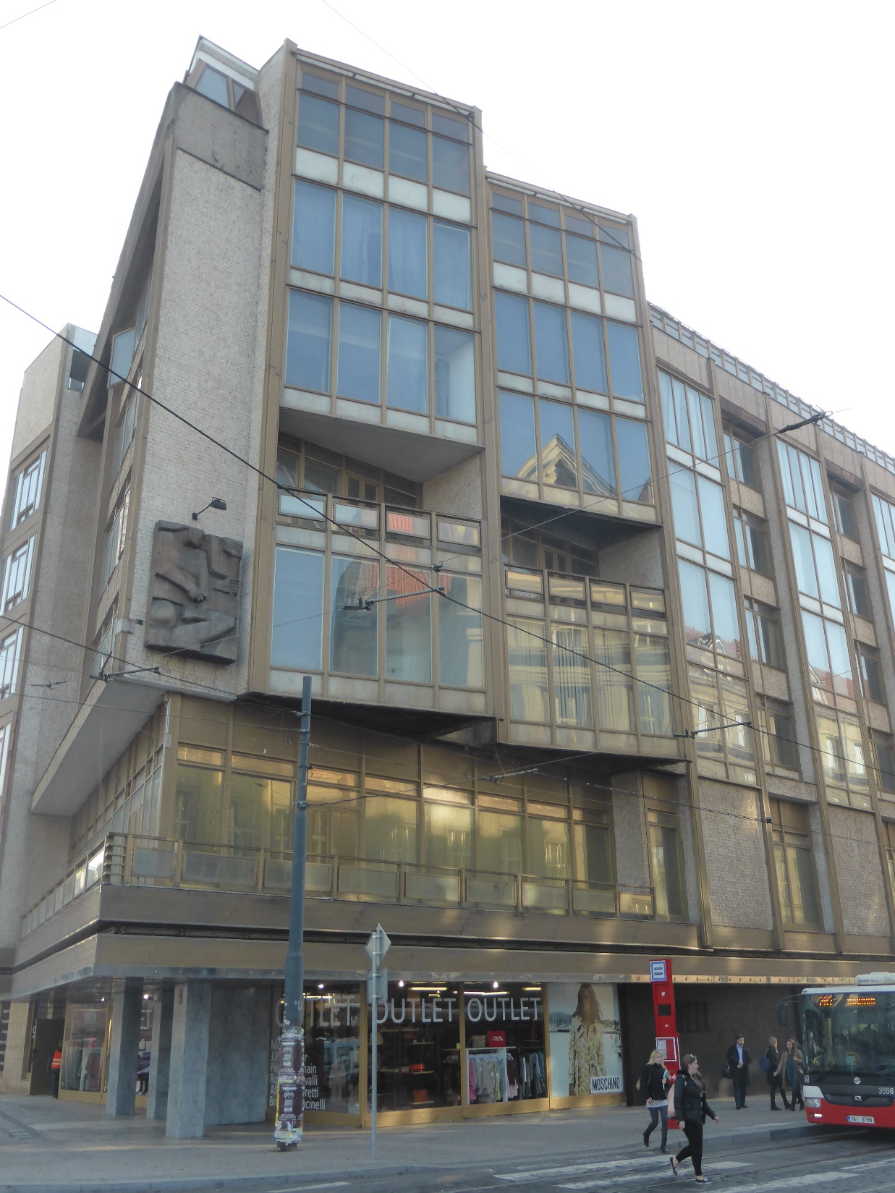
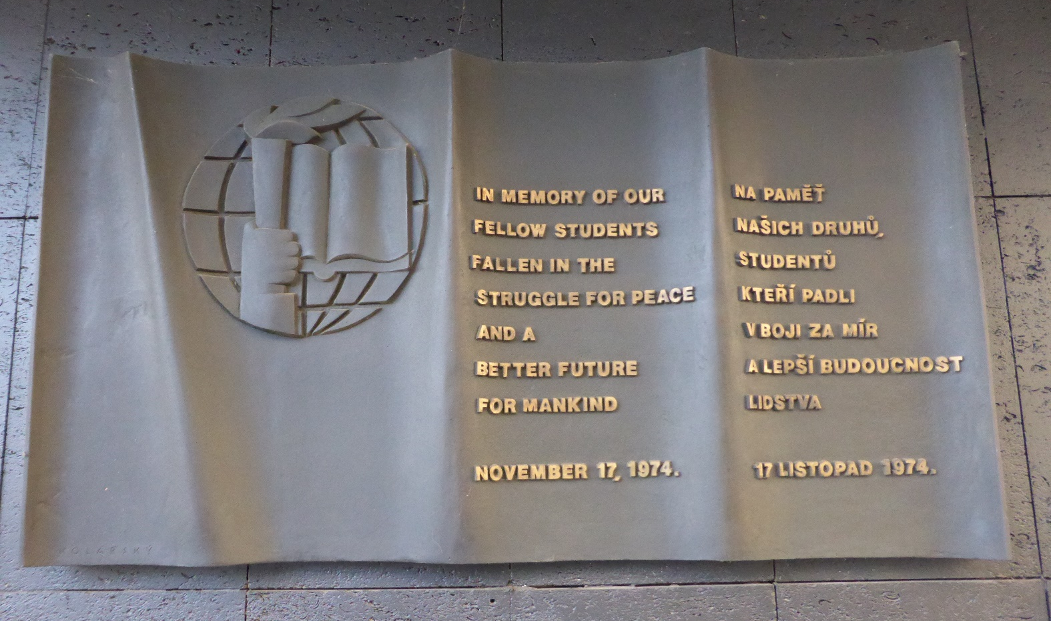
In Greece the Universities have a day off today too, due to the 1973 events at the Athens Polytechnic. The date seems to be purely coincidental, however, the event is implicitly reflected in this commemorative plaque.
Notes:
Seems that the 17 November had been an important day even before…

Slide 4
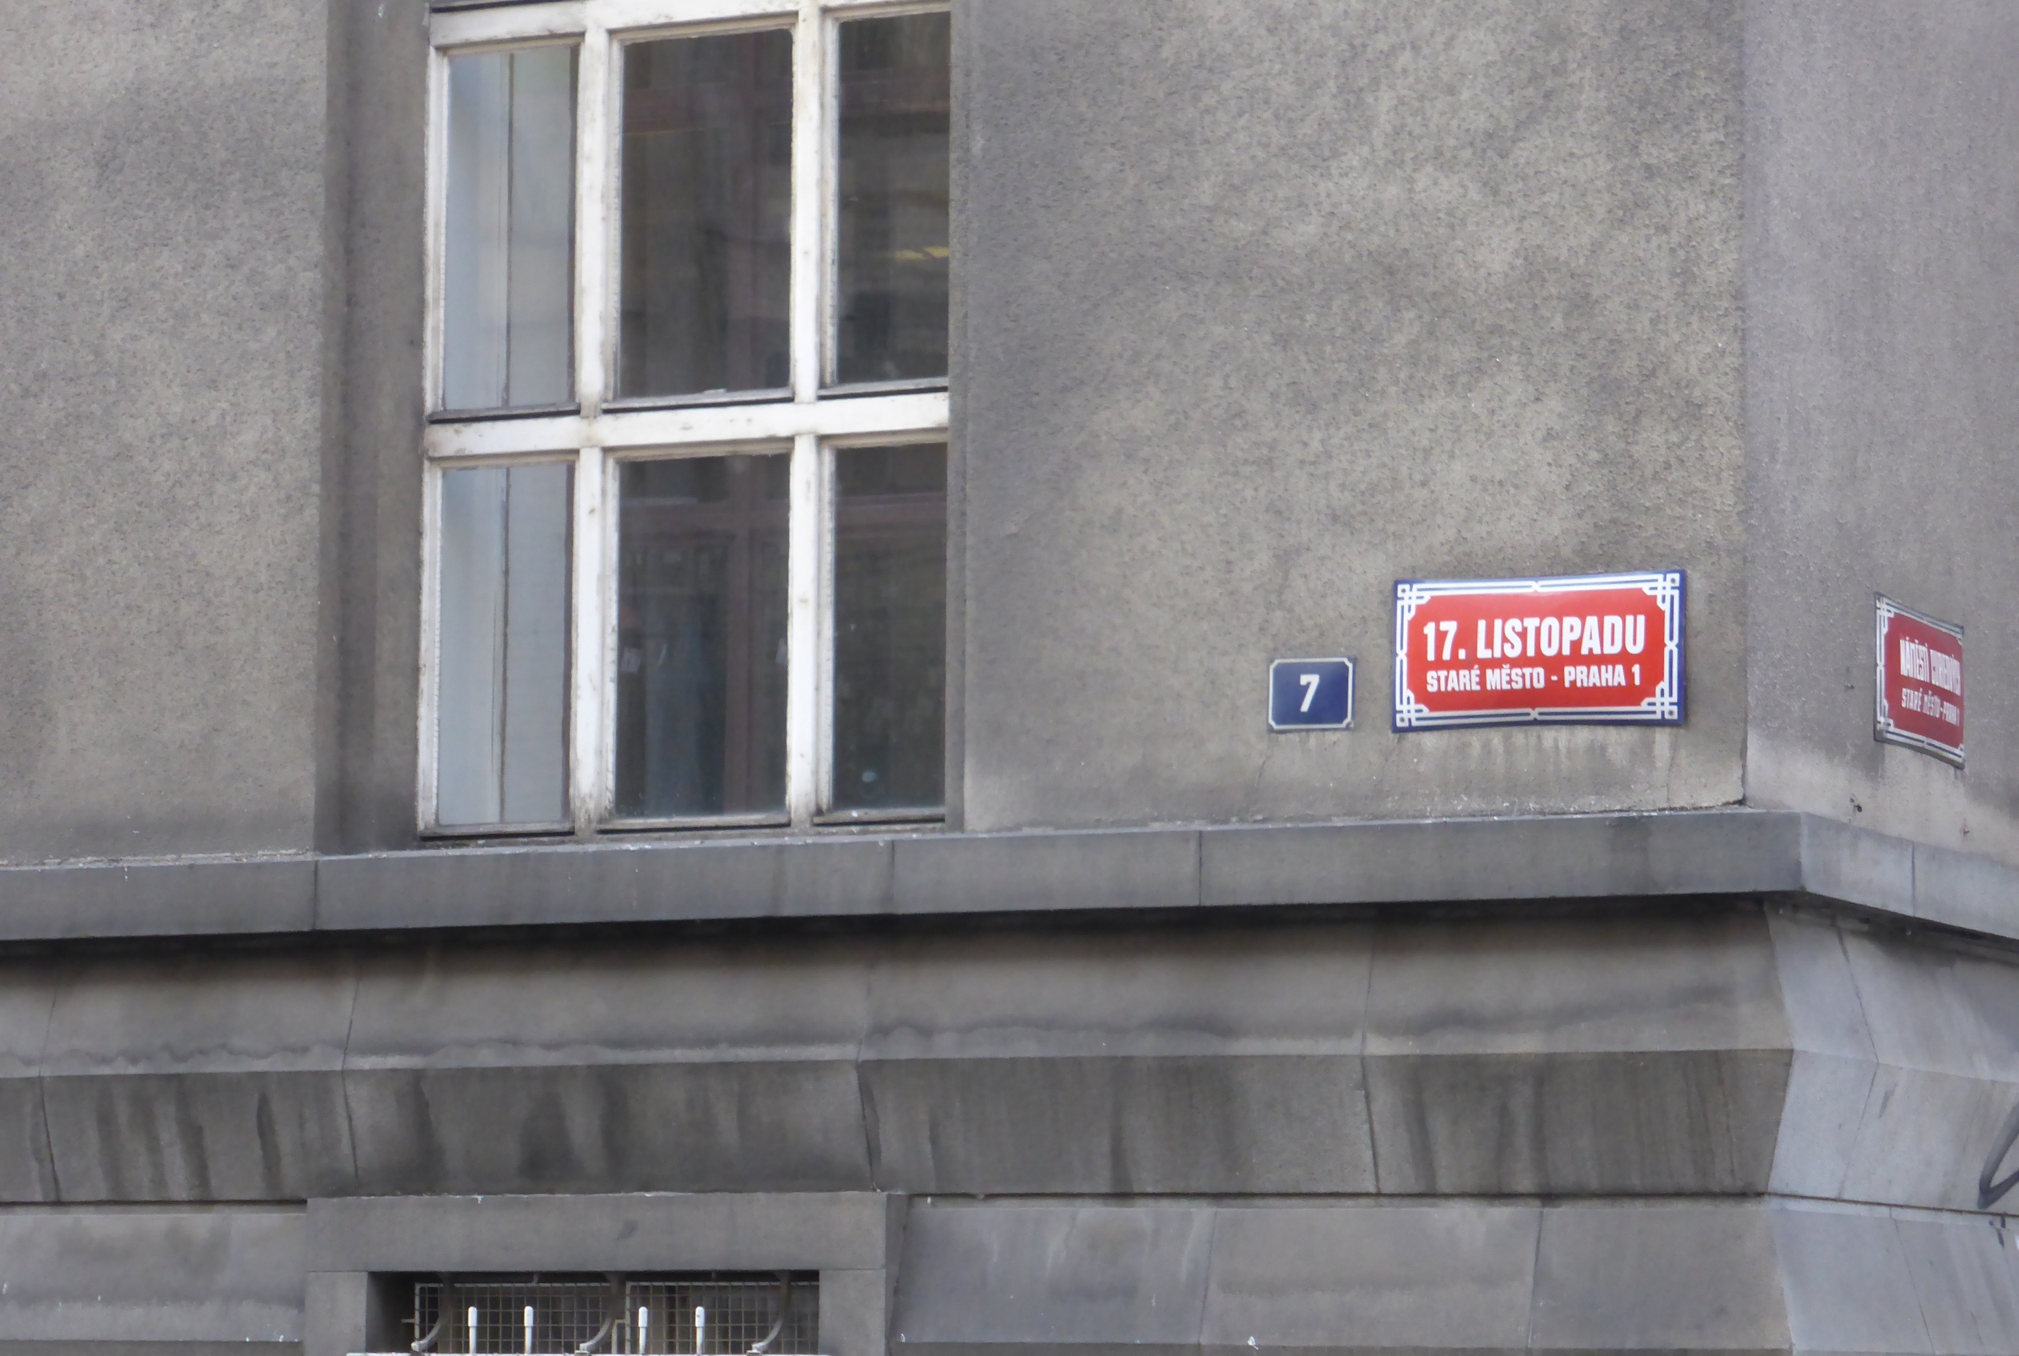
17. listopadu means „of the 17th November“ in Czech
(not in Croatian, where the word listopad means October, but who cares…)
Notes:
Vyhlášen v Londýně 1941 delegáty 26 zemí.

Slide 5
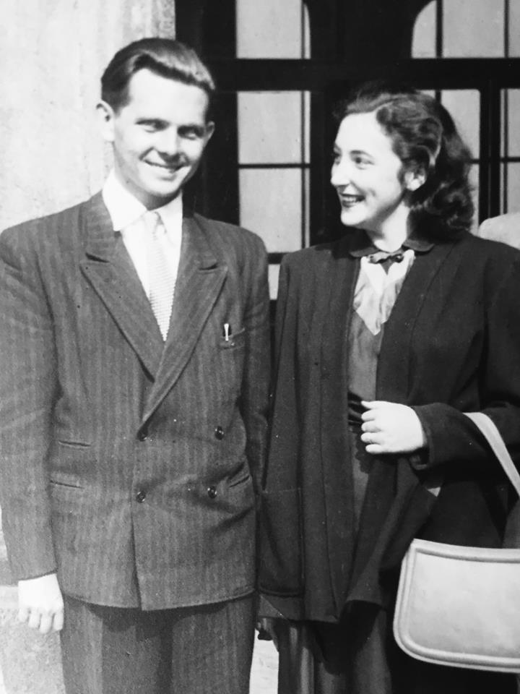
I really do not like political debates…
…let me give you my personal experience instead
my grandfather 1895 – 1981 right hand disabled in the 1st war → no good job
my father 1922 – 1988 universities closed in the 2nd war lost good job in 1969
me 1966 minor conflicts only
my parents, approx. 1950
Notes:
„it was not acceptable“
Read GAMOW biography “my world line“
Situation in the end of 80th

Slide 6
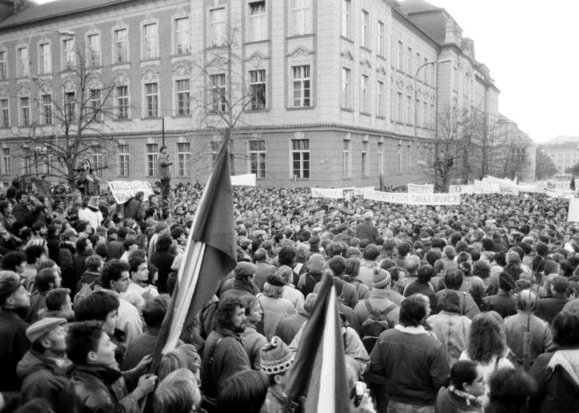
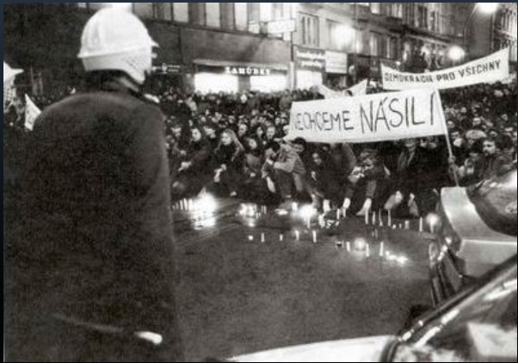
17th November 1989: commemoration of 50 years from the Nazi closure of the universities
Notes:
Suddenly, students united and started to speak openly. Conservative power was our joint enemy, we all wanted progress.
Jak to došlo na Národní a pak falešná zpráva a

Slide 7
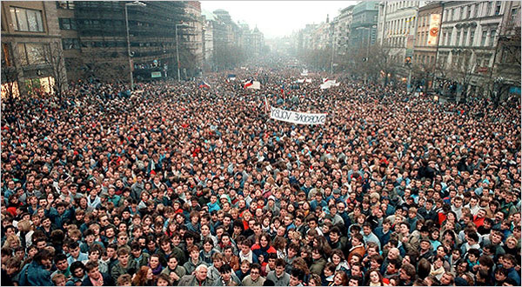
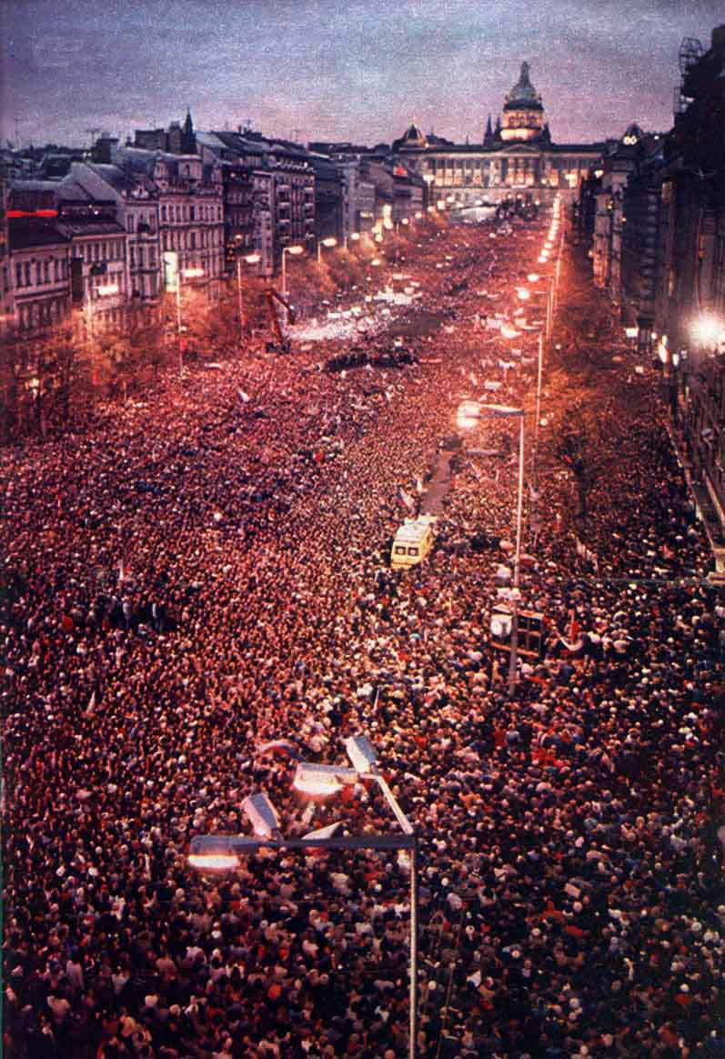

Slide 8
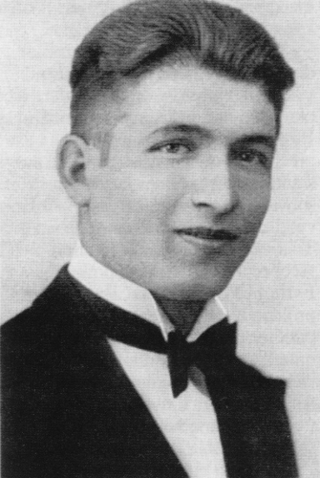
50 year of what did we exactly commemorate in 1989?
Our independence day is 28th October (1918)
Nazis took control over my country in two steps, on 29th September 1938 and on 15th March 1939
The war started in Poland on 1st September 1939
28th October 1939 – manifestations in Prague were severely suppressed by Nazi forces, one young baker (Václav Sedláček) was shot dead, one student (Jan Opletal) shot and died later
Funeral of Jan Opletal turns into a manifestation on 15th November
On 17th November Nazi storm the University, execute nine, and send 1200 students to concentration camps for 3 years 35 would not survive the imprisonment
All the Czech Universities were closed down
In 1941, the International Student’s day was proclaimed in London by the International Students’ Council
Jan Opletal

Slide 9
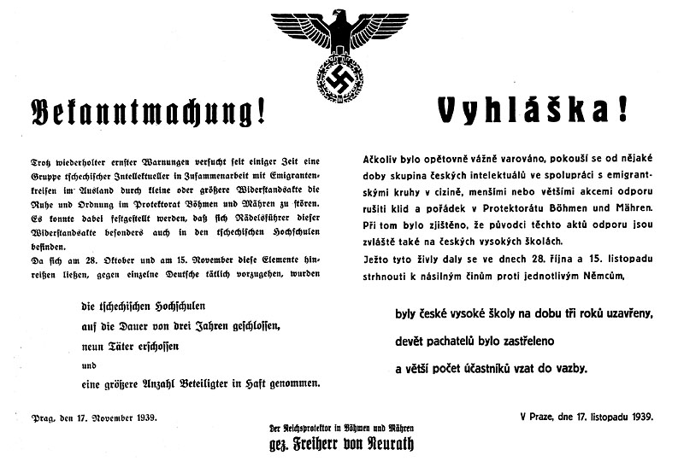
Notes:
A decree
1200 students sent to concentration camps, for 3 years. 35 did not survive.
1989 we experienced hope, friendship and liberty
1939 our parents experienced defeat, hostility and despair

Slide 10
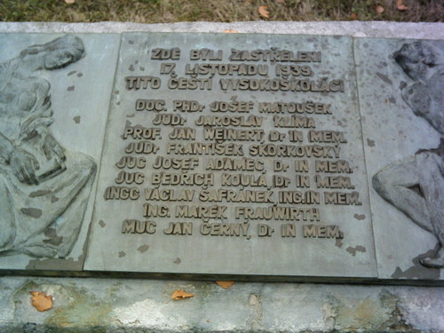
This is what we commemorated in 1989
Notes:
Memorial, barracks in Ruzyne
1989 we experienced hope, friendship and liberty
1939 our parents experienced defeat, hostility and despair

